Slide 1
The Islamic World
6th Century to 13th Century

Slide 2
The Beginning

Slide 3
The Story Starts…
570 CE Birth of Prophet Muhammad (SAW)
622 CE Hijrah (Migration to Madinah)
624 CE Battle of Badr
632 Death of Prophet Muhammad (SAW)

Slide 4
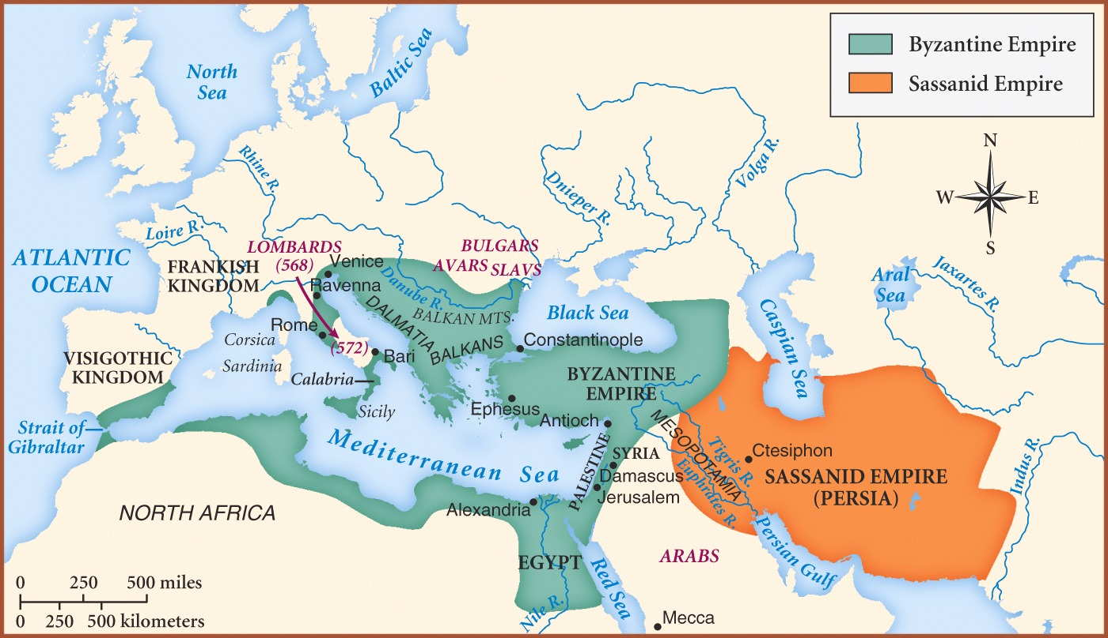

Slide 5
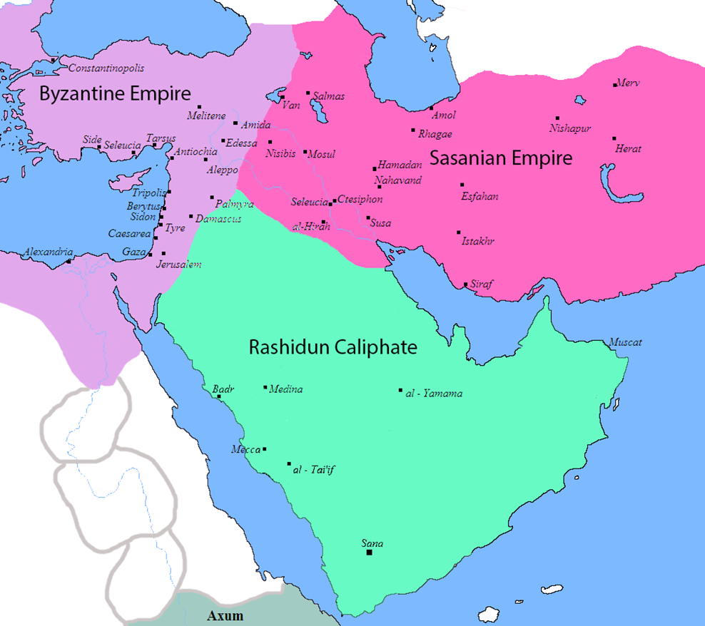


Slide 6
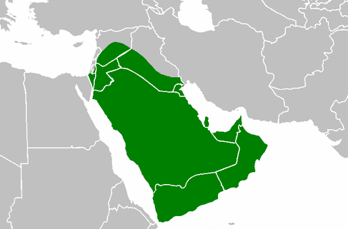
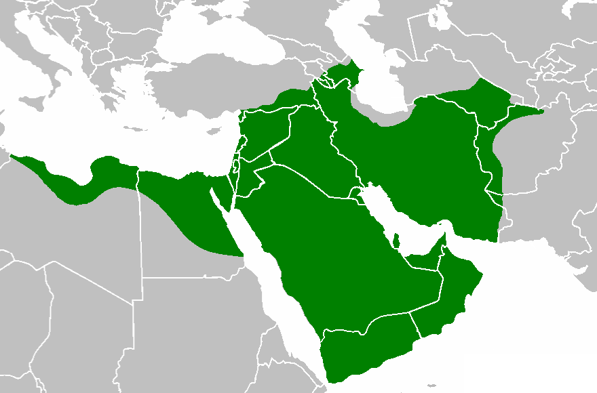
Rashidun Period (632-661)
The Period of the Khulafah Ar-Rashidun (The Rightly Guided Khulafah)
All of Arabia came under the Khilafat (Islamic State) of Abu Bakr (RA)
Qur’an was collected into a book form
Conquest of Syria and Jerusalem 637 CE
The Persian empire crushed
Conquest of Egypt 639 CE and parts of North Africa
First naval fleet
Distribution of the mushaf to all parts of the Muslim world

Slide 7
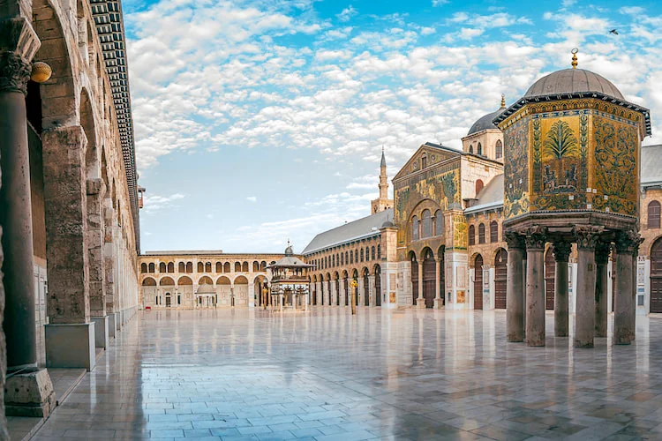
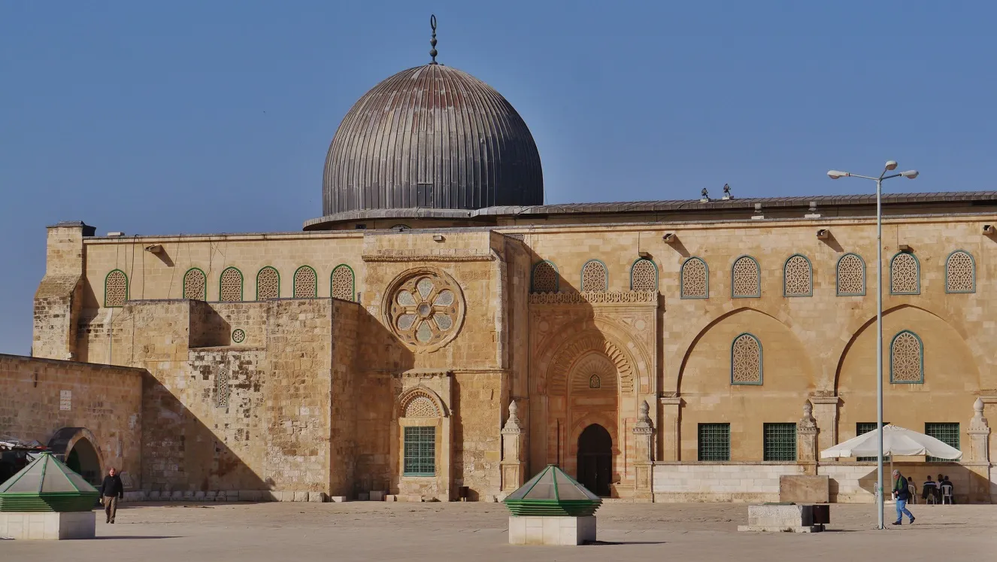
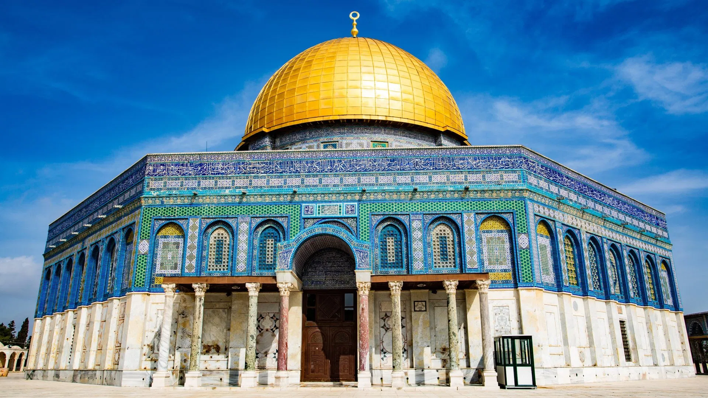
Umayyad Period (661-750)
Rule of Mu’awiyah
North Africa and Spain conquered
Khorasan conquered
Construction of Masjid Al-Aqsa, Dome of the Rock and Umayyad Mosque in Damascus

Slide 8
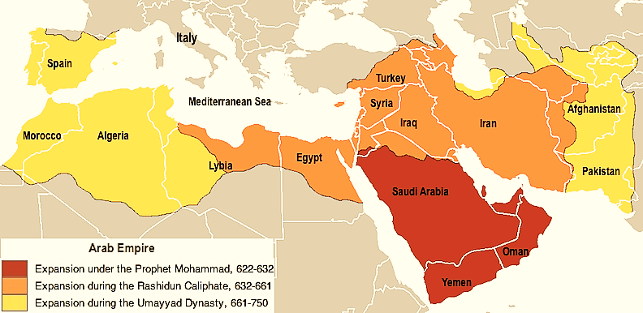

Slide 9
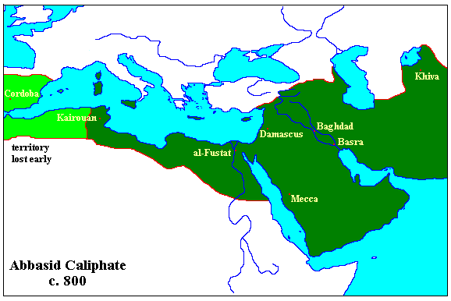
Abbasid Period (750–1258)
Golden Age of Islamic culture and civilisation
Some territories lost, independent governors
Some great rulers e.g. Harun Rashid
Peak of science and learning
Bait al-Hikmah (House of Wisdom)
Baghdad is the centre
Paper making becomes common
Persians prominent in politics
Acceptance and freedom of religion for all people
Knowledge of the east and west joined together
First 10 were effective
Mamluks introduced

Slide 10
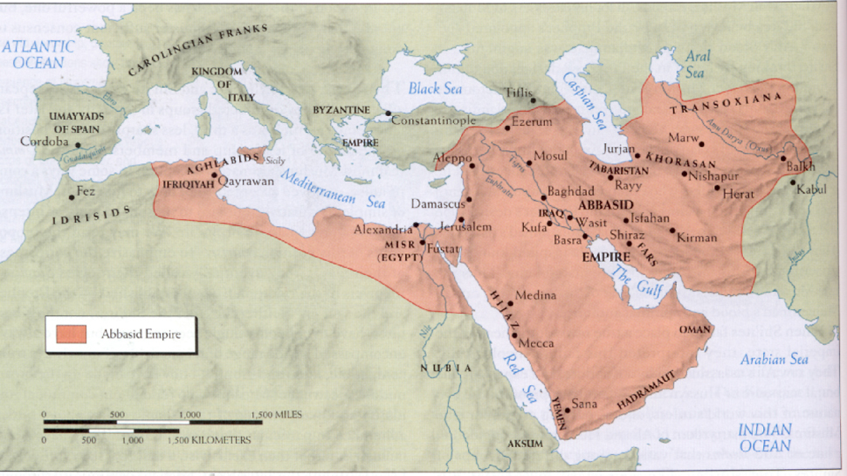

Slide 11
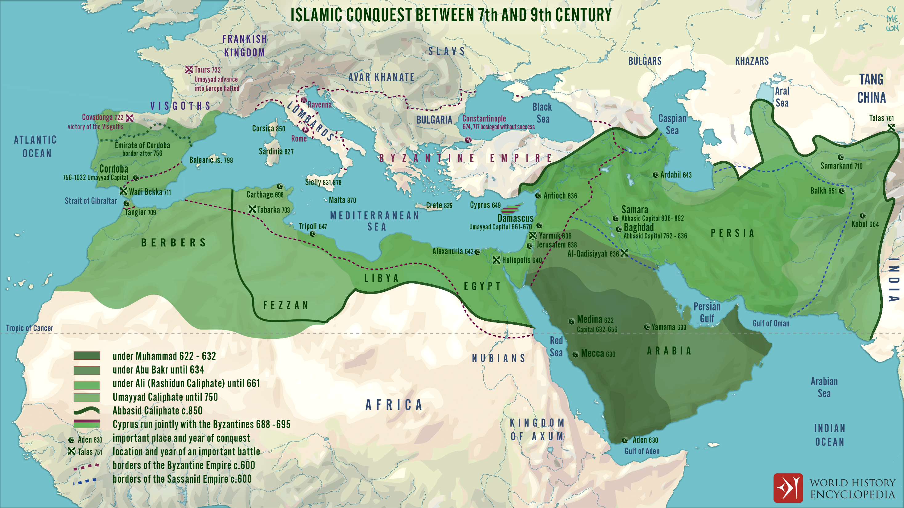

Slide 12
Fragmentation of the Abbasid Caliphate
There was a period 100 years (750 – 861) of stable Abbasid rule with central authority from 1st Khalifah Abu Al-Abbas al-Saffah to the 10th Khalifah Al-Mutawakkil.
There was the emergence of minor dynasties who although were autonomous, were still loyal to the Abbasids.
This was followed by larger dynasties. The various dynasties fought over land and power.
Most of the Eastern dynasties continued to recognise the Khalifah at Baghdad out of respect and took his name during Friday sermons.
The Western dynasties tended to be much more independent and two of them – the Umayyads of Spain and the Fatimids of Egypt set up rival caliphates.

Slide 13
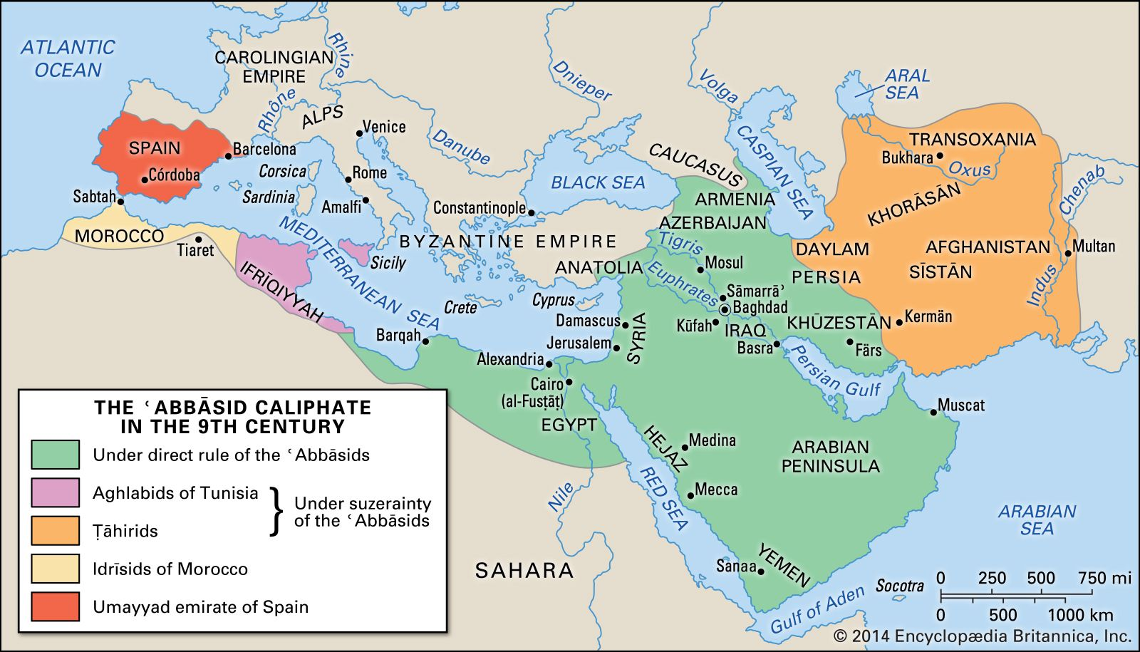

Slide 14
Why did the Abbasid Empire fragment?
Extravagant lifestyle, pomp and ceremony of some of the caliphs
Decentralization of the administration/power. Abbasid rulers gave too much power to provincial governors.
Provisional governors began to exert greater autonomy, using their power to make their positions hereditary.
Some governors even rebelled against the Khalifah at Baghdad
Shi’as became more powerful
Racial discord between Arabs and non-Arabs. Maintaining a large multi-ethnic group was problematic.
Rise of Persian nationalism – Persian Renaissance
Turkish military commanders (Mamluks) gained greater power. They would support rival contenders in succession disputes, leading to chaos and weakening the state.
Succession problems
Crusades and Mongol invasions.

Slide 15


Slide 16
Islamic Dynasties: 9th and 10th Centuries
WESTERN DYNASTIES
Aghlabids 800 – 909 (A) (Tunisia)
Tulunids 868 – 905 (T) (Egypt)
EASTERN DYNASTIES
Samanids 819 – 1005 (P) (Transoxiana)
Tahirids 821 – 873 (P) (Khorasan)
Saffarids 861 – 1003 (P) (Eastern Iran – Sistan)
*Alids 864 – 928 (P) (Northern Iran)
Sajids 889 – 929 (P) (Azerbaijan & Armenia)
*Hamdanids 890 – 1004 (A) (Northern Iraq and Syria)
*Buyids (or Buwayhids) 945 – 1055 (P) (Iraq – inc. Baghdad & Western Iran)
* = Sh’ia dynasties
A = Arab dynasties
T = Turkic dynasties
P = Persian dynasties

Slide 17
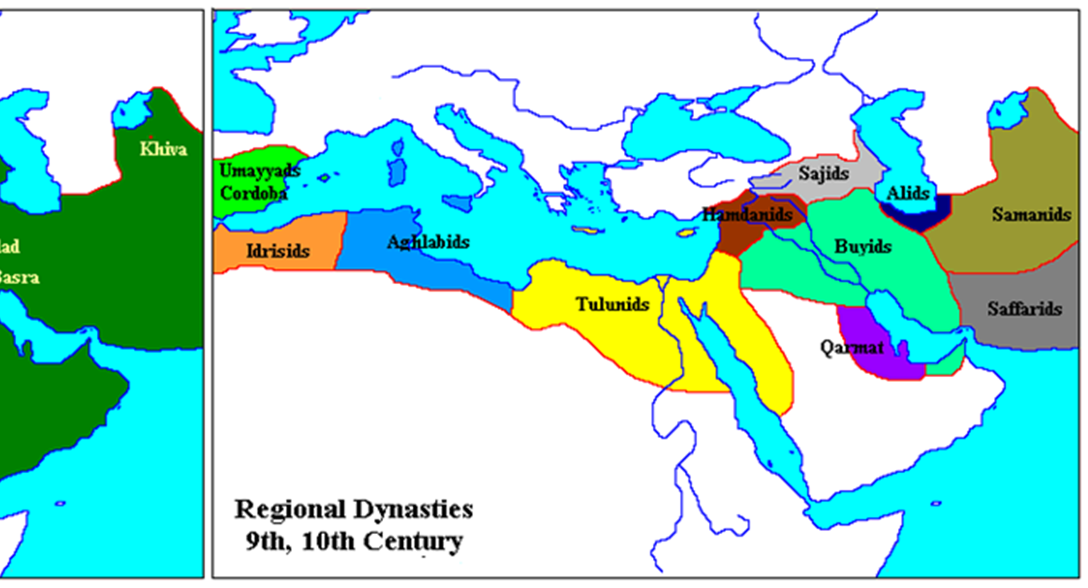
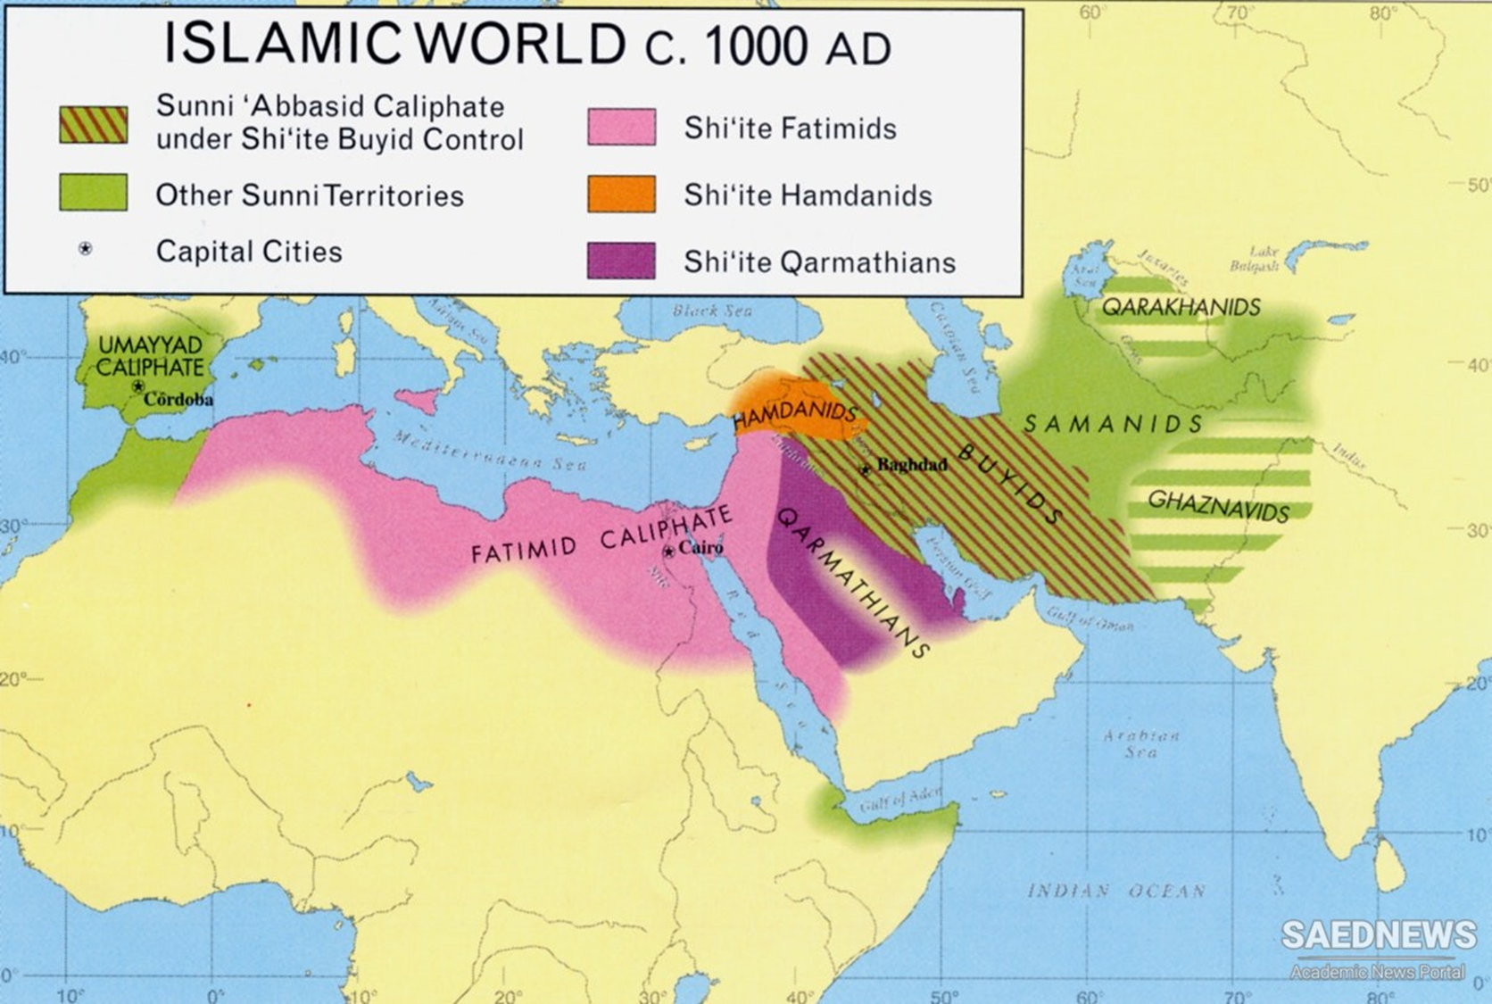

Slide 18
* = Sh’ia dynasties
A = Arab dynasties
T = Turkic dynasties
P = Persian dynasties
Islamic Dynasties: 11th Century
WESTERN DYNASTIES
*Fatimids 909 - 1171 (A) (North Africa & Levant)
EASTERN DYNASTIES
Samanids 819 – 1005 (P) (Transoxiana)
*Hamdanids 890 – 1004 (A) (Northern Iraq and Syria)
*Qaramatians 899 -1078 (P) (Eastern Arabia)
*Buyids (or Buwayhids) 945 – 1055 (P) (Iraq – inc. Baghdad & Western Iran)
Ghaznavids 977 – 1186 (T-P) (Persia, Khorasan, Afghanistan, Northern India)
Seljuks 1037 – 1194 (T-P) (Central Asia, Middle East, Anatolia)

Slide 19
Shi’a Century (945-1055)
The Shi'a Century or Shi'ite Century is a term used to describe the period between 945 and 1055, when Shi'a Muslim regimes, most notably the Fatimids and the Buyids, held sway over the central lands of the Islamic world.

Slide 20
Eastern Dynasties

Slide 22
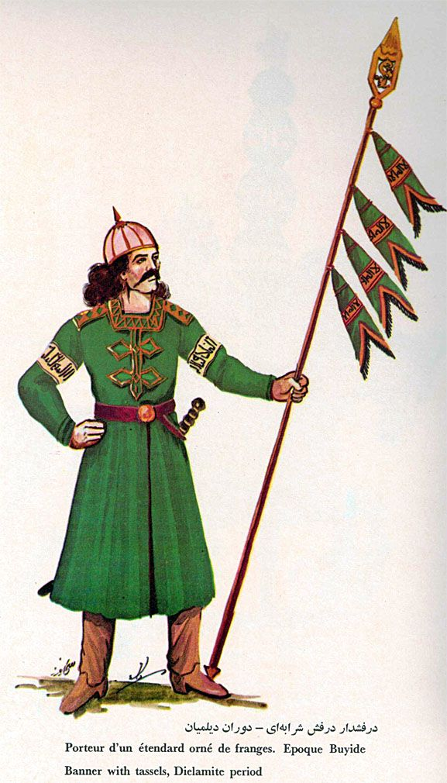
Buyids (Buwayhids) (945-1055)
From the northern parts of Iran
Powerful Shi'a family
Capture some western parts of Iran
In 945, a Buyid prince took control of Baghdad
Khalifahs were kept in place, but figure heads and puppets
Rruled over Baghdad and surrounding areas for 100 years from 945-1055
Introduced the 10th of Muharram as an official holiday
Notes:
From the northern parts of Iran emerged a powerful shi’a family who managed to capture some western parts of Iran.
Then in 945 a Buyid prince led his army to Baghdad and took control.
The Khalifahs were kept in place, but they were nothing more than figure heads and puppets.
They ruled over Baghdad and surrounding areas for 100 years from 945-1055.
The Buyids introduced the 10th of Muharram as an official holiday.

Slide 24
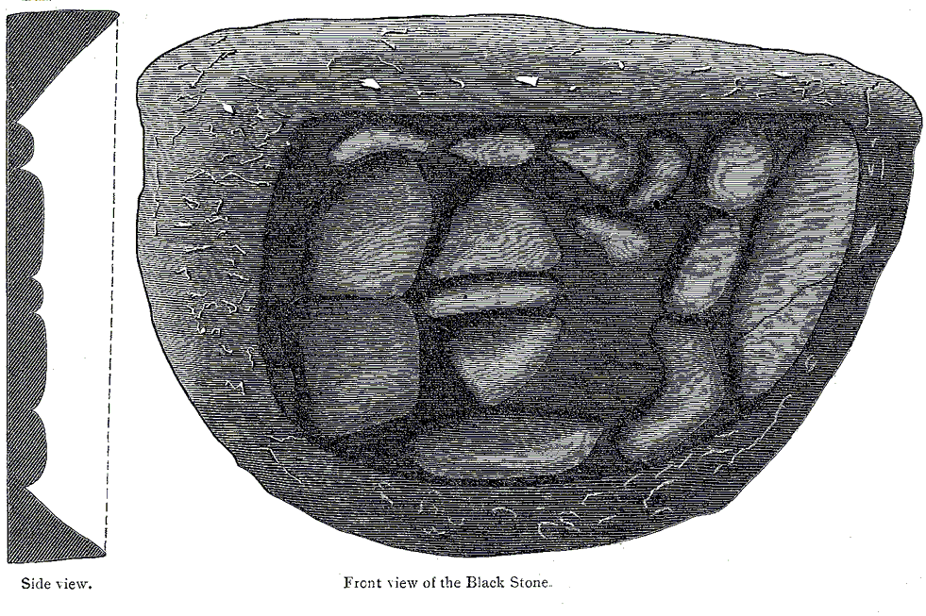
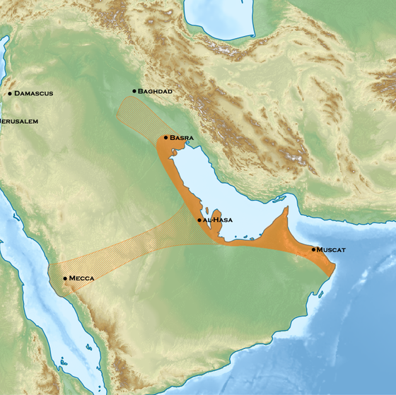
The Qaramatians 899 – 1078
Located in Eastern Arabia
Small extremist Shi’a group
Menace and source of fear for the Muslim world
Despised as heretics by both Sunni and Shi’a Muslims
930 - Attack on Makkah during the Hajj pilgrimage season
Tens of thousands of Muslims massacred
Bodies were thrown into the well of Zam Zam
Stole Al-Hajrul Aswad (the black stone), kept it for 20 years, returned it in 951 after receiving a huge ransom from the Abbasid Khalifah
Notes:
The Qaramatians were a small extremist Shi’a group.
They were a menace and source of fear for the Muslim world.
The Qaramatians were located in Eastern Arabic and despised as heretics by both Sunni and Shi’a Muslims.
In the year 930 CE, the Qarmatians launched an attack on Makkah during the Hajj pilgrimage season.
Tens of thousands of Muslims were massacred, and bodies were thrown into the well of Zam Zam.
The Qaramatians also stole Al-Hajrul Aswad (the black stone) from the Kabah. They kept it for 20 years and returned it in 951 after receiving a huge ransom from the Abbasid Khalifah.

Slide 26
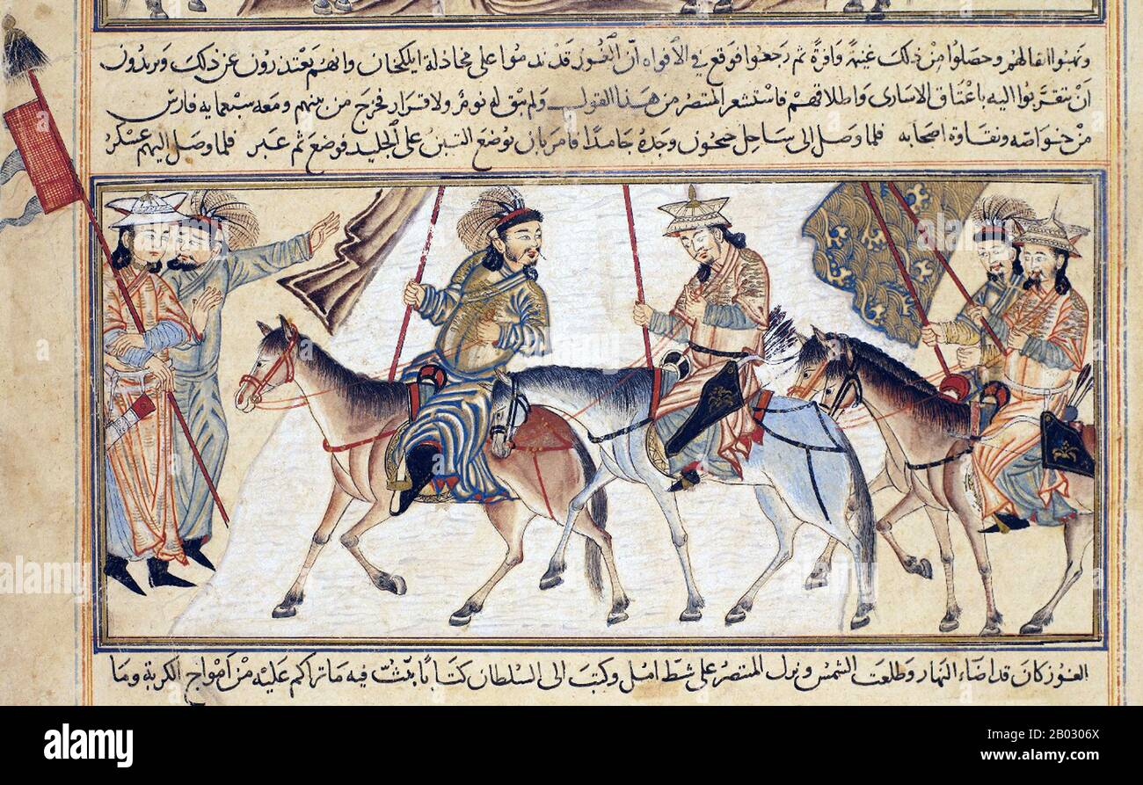
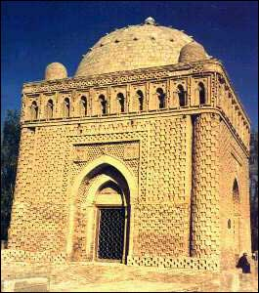
Samanids (819–1005)
Ruled over Transoxiana
Sunni Muslim rulers under Abbasid authority
Capital city: Bukhara flourished in commerce,
religion, education, science
Persian revival with Arabic script and grammar,
explosion of Persian literature and culture
Ibn Sina, Ar-Razi, Imam Muslim, Imam Bukhari
Samanids propagated Islam, aided Turkic tribe conversion
The last ruler sought Turkish aid (Sebuktigen) against enemies
Sebuktigen was given Ghazna
Sebuktigen's son, Mahmud Ghaznavi, gained independence and overthrew Samanids
This led to Ghaznavids and Karakhanids emerging
Amu Darya river formed boundary between Ghaznavids and Karakhanids
Notes:
Ruled over Transoxiana region were Sunni Muslim rulers under Abbasid authority
Their capital city Bukhara flourished in commerce, religion, education, and science
Cultural and Linguistic Impact: Persian revival with Arabic script and grammar, Explosion of Persian literature and culture, Bukhara became cultural hub attracting scholars and artists
Intellectual Achievements: Islamic scholars and scientists thrived such as Ibn Sina, Ar-Razi, Imam Muslim, Imam Bukhari
Samanids propagated Islam, aided Turkic tribe conversion
The last ruler sought Turkish aid (Sebuktigen) against enemies; Sebuktigen was given Ghazna (now Ghazni, Afghanistan) to rule
Sebuktigen's son, Mahmud Ghaznavi, gained independence and overthrew Samanids; this led to Ghaznavids and Karakhanids emerging
Amu Darya river formed boundary between Ghaznavids and Karakhanids

Slide 28
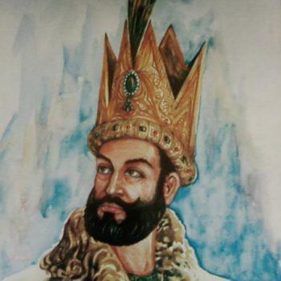
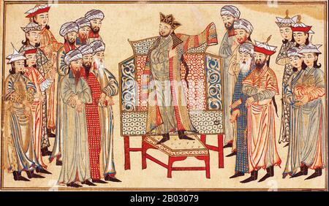
Ghaznavids (977-1186)
Emerged after the Samanid decline, capital was Ghazna
Mahmud Ghaznavi raided India 17 times, conquered Punjab
Promoted Persian language, art and literature and
  encouraged scholars, poets and artists
Gained immense wealth through conquests
Sponsored grand architectural projects, including mosques and palaces
Attracted scholars and thinkers like Al-Biruni
Promoted Islam in the Indian Subcontinent and had an influence on Central Asian and Indian culture, art, and literature
Notes:
The Ghaznavid Dynasty emerged after the Samanid decline
in 10th century, their capital was Ghazna
Mahmud Ghaznavi, their renowned ruler expanded
territories, he raided India 17 times, conquered Punjab,
established Ghaznavid Empire's prominence
They promoted Persian language, art, and literature and
encouraged scholars, poets, and artists
The Ghaznavids gained immense wealth through conquests
They sponsored grand architectural projects, including mosques and palaces
They attracted scholars and thinkers from various regions and patronized scholars like Al-Biruni, aiding in intellectual exchange
They promoted Islam in the Indian Subcontinent and had and influence on Central Asian and Indian culture, art, and literature

Slide 29
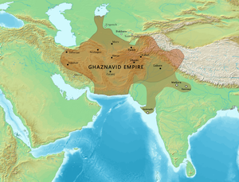
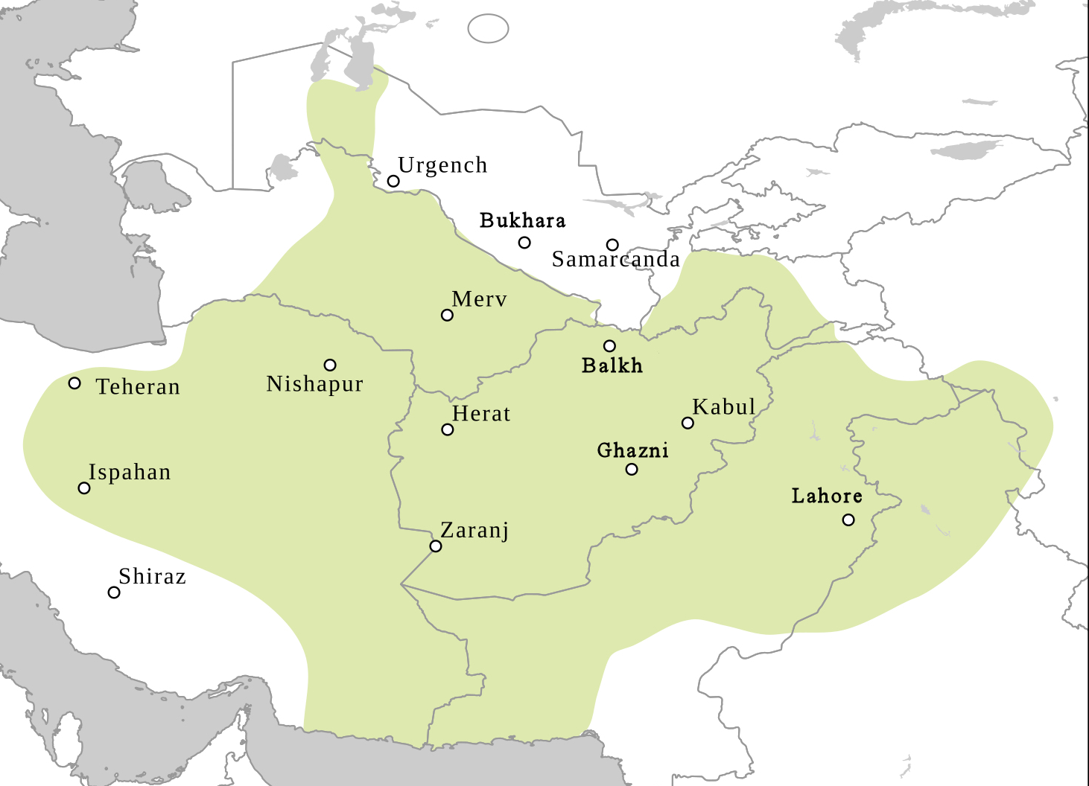

Slide 31
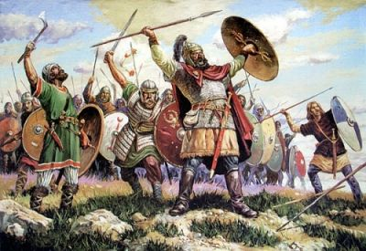
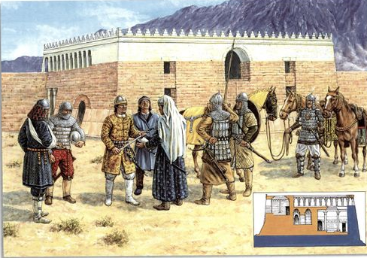
Karakhanids (840-1212)
Turkic ruling dynasty in Central Asia
Originally Tengri followers, they converted to Sunni Islam
Controlled parts of modern-day Uzbekistan, Kazakhstan, Kyrgyzstan, and Turkmenistan
Positioned along the Silk Road, their empire thrived through trade and cultural exchange
Internal strife and external pressures led to their decline, resulting in the division of their empire into smaller states

Slide 32
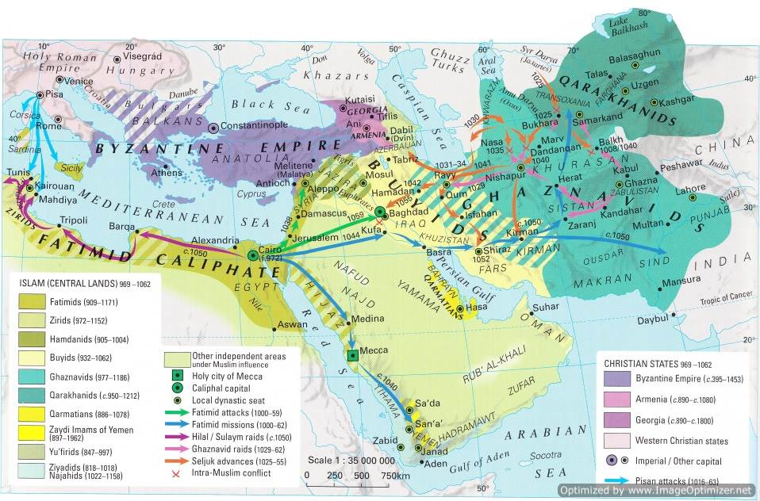

Slide 33
Western Dynasties

Slide 35
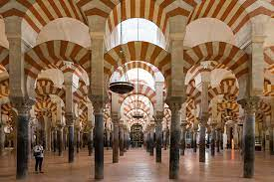
Umayyads of Spain, Taifas – Al Andalus (711-1492)
711 – Conquered by Muslims from North Africa, led by Tariq ibn Ziyad
Al-Andalus became a cultural hub, known for its tolerance, architectural marvels like the Great Mosque of Cordoba, and contributions to science, philosophy, and art
756-1031 Umayyad Caliphate of Spain - characterized by periods of relative unity and fragmentation into smaller kingdoms (taifas)
Christian kingdoms in northern Spain launched the Reconquista, leading to gradual Christian advances
1492, Fall of Granada, the last Muslim stronghold
Notes:
Islamic Conquest: Muslims from North Africa, led by Tariq ibn Ziyad, conquered the Iberian Peninsula in 711 AD, establishing Muslim rule in the region.
Cultural Center: Al-Andalus became a cultural hub, known for its tolerance, architectural marvels like the Great Mosque of Cordoba, and contributions to science, philosophy, and art.
Umayyad Dynasty: The Umayyad Caliphate of Spain ruled from 756 AD to 1031 AD, characterized by periods of relative unity and fragmentation into smaller kingdoms (taifas).
Reconquista: Christian kingdoms in northern Spain launched the Reconquista, a series of campaigns to retake territory from Muslim rule. This led to gradual Christian advances.
Fall of Granada: In 1492, the Catholic Monarchs captured Granada, the last Muslim stronghold. This marked the end of Muslim rule in Spain and the completion of the Reconquista.

Slide 36
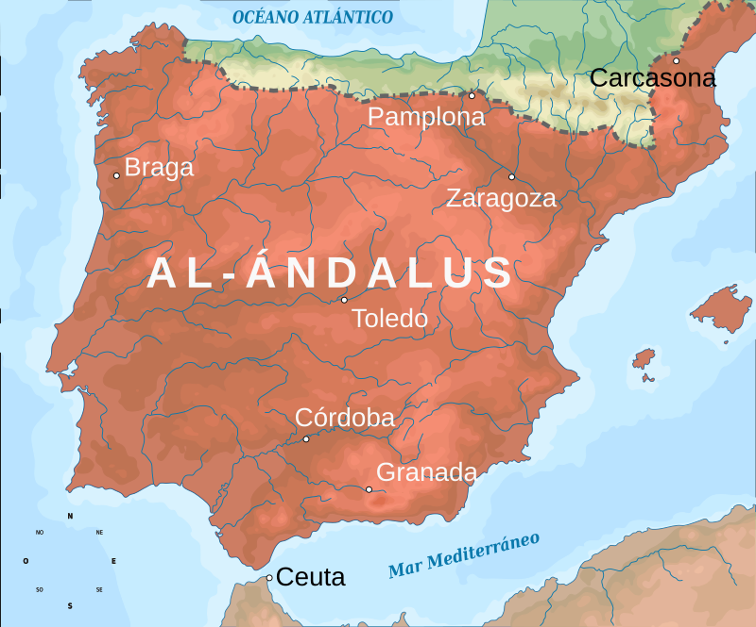

Slide 37
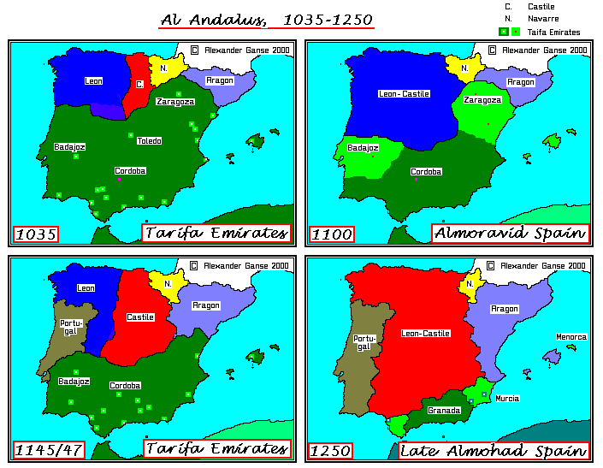

Slide 38
Idrisids (789–974 AD), Almoravids (1062–1147 AD), Almohads (1121–1269 AD)
The Idrisids were a Moroccan Muslim dynasty founded by Idris I in the early 8th century
They established a kingdom centered in northern Morocco, with their capitals at Volubilis and Fes; initially recognized the authority of the Abbasid Caliphate in Baghdad but maintained a degree of autonomy in Morocco
They were known for promoting scholarly and cultural activities, contributing to the development of Fes as a prominent center of learning and architecture
Over time, the Idrisid dynasty faced internal conflicts and external pressures from various forces, it gradually fragmented into smaller territories, leading to its decline
The region was subsequently ruled by various Berber and Arab groups.
The Almoravid, a Berber-Muslim dynasty, emerged in the 11th century
They managed to unify much of North Africa and parts of Spain under their rule
They played a crucial role in stemming the Christian Reconquista
The Almohads also a Berber dynasty took over after them
They ruled over a significant portion of North Africa and Spain
They practiced a more strict form of Islam and emphasized unity under their rule.

Slide 39
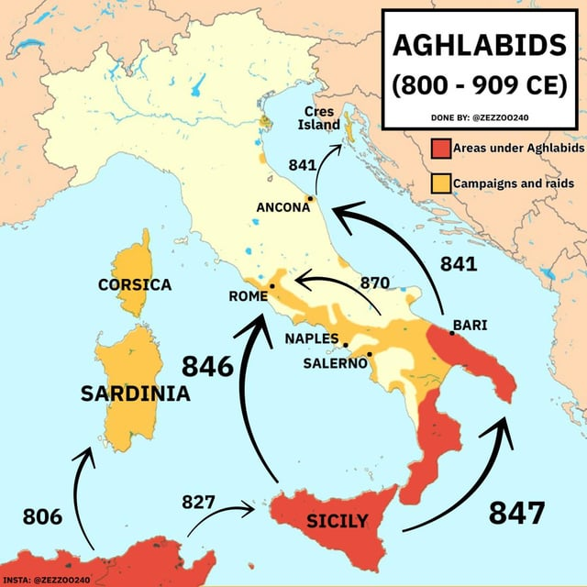
Aghlabids (800-909)
Arab dynasty that ruled Ifriqiyah (Tunisia and eastern Algeria) from 800 to 909
An Arab general Al Aghlab and his descendants exercised autonomous control over Algeria and Tunisia
Ccapital city was Kairouan (al-Qayrawān), in Tunisia
Fleet was supreme in the central Mediterranean
They conquered Sicily; they even raided Sardinia
They left great engineering works, such as the huge water storage basins, a number of aqueducts and bridges, and complex sewage system.

Slide 40
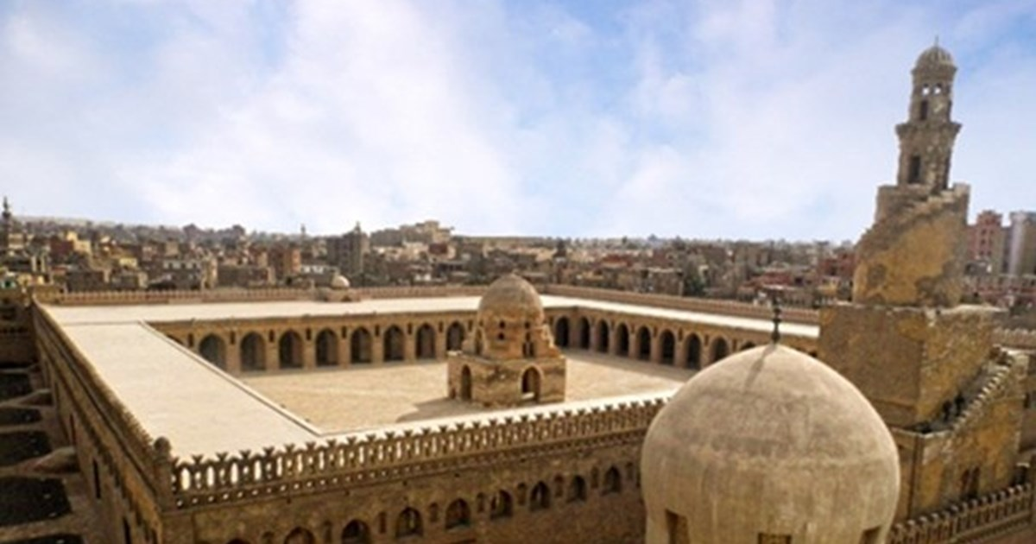
Tulunids (868-905)
Mamluk Dynasty
Founded by Ahmad Ibn Tulun,
a Turkic slave-commander
The Tulunids introduced innovative
economic policies, including land
redistribution and taxation
reforms and expanded agricultural production, improving the economy
Instituted administrative reforms that enhanced governance efficiency and stability.
Constructed significant architectural marvels, like the Ibn Tulun Mosque in Cairo
Undertook extensive public projects, including canals for irrigation and transportation
Improved infrastructure and urban planning in Cairo

Slide 41
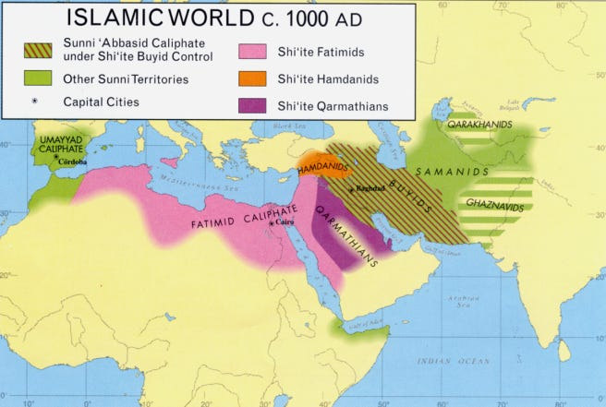
The dynasties of North Africa and Hijaz were the replaced by the Fatimids

Slide 43
Fatimids (909-1171)
Significant Ismaili Shi'a dynasty in Islamic history
Held control over nearly half of the Islamic world with a Khalifa of their own
They exploded into prominence in North Africa toppling various dynasties
After the Buyid takeover of Baghdad in 945, the Fatimids entered Egypt in 969 and then extended their influence to Syria, including Damascus, Makkah and Madinah
They maintained a robust naval fleet, competing against the Umayyads of Spain and the Byzantines for Mediterranean control
They established Al Azhar University in 970, serving as one of the world's oldest surviving institutions of higher learning
The Qaramatians and Buyids did not support them, despite being Shi'a themselves
Byzantine challenges in the Mediterranean and conflicts with the Seljuk Turks in the Syrian highlands added to their difficulties
Internal strife arose, with the Berber, Sudanese and Turkish vying for power in the army
Caliph Al-Hakim's destruction of the Church of the Holy Sepulchre instigated the Crusades, while the Murabitun (Almoravids) revolution countered Shi'ism and took over the Maghrib in 1051, later also conquering Al-Andalus
Salahuddin Ayyubi was the one who defeated the Fatimids, ending their reign in 1171

Slide 45
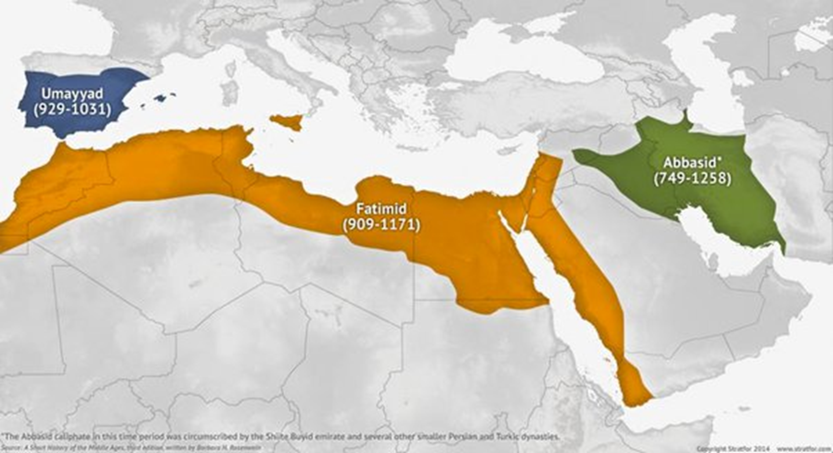
Three Caliphs

Slide 46
Seljuks, Ayyubids and Khwarazmians

Slide 47
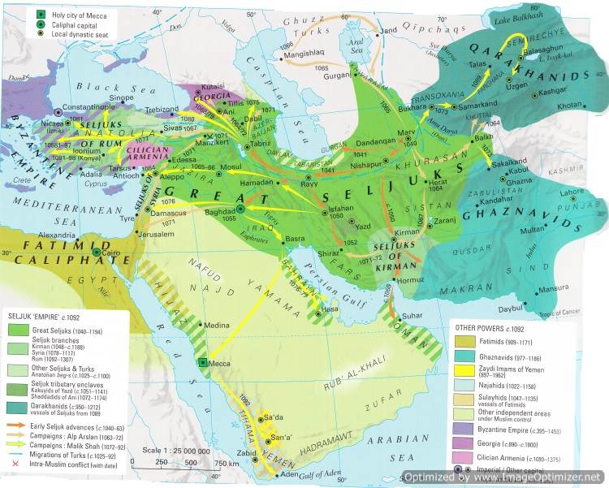
A New Power Emerges

Slide 48
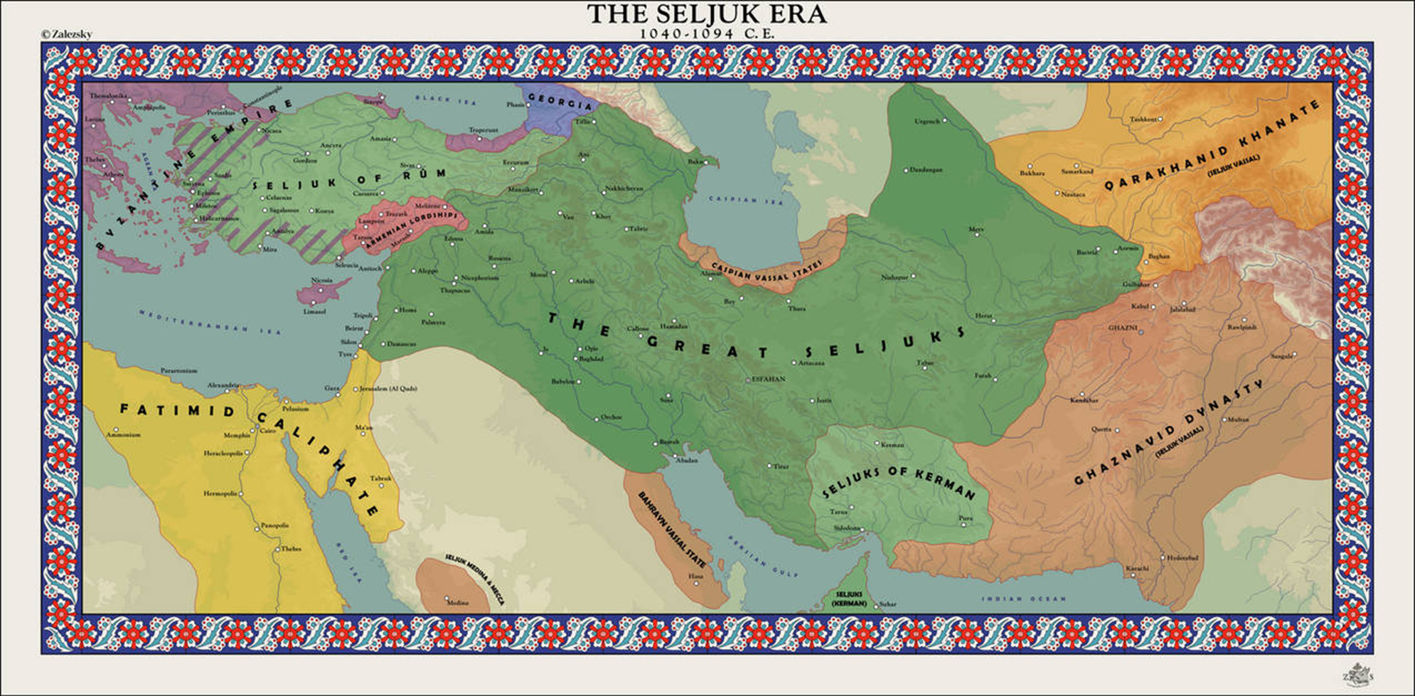

Slide 49
The Great Seljuks
Central Asian nomads, migrating west to Persia in the 10th century
Seljuk Bey founded the Great Seljuks in the 11th century, Tughrul and Chagri Bey defeated the Ghaznavids and captured cities like Merv, Nishapur, Rey, Isfahan, Baghdad, and Jerusalem
Their victory at the Battle of Manzikert (1071) by Alparslan allowed them to control Anatolia, laying the groundwork for later Turkish empires, such as the Ottomans
The Seljuks, especially Alparslan’s son Malik Shah were patrons of art and education, constructing mosques and madrasas, e.g. Nizamiyyas which had teachers like Imam Ghazali
Internal conflicts, succession issues led to fragmentation, and gave rise to the Seljuks of Rum
By the late 12th century, the empire weakened, exploited by Crusader states and Mongol invasions that led to its disintegration
They were the SAVIOURS OF SUNNI ISLAM…
  The Seljuks fought against the Buyids
  The Seljuks fought against the Qaramatains
  The Seljuks fought against the Fatimids
  The Seljuks fought against the Assassins
  The Seljuks fought against the Byzantines
  The Seljuks fought against the Crusades
SELJUK SULTANS
Sultan Tughrul r1037 – 1063
Sultan Alp Arslan r1063 – 1072
Sultan Malik Shah r1072 – 1092

Slide 50
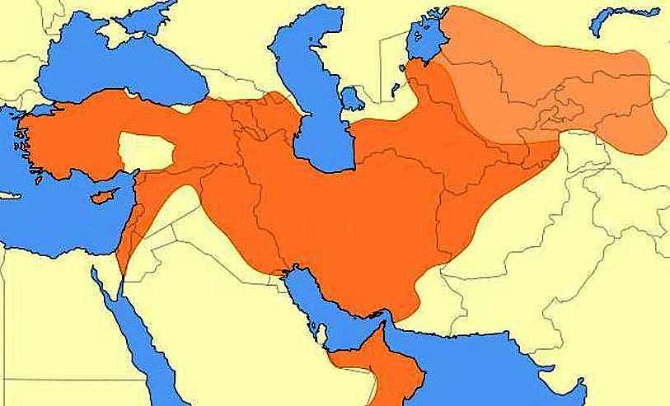
A map showing the Great Seljuk Empire at its height, upon the death of Malik Shah in 1092

Slide 51
The End: Succession Struggles
The among the sons of Malik Shah, marked a period of decline for the Seljuk Empire.
After Malik Shah's death, Berkyaruq assumed power in 1092. During his reign, the Crusaders arrived in the Levant, and the influence of local amirs grew stronger.
Upon Berkyaruq's death, Muhammad Tapar took the throne, making efforts to stabilize the empire. While Muhammad Tapar ruled Iran, different branches of Seljuks governed Aleppo, Damascus, and Kirman, leading to further divisions with each succession. These divisions contributed to the fragmentation of the western part of the Seljuk Empire into weak kingdoms.
Sanjar, Malik Shah's son, established himself in Khorasan in 1097. Although he ruled until 1156, his authority relied on vassals like the Karakhanids and Ghaznavids. Rebellion in the Khwarazm region weakened his control, while a battle against the Kara Khitai in 1141 ended in defeat. Sanjar's death in 1156 marked the decline of Seljuk power.
An attempt at revival was made by Tughrul III (r. 1176-1194), but the Khwarazmian empire's ascendancy proved insurmountable.
By 1194, the last Seljuk Sultan was killed by Khwarazm ruler Ala ad-Din Takash, solidifying Khwarazm's conquest of parts of Khorasan and western Iran, ultimately ending the era of Seljuk dominance.

Slide 52
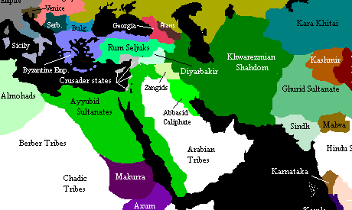
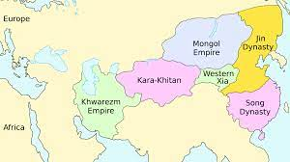

Slide 54
Khwarazmians
In 1077, the Seljuks appointed Anush Tigin as governor of Khwarazm; In 1141, a joint Seljuk and Khwarazmian army was defeated by the Kara Khitai, making Khwarazm a vassal
After Seljuk Sanjar's death in 1156, the Khwarazm-Shahs expanded southward
Khwarazm ruler Ala ad-Din Takash defeated Tughrul III in 1172 and expanded his territory.
Khwarazmians declared independence, gained power to challenge the Kara Khitai and Seljuks.
In 1198, the Abbasid Caliph recognized Ala ad-Din Takash as the Sultan of Khorasan.
Ala ad-Din Muhammad II succeeded Ala ad-Din Takash in 1200, expanded west and south.
The Khwarazm Empire had a formidable cavalry and a period of growth, reaching its peak in 1212 under Shah Muhammad, conquering territories of the Kara Khitai.
However, starting in 1218, the Khwarazmians faced a looming threat … ?????????

Slide 55
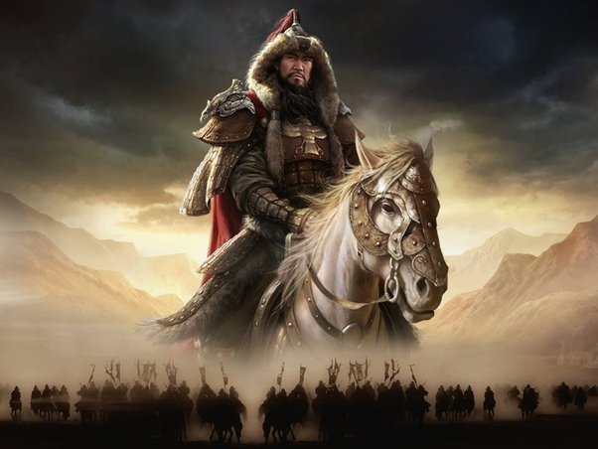

Slide 56
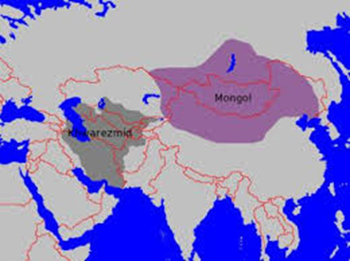
Both Empires were growing and expanding…

Slide 57
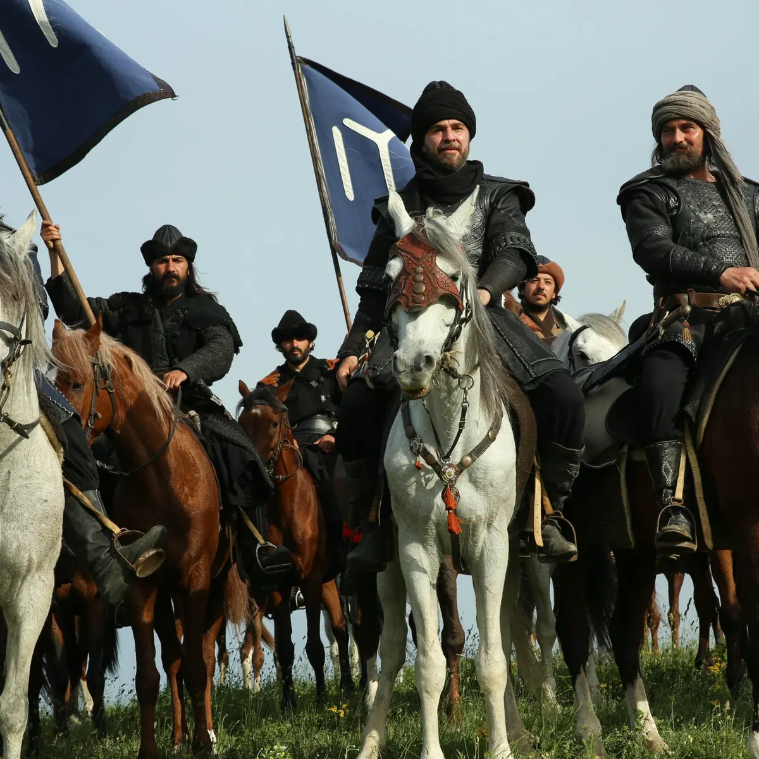

As a point of interest, these events were taking place at the same time as the Kayi tribe was migrating from Central Asia to Anatolia

Slide 58
Khwarazmians (1077–1231)
In 1077, the Seljuks appointed Anush Tigin as governor of Khwarazm; In 1141, a joint Seljuk and Khwarazmian army was defeated by the Kara Khitai, making Khwarazm a vassal
After Seljuk Sanjar's death in 1156, the Khwarazm-Shahs expanded southward
Khwarazm ruler Ala ad-Din Takash defeated Tughrul III in 1172 and expanded his territory.
Khwarazmians declared independence, gained power to challenge the Kara Khitai and Seljuks.
In 1198, the Abbasid Caliph recognized Ala ad-Din Takash as the Sultan of Khorasan.
Ala ad-Din Muhammad II succeeded Ala ad-Din Takash in 1200, expanded west and south.
The Khwarazm Empire had a formidable cavalry and a period of growth, reaching its peak in 1212 under Shah Muhammad, conquering territories of the Kara Khitai.
However, starting in 1218, the Khwarazmians faced a looming threat – The Mongols
Ala ad-Din Muhammad's son, Jalal ad-Din, resisted them, rallying support, winning battles.
The Mongols (Genghis Khan and later Bajju Noyan), invaded Khorasan, weakening him
Seljuk Sultan Kayqubad I and Ayyubids allied against Jalal ad-Din in 1230 at the Battle of Yassicemen. (Ertugrul Ghazi fought with his Alps in this battle)
The Mongols launched another attack on Jalal ad-Din, who was eventually defeated
Jalal ad-Din was killed in 1231, marking the end of the Khwarazmian Empire.
In 1244, the Khwarazmiyya, Khwarazmian Turk mercenaries took over Jerusalem which was under the Franks since the 6th Crusade in 1229

Slide 59
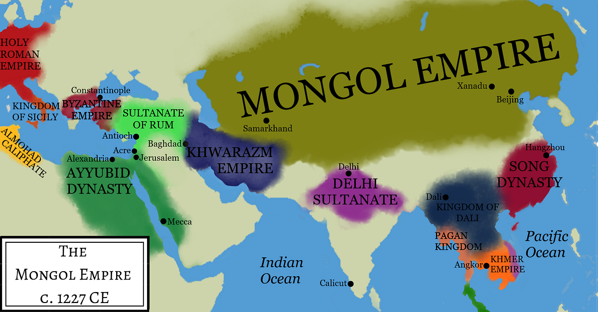

Slide 60
Ayyubids (1171–1260)
The Ayyubid dynasty was founded by Salahuddin (Salah ad-Din Yusuf ibn Ayyub) in the 12th century.
Salahuddin, a skilled military leader and statesman, rose to prominence during the Crusades.
He recaptured Jerusalem from the Crusaders in 1187, gaining fame and consolidating Ayyubid power. (In 1099, during the First Crusade, Jerusalem had been captured by the Crusaders.)
The Ayyubids ruled over various parts of the Middle East, including Egypt, Syria, Yemen, and parts of modern-day Iraq and Jordan.
The Ayyubids are known for their relatively tolerant and just rule, respecting the rights of various religious and ethnic groups under their domain.
The Ayyubid dynasty gradually fragmented after Saladin's death in 1193.
5th Crusade (1217-1221) and 6th Crusade (1228-1229) took place.
During the 6th Crusade, Jerusalem was handed over to the Crusaders by Al-Kamil, the Ayyubid ruler of Egypt and Syria, as part of a peace treaty negotiated between Al-Kamil and Holy Roman Emperor Frederick II in 1229.
Al-Aziz ibn Dhahir Ibn Salahudin of Aleppo (1213 –1236) was Salahuddin’s grandson.
Later, the Mamluks replaced the Ayyubids as the rulers of Egypt and Syria; Beybers I installed Al Muntasir (1261-62) as the Caliph in Cairo with a titular status.

Slide 61
Seljuks of Rum
Alp Arslan appointed his cousin Suleiman ibn Qutalmish (r. 1077-1086) to invade Anatolia. Suleiman founded a Seljuk Turkish state there, ruling independently. In 1086, he laid siege to Aleppo but died in battle; his son Kilij Arslan was captured.
Kilij Arslan I (r. 1092-1107) defeated the People's Crusade, resisting Crusaders and weakening them. Mesud I (r.1116-1156) massacred the Second Crusade, expanded territory, and built Alaeddin Mosque.
Kilij Arslan II (r. 1156-1192) fought Byzantines, strengthened Seljuk presence, faced Third Crusade, fostering economic growth and construction. Sons' power struggle (1192-1204) weakened the Sultanate.
Seljuk Golden Age (1204-1237) thrived under Ghiyath al-Din Kaykhusraw I and Alaeddin Kayqubad I, capturing cities, trade prospered, and construction flourished.
Alaeddin Kayqubad I (1220-1237) succeeded, enjoying military success including against the Ayyubids and the Khwarazmians
Ghiyasuddin Kaykhusraw II's reign weakened Seljuks due to a weak leadership and harmful vizier, Sadettin Kopek
Mongols neared Anatolia; Baiju Noyan captured cities, leading to the Battle of Kosedag in 1243, a defeat ending Seljuk power. They became Mongol vassals, with Beyliks emerging.

Slide 62
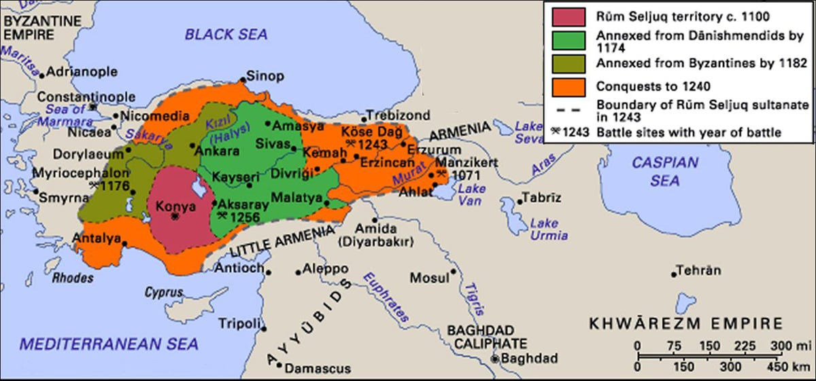

Slide 63
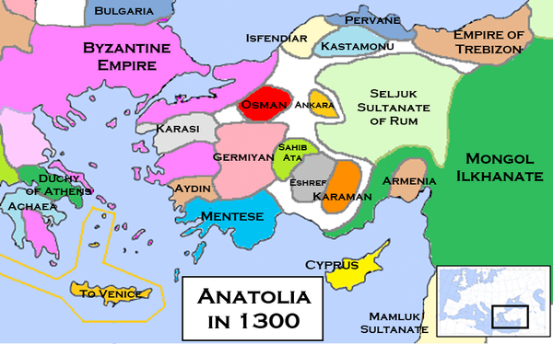
Declining Sultanate of Rum (Vassals of the Mongols) and the Emerging Beylics

Slide 64
Mongols
The Mongol invasion took place between 1218-1260
After Genghis Khan, the Mongols divided into Four groups:
  Yuan
  Ilkhan – became Muslim – Ghazan 1295
  Chagatai – became Muslim
  Golden Horde – became Muslim – Berke 1252
In 1258, Mongols under Hulagu Khan destroyed Baghdad, they rolled up the Abbasid Caliph al-Mustasim in a carpet and rode over him until death, as to not spill royal blood
Berke Khan (of Golden Horde) had become Muslim in 1252 and waged war against Hulagu post fall of Baghdad
The Mongols of the line of Hulagu Khan, known as the Ilkhanids ruled over Persia, Iraq, part of Anatolia, the Rum Seljuks were their vassals
Eventually, some Mongols such as Uljaytu, Ghazan Khan, Abu Said converted to Islam
The Mongol advance was finally halted by the Mamluks (Saifudin Qutz, Baibars) in the Battle of Ayn Jalut in Sept 1260
After the decline of the Mongolsl in the 14th century, it would be the turn of Transoxiana, under the rule of Timur, to shine. But that is a story for another time…

Slide 65
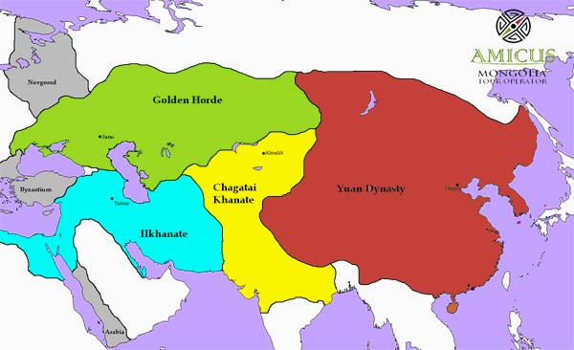

Slide 66
Mamluks
Origins and Rise: Began as slave soldiers of Turkic and Circassian origin; seized power in Egypt in 1250, establishing the Mamluk Sultanate
Two Dynasties
Bahri (1250-1382): Founded by Sultan Baybars, of Turkic origin
Burji (1382-1517): Primarily Circassian rulers
Military Achievements
Defeated the Mongols at the Battle of Ain Jalut (1260)
Ended Crusader presence in the Holy Land (1291)
Cultural Impact: Major patrons of Islamic art and architecture; developed a distinctive Mamluk style in Cairo
Economic Power: Controlled key trade routes between Europe, Asia, and Africa, boosting regional prosperity
Decline: Defeated by the Ottomans in 1517 but retained local influence in Egypt
Legacy: Known for military prowess, governance, and cultural contributions, leaving a lasting impact on Islamic history
Notes:
Origins and Rise: Began as slave soldiers of Turkic and Circassian origin; seized power in Egypt in 1250, establishing the Mamluk Sultanate.Two Dynasties:Bahri (1250-1382): Founded by Sultan Baybars, of Turkic origin.
Burji (1382-1517): Primarily Circassian rulers.
Military Achievements:Defeated the Mongols at the Battle of Ain Jalut (1260).
Ended Crusader presence in the Holy Land (1291).
Cultural Impact:Major patrons of Islamic art and architecture; developed a distinctive Mamluk style in Cairo.
Economic Power: Controlled key trade routes between Europe, Asia, and Africa, boosting regional prosperity.Decline: Defeated by the Ottomans in 1517 but retained local influence in Egypt.Legacy: Known for military prowess, governance, and cultural contributions, leaving a lasting impact on Islamic history.

Slide 67
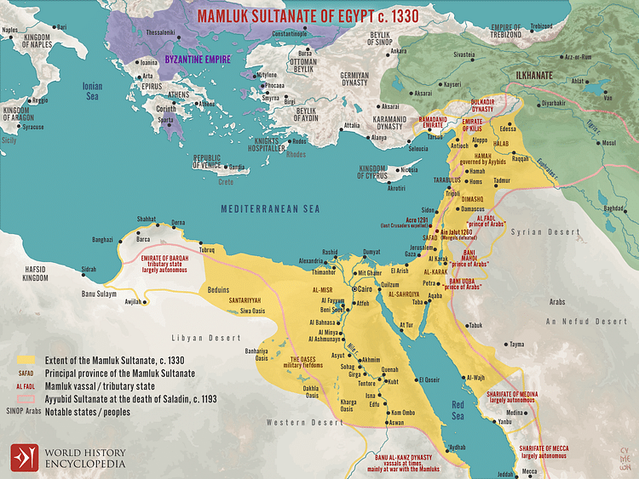

Slide 68
Let’s Summarize

Slide 69
570 - Birth of Prophet Muhammad (saw)
622 - Hijrah (Migration to Madinah)
632-661 - Rashidun Period
637-639 - Conquest of Syria and Jerusalem, Egypt and parts of North Africa
651 - Most of Sassanian Persia comes under Muslim control
661-750 - Umayyad Period, North Africa, Spain and Khorasan are taken
750-1258 - Abbasid Period, Golden Age of Islam
750-861 - Stable Abbasid rule with central authority until the 10th Caliph Al-Mutawakkil
861-onwards - Emergence of minor dynasties loyal to Abbasids, followed by larger dynasties and fragmentation
900s - Rise of the Great Seljuks, slowly taking over Ghaznavid and Karkhanid territory
909-1171 - Fatimid Dynasty in North Africa and Levant
945-1055 - Buyid Dynasty rules Baghdad
950s - Rise of the Seljuks of Rum in Anatolia
977-1186 - Ghaznavid Dynasty in Persia, Khorasan, Afghanistan, and Northern India
1037-1194 - Seljuk Dynasty in Central Asia, Middle East, and Anatolia
1055-1194 – Seljuk Dynasty rules Baghdad
1071 - Battle of Manzikert, Seljuks under Alparslan establish control over Anatolia
1092 - Death of Malik Shah, son of Alparslan
1092-1107 - Rule of Kilij Arslan I (Seljuks of Rum), first to fight the Crusaders
1099 - Crusaders capture Jerusalem on July 15, 1099, during the First Crusade
1047-1149 - Second Crusade, main player Nur Ud Deen
1171-1260 - Ayyubid Dynasty founded by Salahuddin, in Egypt, Syria, etc., after destroying the Fatimids
1187 - Salahuddin recaptures Jerusalem from Crusaders, Ayyubids play a key role in subsequent Crusades
1189-1192 - Third Crusade
1193 - Death of Salahuddin
TIMELINE

Slide 70
1196 - Birth of Erturgul Ghazi of the Kayi Tribe
1202-1204 - Fourth Crusade, Attack on Constantinople
1204-1237 - Seljuks of Rum Golden Age under Ghiyath al-Din Kaykhusraw I and Alaeddin Keykubad I
1217-1221 - Fifth Crusade, Damietta was the target, and Ayyubid Sultan al-Kamil offered Jerusalem
1218 - Mongols started their invasion, Turkish tribes such as the Kayi start migrating eastward
1220 - Mongols enter Khwarazm Empire, and by 1228 they entered Khorasan
1227 - Genghis Khan dies, the Mongol empire splits into four main khanates
1228-1229 - Sixth Crusade, Sultan al-Kamil gave Fredrick II Jerusalem
1230 - Battle of Yassicemen, Keyqubad I and Ayyubids allied against Jalal ad-Din, Ertugrul fights with his Alps
1243 - Battle of Kosedag, Ertugrul fights with his Alps, Seljuks defeated by the Mongols, became vassals, they slowly decline and various Beyliks emerge in Anatolia
1244 - Khwarizmian Turks take back Jerusalem
1248 - 1250​ - Seventh Crusade, Louis IX captures Damietta, Sultan al-Salih Ayyub dies, wife and Mamluks take over
1250 - Battle of al-Mansurah, Mamluk Baybars wins against the crusaders, Aybak becomes first Mamluk Sultan
1252 - Berke Khan of Golden Horde converts to Islam, followed by Ghazan Khan of Ilkhanate in 1295
1258 - Mongols under Hulagu Khan (Ilkhanate) sack Baghdad, Abbasid Caliph al-Mustasim killed
1258 - Birth of Osman Ghazi, son of Ertugrul Ghazi of the Kayi tribe
1260 - Battle of Ayn Jalut, Mongol advance halted by Mamluks
1261 - Byzantine Empire recaptures Constantinople from the Latin Empire
1265 - Death of Hulagu Khan
1270 - Eighth Crusade by Louis IX of France, unsuccessful campaign in Tunisia
1271 - Baybars Becomes Mamluk Sultan after overthrowing Sultan Qutuz
1277 - Death of Baibars
1289-1291 - Mamluks capture the Crusader cities of Tripoli and Acre, marking the decline of Crusader presence
1299 - Rise of the Ottoman Empire
TIMELINE

Slide 75
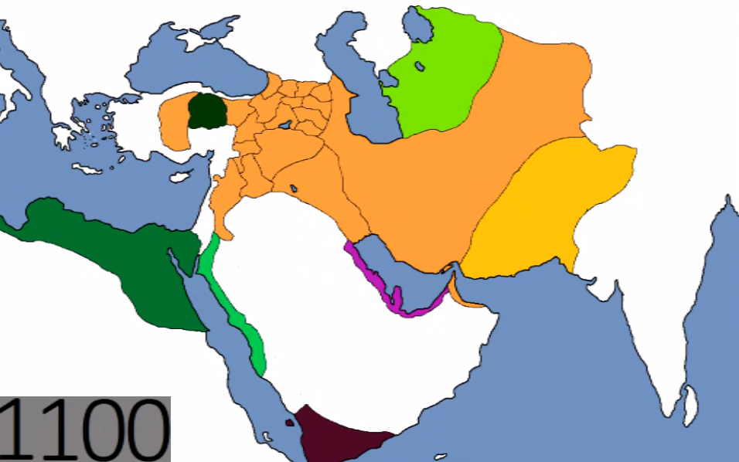
Khwarazmians
Abbasids
Great Seljuks
Ghaznavids
Fatimids

Slide 76
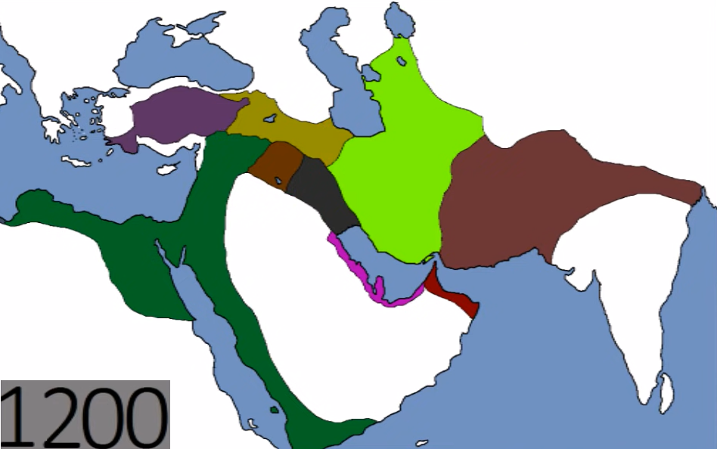
Rum Seljuks
Khwarazmians
Ghorids
Ayyubids

Slide 77
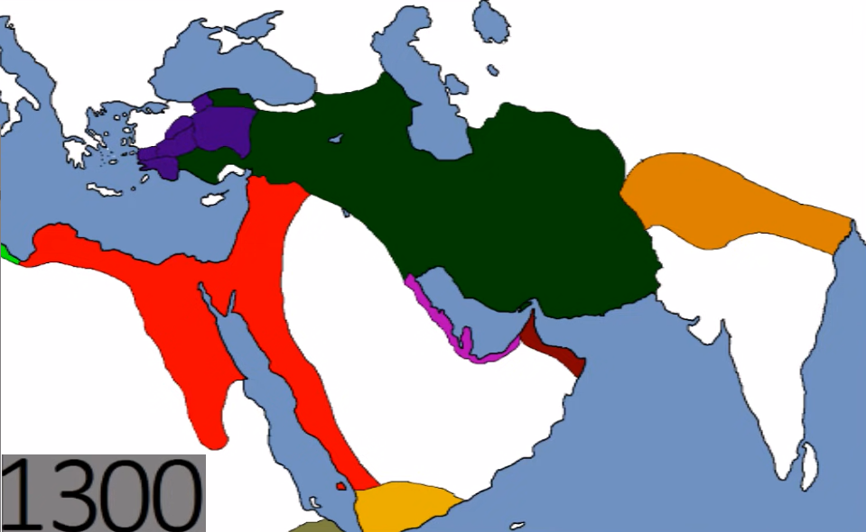
Anatolian Beyliks
Delhi Sultanate
Ilkhanate (Mongol)
Mamluks of Cairo

