Slide 1
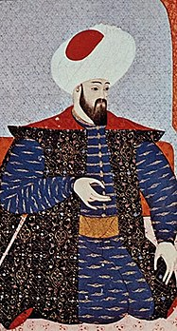
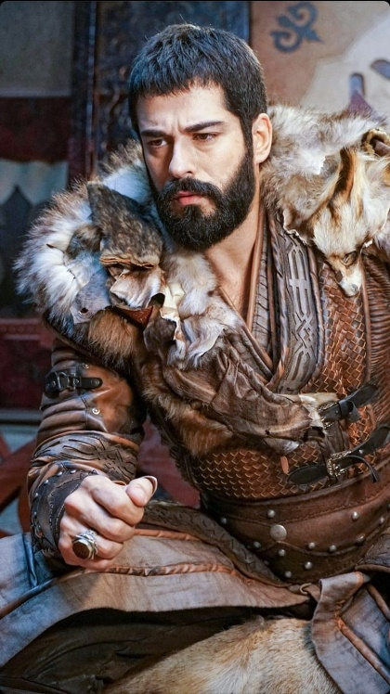
The Ottoman Sultans of Bursa
Osman Ghazi
(1299-1326)

Slide 2
Let’s Recap…
Notes:
Let’s Recap…

Slide 3
Timeline and What was Happening Elsewhere
8th and 9th Century: Oghuzz Tribes migrate west
1187: Salahuddin recaptures Jerusalem from Crusaders
1193: Death of Salahuddin
1196: Birth of Ertugrul Ghazi
1199: Richard the Lionheart, King of England and leader of the Third Crusade, dies, and his brother John becomes King.
1202-1204: The Fourth Crusade results in the sack of Constantinople, by the Crusaders, and the establishment of the Latin Empire
1204-1237: Seljuks of Rum Golden Age.
1206: Genghis Khan establishes the Mongol Empire.
1215: King John of England signs the Magna Carta, a document that limits the powers of the monarch and establishes certain rights for English nobles and subjects.
1218: Genghis Khan’s invasion of Middle East and Eastern Europe.
1227: Genghis Khan dies, and his Mongol empire is divided among his sons and grandsons.
1227: Kayi tribe cross Euphrates and enter into Anatolia
1228-1229: Sixth Crusade, Sultan al-Kamil gave Jerusalem to Fredrick II
Notes:
1299: Ilkhanate ruler Ghazan invades Syria and defeats the Mamluks

Slide 4
1230: Battle of Yassicemen: Seljuks and Ayyubids against the Khawarezmian Jalal Al Din
1237: In return for his courage on the battlefield, Seljuk Sultan Alaeddin Keyqubad I awarded Ertugrul the title of Ghazi as well as Karacadag, Sogut and Domanic
1237: Death of Sultan Alaeddin Keyqubad I (r. 1220-1237)
1243: Battle of Kosedag, Seljuks lose to Mongols, become vassals under the Ilkhanate
1244: Khwarizmian Turks take back Jerusalem
1250: Mamluks, led by Baybars (under Ayyubid Shajar Ad Durr), defeat the Crusaders at the Battle of Al Mansurah (7th Crusade), Mamluks come to power after this
1258: Fall of Baghdad to the Mongol Hulagu Khan
1258: Birth of Osman
1260: Mongols are defeated by the Mamluks at the Battle of Ain Jalut
1261: Reconquest of Constantinople by the forces of the Empire of Nicaea, leading to the re-establishment of the Byzantine Empire under the Palaiologos dynasty
1265-1271: Mamluk Baybars takes over Crusader states
1271-1295: Marco Polo embarks on his journey to Asia, stays at the court of Kublai Khan
1277: Mamluk Baybars defeats the Mongols in Anatolia, this breaks Mongol power
1284: Alaeddin Keyqubad III comes to power
1289: Ertugrul Ghazi dies and Osman ( r. 1289-1326) his youngest son comes to power
Notes:
1299: Ilkhanate ruler Ghazan invades Syria and defeats the Mamluks

Slide 5
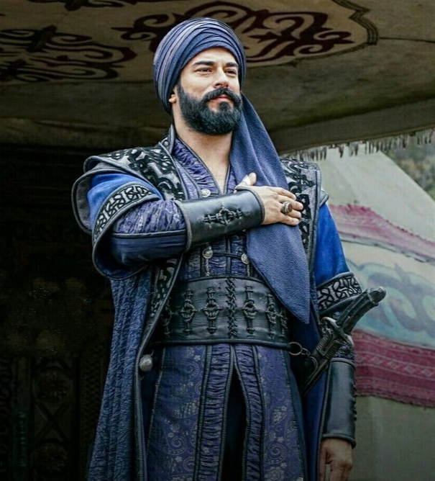
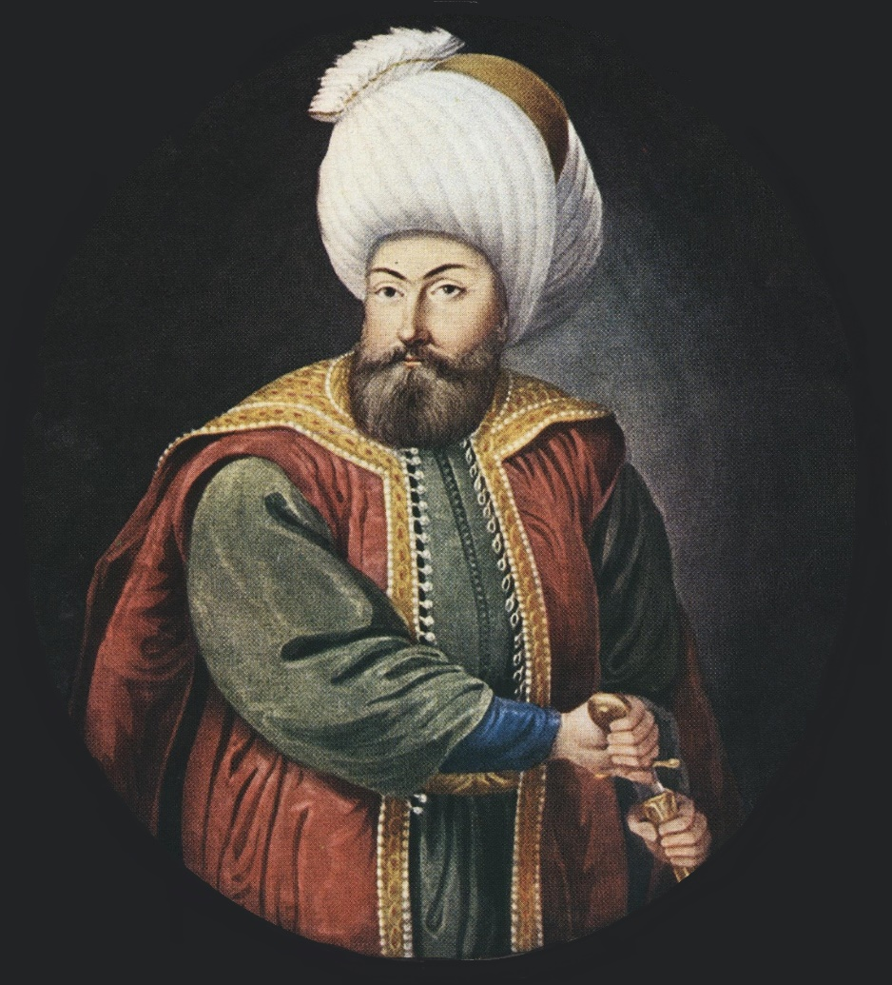
The Founding of the Ottoman Dynasty: Osman (1299–1326)

Slide 6
Osman Ghazi (r. 1289–1326)
Descendant of the Kayi tribe, Son of Ertugrul Ghazi and Halime Hayme Ana
Osman was born the same year that Baghdad was sacked by the Mongols - 1258
Gunduz and Saru Batu are his brothers - some mention a third by the name of Savci
Learned horsemanship, archery, wrestling, swordsmanship and falconry at a young age
Studied Quran and spiritual sciences under Sheikh Edebali, who was his mentor and father in law
Gained battle experience with his father
On the death of Ertugrul, Seljuk Sultan Giyasuddin Mesud II allocated Sogut and its environs to Osman along with gifts: a white standard, a tug (horsetail standard/emblem) and a mehterhane (military band)
Was supported by warriors such as Turgut Alp (d. 1335), Aykut Alp, Saltuk Alp, Hasan Alp, Konur Alp, Abdurrahman Gazi and Akcakoca
Also known as Osmancik and Kara (Black) Osman
Took advice from Sheikh Edebali and Faqih Dursun and governed in compliance with Islamic Law
Started with 2,000 people living in 400 tents; about 400 horsemen
He was responsible for the establishment of the Ottoman principality
He turned the Turkoman population trying to get a foothold, into the seed of what would become a vast empire
Married Mal Hatun mother of Orhan in 1280 and Rabia Bala Hatun in 1289
He was buried in Bursa and his son Orhan is buried next to him
Notes:
Mehterbane: Marching Band

Slide 7
Key Achievements and Contributions
Founder of the Ottoman Empire
  United under a single flag all his soldiers in spite of diverse backgrounds
  Welcomed and trained Turkoman refugees known as garips who did not have their own homeland
  Tekfurs of conquered lands turned into Osman’s new companion in arms
Expansion from Sogut into Bithynia
  Sogut was frontier territory that was closest to the Byzantine Empire and thus there was opportunity for territorial expansion
  Fortified physical strength through military might, economic opportunities and diplomacy
  Strengthened religious foundations – support of ahi dervishes, Islamic jurists, spiritual master – Edebali, endowments of land for religious foundations
Methods of Conquest
  Ghaza: System of opening new lands to Islam
  Istimalah: Warming of hearts and gaining the favour of non-Muslims and the newly conquered
Conversions
  No forced conversions
  Methodology: Gain the goodwill of the conquered, embellish their cities, facilitate their commercial activities, promote their welfare while allowing them to practice their respective religions
Notes:
Tekfurs = Old Christian Lords

Slide 8
“Thou that oppress evermore shall expect a good end no more…!”

Slide 9
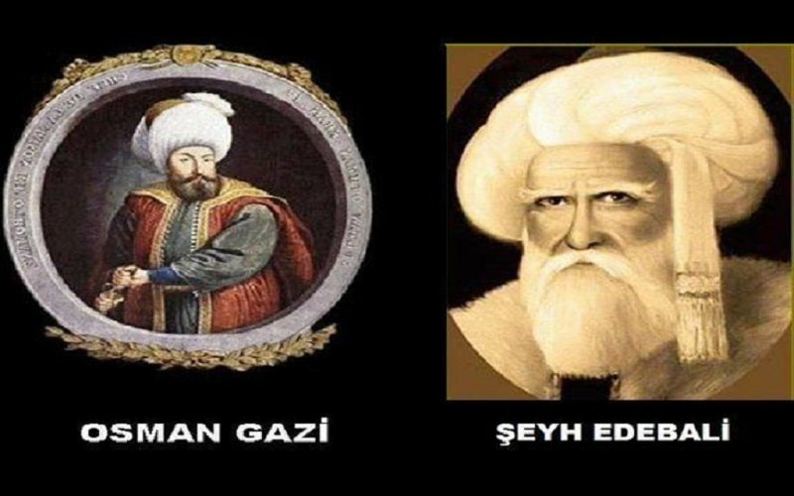

Slide 10
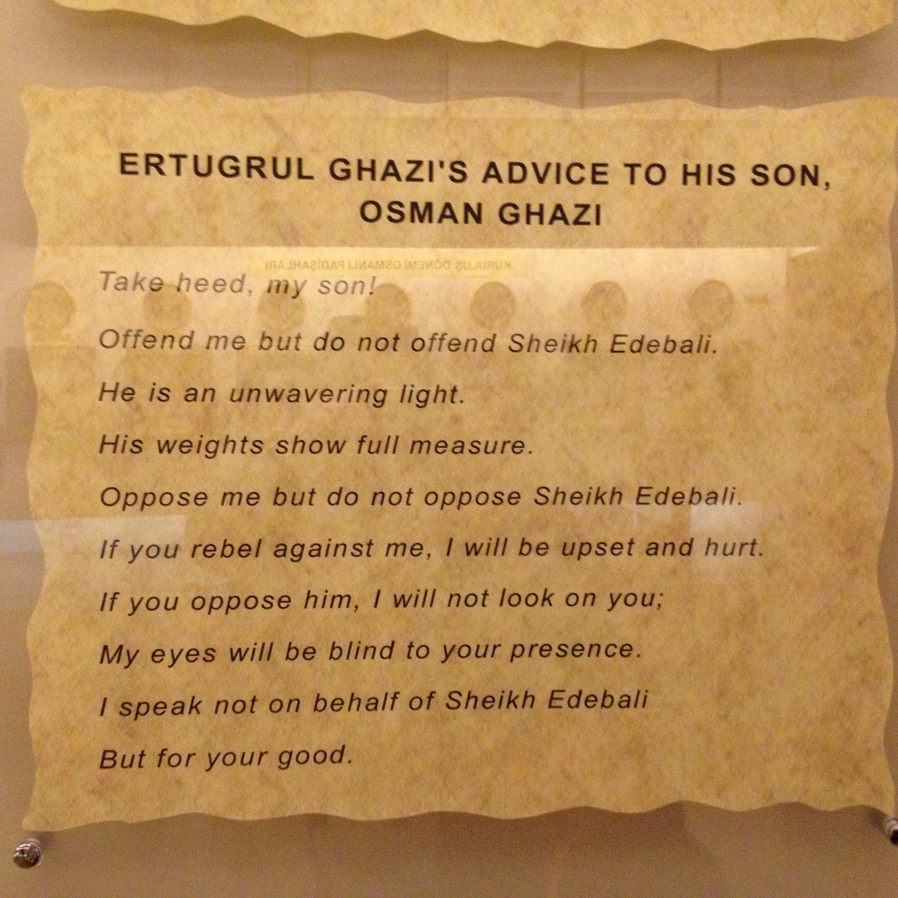

Slide 11
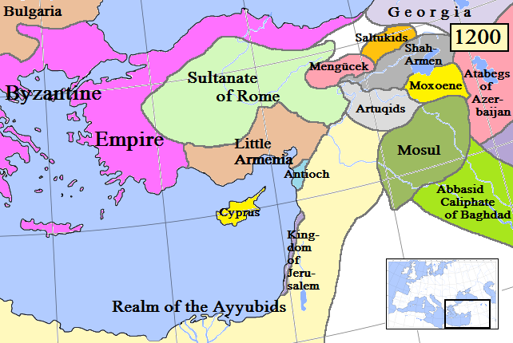
Notes:
By Khateeb88 - Own work, CC BY-SA 3.0, https://commons.wikimedia.org/w/index.php?curid=23864128

Slide 12
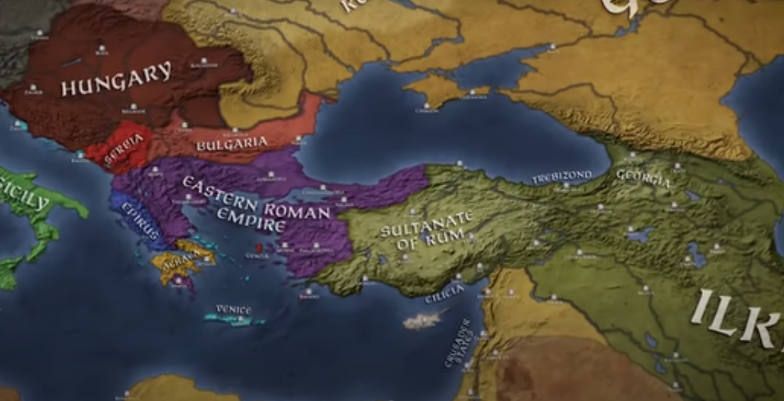
1280

Slide 13
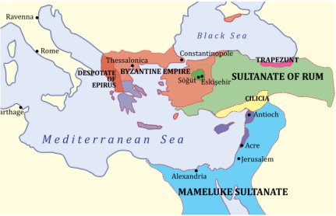

Slide 14
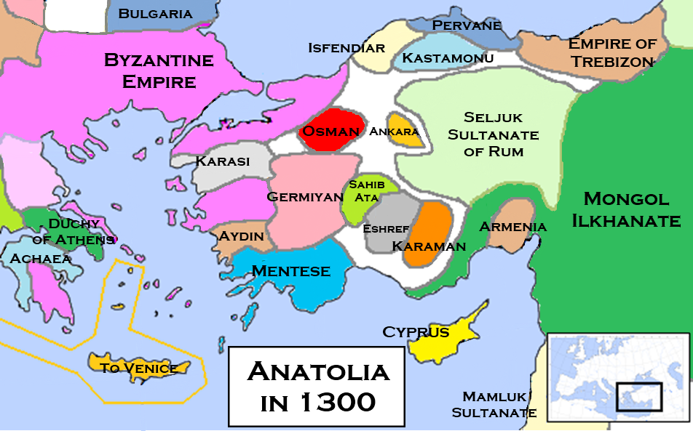
Notes:
By Khateeb88 - Own work, CC BY-SA 3.0, https://commons.wikimedia.org/w/index.php?curid=23864128

Slide 15
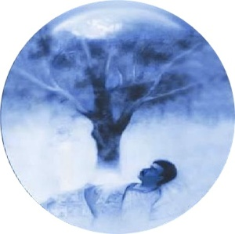
Osman’s Dream - 1277
“When Osman fell asleep, he saw a moon rising from his teacher’s breast and enter his own breast, and then a tree emerges from his navel. Its shadow cast over the world. On it were mountains with water flowing down each. Some people drank from these waters, others watered gardens, while others caused fountains to flow.”
Source: Tevarib-i Al-i Osman
“ Congratulations Oh Osman, Allah gave you and your child sovereignty. The whole world will be under your son’s control and my daughter will be your wife.” – Sheikh Edebali
Click above to see a video of the dream
Notes:
Click here to see the dream

Slide 16
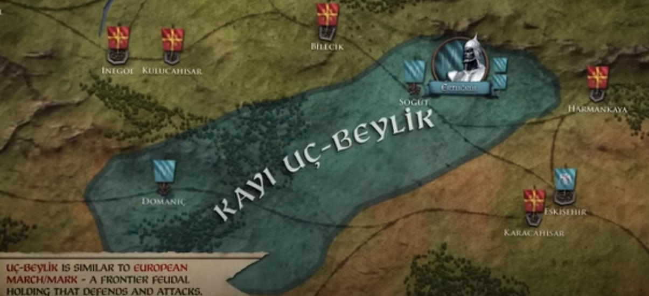
1280
Notes:
Domanic in summer and Sogut in winter
Bilecik Tekfur was on friendly terms and they could migrate freely. But Inegol Tekfur started ambushing and making it difficult.
No choice but to fight

Slide 17
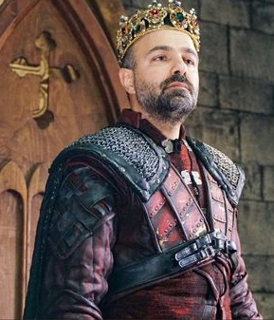
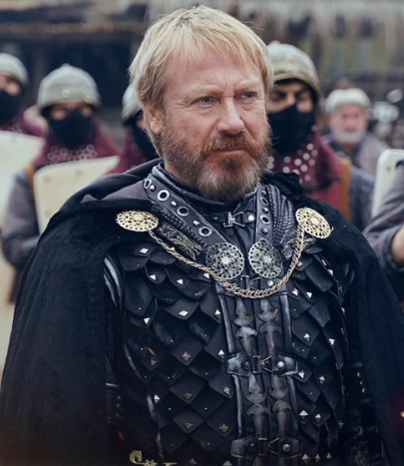
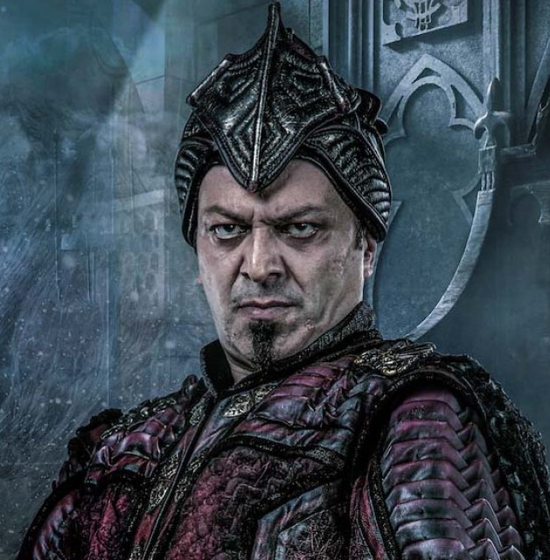
Aya Nikola
Rogatos Laskaris
Michael Kosses
Tekfur of Inegol
He is an atheist
Aspired to follow Julius Caesar
Skilled in pottery and making sculptures
Tekfur of Bilecik Castle
Member of Laskaris family
Nephew of the Emperor Andronicus II Palaiologos
Best friend of Tekfur Kosses
Tekfur of Harmankaya
Member of Palaiologos family
Skilled fighter, a shrewd politician, and a skillful administrator.
Notes:
Bilecik and Harmankaya principalities are for the royal family members only

Slide 18
First Decade of Osman’s Reign
1284: First Holy Wars
  Osman moved to take Angelokoma (Inegol); Governor of Inegol, Nikola set up an ambush
  Osman with his 70 Alps were defeated and Osman’s nephew, Bay Hoca was martyred
1285: Battle of Kulaca Hisar
  Osman conquered the castle at Kulaca Hisar (12 kms from Inegol) with 300 warriors
  Nikolo was incensed and allied himself with the governors of Malachia (Karaca Hisar) (United Byzantine Army)
1286: Battle of Domanitis
  Nikola made a plan to assassinate Osman, but Osman found out and ended up conquering the Castle of Yarhisar
  Osman then attacked Inegol and killed the governor Aya Nikola (reports vary)
1288: Battle of Karaca Hisar
  Osman sent Turgut Alp to conquer Malachia and renamed it Karaca Hisar
  With the capture of these territories, the door to Bursa opened for Osman
  His name was read out during the Khutbah by Dursun Fakih, he was permitted to mint coins, and wear robes of honour (Signs of sovereignty)
Notes:
Name being read out in Khutbah: Indication of sovereignty, Khalifa and Seljuk ruler recognize him as a Bey, Prince, Emir
Harmankaya’s Tekfur Kose Mihal, who embraced Islam secretly and was a friend of Osman, leaked Nicola’s plan. In this scenario, Tekfur of Yarhisar and Bilecik invited Osman to their children’s wedding. Their intention was that when Osman came to the wedding here, he would be arrested and killed. As soon Osman heard this, he devised a plan. He sent his forty alps in women’s clothing to Castle . When these fighter arrived, they captured all the people and conquered the castle. It is worth mentioning that among them was the daughter of Tekfur or Yarhisar castle who’s name was Hola Fira. This girl’s name was changed by Osman to Nilufer Hatun. She was chosen by Osman as his son Orhan’s wife. And after marrying Orhan, they had a son named Murad I.
Osman also tried to overthrow the tekfur of lnegol after conquering both Karacahisar and Kulucahisar, who had already fought against the Ottoman in alliance with the previous Tekfur of Karacahisar. This is called the Battle of Domanic, fought in 1286 CE, in which Osman Bey’s brother Savci Bey was martyred. Osman sent an army under the command of Turgut Alp to strike the Byzantine final defeat. He then later joined the army and conquered the city. It is said that Osman gave this city to Turgut.
https://historicales.com/real-history-of-aya-nikola/

Slide 19
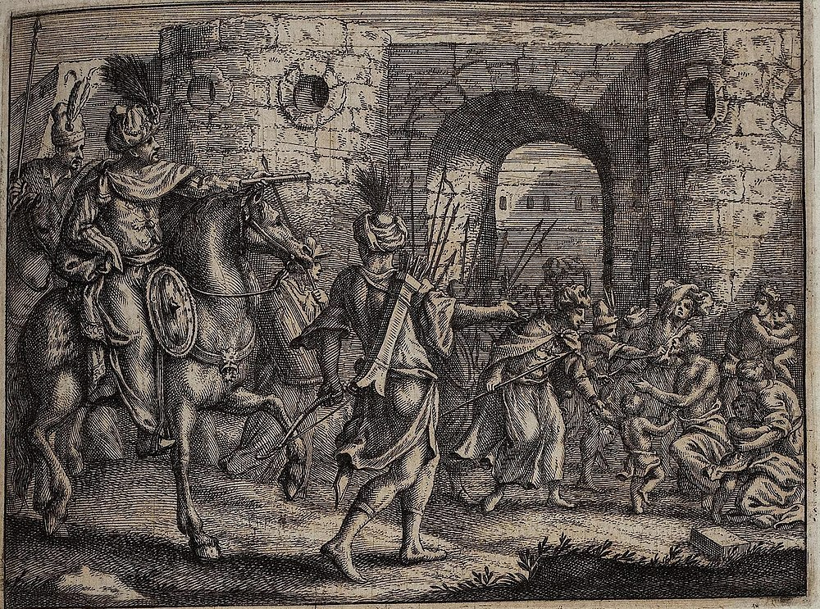
Battle of Kulaca Hisar

Slide 20
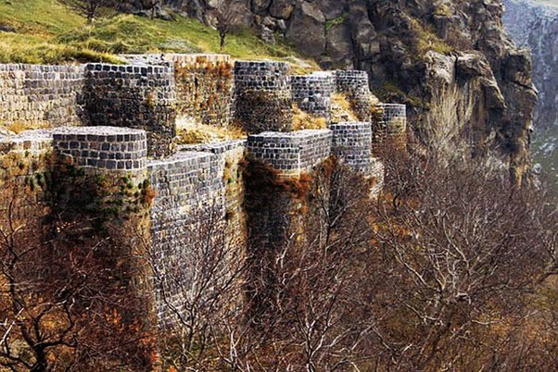
Karaca Hisar Castle

Slide 21
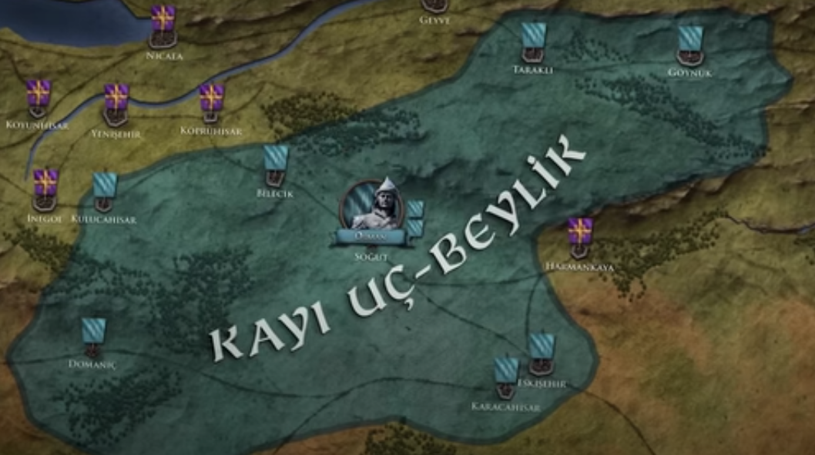
1290
Tarakali
Goynuk
Belicik
Kulucahisar
Harmankaya
Eksehir
Karacahisar
Notes:
Kulucahisar

Slide 22
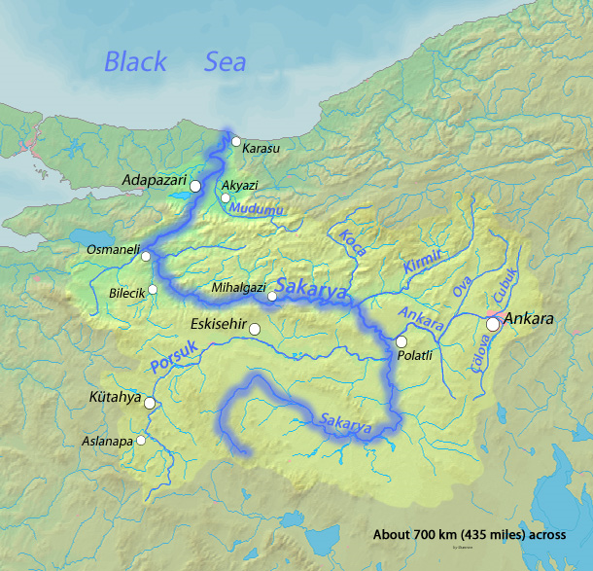

Slide 23
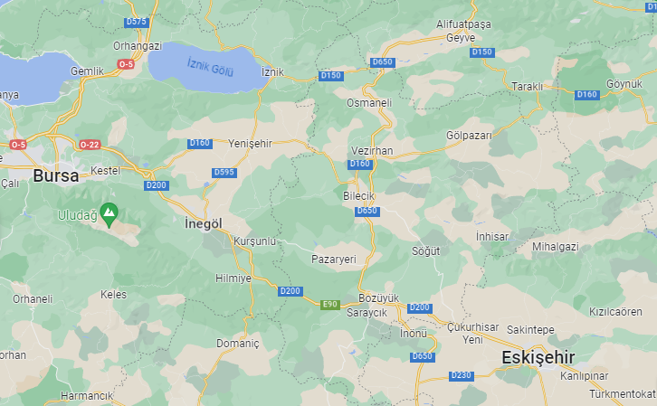

Slide 24
Second Decade of Osman’s Reign
Near Sakarya River
  Support of Kose Mihal (Tekfur of Harmankaya) and Samsa Cavus
  Christian rulers submitted, various towns opened to Osman: Belicik, Goynuk, Tarakali
1299: Yenisehir
  Turgut Alp conquered Inegol, followed by Bilekoma and Melangia which was renamed Yenisehir
  Yenisehir remained the capital until the conquest of Prousa (Bursa) in 1326
  Moschonisi fortress and Pithekas conquered in 1301 and 1302 respectively
Founding of Ottoman Empire
  Memalik i Osmaniye – Country of Osman is being built
  27 January 1300 (699/700 AH) – frontier ghazis gathered and enthroned Osman Ghazi as ruler
  Turkomans settled in these areas providing necessary manpower
1308: Seljuqs Collapse
  Ahmed Ghazan of the Ilkhanate, exterminated the Seljuk state
  Osman takes the title Padishah Al i Osman – Sovereign of the House of Osman
  Many religiously motivated warriors join him
Notes:
Name being read out in Khutbah: Indication of sovereignty, Khalifa and Seljuk ruler recognize him as a Bey, Prince, Emir
Sultan’s hand was kissed and people paid homage to him
1300 is said to be the date chosen as it is the turn of the century, Hadith – a Mujaddid was to come every hundred years – Osman considered the Mujaddid of the 8th century of Hijrah
Alauddin keyqubad III sent the drum, the banner, the horsetail and the tokens of the Sultanate to Osman, alongwith a firman

Slide 25
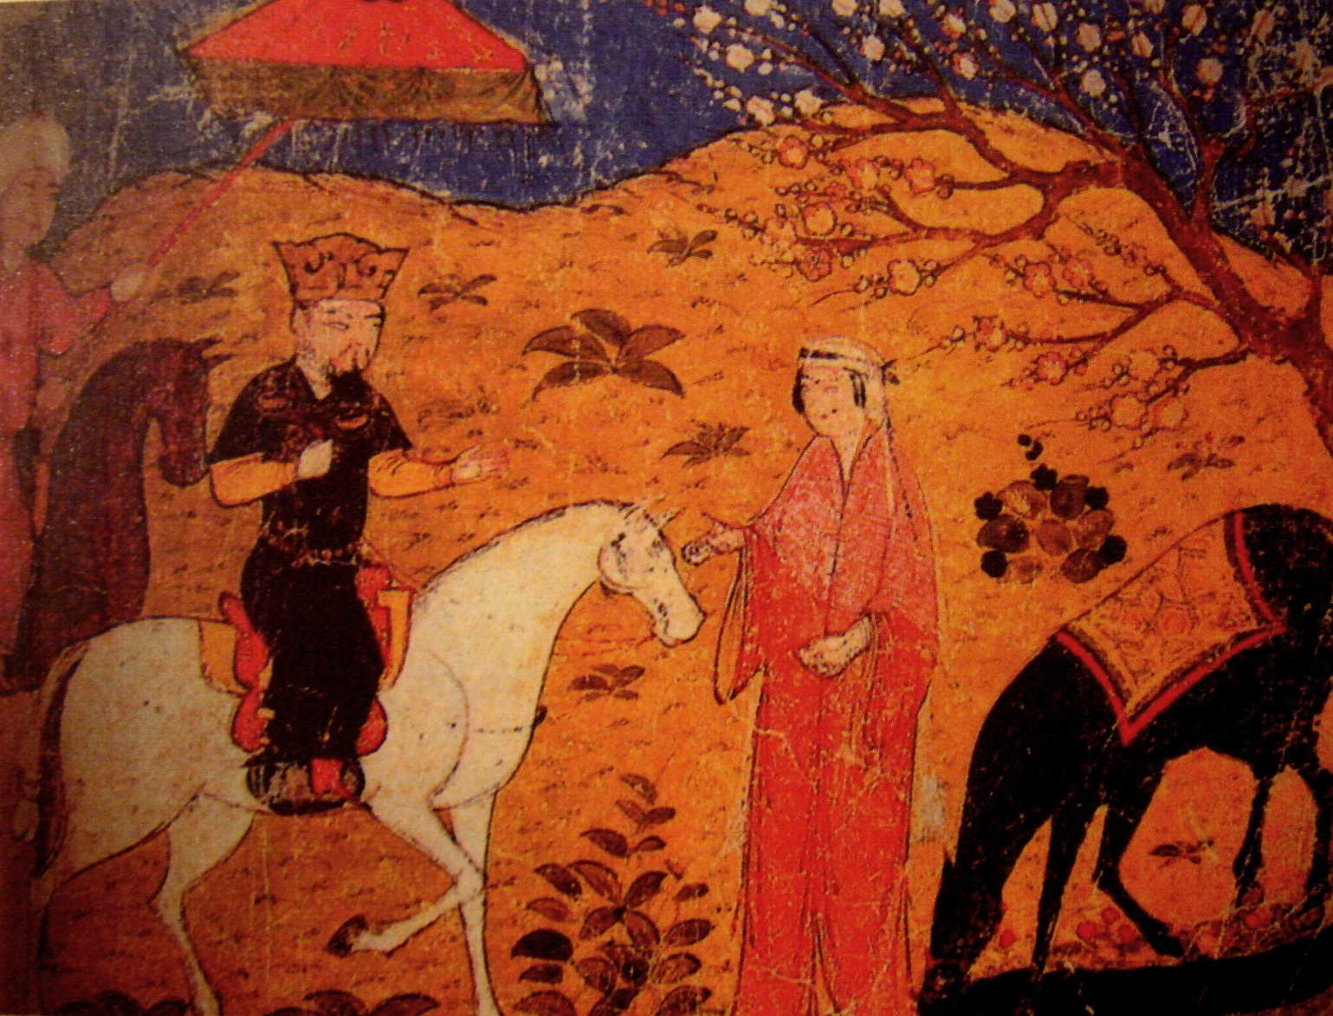
Ahmed Ghazan

Slide 26
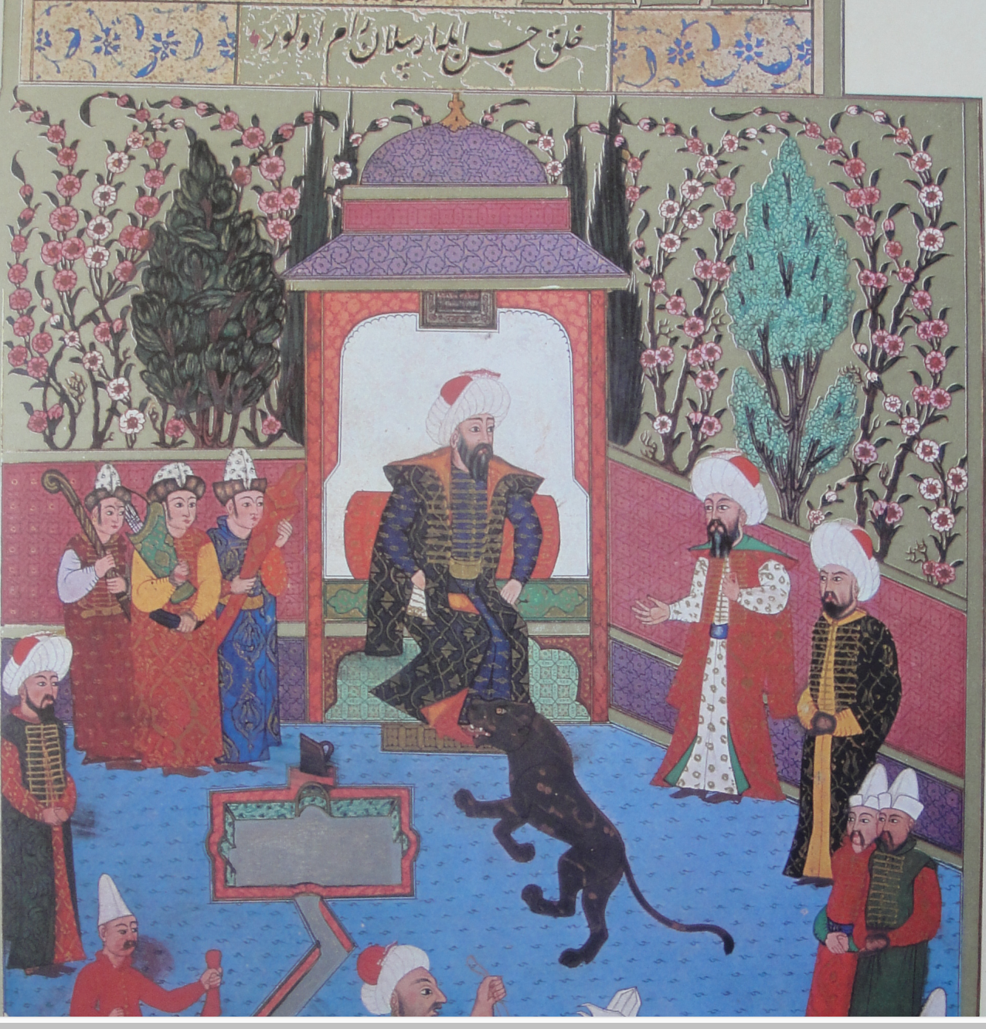
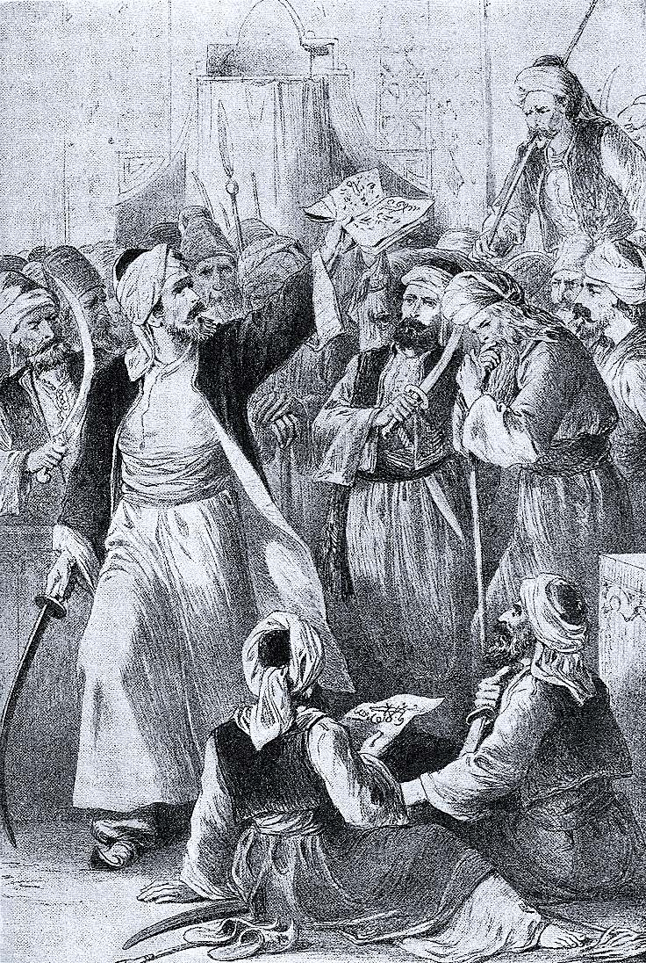
Osman Ghazi

Slide 27
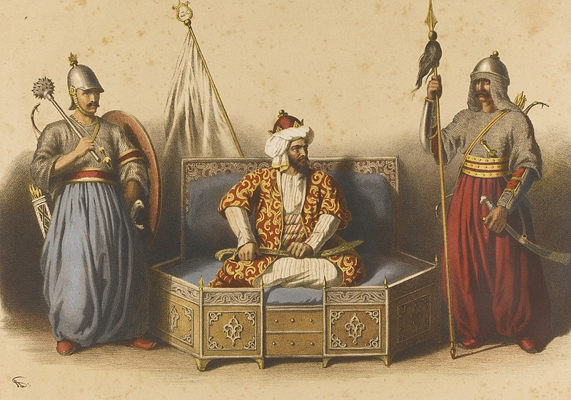

Slide 28
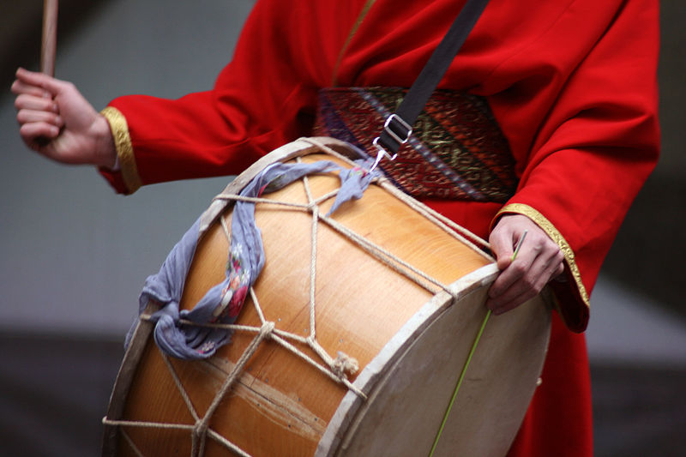

Slide 29
Battle of Bapheus (Koyun Hisar): 1302
Iznik (Nicaea) was besieged following a series of initial incursions
This got the Byzantine Emperor Andronikos II Palaiologos to jump to action
He mobilized troops for a rescue mission; lords of Bursa, Kestel and Orhanli began attacking
The army that came from Constantinople under the command of Georgios Mouzalon, was composed of forces of the governors of the region and recently recruited Alan mercenaries; they were 2000 strong, mostly foot infantry
Osman first clashed at the Battle of Bapheus (Koyun Hisar) before they could reach Pylae (Yalova) where the main battle took place
A night raid by Osman and the conflict between the Greek and Alan contingents played an important role in the eventual victory on 27 July 1302
This date is also sometimes considered as the date of foundation of the Ottoman Empire
This victory gave recognition and fame to Osman; and Byzantine Dominion in southern Marmara came under jeopardy
The siege of Iznik (Nicaea) continued, and Orhan Gazi would eventually collect the city in 1331.
Notes:
The Alans (Latin: Alani) were an ancient and medieval Iranian nomadic pastoral people of the North CaucasusAlan mercenaries were involved in the affair with the Catalan Company

Slide 30
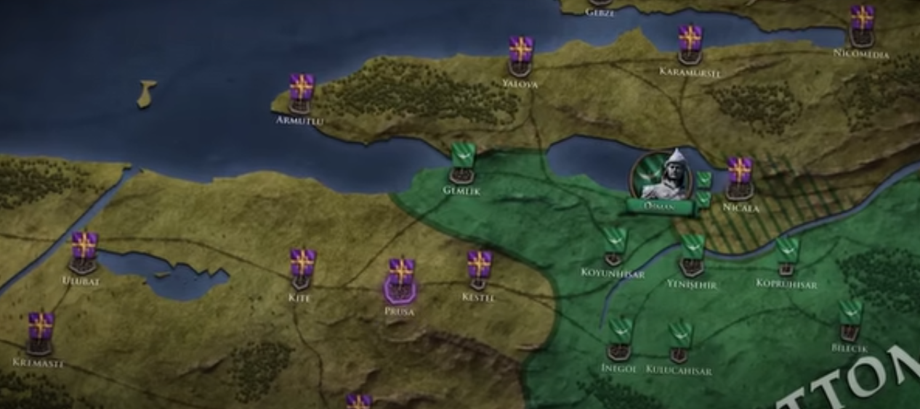
Battle of Dimbos: 1303
Gemlik
Nicaea
Ulubat
Bapheus/ Koyunhisar
Kopruhisar
Yenisehir
Kite
Kestel
Prousa/Bursa
Dimbos
Belicik
Inegol
Kulucahisar

Slide 31
En Route to Bursa
1303: Battle of Dimbos
  Governors of the region (Prousa, Kestel, Kite, Adranos) united their forces, crossed the Dimbos Pass and marched on Yenisehir
  Osman won the Battle of Dimbos
  This opened the Bursa Plain and Mysia Olypos (Uludag) all the way to Lopadion (Ulubad) to Turkmen settlement
1304: Sankarya Campaign
  Osman organized a campaign against the Byzantine fortress along the Sankarya River
  Harmankaya’s Michael Kosses converted to Islam in 1313, his name becoming Kose Mihal; Makacah Ahisar, Golpazari were annexed to Ottoman territories
  Koubouklia Fortress (Leblebuci Hisari), Cadirlu, Leukai (Osmaneli) and Mekece submitted
  This was followed by conquests at Kabakia (Geyve) and Pinari
  While he was away, the Mongol Ilkhanids had plundered Karaca Hisar, so Osman stayed back
  He sent his son Orhan, alongwith Kose Mihal, Akca Koca, Konur Alp, Abdurrahman Gazi to continue the conquests

Slide 32
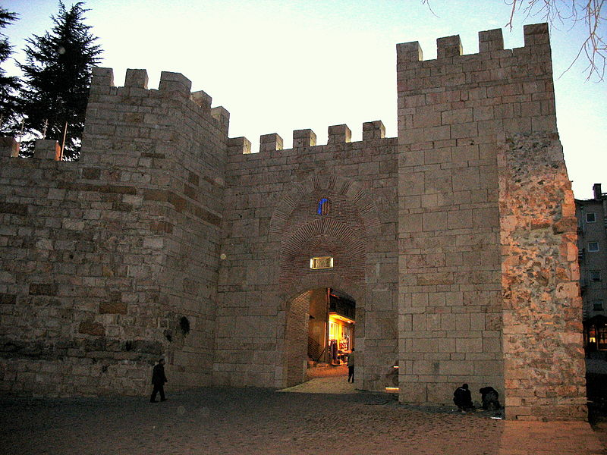
Gate of Bursa's Byzantine castle, which witnessed the long Ottoman siege

Slide 33
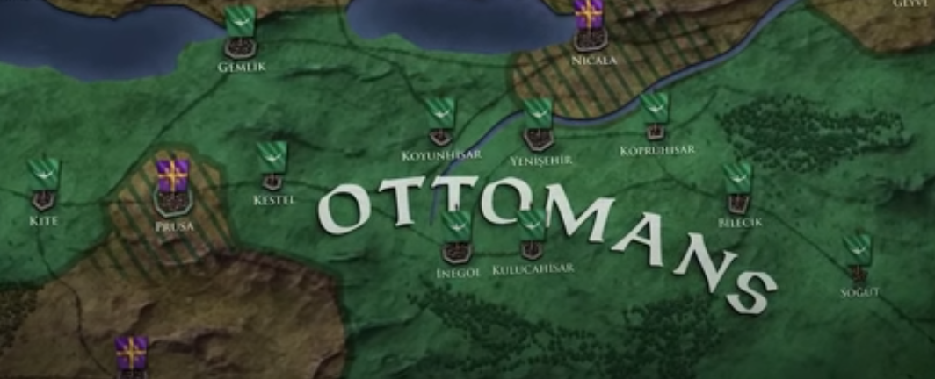
After the Battle of Dimbos: 1303
Nicaea and Prousa under Seige
Gemlik
Nicaea
Koyunhisar
Kopruhisar
Yenisehir
Kestel
Kite
Prousa/Bursa
Belicik
Inegol
Kulucahisar
Sogut

Slide 34
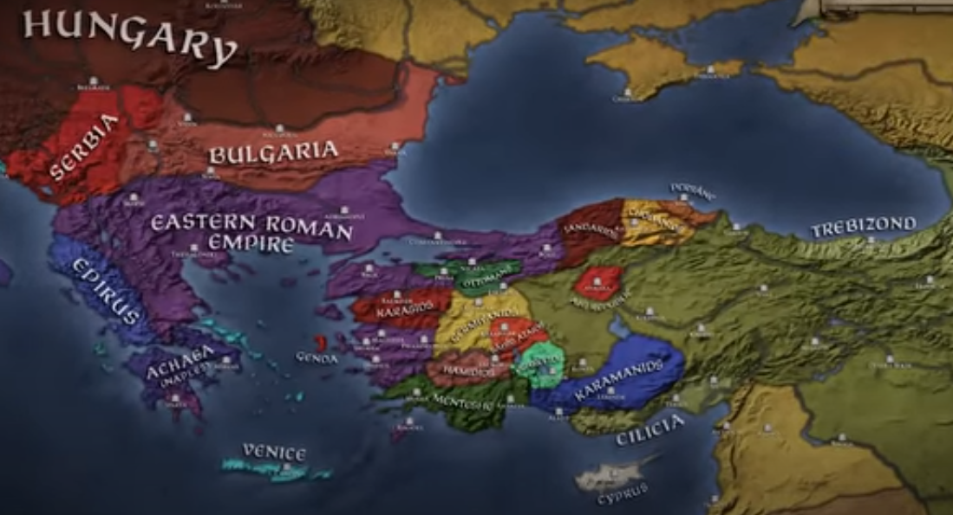

Slide 35

The Sieges of Prousa (Bursa) and Nicaea (Iznik)
Importance
  Of Bursa: Large metropolitan center, Center of silk production, Proximity and connectivity to Constantinople, Geographically well situated
  Of Nicaea: Anatolian Seljuqs first capital, which was lost in the First Crusade. Attempts by the Seljugs and Anatolian Beyliks to wrest it back had failed
Challenges
  Ottoman Turks were expert horsemen and excellent in battle, but they did not have the tools and technological expertise or experience required for siege
  The siege included long blockades; provision and supply routes were cut, and took many years
Positives
  Some Roman notables, minor lords, Tekfurs embraced Islam, e.g. Kosses
  Michael of Harman Kaya, became a close associate of Osman
  Nearby fortresses were being reduced – every victory tightened the noose
Surrender
  On 6th April 1326, Bursa surrendered to Orhan, Osman’s son; the capital was moved there
  Osman was 69 years old and bedridden; he died after hearing the news of the conquest
  Orhan later took Nicaea in 1331
Notes:
6-8 years or 25-30 years: may not be continuous, maybe they would retire in the winter, supplies would get sneaked in.
Kosses’ family become a prominent Muslim family – Mihalzade family – frontier lords and raiders in Rumelia
Lacking the siege equipment to seize the city, Osman would instead order the construction of two major forts around Prusa to oversee the city's blockade. Upon the construction of the forts, a 10,000-strong Ottoman garrison led by Osman’s son, Orhan Gazi, was installed, thus cutting off Prusa from the rest of the world. As the Byzantine civil war raged on in Thrace between the members of the Palaiologos dynasty, Prusa was left at the mercy of Osman and his armies. After many years of withstanding the Ottoman army at his gates, on April 6th of 1326, the governor of Prusa would officially surrender the city to Orhan after seeing that no reinforcements from Constantinople were coming to their aid. The city of Prusa would be the first major walled city to come under Ottoman rule, effectively doubling the wealth and population of the beylik overnight.

Slide 36
Osman’s Inheritance: What he left behind…
A piece of cloth for his turban, which was about 6 feet long
An armor set for his horse
A saddlebag
One single garment
A saltshaker
A spoon holder
A pair of boots
A prayer beads chain
An elegant sword
A shield and spear
A few horses
Several sheep grazed to sacrifice for his guests
Eksehir to Gunduz Alp, Inonu to Orhan, Yarhisar to Hasan Alp, Inegol to Turgut Alp, Bilecik to Edebali

Slide 37
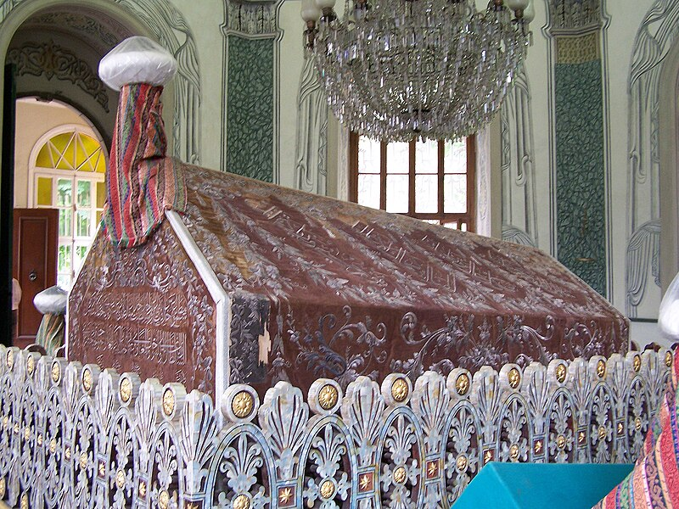

Slide 38
Timeline of Osman’s Reign
1258: The Mongol Empire captures and sacks Baghdad.
1258: Osman Ghazi, the founder of the Ottoman Dynasty, is born.
1281: Orhan, one of Osman's sons, is born.
1284: First Holy War as Osman attempts to capture Inegol.
1285: Osman conquers the castle at Kulaca Hisar near Inegol.
1286: Battle of Domanitis - Osman's brother Saru Batu is martyred.
1288: Osman conquers Malachia and renames it Karaca Hisar, establishing his first capital.
1299: Osman captures Bilekoma and Melangia, which is renamed Yenisehir, Ottoman Empire's official establishment.
1302: Battle of Bapheus marks the foundation of the Ottoman Empire.
1303: Battle of Dimbos opens the Bursa Plain and Mysia Olypos to Turkmen settlement.
1304: Sangarios Campaign leads to the conquest of various fortresses.
1326: Capture of Prousa (Bursa)
1326: Death of Osman Ghazi

Slide 39

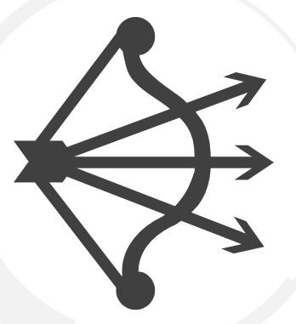
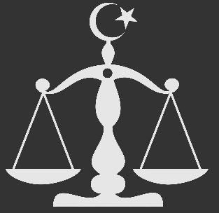

Osman’s Legacy
Split Lands
Seal of Kayi
Islamic Law
Modest Life
A tribe of 400 Horsemen conquered Byzantine lands, which were split among the dynasty and companions who made it possible. Collective governance and not monarchical structure.
Seal of Kayi (Three arrows and a bow) was painted on Flags and minted on coins. He transformed a Beylik into a principality
He wished that his son would conform to Islamic Law, protect and accommodate his subjects, seek consultations, remain just and defend his people.
He set a good example for the future guests of the throne of how an ideal sultan should live on modestly.
Notes:
Inonu to Orhan, Yarhisar to Hasan Alp, Inegol to Turgut Alp
This method of granting lands to commanders who conquered them would be applied in Rumelia as the chief method of conquests
In the centuries after his death, Osman Gazi would be regarded as the ideal sultan in which all future Ottoman Sultans tried to replicate his reputation as a brave and just leader. Every Ottoman leader from then onwards would carry the Sword of Osman during their enthronement ceremony as a way to proclaim their reign to be noble and just like the humble founder of the empire.

Slide 40
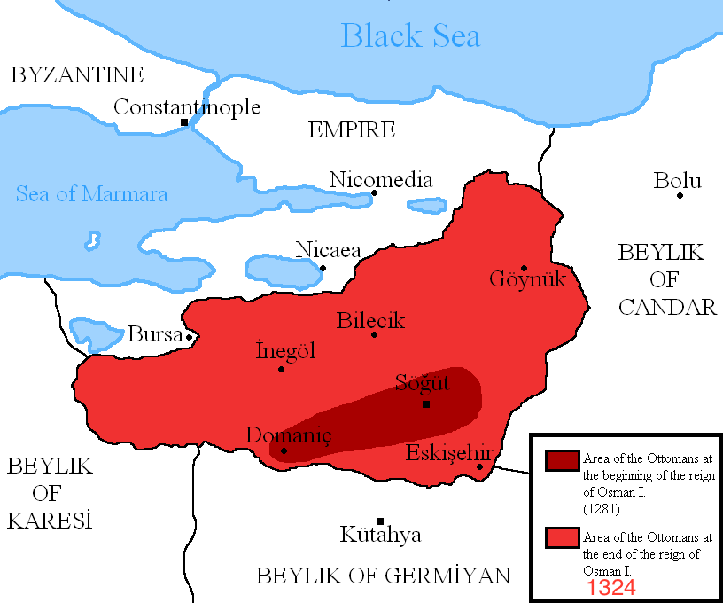

Slide 41
What was Happening Elsewhere (1258-1325)
1258: Henry III (1216-1272), the first Plantagenet King of England faced the "Provisions of Oxford," where English barons attempted to limit his power
1261: Byzantine Emperor Michael VIII Palaiologos (1259-1282) managed to recapture Constantinople from the Latin Empire
1272: Edward I (1272-1307), often known as "Longshanks" due to his tall stature, succeeded his father, Henry III
1275: Marco Polo visited China
1282: Andronikos II (1282-1328) became Byzantine emperor; faced a period of economic difficulties, military challenges, and internal strife during his reign
1304-1307: Edward II (1307-1327), the son of Edward I, became king; his reign was marred by conflicts with nobles, particularly his cousin Thomas of Lancaster
1304-1369: Ibn Batuta’s travels
1314: Scotland won against England at the Battle of Bannockburn, after the reign of King Alexander III (1249-1286)
1325-1337: The Aztec Empire begins to expand its territory in Mesoamerica under the rule of Emperor Itzcoatl, they build the city of Tonochitlan.
1325: Mansa Musa went on Haj

Slide 42
Major Battles
Year | Name of Battle | Sultan | Against | Impact
1302 | Battle of Bapheus (Bafeos) | Osman Ghazi | Byzantine forces | The Ottoman victory at Bapheus boosted the morale of Osman's forces and established their presence in the region, contributing to the early growth of the Ottoman state.
1326 | Siege of Bursa | Osman and Orhan Ghazi | Byzantine forces | The Ottoman forces successfully captured Bursa in 1326 or 1327, marking a significant territorial gain. Bursa would later become the first capital of the Ottoman Empire under the reign of Orhan Gazi.

Slide 43
Videos to Watch
Era of Osman Gazi | 1281-1326 | History Map of Osman Gazi
Osman: The Man Who Founded The Ottoman Empire
The Dream of Osman
Rise of the Ottoman Empire - Bapheus 1302
Bapheus Short

