Slide 1
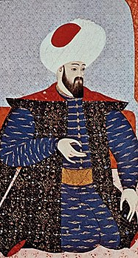
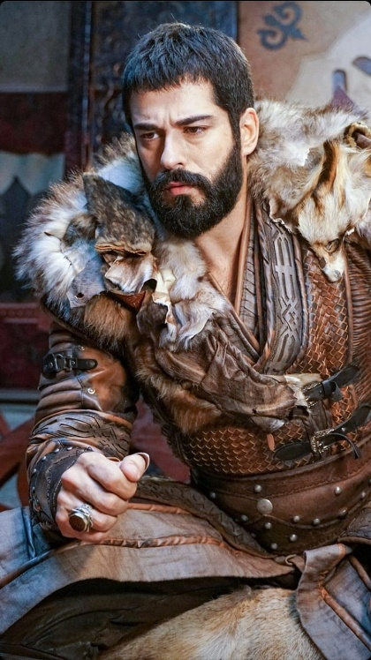
The Ottoman Sultans of Bursa
Orhan Ghazi
(1326-1360)

Slide 2
Let’s Recap…
Notes:
Let’s Recap…

Slide 3
Timeline of Ertugrul and Osman
1196: Birth of Ertugrul Ghazi
1227: Kayi tribe cross Euphrates and enter into Anatolia
1237: Alaeddin Keyqubad I awards Ertugrul title of Ghazi and Karacadag, Sogut, Domanic
1258: Birth of Osman, same year as the sack of Baghdad by Mongols
1281: Birth of Orhan, one of Osman's sons
1289: Ertugrul Ghazi dies and Osman comes to power
1285: Osman conquers the castle at Kulaca Hisar near Inegol.
1286: Battle of Domanitis - Osman's brother Saru Batu is martyred.
1288: Osman conquers Malachia and renames it Karaca Hisar.
1299: Osman captures Bilekoma and Melangia, which is renamed Yenisehir, the new capital
1302: Battle of Bapheus marks the foundation of the Ottoman Empire.
1303: Battle of Dimbos opens the Bursa Plain and Mysia Olypos to Turkmen settlement.
1304: Sangarios Campaign leads to the conquest of various fortresses.
1326: Capture of Prousa (Bursa)
1326: Death of Osman Ghazi

Slide 4
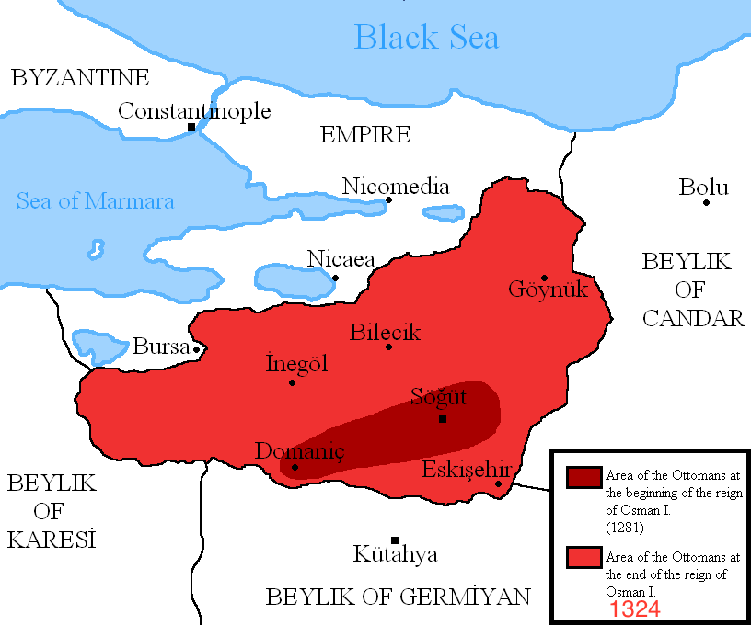

Slide 5
Expansion and Consolidation
Orhan (r. 1326–1360)

Slide 6
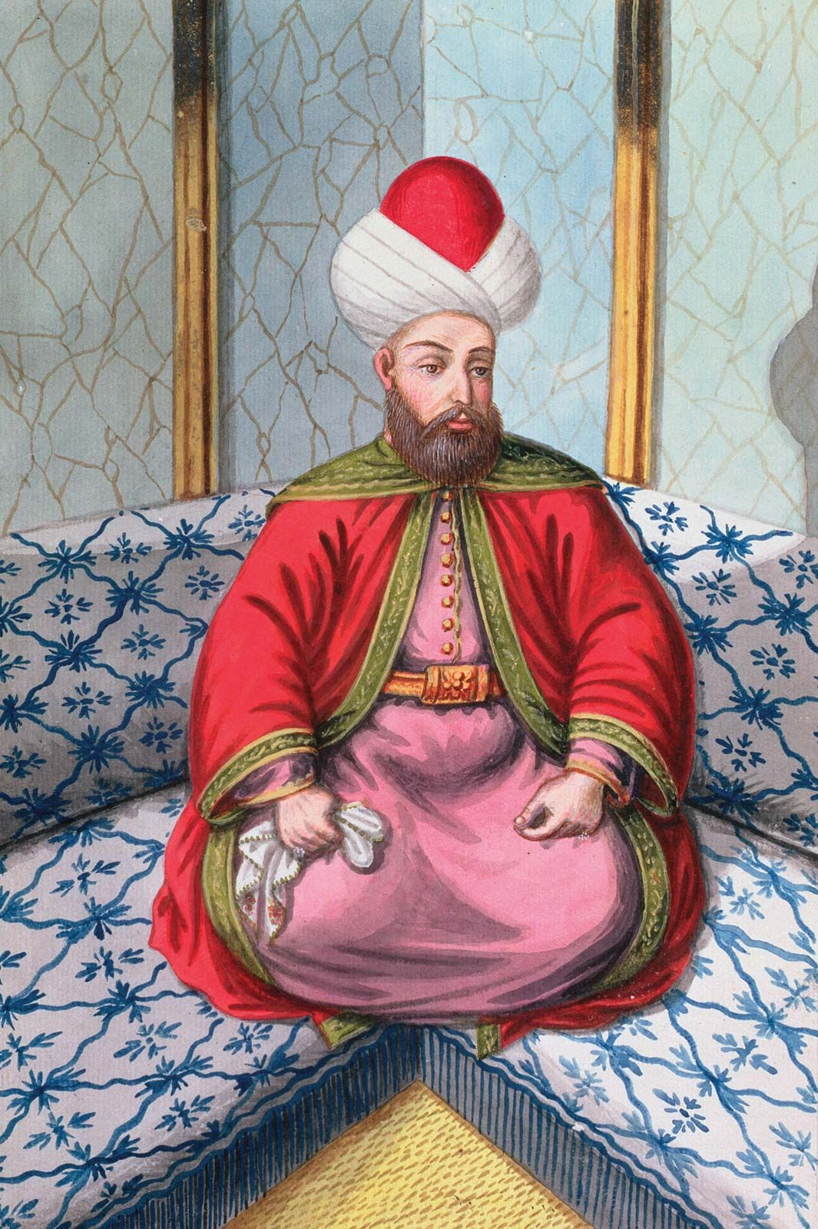

Slide 7
“Like his father, (Orhan) conquered many places and is known for his charitable acts and liberality. He had the soul of a dervish and was not interested in amassing riches and property… He had no eye for luxury and spent his life on the battlefields waging holy war”
Source: Lokmen Celebi, Kiyafetul Insaniyya fi Semail Osmaniyya
“This Sultan (Orhan Gazi) is the greatest of the kings of the Turkmens and the richest in wealth, lands and military forces… he fights against the nonbelievers continually and keeps them under siege.”
Source: Ibn Batuta, Tuhfat An Nuzzar fi Gharaib Al Ansar wa Ajaib al Asfar
“Orhan Gazi was good-natured and very patient. He knew how to take advice, and his speech was gentle. However, he was also very determined and unyielding.”
Source: Lokmen Celebi, Kiyafetul Insaniyya fi Semail Osmaniyya
Notes:
IbnBatuta was impressed – he had seen Egypt, Baghdad

Slide 8
Orhan (r. 1326–1360)
One of eight sons of Osman, born in 1281 in Sogut
Educated by Sheikh Edebali and Faqih Dursun; he always kept the company of scholars
He was physically tall and well-built, a brave warrior, modest and hardworking
He handed out soup to the poor and lit his own oil lamps
In 1288, at the age of 7 years, he became the Governor of Karaca Hisar
He was guided by experienced officials such as Kose Mihal, Akca Koca, Konur Alp
When he came to power at the age of 43*, he already had more than three decades of experience
He consolidated power in Bursa, Nicaea, Nicomedia and Ankara before entering Rumelia on the European side of the Bosporus; he expanded east and west of Anatolia, uniting some of the Beyliks born after the collapse of the Seljuqs
He minted his own coins, independent of the Seljuq ruler
He built the Ottoman state on an Islamic model, established full fledged state institutions including the Divan – an administrative and judiciary body, a regular standing army, religious institutions and madrassas
He helped to convert a small Tribal Beylik into the greatest dynasty in Islamic history
He sought counsel from eminent state officials who came from the ilmiyye (Ulema, scholars) class
He died in 1362, at the age of 81, after 38 years in power
Notes:
Alauddin Pasa was Orhan’s older brother and he believed that even though Orhan was not the eldest, he was most equipped to lead the Ottomans
He chose not to split the empire between himself and Orhan
Conquered Bursa
Orhan marries Emperor John VI daughter Theodor in 1346 after assisting the Byzantines
Ibn Battuta visited Bursa and praised the people
Faqih Dursun led Eid prayers, lead first Jumma in Bursa

Slide 9
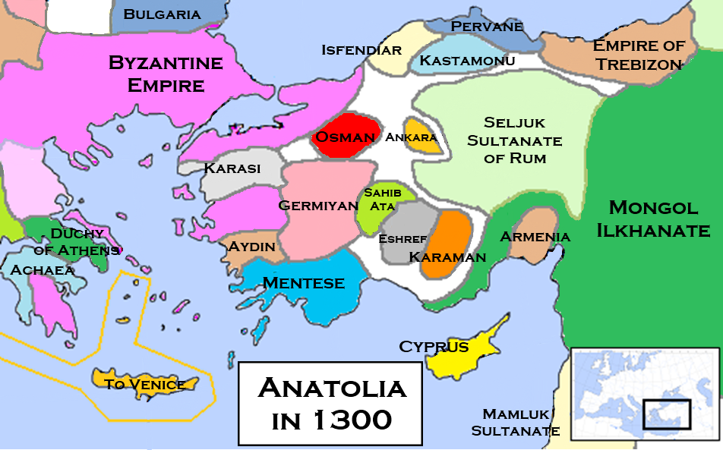
Notes:
By Khateeb88 - Own work, CC BY-SA 3.0, https://commons.wikimedia.org/w/index.php?curid=23864128

Slide 10
Campaigns against the Byzantines in Bithynia
1326: Capture of Prousa (Bursa)
  Bursa was established as the capital, the city was renovated, many constructional projects were undertaken, Mercantile establishments as well as open and covered bazars were built
  Forts on the northwest Anatolian coast were conquered: Kocaeli, Kartal and Aydos
1329: The Battle of Pelekanon
  Emperor Andrenikos III Palaiologos ventured on a imperial campaign to take back the lost provinces. The plan was lift the siege on Nicomedia (Izmit) and then repeat for Nicea (Izmir)
  The Ottomans were prepared and attacked the army at Pelekanon, a site between Darica and Eskihisar; much before they reached Nicomedia.
  The emperor was wounded by an arrow and his army scattered
  In 1333, Andonikos agreed to pay tribute in exchange for maintaining control of some cities
1331: Conquest of Nicaea (Iznik)
1334: Conquest of Gemlik
1335: Osman began to be called Sultan
1337: Conquest of Nicomedia (Izmit)
  All the land upto Bosporus was under Ottoman control, the Romans entered into a peace treaty
  Many offered their daughters in marriage to Orhan
Notes:
Previously Andronicus II wanted to aid the city of Nicaea; he used the Catalans led by Roger De Flor. However, the Catalans did more damage and Roger De Flor was eventually killed by the emperor in 1305
Bosporus is the waterway separating Europe from Asia
Nicaea is important for the Christians, it is where the councils were held, all gospels were collected, chosen and the divine nature of Isa as was decided.
Romans were facing civil wars and recognized the threat. Son and grandson were fighting.
Lacking the siege equipment to seize the city, Osman would instead order the construction of two major forts around Prusa to oversee the city's blockade. Upon the construction of the forts, a 10,000-strong Ottoman garrison led by Osman’s son, Orhan Gazi, was installed, thus cutting off Prusa from the rest of the world. As the Byzantine civil war raged on in Thrace between the members of the Palaiologos dynasty, Prusa was left at the mercy of Osman and his armies. After many years of withstanding the Ottoman army at his gates, on April 6th of 1326, the governor of Prusa would officially surrender the city to Orhan after seeing that no reinforcements from Constantinople were coming to their aid. The city of Prusa would be the first major walled city to come under Ottoman rule, effectively doubling the wealth and population of the beylik overnight.
1341 – Byzantine threat from growing Serbia and Bulgaria – Christians – 1341-1347, 1352-1357 Civil War
Emperor Andrenikos III Palaiologos tried to get the Mongols to help, but they didn’t, so he used the Catalans
The Catalan Company or the Great Catalan Company was a company of mercenaries led by Roger de Flor in the early 14th century and hired by the Byzantine Emperor Andronikos II Palaiologos to combat the increasing power of the Anatolian beyliks. It was formed by almogavar veterans of the War of the Sicilian Vespers, who had remained unemployed after the signing in 1302 of the Peace of Caltabellotta between the Crown of Aragon and the French dynasty of the Angevins.
Roger De Flor was given titles, promise of a Byzantine princess.
But the Catalans instead of taking back Byzantine lost lands, plundered the country side, further alienating the Christian population’
Andrenikos killed Roger De Flor
Black death, internal civil wars and power struggles, Serbia and Bulgaria – all weakened it

Slide 11
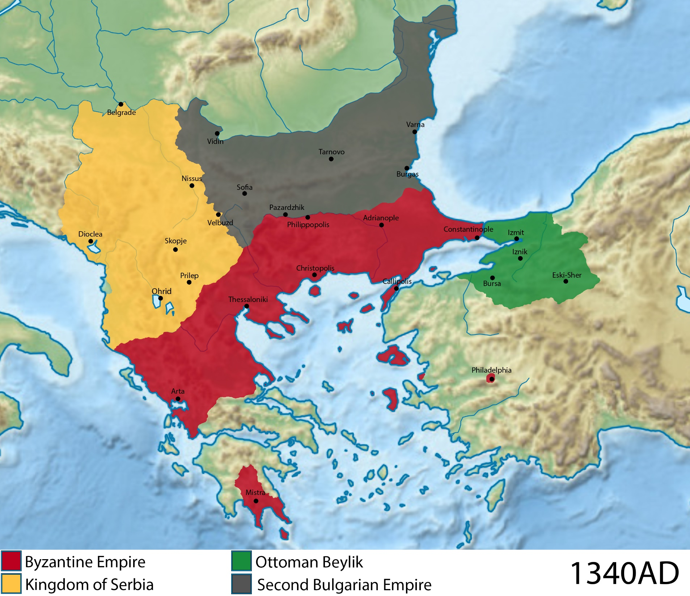

Slide 12
Beyliks after Kosedag
Afshar
Ahiler
Alaiye
Aydinids
Canik
Candar
Chobanids
Dulkadirids
Eretnids
Erzincan
Eshrefids
Germiyanids
Hamidids
Kadi Burhan al-Din
Karamanids
Karasids/Karası
Ladik
Menteşe
Ottomanids
Pervâneid
Ramadanids
Sahib Ataids
Sarukhanids
Teke

Slide 13
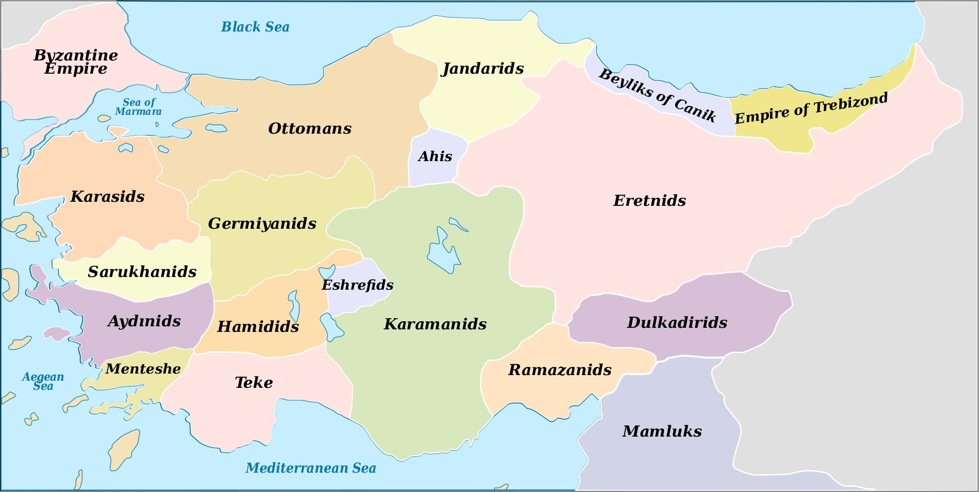

Slide 14
Takeover of Beyliks in Western Anatolia
1345: Annexation of the Karasids
  A power struggle erupted after the death of Karasi Beys’s son Aclan Bey passed away and Dursun Bey asked for help from Osman
  He offered Bergama, Edremit and Balikesir in return
  Dursun Bey died in battle and Demirhan Bey, his brother died soon after
  All the Karasid lands passed to Ottomans; Suleyman Pasa, Orhan’s son and heir apparent was handed administration
  The Karasids was the only Beylik with a fleet, and helped the Ottomans to cross the Hellespont (Dardanelles) from Anatolia to Rumelia in Europe
  Former Karasid commanders encouraged Orhan to enter Rumelia and played a large role in the later Ottoman conquest of the Balkans
1354: Conquest of Ankara
  Ankara was part of the Eretna Beylic
  It was taken by Suleyman Pasa
  Orhan proceeded as far as the Bey of Candar in the south, the principality of Ulug Beyogullari was also taken
  The last territories of the Byzanties south of the Marmara Sea, Uskudar was annexed
Notes:
Expansion into East Anatolia – Beyliks
Orhan did not go to war with the Beyliks, but rather he incorporated these territories into his own
The Beyliks were suffering due to the instability caused by succession issues and this consolidation was needed for the peace and security of the Muslim world.
Thus, Orhan’s expansion into Muslim lands was legitimized
KARASIDS
The Karasids or Karasid dynasty (Ottoman قرا صي; Modern Turkish Karesioğulları, Karesioğulları Beyliği), also known as the Principality of Karasi and Beylik of Karasi (Karasi Beyliği or Karesi Beyliği ), was an Anatolian beylik in the area of classical Mysia (modern Balıkesir and Çanakkale provinces) from ca. 1297–1360. It was centered in Balıkesir and Bergama, and was one of the frontier principalities established by Oghuz Turks after the decline of the Seljuk Sultanate of Rum.
They became a naval power in the Aegean and the Dardanelles.
History
Karasi Bet was a descendent of the Danishmends. He was sent by the Seljuks to takeover the Mysia region. He was known as Amir ul Savahil ( Amir of the coast). When the Seljuks fell, the Karasi beylic was established.
The Byzantines tried to incite beyliks like Karasids against the Ottomans. However, routes of conquest and other objectives of beyliks such as Karasids did not initially conflict with the Ottomans. The political situation clearly favored the Ottomans.
Karesi Bey died before 1330, when exactly is not known. He was succeeded by his son Aclan Bey. He had good relations with the neighboring Ottomans. After Aclan Bey, his sons ruled over the Beylik. One of the sons was Demirhan Bey. His brother Yahşi Bey ruled from Bergama from over part of the Beyliks, so that the Beylik was de facto divided into two dominions. A third brother named Dursun Bey lived at the Ottoman court in Bursa and had good relations with Sultan Orhan I.. Demirhan Bey treated his subordinates bad, so that the population Dursun Bey asked for help. 1345 came Dursun Bey Orhan after Karesi, but was killed by the men of his brother. The power struggle took advantage of Orhan and took over in 1361 Karesi. According to some sources, the people should have asked the Ottoman Sultan it.
Karasids were the first beylik to be taken over by the neighboring Ottoman dynasty, who were later to found the Ottoman Empire. The acquisition of Karasi allowed the Ottomans to begin the conquest of European lands in Rumelia across the Dardanelles.
Karesi was one of the few Beyliks which had a fleet. Later, the Ottomans should benefit greatly from this fleet. The Karesis covered with their fleet twice against Rumelia. 1331 they attacked with 70 boats Feres and 1333 with 60 boats on Athos. On the political and military level Karesi was the Ottomans a great help in their transition from the Ottoman Beylik the Ottoman State. In the newly conquered areas of Europe, the Ottomans people from Karesi settled.
The province (sanjak, later vilayet) of Balıkesir was called the sub-province (sanjak, later vilayet) of Karasi until the early years of the Republic of Turkey, after which it was renamed after its central town Balıkesir.

Slide 15
Expansion into Rumelia
1334: Going to Rumelia
  With the help of the Karasids, the Ottomans repeatedly crossed the Hellesport (Dardanelles)
  In 1349, at the request of the Byzantine emperor, the Ottoman army was sent to Rumelia to aid the local peasants; in return they were gifted a small castle on the European side of the Dardanelles
1352: Battle of Demotika
  Byzantine Emperor John VI Kantakouzenos asked Orhan to intervene in the internal Byzantine struggles and to fight against the Serbs and Bulgars who were pressuring the empire
  Suleyman Pasa went to Edirne, defeated the collaboration, and left a contingent at Cimbi Castle
1354: Capture of Gallipoli
  The Gallipoli Fortress was besieged
  Following an earthquake in the region, Suleyman Pasa captured castles in Gallipoli and settled Turkomans from Baliksehir region
  Conquered lands were developed, repopulated and brought back to life
  Kantakouzenos offered four times the tribute to give up these lands, but Suleyman Pasa insisted that this was a gift from God ( because of and earthquake) and not acquired by force
1354: Campaign into Byzantine Thrace
  Suleyman Pasa quickly took Kesan, Tekirdag and Corlu
  By the time of Orhan’s death, the Ottomans had a foothold in Rumelia
Notes:
1347: The Byzantine empire was attacked by the Slavs and Bulgars, Ottomans were able to enter Constantinople for the first time
Gathering up Serbian, Venetian, and Genoese fiscal and military support, in 1352, the junior co-emperor John V Palaiologos of the Byzantines would invade the territories of Kantakouzenos’s holdings in Thrace, thus sparking a new round of civil war. John VI Kantakouzenos would once again call forth Ottoman support for his war effort. Now in his seventies, Orhan Gazi would entrust Ottoman military operations to his son Suleyman Pasha. A 10,000 strong Ottoman army consisting of mostly calvary would be transported to Thrace which would result in Kantakouzeni forces defeating the coalition army of John V during the Battle of Didymoteicho by the end of the year.
The Battle of Demotika was a battle that took place during the Byzantine civil war which began in 1352 between the forces of the Ottoman Empire and those of the Serbian Empire and Second Bulgarian Empire.
Background
John Palaiologos obtained the help of Serbia, while John Kantakouzenos sought help from Orhan I, the Ottoman bey.[1] Kantakouzenos marched into Thrace to rescue his son, Matthew, who was attacked by Palaiologos shortly after being given this appanage and then refusing to recognize John Palaiologos as heir to the throne.[1] Ottoman troops retook some cities that had surrendered to John Palaiologos, and Kantakouzenos allowed the troops to plunder the cities, including Adrianople. Thus it seemed that Kantakouzenos was defeating John Palaiologos, who now retreated to Serbia.[1]
Battle
Emperor Stefan Dušan sent Palaiologos a cavalry force of 4,000[1] or 6,000[2] under the command of Gradislav Borilović[3][2] while Orhan I provided Kantakouzenos 10,000 horsemen.[1] Also Bulgarian tsar Ivan Alexander sent an unknown number of troops to support Palaiologos and Dušan. The two armies met at an open-field battle near Demotika (modern Didymoteicho) in October 1352,[1] which would decide the fate of the Byzantine Empire, without the direct involvement of the Byzantines.[4] The more numerous Ottomans decisively defeated the Serbs and Bulgarians, and Kantakouzenos retained power, while Palaiologos fled to Venetian Tenedos.[4] According to Kantakouzenos about 7,000 Serbs fell at the battle (deemed exaggerated), while Nikephoros Gregoras (1295–1360) gave the number as 4,000.[3]
Aftermath
The battle was the first major battle of the Ottomans on European soil, and it made Stefan Dušan realize the major threat of the Ottomans to Eastern Europe.[4]

Slide 16
Ottoman Firsts and the Role of Alauddin Pasa
Alauddin Pasa was Orhan’s older brother and he sincerely supported Orhan; Orhan established the imperial position of Grand Wazir and appointed Alauddin Pasa to it
Orhan molded the Ottoman state into the institution it became based on the sound counsel from Alauddin Pasa and others
He set up the Divan (Imperial Council), the highest administrative, judiciary and political body of the state, whereby he would have the Grand Wazir, Grand Mufti and Qadi Askar (Chief Islamic Judge) performing various roles; The Qadi Askar was a military, religious and administrative judge
Introduced the monetary system, minting independent coins called akce meaning silver in 1327 (Kalima, 4 caliphs on one side, 727 AH, Kayi sign and about the one who minted it on the other side)
Reorganized the army
  An elite military unit which would be a paid standing army was instituted – it included 1000 Turkish youths under the name yaya and 1000 cavalry called musallam.
  When yayas and musallams began to commit abuses and disobedience, the formation of a regular army to be recruited from Christian prisoners of war was recommended by the Qadi Askar
Instituted an official Ottoman dress code
Orhan commissioned the construction of mosques, an almshouse and madrasah in Iznik
Turkish was accepted as the first official language
Notes:
Alauddin Pasa was Orhan’s older brother and he believed that even though Orhan was not the eldest, he was most equipped to lead the Ottomans
He chose not to split the empire between himself and Orhan
Official Ottoman dress code: type and material of turban, how tall should it be, how many sections, color, for the robes of honour – how much material of clothing can be used, which material – silk, linen, etc. The turban determined rank in society, graves would have the turbans.
When Orhan was off on military campaigns conquering new lands, Alaeddin would oversee running the daily domestic matters of state from Bursa.

Slide 17
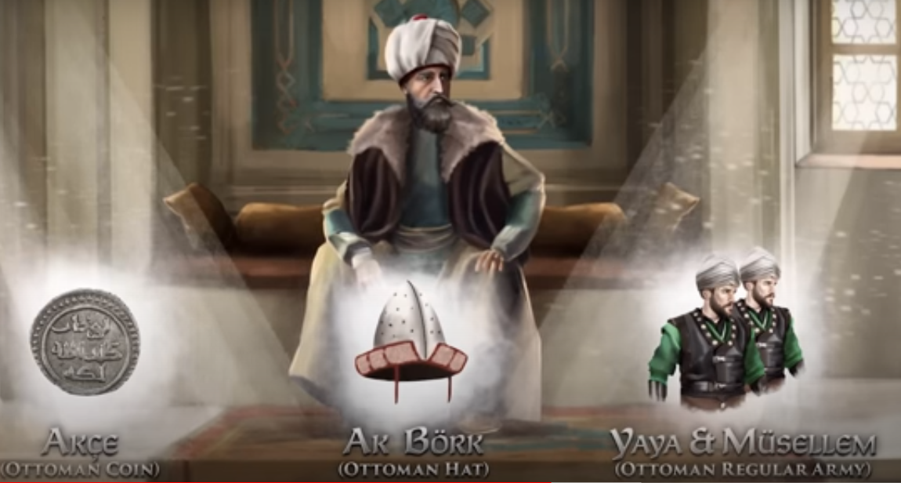

Slide 18
Orhan’s Wives
Nilufer Hatun (Holofira)
  Daughter of the tekfur of Yarhisar/Bilecik
  She married Orhan after Osman raided Bilecik
  Became Muslim
  Mother of Suleyman Pasa, Murad I, Kasem
Asporca Hatun
  Daughter of the Byzantine emperor Andronikos III Palaiologos
  Became Muslim
  Mother of Shahzade Ibrahim, governor of Eskisehir
Theodora Hatun
  Daughter of Byzantine emperor John VI Kantakouzenos and Irene Asanina
  Did not convert to Islam
  Marriage did not last long
  Mother of Prince Halil
Eftandise Hatun
  Mahmud Alp’s daughter
Notes:
Şehzade Halil (probably 1346–1362) was an Ottoman prince. His father was Orhan, the second bey of the Ottoman beylik (later empire). His mother was Theodora Kantakouzene, the daughter of Byzantine emperor John VI Kantakouzenos and Irene Asanina. His kidnapping was an important event in 14th century Ottoman-Byzantine relations. He was killed by his brother Murad I.
Kidnapping
In the mid-14th century, piracy along the Aegean Sea and the Marmara Sea coasts was widespread. The pirates usually kidnapped people for ransom. In 1357 they kidnapped Halil near İzmit (ancient Nikomedia) on the Marmara coast. It is not known whether they knew the identity of their prey beforehand, but upon learning it, they escaped to Phocaea (modern Foça) on the Aegean coast. Phocaea was a Byzantine fort recently captured from Republic of Genoa and commanded by Leo Kalothetos. Orhan appealed to the Byzantine emperor Andronikos IV Palaiologos to rescue his son. He offered to cancel Byzantine debts and promised not to support the Kantakouzenos family's claims on the Byzantine throne. Andronikos agreed and tried to rescue Halil, but Leo was reluctant and in 1358 Andronikos had to lay siege to Phocaea with a small fleet of three vessels (the expenses of which were paid by Orhan).[1] He also called Ilyas Bey, the ruler of Saruhan (a small Turkmen beylik in west Anatolia formed after the disintegration of the Sultanate of Rum), for a joint operation against Phocaea. However Ilyas was playing both sides and planning to kidnap Andronikos during a hunting party. Nevertheless Andronikos was able to forestall his plans by arresting him.[2] Without Saruhan collaboration, he lifted the siege. After the failure of the 1358 operations, Orhan came to Scutari (modern Üsküdar) on the Asiatic shore of the Bosporus for talks and agreed to pay 30,000 ducats as a ransom. In 1359, Halil was released.
Aftermath
As a part of the agreement, Halil was engaged to his first cousin, Irene Palaiologina, the 10-year-old daughter of John V Palaiologos.[3] The Ottoman prince and Byzantine princess later married and had two sons. Since Halil's elder brother Şehzade Süleyman had already died, the Palaiologos family hoped to see him as the new ruler of the Ottoman beylik. But to their dismay, after Orhan’s death, Halil's brother Murad I was enthroned as the new bey.[1] Although Halil tried to fight for the throne, he was executed in 1362 by his brother.
Issue
Gündüz Bey (born in 1361)[citation needed]
Ömer Bey (born in 1362)

Slide 19
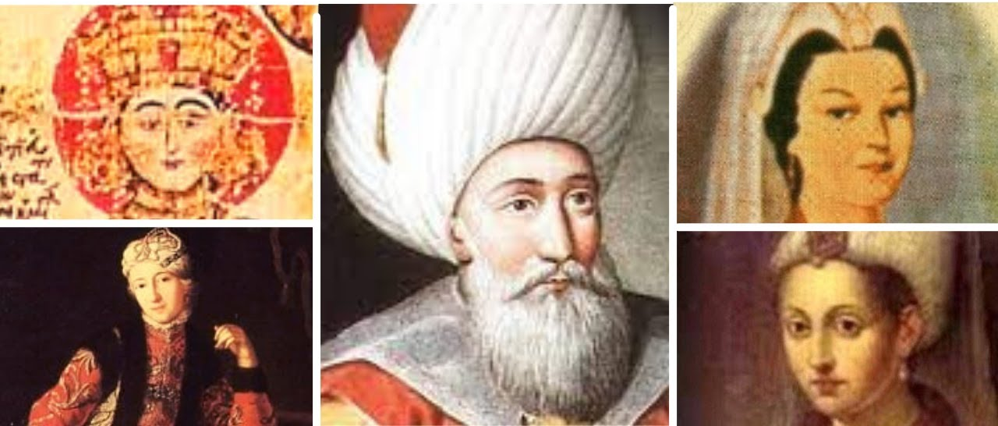

Slide 20
Orhan’s Sons
Shehzade Suleyman Pasa
  Most beloved son, key successor, was part of his father’s campaigns
  Died in a accident in 1357 (fell off and his horse tumbled on him, he succumbed to his injuries)
Sultan Murad
  After the death of Suleyman, Orhan was miserable and isolated himself
  Murad took command of Rumelia
  Orhan died in 1360, as a result of the mental anguish (or plague) he faced due to Suleyman’s death
  Murad ascended the throne as the third Ottoman Sultan
Shehzade Halil
  He was the son of the Roman princess Theodora
  He was kidnapped from the shores of Gulf of Nicomedia by Genoese pirates in 1359
  His grandfather John VI Kantakouzenos interceded and paid 100,000 gold coins for him
Shehzade Ibrahim
  Halil and Ibrahim, in Iznik and Eskisehir, respectively made a move to seize the throne with support from the Karamanids and Eretnids
  The Lord of Amasya, Bahtiyar Bey, occupied Ankara and the Karamanids took Sivrihisar
  In 1362, Murad had both of his brothers executed for treason against the state
Notes:
Şehzade Halil (probably 1346–1362) was an Ottoman prince. His father was Orhan, the second bey of the Ottoman beylik (later empire). His mother was Theodora Kantakouzene, the daughter of Byzantine emperor John VI Kantakouzenos and Irene Asanina. His kidnapping was an important event in 14th century Ottoman-Byzantine relations. He was killed by his brother Murad I.
Kidnapping
In the mid-14th century, piracy along the Aegean Sea and the Marmara Sea coasts was widespread. The pirates usually kidnapped people for ransom. In 1357 they kidnapped Halil near İzmit (ancient Nikomedia) on the Marmara coast. It is not known whether they knew the identity of their prey beforehand, but upon learning it, they escaped to Phocaea (modern Foça) on the Aegean coast. Phocaea was a Byzantine fort recently captured from Republic of Genoa and commanded by Leo Kalothetos. Orhan appealed to the Byzantine emperor Andronikos IV Palaiologos to rescue his son. He offered to cancel Byzantine debts and promised not to support the Kantakouzenos family's claims on the Byzantine throne. Andronikos agreed and tried to rescue Halil, but Leo was reluctant and in 1358 Andronikos had to lay siege to Phocaea with a small fleet of three vessels (the expenses of which were paid by Orhan).[1] He also called Ilyas Bey, the ruler of Saruhan (a small Turkmen beylik in west Anatolia formed after the disintegration of the Sultanate of Rum), for a joint operation against Phocaea. However Ilyas was playing both sides and planning to kidnap Andronikos during a hunting party. Nevertheless Andronikos was able to forestall his plans by arresting him.[2] Without Saruhan collaboration, he lifted the siege. After the failure of the 1358 operations, Orhan came to Scutari (modern Üsküdar) on the Asiatic shore of the Bosporus for talks and agreed to pay 30,000 ducats as a ransom. In 1359, Halil was released.
Aftermath
As a part of the agreement, Halil was engaged to his first cousin, Irene Palaiologina, the 10-year-old daughter of John V Palaiologos.[3] The Ottoman prince and Byzantine princess later married and had two sons. Since Halil's elder brother Şehzade Süleyman had already died, the Palaiologos family hoped to see him as the new ruler of the Ottoman beylik. But to their dismay, after Orhan’s death, Halil's brother Murad I was enthroned as the new bey.[1] Although Halil tried to fight for the throne, he was executed in 1362 by his brother.
Issue
Gündüz Bey (born in 1361)[citation needed]
Ömer Bey (born in 1362)

Slide 21
Orhan’s Timeline
1326: Capture of Prousa (Bursa) establishes it as the new Ottoman capital.
1326: Orhan takes over after the death of Osman
1329: Battle of Pelekanon - Ottomans decisively defeat the forces of John V Palaiologos.
1331: Conquest of Nicaea (Iznik) after the victory at Pelekanon.
1334: Conquest of Gemlik.
1337: Conquest of Nicomedia (Izmit).
1345: Annexation of the Karasids' lands.
1352: Ottoman expansion into Rumelia begins.
1352: Battle of Demotika - Ottomans defeat Serbian and Bulgarian forces.
1354: Capture of Gallipoli.
1354: Campaign into Byzantine Thrace.
1356: Ottoman troops under Suleyman Pasa defeat John V Palaiologos' forces.
1357: Suleyman Pasa dies in an accident, Orhan is miserable and isolates himself, Murad takes command of Rumelia
1359: Ottoman prince Şehzade Halil is kidnapped by Genoese pirates and later ransomed.
1360: Orhan dies, and his son Murad I ascends to the throne.
1362: Execution of Halil and Ibrahim.

Slide 22
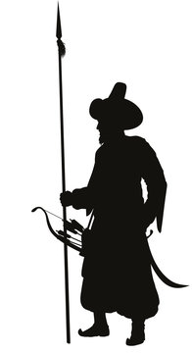



Orhan’s Legacy
Centralization
Standing Army
Onto Europe
True Leader
He constructed a centralized administration which assigned officials to the newly conquered lands under the counseling of Viziers .
He insisted that his principality have a professional army and so he stablished a regular standing army composed of infantry and cavalry units.
The Muslims boxed in Anatolia for three centuries were able to go into Europe following the conquests in Rumelia.
His brother had insisted that he accepted the throne, he led his army from the very front ranks and he was always among the people.
Notes:
Osman – Beylik into principality
Orhan – Principality into state

Slide 23
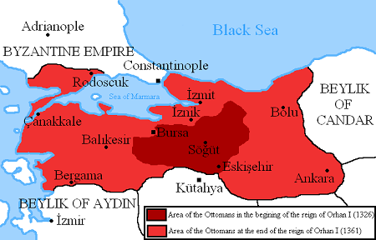

Slide 24
Osman (1281-1326)
Orhan (1326-1362)

Slide 25
Major Battles
Year | Name of Battle | Sultan | Against | Impact
1329 | Battle of Pelekanon | Orhan Ghazi | Byzantine forces | The Ottoman victory solidified their control over the northwestern Anatolian region. The capture of territories like Pelekanon played a role in the Ottoman Empire's expansion and consolidation.
1331 | Battle of İznik (Nicaea) | Orhan Ghazi | Byzantine forces | The Ottoman victory at İznik solidified their control over the region, contributing to their expansion and consolidation. This victory further weakened the Byzantine Empire in Anatolia.

Slide 26
What was happening elsewhere (1326-1360)
1304-1369: Ibn Batuta’s travels.
1325-1337: The Aztec Empire begins to expand its territory in Mesoamerica.
1325: Mansa Musa went on Haj.
1328: Scotland is independent.
1325: Muhammad bin Tughlaq (r. 1325-1351) of the Tughlaq dynasty ruled the Delhi Sultanate.
1335: End of the Ilkhanate.
1337-1453: The Hundred Years' War between England and France
1341-1347: Byzantine Civil War between John VI Kantakouzenos and John V Palaiologos
1347-1351: The Black Death
1348: Jews expelled from Germany, and go to Poland
1352-1357 Second Byzantine Civil War between John V Palaiologos and Matthew Kantakouzenos
1356: The Holy Roman Emperor Charles IV issues the Golden Bull of 1356, a constitutional document that establishes the electoral college and the process for electing Holy Roman Emperor.
1360: The Treaty of Brétigny is signed, temporarily ending the first phase of the Hundred Years' War between England and France. The treaty cedes significant territories in France to England.
1360: Timur starts building his Empire

Slide 27
Videos to Watch
How the Ottomans Took Over Western Anatolia – Pelakanon 1329
10 Historical facts about Sultan Orhan Ghazi

