Slide 1
Who am I?
I am not of royal blood and did not inherit any kingdom or empire from my father.
I was a self-made man, an illiterate barbarian, a famous conqueror and a ruler from Central Asia.
I was born in 1336, in what is now Uzbekistan and my Imperial Capital was Samarkand.
Despite a leg injury, I became a skilled military leader and built a vast empire.
I am known for my brutal tactics in warfare and conquering many lands.
I invaded and conquered parts of Persia, India and the Middle East.
I was also a patron of the arts and promoted the cultural development of my empire.
My descendants established the Mughal Empire in India.
My military campaigns were often marked by the construction of large architectural projects.
I am sometimes referred to as the “Lord of the Fortunate Conjunction”, “Conqueror of the World”, “Emperor of the Age”, “Unconquered Lord of the Seven Climes”, “Scourge and Wrath of God”

Slide 2
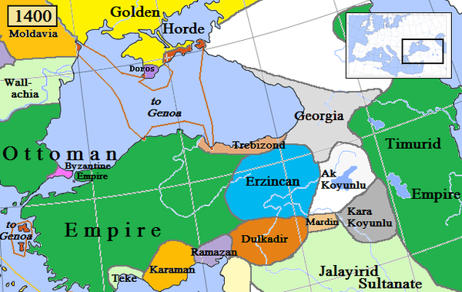

Slide 3
Tamerlane

Slide 4
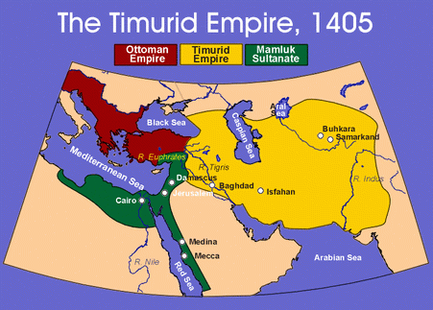

Slide 5
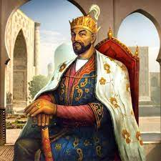
Tamerlane: Conqueror and Builder of Empires
Early Life and Rise to Power:
  Full Name: Timur, also known as Tamerlane, Birth: April 9, 1336, Death: February 18, 1405
  Born in Kesh, near Samarkand, in present-day Uzbekistan.
  Suffered a leg injury in his youth, earning him the nickname "Timur the Lame."
Conquests and Empire-Building:
  Gained prominence as a military leader, capitalizing on the power vacuum in Central Asia.
  Led a series of campaigns that resulted in the creation of the Timurid Empire.
  Conquered vast territories in Central Asia, Persia, India, Anatolia and beyond.
  Known for his strategic brilliance and military tactics.
Notes:
He was said to have received crippling arrow wounds for stealing sheep as a child.

Slide 6
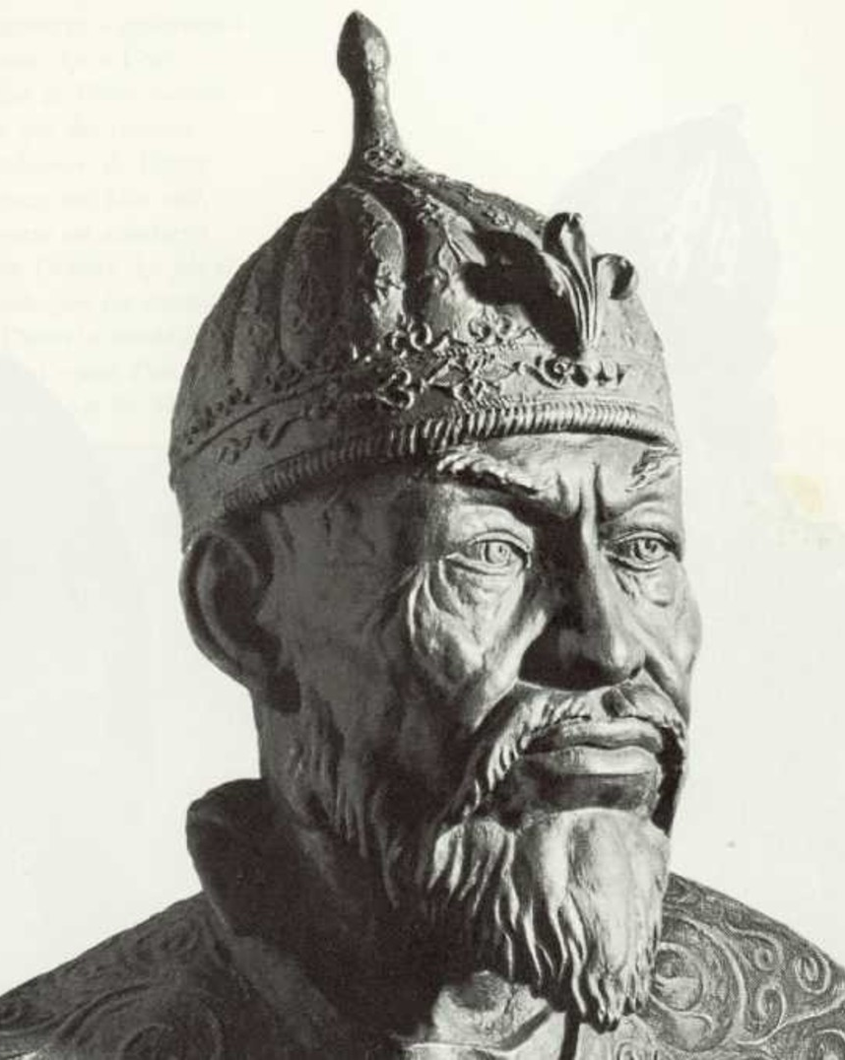
Tamerlane: Conqueror and Builder of Empires
Architectural Patronage:
  Beyond his military achievements, Tamerlane was a patron of art and architecture.
  Commissioned stunning structures like the Registan Square and Gur-e-Amir Mausoleum in Samarkand.
  Blended his Turkic-Mongol heritage with Islamic art and culture.
Cultural Impact:
  Fostered a cosmopolitan environment that attracted scholars, artists, and thinkers.
  His empire became a center of cultural exchange and intellectual advancement.
Legacy and Controversies:
  Left a complex legacy due to his brutal military campaigns and conquests.
  Celebrated as a hero by some, criticized for his ruthlessness by others.
Notes:
Send Outline Map

Slide 7
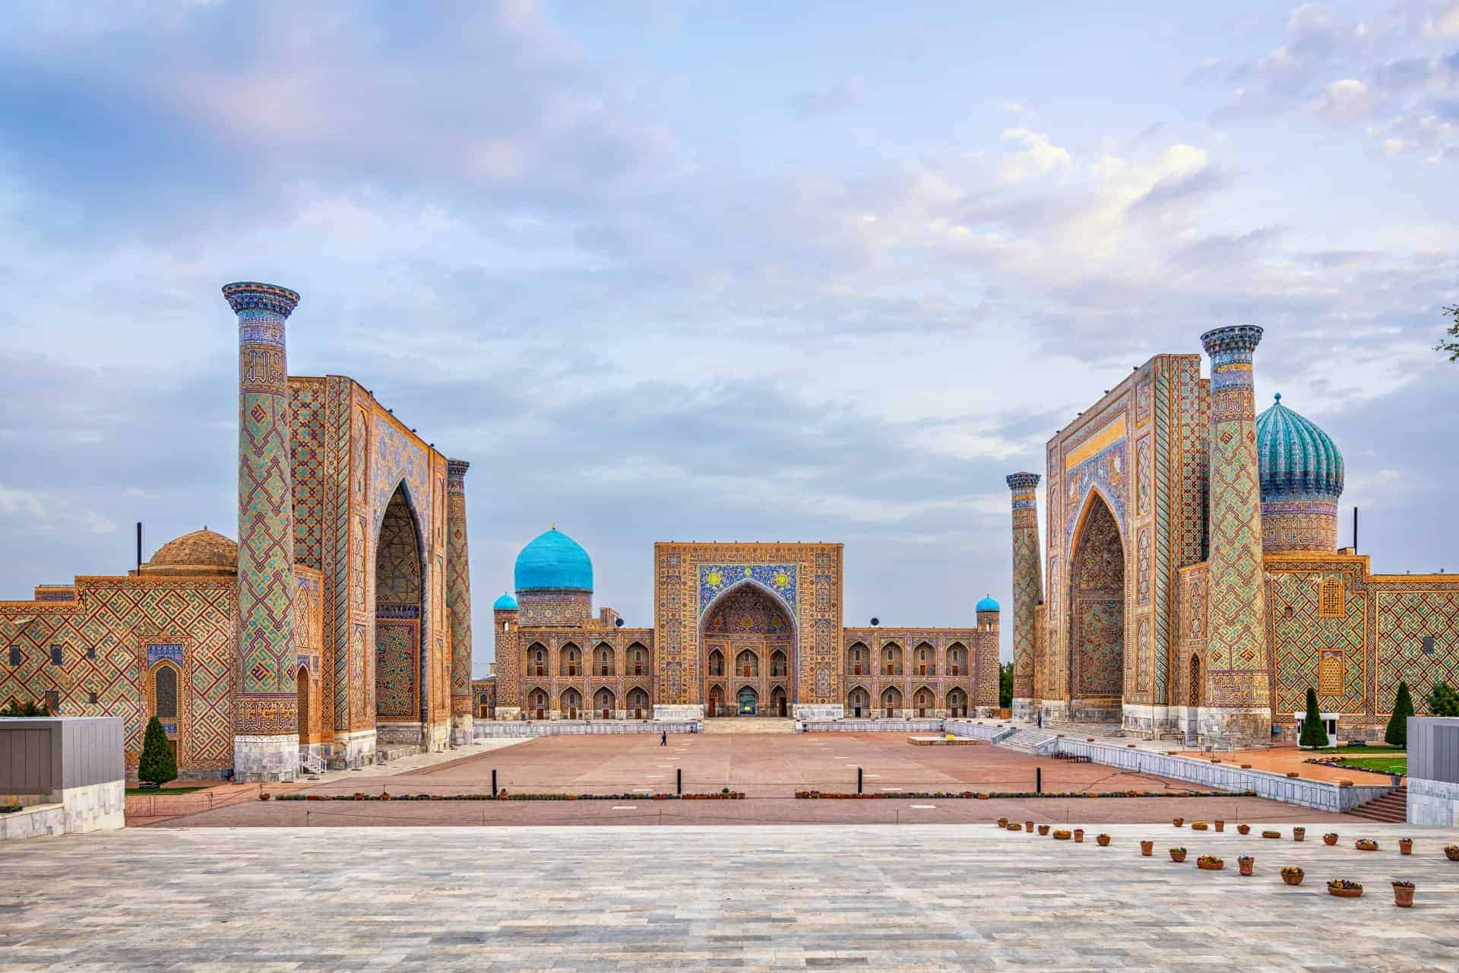
Registan Square

Slide 8
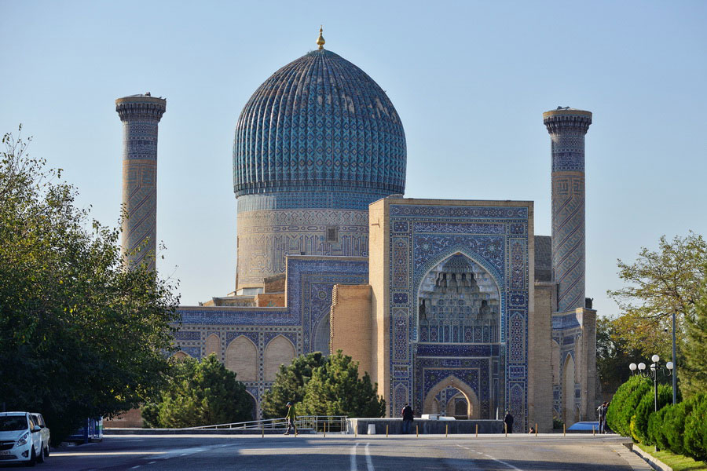
Gur-Emir Mausoleum

Slide 9
Rise to Power
Tamerlane's mother
  Tekina Khatun was a descendant of Genghis Khan
Tamerlane's father
  Amir Taraghay was a local chieftain and noble in the Barlas tribe, which was a Turco-Mongol group in the region of Central Asia
  He held a position of authority within the tribe and his lineage was an important factor in Tamerlane's rise to power
Decline of the Mongol Empire
  Fragmented into several smaller khanates and kingdoms due to internal conflicts, succession disputes, and external pressures
  Timur capitalized on the political divisions and rivalries among the successor states
Military Campaigns
  Timur's military prowess and strategic genius played a significant role in his rise to power
  He led successful campaigns against neighboring states, gradually expanding his territory
  He established an empire that stretched from the southeastern shores of the Black Sea and northern Mesopotamia to northern India
Notes:
1. Decline of the Mongol Empire:
The Mongol Empire, founded by Genghis Khan, had been the dominant power in Central Asia, Persia, and beyond. However, by the late 14th century, the empire had fragmented into several smaller khanates and kingdoms due to internal conflicts, succession disputes, and external pressures.
2. Rise of Timur:
Timur, born in 1336, came from a Turco-Mongol background. He seized the opportunity presented by the fragmented post-Mongol landscape to establish his own authority and expand his influence.
3. Exploiting Divisions:
Timur capitalized on the political divisions and rivalries among the successor states of the Mongol Empire. He skillfully navigated these complexities to forge alliances and exploit weaknesses.
4. Military Campaigns:
Timur's military prowess and strategic genius played a significant role in his rise to power. He led successful campaigns against neighboring states, gradually expanding his territory.
5. Claiming Mongol Legacy:
Timur claimed descent from Genghis Khan through his maternal lineage. This claim helped legitimize his authority and authority to rule, drawing on the historical prestige of the Mongol legacy.
6. Establishment of the Timurid Empire:
Timur's conquests and political maneuvering culminated in the establishment of the Timurid Empire. He centered his rule in Samarkand and expanded his empire to encompass parts of Central Asia, Persia, and beyond.
7. Consolidation and Patronage:
Timur not only conquered territories but also established a stable administration. He patronized art, culture, and architecture, fostering a vibrant cultural environment.
8. Legacy and Succession:
Timur's legacy as a powerful conqueror and ruler persisted after his death in 1405. His descendants, known as the Timurids, continued to rule in various parts of his empire.
In summary, the decline of the Mongol Empire created a power vacuum in the region, which Timur skillfully exploited through his military campaigns, alliances, and strategic leadership. His rise to power and the establishment of the Timurid Empire marked a new chapter in Central Asian history and shaped the geopolitical landscape for centuries to come.

Slide 10
Military Conquests: Timeline
April 9, 1336: Timur is born in the city of Kesh (modern-day Shahrisabz, Uzbekistan).
1360s: Timur begins his military career, serving various leaders and gaining experience in warfare.
1370: Timur establishes himself as the ruler of Samarkand after a series of conquests and political maneuvers.
1370s-1380s: Timur expands his empire by conquering neighboring territories, including parts of Persia and Central Asia.
1393: Timur captures and sacks the city of Herat in Persia.
1398: Timur launches a campaign into India, capturing Delhi and looting the city.
1400-1401: Timur's forces capture Aleppo and Damascus in the Middle East.
1402: Timur's forces defeat the Ottoman Sultan Bayezid I at the Battle of Ankara.
1404: Timur dies while preparing for a campaign against Ming China. He is buried in Gur-e-Amir, Samarkand.
Notes:
Send Outline Map

Slide 11
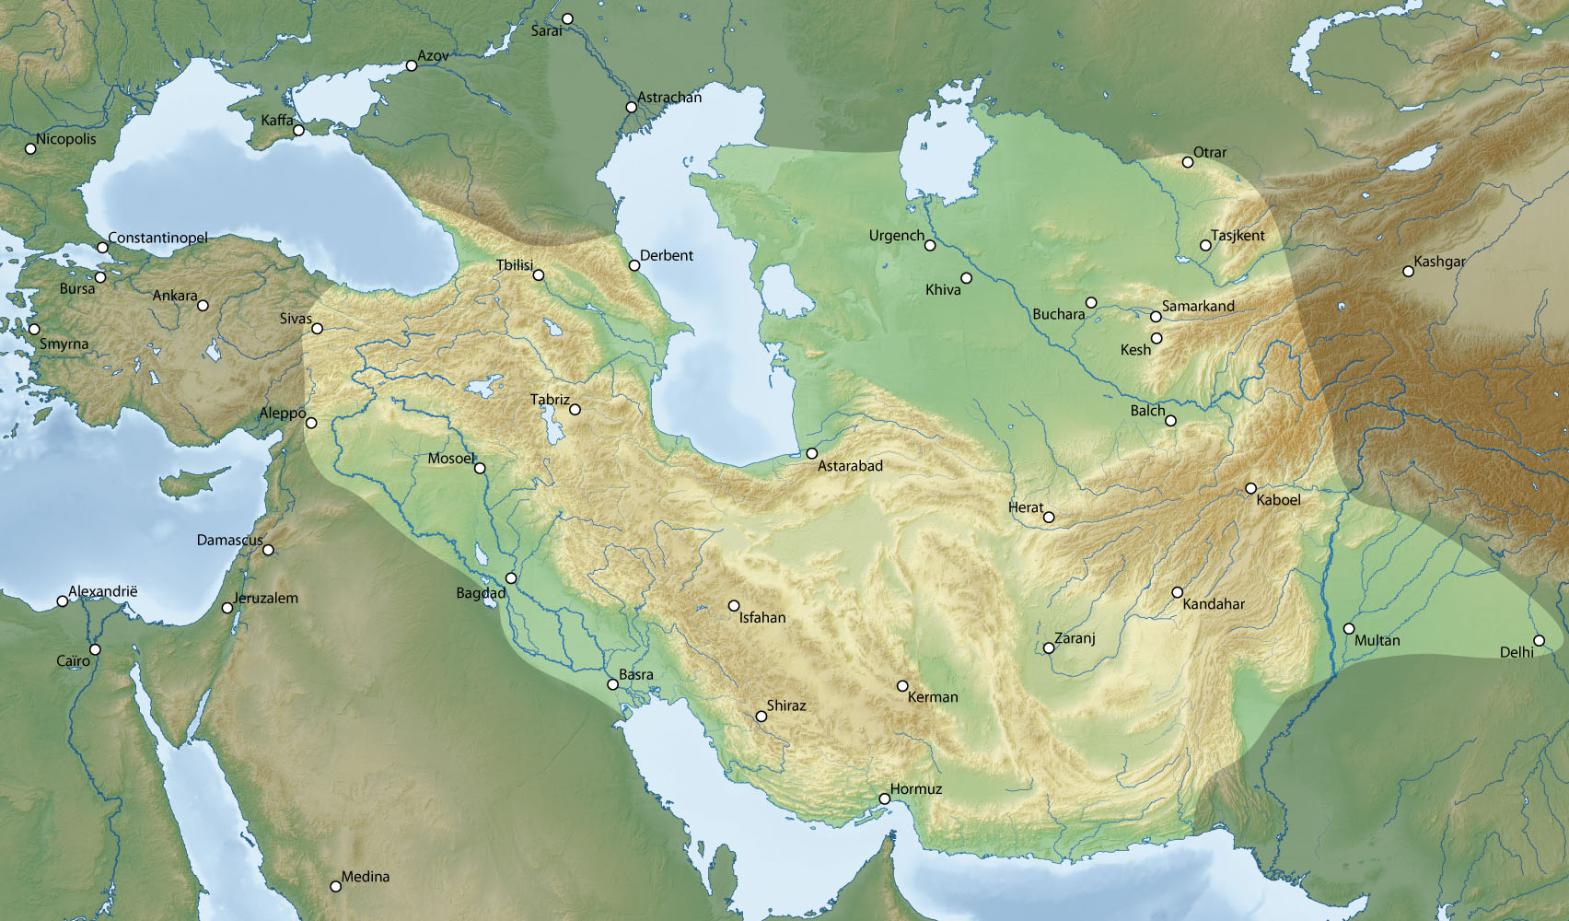

Slide 12
Samarkand
Architectural Projects
  Grand mosques, madrasas, palaces, and mausoleums
  Registan Square, a complex of three stunning madrasas adorned with intricate tilework and designs
  Gur-e-Amir Mausoleum, a final resting place for his grandson Muhammad Sultan; its design and decoration set the standard for Timurid architecture
  Tamerlane's Palaces showcased his power and wealth, combining both functional and aesthetic elements, featuring impressive courtyards, decorative tiles, and ornate carvings
  Samarkand's layout was organized improving its infrastructure and overall design with wide avenues, squares and grand entrance gates
Cultural Patronage
  Scholars, artists and intellectuals fostered a rich cultural environment
  Poets, scientists and scholars came to his court, contributing to the city's reputation as a center of learning and cultural exchange
Trade and Commerce
  Tamerlane's conquests and control of trade routes brought prosperity to Samarkand.
  The city became a hub for trade between the East and West
Samarkand being the capital significantly boosted the city's importance and led to its growth as a political and administrative center

Slide 13
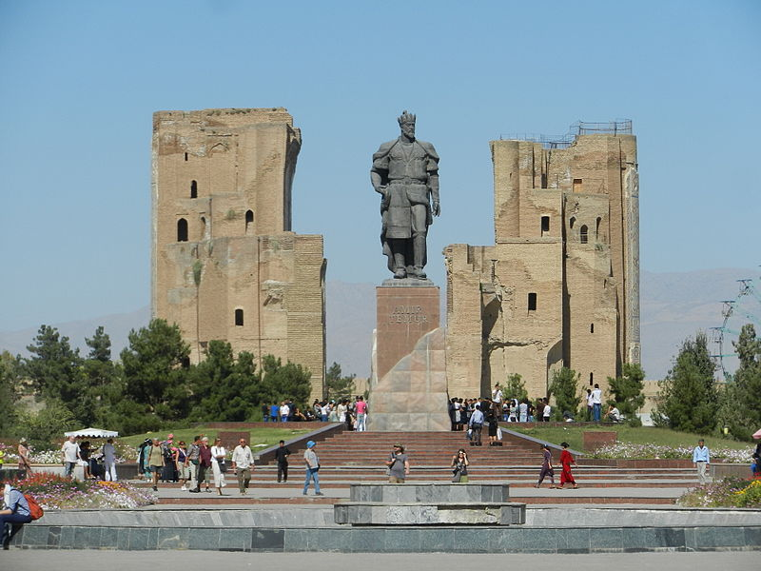
Ak Saray Palace in the city of Shahrisabz, Uzbekistan with the monument to Timur

Slide 14
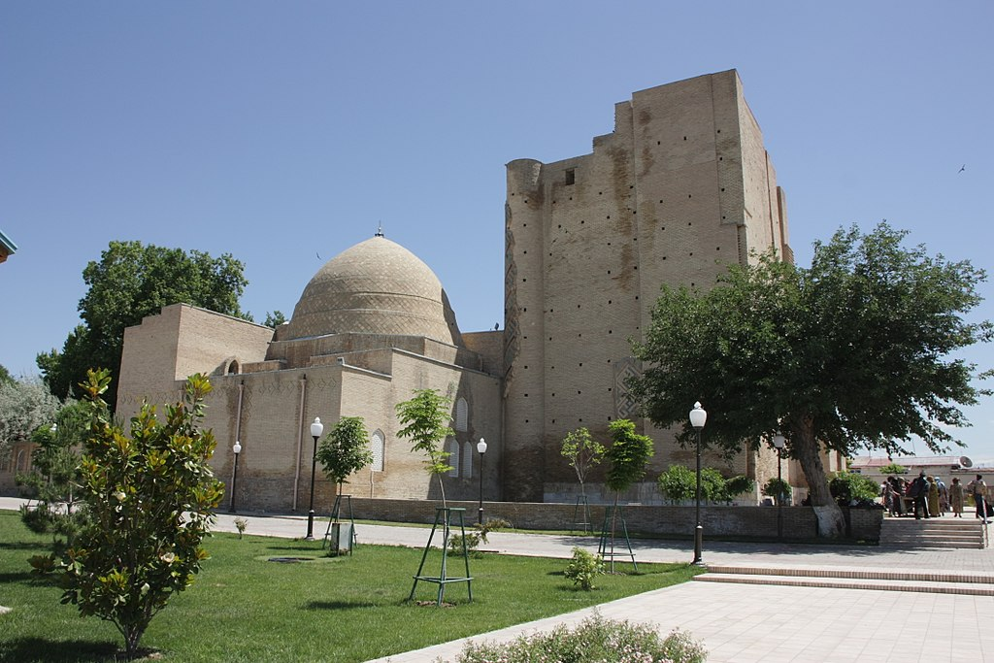
Jahangir Mausoleum in Shahrisabz

Slide 15
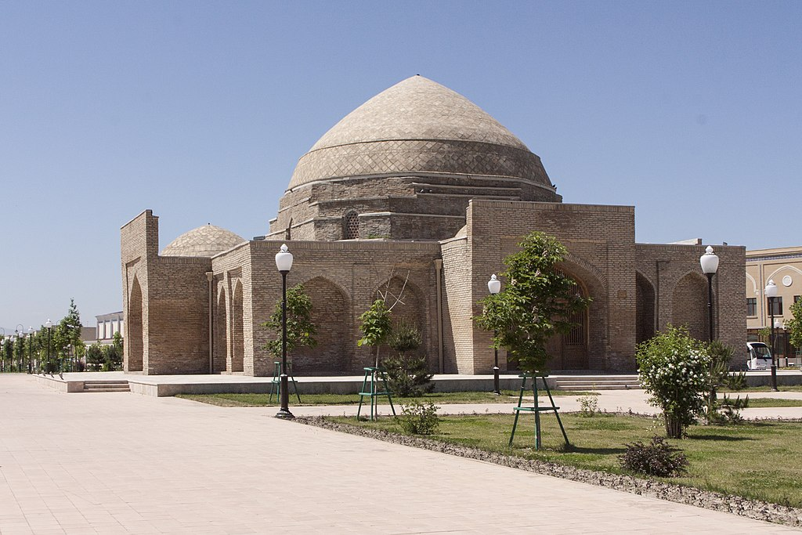
Shahrisabz Chorsu

Slide 16
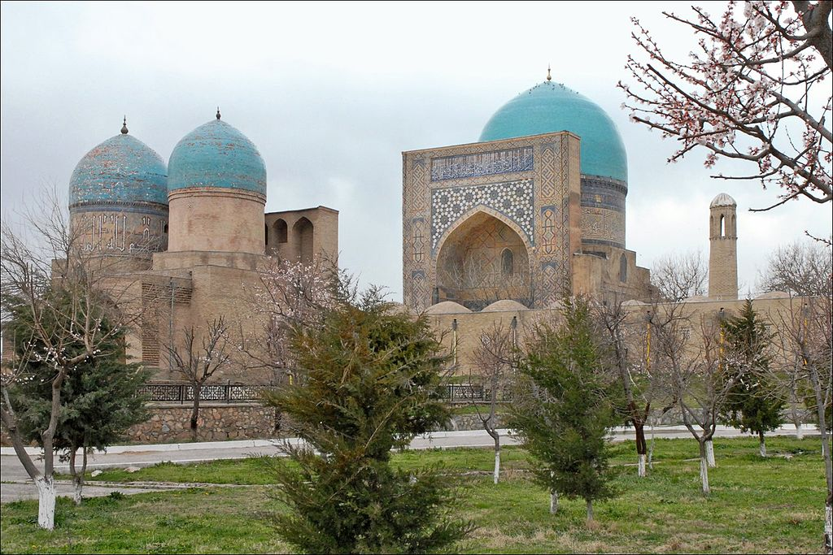
Kok-Gumbaz mosque, mausoleums and madrasa

Slide 17
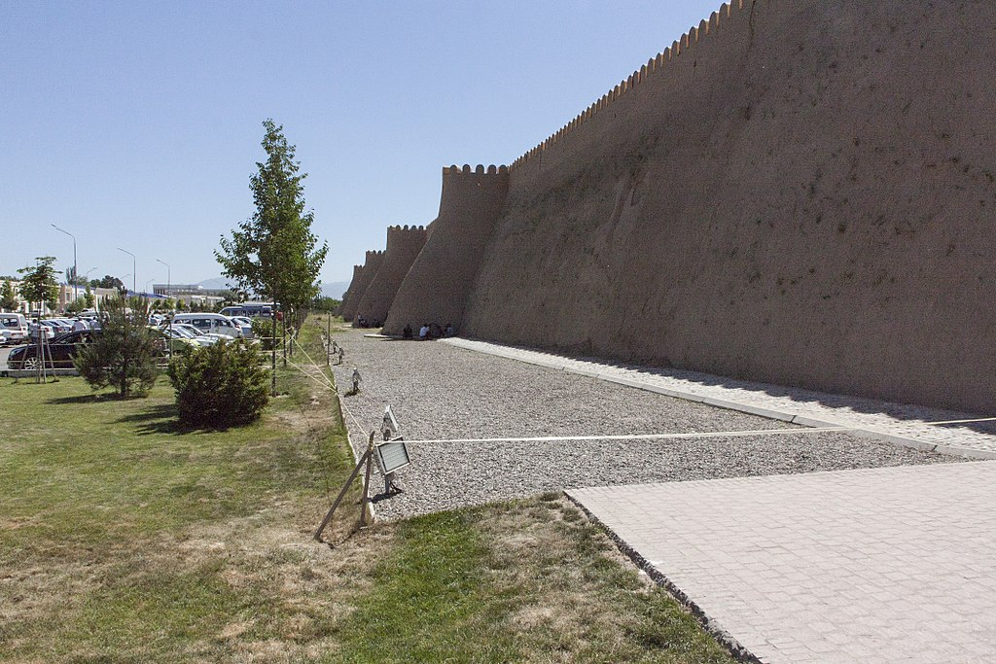
Walls of Shahrisabz

Slide 18
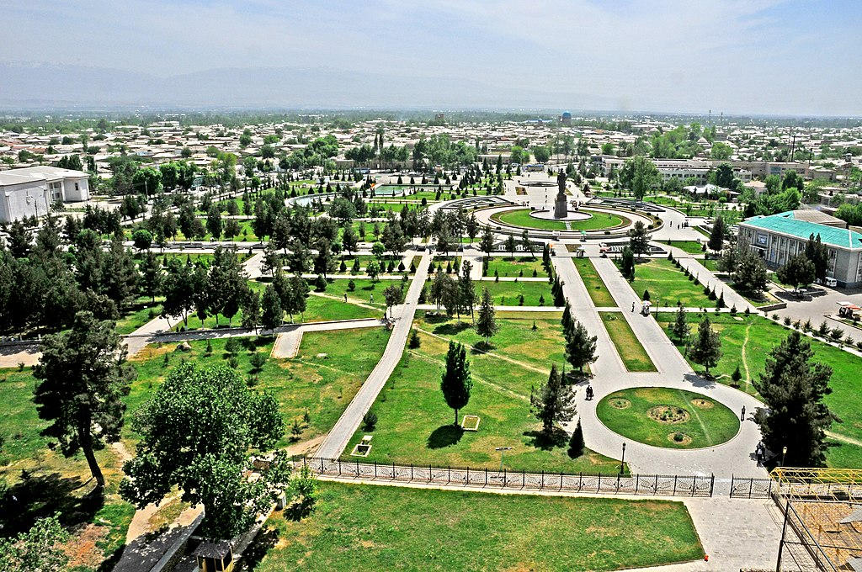
Town view from the White Palace (Ak Saray) top

Slide 19
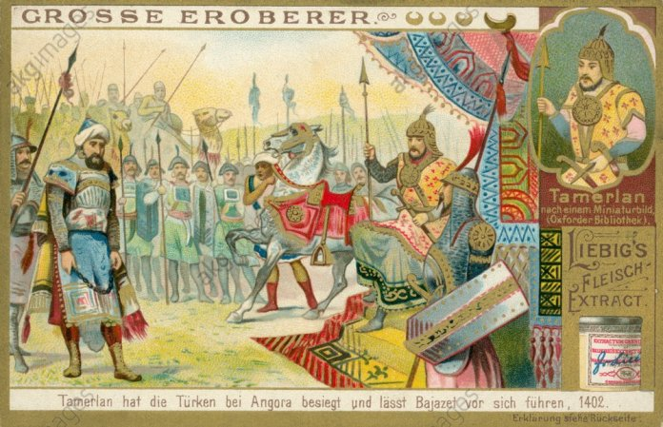
Why did Tamerlane attack the Ottomans?
Desire for Power and Territory
Rivalry and Competition
Prestige and Reputation
Defiance and Disrespect
Religious Justification
Opportunistic Timing
Battle of Ankara
Notes:
Desire for Power and Territory: Tamerlane was a conqueror who aimed to expand his empire's territory. The Ottoman Empire, under Bayezid's rule, was a growing power that controlled significant territories in Anatolia, the Balkans, and the Middle East. Tamerlane's ambition for territorial expansion likely played a significant role in his decision to attack the Ottomans.
Rivalry and Competition: Tamerlane and Bayezid were both ambitious rulers with expansive ambitions. This led to a rivalry for dominance in the region. Tamerlane saw Bayezid as a potential threat and competitor, which contributed to the tense relations between the two empires.
Prestige and Reputation: Tamerlane was known for his military conquests and his desire to establish a legacy as a great conqueror. Defeating a powerful ruler like Bayezid would have added to Tamerlane's prestige and reputation as a formidable military leader.
Defiance and Disrespect: There were instances of perceived defiance and disrespect between Tamerlane and Bayezid. Bayezid allegedly imprisoned Tamerlane's envoys and questioned Tamerlane's legitimacy as a ruler. These actions may have fueled Tamerlane's desire to assert his authority and seek retribution.
Religious Justification: Tamerlane often used religious rhetoric to justify his military campaigns. He portrayed himself as a defender of Islam and claimed that he was fighting against non-Muslim rulers. Bayezid was a Sunni Muslim ruler, and Tamerlane may have used this religious narrative to gain support and legitimacy for his attack.
Opportunistic Timing: Bayezid was engaged in conflicts in Europe and Anatolia when Tamerlane launched his attack. Tamerlane might have viewed this as an opportune moment to strike while Bayezid was preoccupied.

Slide 20
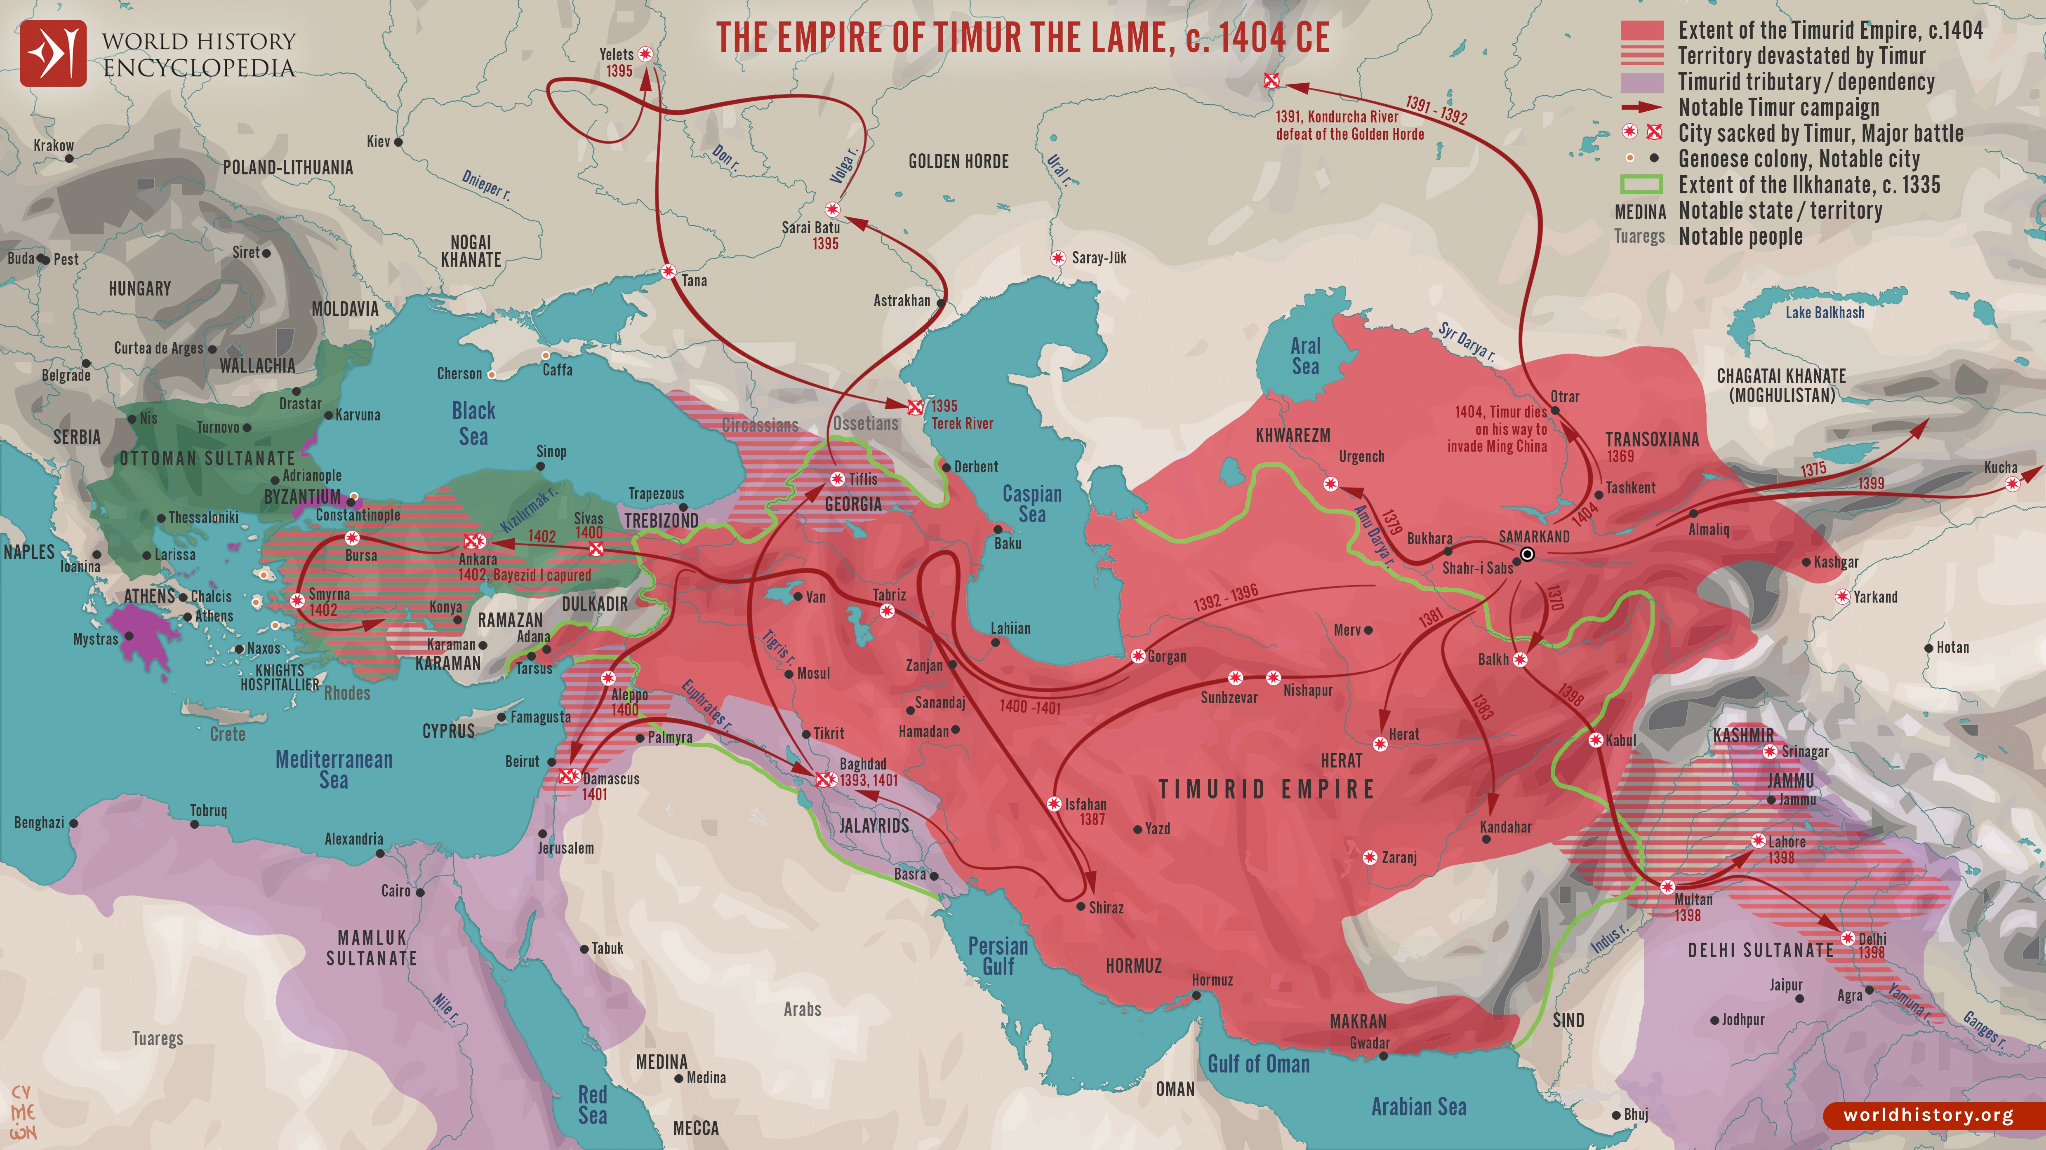

Slide 21
Legacy and Influence
Positive Legacy
  Architectural Marvels
  Cultural Exchange
  Artistic Contributions
  Timurid Dynasty
  Influence on Later Empires
Controversial Legacy
  Brutal Conquests: Tamerlane's military campaigns were marked by extreme violence, leading to widespread destruction and loss of life.
  Humanitarian Consequences: Tamerlane's conquests led to significant human suffering, including enslavement, displacement, and cultural upheaval
  Ethical and Moral Questions: Tamerlane's methods raise ethical questions about the means he employed to achieve his goals
  Historical Interpretations: Tamerlane's legacy has been interpreted differently across cultures and regions. While some view him as a national hero, others see him as a conqueror responsible for immense suffering.

Slide 22
Timurids

Slide 23
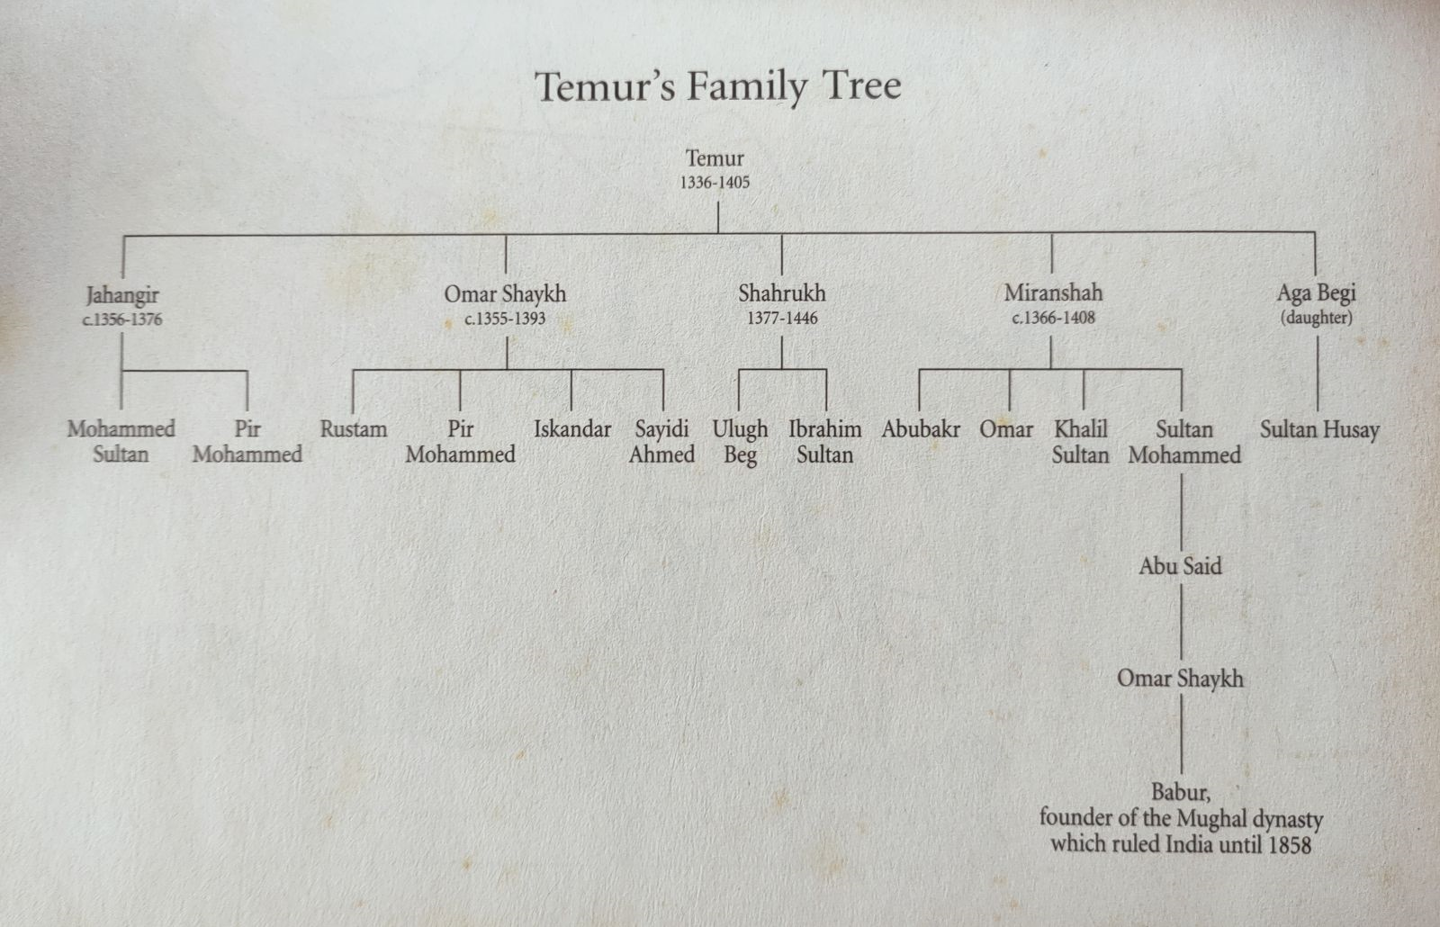

Slide 24
Timurids (1370-1507)
After his death, Timur's empire began to decline as internal conflicts and external pressures weakened his successors' rule
1405-1447: Shah Rukh, Tamerlane's son, focused on consolidating the empire's territories, promoting culture, and strengthening ties with neighboring powers
1447-1449: Ulugh Beg, the son of Shah Rukh, came to power; he is known for his patronage of astronomy, mathematics, and culture; his reign saw a focus on intellectual pursuits, including the establishment of an observatory in Samarkand
1449-1457: The Timurid Empire experienced internal divisions and power struggles among his descendants
1457-1506: Sultan Husayn, a grandson of Tamerlane, managed to reunite parts of the Timurid Empire, he faced conflicts with the Uzbeks and the Safavid Empire
1526-1540: Babur, a descendant of Timur through his father's side, captured Delhi and established the Mughal Empire in India, marking the end of the Timurid Dynasty's direct rule in Central Asia.
16th century: The Timurid Empire fragmented into smaller states such as the Khanate of Bukhara and the Khanate of Khiva
The Timurid cultural and artistic legacy continued to have an impact, but the political influence diminished, as the Safavids, Ottomans, and Russians, exerted control over the region.

Slide 25
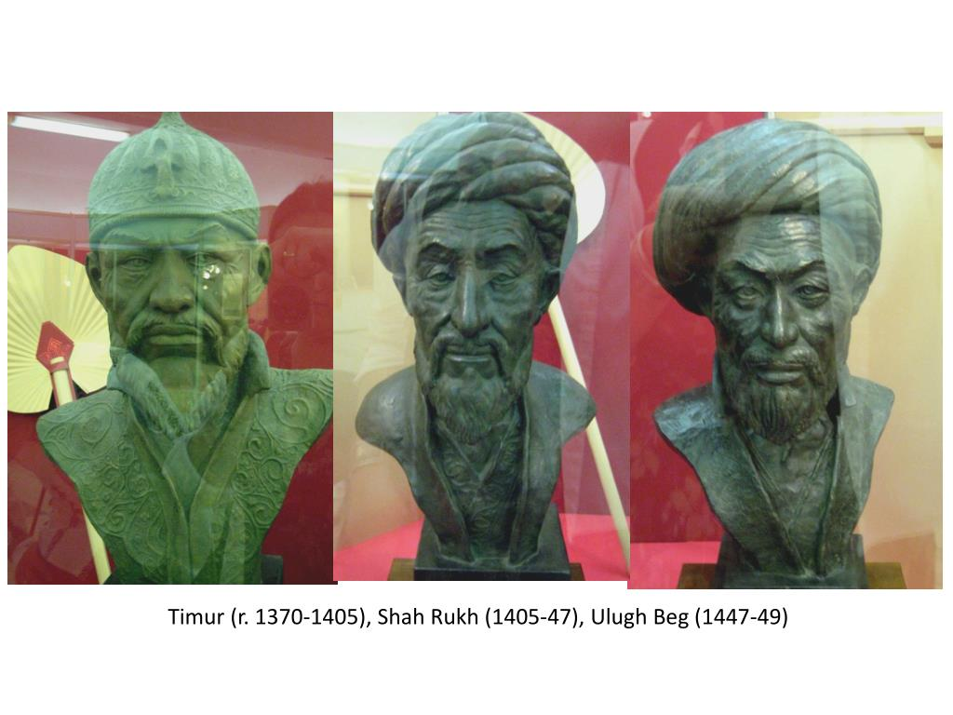

Slide 26
Ulugh Beg
Ulugh Beg was born on March 22, 1394, in Sultaniyeh, Persia (modern-day Iran)
Scientific Contributions:
  Renowned for his contributions to astronomy and mathematics; established an observatory in Samarkand, which became a center for astronomical research
  He constructed a large sextant, an instrument used to measure angles in astronomy; He used it to compile a star catalog known as the "Zij-i Sultani" containing the positions of over a thousand stars
Ruler of Samarkand:
  He ruled over the city of Samarkand from 1409 to 1449, promoting learning, culture, and scientific research
  He was also engaged in political affairs and military campaigns to expand and maintain his territories
Downfall and Death:
  In 1449, he was overthrown and assassinated by his own son, Abdal-Latif, who sought to gain power. This event marked the decline of the Timurid dynasty in Central Asia
Notes:
Send Outline Map

Slide 27
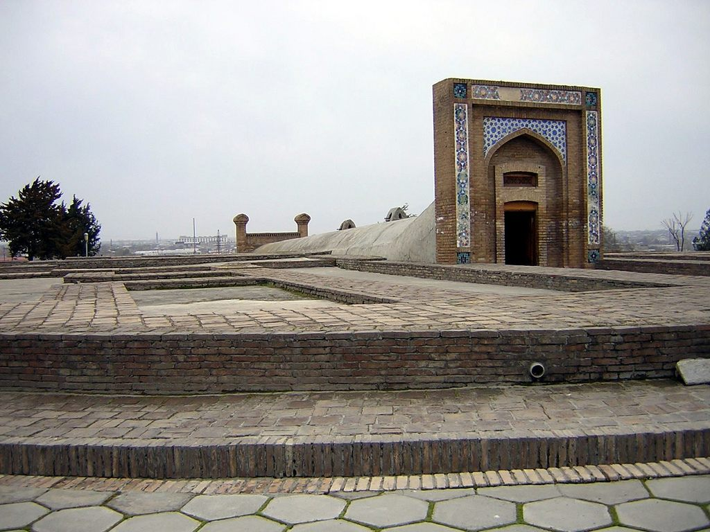
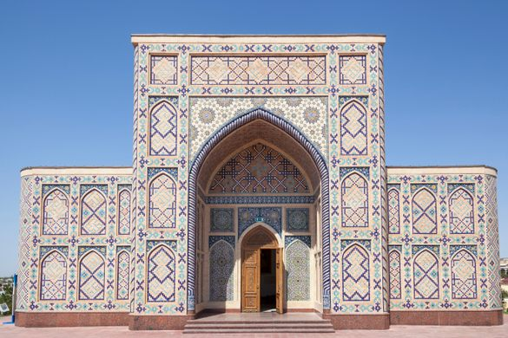
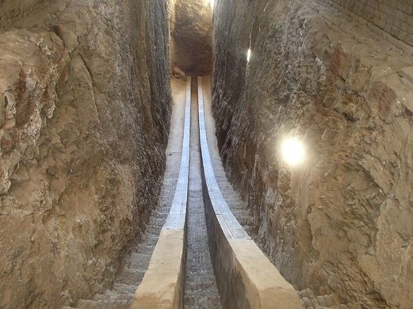
Ulugh Beg ‘s
Observatory

Slide 28
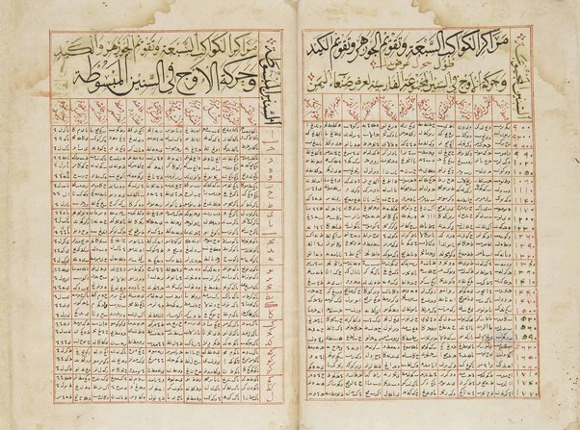
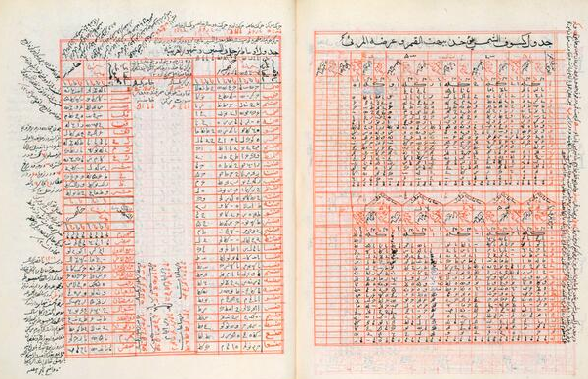
Ulugh Beg ‘s
Zij-i Sultani: Star Catalogue

Slide 29
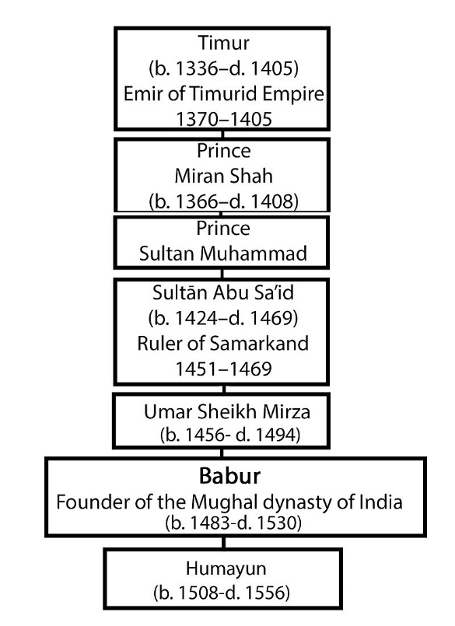

Slide 30
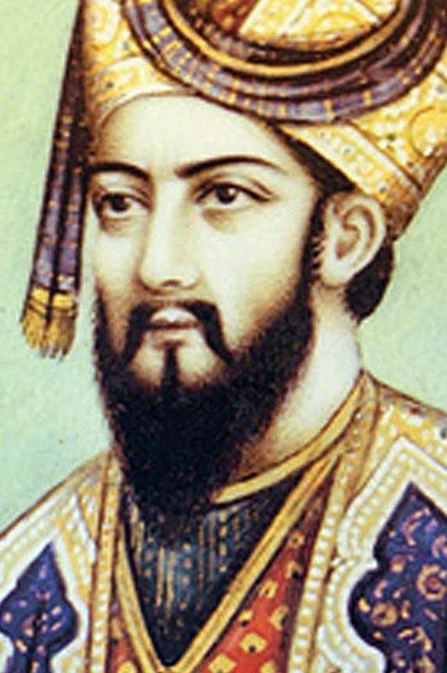
Babur: Founder of the Moghul Empire
Zahir-ud-din Muhammad Babur was born in 1483, in Andijan, Uzbekistan
Babur was a descendant of Timur on his mother's side and Genghis Khan on his father's side
He inherited the kingdom of Fergana in Central Asia at a young age but faced political rivalries and external threats.
He embarked on a series of military campaigns to expand his territory
In 1526, he defeated the Sultan of Delhi, Ibrahim Lodi, at the First Battle of Panipat, establishing the foundation of the Mughal Empire.
He appreciated the arts and literature. He wrote his memoir, "Baburnama," which provides valuable insights into his life and the historical context of his time.
He passed away on December 26, 1530, in Agra, India and was succeeded by his son, Humayun.
Notes:
Send Outline Map

