Slide 1
The Ottoman Sultans of Edirne
Murad I and Bayezid I
(1362-1402)

Slide 2
Let’s Recap…
Notes:
Let’s Recap…

Slide 3
Timeline of Ertugrul, Osman and Orhan
1196: Birth of Ertugrul Ghazi
1227: Kayi tribe cross Euphrates and enter into Anatolia
1237: Alaeddin Keyqubad I awards Ertugrul title of Ghazi and Karacadag, Sogut, Domanic
1289: Ertugrul Ghazi dies and Osman comes to power
1285-88: Osman conquers Kulaca Hisar, Karaca Hisar, Bilekoma and Melangia, which is renamed Yenisehir, the new capital
1302-04: Battle of Bapheus and Dimbos opens the Bursa Plain and Mysia Olypos
1326: Capture of Bursa, made new capital, Orhan comes to power
1329-37: Battle of Pelekanon against Byzantines, Conquest of Nicaea (Iznik), Gemlik, Nicomedia (Izmit).
1345: Annexation of the Karasids' lands.
1352-54: Ottoman expansion into Thrace: Battle of Demotika against Serbians and Bulgarias, Capture of Gallipoli.
1356: Ottoman troops under Suleyman Pasa defeat John V Palaiologos' forces.
1357: Suleyman Pasa dies in an accident, Orhan is miserable and isolates himself
1360: Orhan dies, and his son Murad I ascends to the throne.

Slide 4
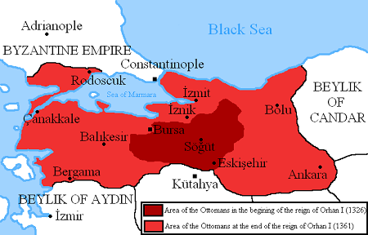

Slide 5
Expansion and Centralization
Murad I (r.1362-1389)

Slide 6
Murad I (r1360–1389)
Murad was born in 1326 in Bursa to Nilufar Hatun and Orhan Bey
He was handsome, brave, humble, good- natured, prudent, wise and perceptive
He was spiritual, had the soul of a Dervish and was indifferent to worldly matters
His the soul purpose was to engage in holy war and holy raid to expand Muslim territory and to bring Islam to the world
He was tutored by Lala Sahin Pasa, who served him later as well
He had ruled as the governor of Bursa and then Sultanoyugu (Eskisehir)
In 1357, he took over the control of state affairs as Orhan’s health declined
In 1362, at the demise of Orhan, he was recalled from his campaigns in Rumelia to Bursa, to ascend to the throne, at the age of 36 years
Murad expanded Ottoman territory by over 400,000 Sq kms
He died at the age of 63 after ruling for 27 years
Titles:
  Hudavendigar (Devotee of Allah)
  Gazi Hunkar (Veteran Ruler)
  Emir i Azam (Great Emir)
  Sultanus selatin (Sultan of sultans)
  Melikul Muluk (King of kings)
Notes:
Murad I started the Janissary. One might argue this was unislamic as they were taken from conquered Ottoman lands and not via wars.

Slide 7
Conflict on 3 Fronts in Anatolia
Inhabitants of Ankara rebelled
  The lord of Amastya, Bahtiyar Bey occupied Ankara
  Armies were sent and they succeeded in quelling the rebellion and recapturing Ankara
Surrounding Beyliks prepared to invade, with the Karamanids at the forefront
  The Karamanids took Sivrihisar
  The Ottomans met in them battle
  Many Karamanids of Varsak, Tatar and Turkmen origins fell
  The Bey of the Karamanids abandoned his armour and treasury, and fled
Romans attacked and plotted against the Throne
  Ibrahim (in Ekisehir) and Halil (in Iznik), Murad’s brothers backed by Romans, Karamanids and Ertenids plotted to overthrow Murad
  Murad defeated their armies and had his brothers executed in 1365
  Rebellion means Bagi and the penalty of death applies by Shariah
  Treason against your nation is punishable by death even in today’s day and age
Through these actions, Murad consolidated power in Anatolia and became the Master of Turks
Notes:
Beyliks
Kayi Beylik used to be amongst the smallest, so when they grew, others were jealous
Karamanids were based in South Central Anatolia and had ruled from their capital of Konya from the time of the fall of the Seljuqs
Halil
Theodora’s son
Married Irene, his cousin when she was 10 years old
Had two sons from her, she died at the age of 13

Slide 8
Expansion into Rumelia
Murad made six campaigns during his reign to Rumelia and carried Islam to the Balkans
Recapturing
  While Murad was busy in Anatolia at the start of his reign, the Byzantines took back the cities of Tzouroulos (Corlu), Arkadiapolis (Luleburgaz) and Malgara (Malkara)
  Ottomans returned to Rumelia and recaptured these castles
1363: Take over of Bulgaria
  Capture of Adrianople (Edirne), in 1362, the 3rd largest Roman city and the gateway to the Balkans
  Philippopolis (Filibe or Plovdiv) was conquered by Sahin Bey
  Byzantine Empire signed a treaty in 1363 recognizing the Ottoman conquests in Thrace
1364: Battle of Sirpsindigi
  Frightened by the advances, Pope Urban V called for a crusade, the King of Bulgaria responded
  The Crusader army of 60,000 included Papal states, Hungarians, Serbians, Bosnians, Wallachians
  Ottoman army of 10,000 destroyed the Serbian army, battle was known as "sırp sındığı" (destruction of Serbs).
1366: Loss of Gallipoli (Amadeus IV of Savoy captured it)
  This made it difficult for Murad to leave Rumelia; he stayed in Rumelia for five years and captured many cities there such as Kirkareli, Vize, Cermen (Ormenio) and Yanbolu (Yambol)
  They were able to recover Gallipoli only in 1377
Notes:
Bulgarians were a mighty kingdom who sometimes aligned with the Romans and at other times tried to take Constantinople
Bulgaria had 50% Muslims who were driven out in 1900

Slide 9
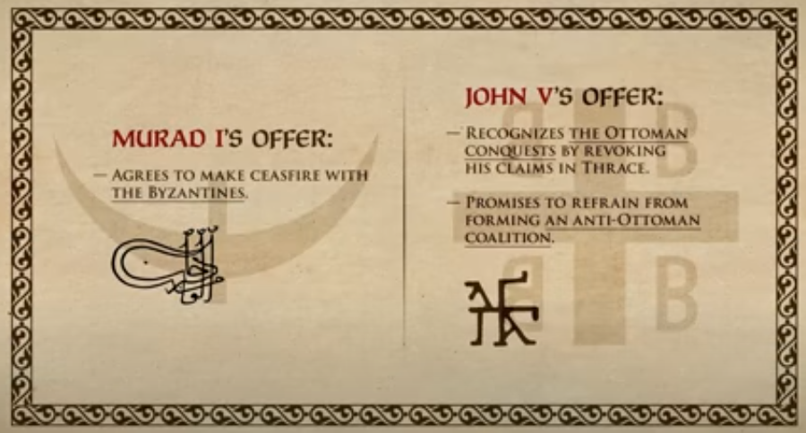

Slide 10
Further Expansion into Rumelia
1365: The Ottoman capital was moved from Bursa to Edirne
1371: Battle of Maritsa (Bulgaria and Serbia)
  The Maritsa river and the Maritsa (Meric) Valley, which provided Constantinople with cereals and tax revenue fell under Ottoman control
  By taking Bulgaria and Serbia, Constantinople was cut off from important allies (like Crusader armies) and revenue streams; this led to the further decline of the city
1373: Sons Rebel
  Shezade Savci Bey, Murad’s youngest son and Andronikos IV, John V Palaiologos’s son both wanted their respective fathers’ throne and rebelled by trying to take over the capitals
  Murad captured his son in an encounter near the Valley of Kite and killed the provocateurs
  Savci Bey was defiant and was later blinded to eliminate any possibility of him usurping the throne
Vassal States: 1368: Bulgaria, 1373: Constantinople, 1374: Serbia
John V sought support from the Pope, converted to Catholicism
1385: More Balkan provinces taken
  Sofia was conquered in 1385
  Western Thrace, parts of Macedonia – Kavala, Drama, Serres, Niz and Salonika, and inner Albania were taken

Slide 11
Beyliks Subdued
Through Marriage
  Germiyanids: Germiyanid lord Suleyman Bey feared a Karamanid attack; In 1382, he married his daughter Devletsah Hatun to Murad’s eldest son Bayezid; Murad got Germiyanid cities of Kutahya, Simav, Emet and Tavsanli as a gift from the bride’s father
  Karamanids: Murad betrothed his daughter Melek Hatun to Karamanid lord Alaeddin Bey
    Kastamonu Bey: Murad wedded his niece Sultan Hanun with Suleyman Bey, the son of Kastamonu Bey, who then expressed his allegiance to Murad
  Through Purchase of Land
  The Hamidids sold the cities of Aksehir, Beysehir, Seydisehir, Yalvac and Karaagac for 80,000 gold coins (1375)
  Karamanids were upset about this as they had their eyes on these territories
  Ottomans and Karamanids fought many battles for these lands
Through Force: 1386: Battle of Frenk Yazisi
  When Murad returned to Edirne after conquering Nis, Alaeddin Bey attacked Ottoman lands
  Both armies met at the Battle of Frenk Yazisi in 1386 and the Ottomans were victorious
  Murad besieged Konya, Karamanid capital
  Following this, the Karamanid and Isfendiyarids in northern Anatolia accepted Ottoman rule

Slide 12
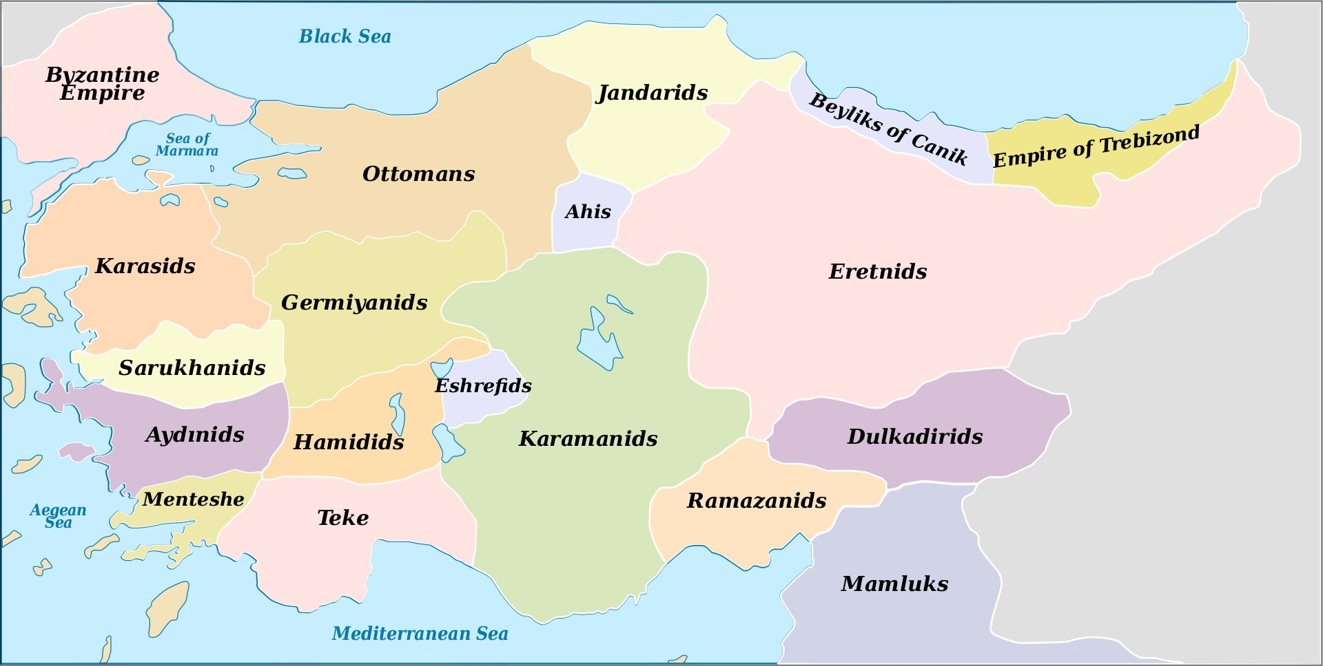

Slide 13
Battle of Kosovo and Martyrdom
1389: Battle of Kosovo – First Victory of Kosovo
  Moravian Serbian Prince Lazar Hrebeljanović refused to pay tribute, massacred innocent Muslim villagers, was declared by the Serbian Church as ‘the grand imperator”; Serbian vassalage had broken
  Bosnian and Serbian lords allied with the prince of Moravian Serbia and the Knights Hospitaller; the composite crusader army also included soldiers from Kosovo, Bulgaria, Catalan, Hungary, Czech, Albania and Wallachia. They declared war.
  The armies met on 15 July 1389 and the Ottomans were victorious
  Bulgaria was completely annexed and a considerable part of Serbia was conquered
  Both sides had used cannons for the first time
  The two wings were commanded by Sehzade Bayezid and Sehzade Yakup Bey
  A Serbian knight who was hidden among the dead and wounded soldiers, approached Murad, pretending to kiss the Sultan’s coattail, lied that he wanted to convert and had important information, and then stabbed the Sultan twice – once on the neck and once on the shoulder
Murad died at the age of 63 after ruling for 27 years, fighting 37 battles
  He was buried in Edirne and Bursa, he asked Bayezid to succeed him to the throne
  Worried about sedition, the high officials of the state had Yakup Bey assassinated and his coffin sent to Bursa with his father’s
  Murad had quintupled the legacy he inherited from his father (500,000 sq km)
Notes:
Murad held the sword of Jihad Fi Sabi Lillah in the true sense
On the eve of the battle, a could of dust descended on his army; Murad prayed all nigh long and it started to rain, dispelling the cloud of dust. He also asked to be a martyr.
Canons - engineered by craftsmen in Dubrovic on the Adriatic Sea
Christian world was happy at the death of Murad and the were celebrations in Paris and Constantinople
False news spread, that the Christians were victorious and the Ottomans had suffered a total defeat with the Sultan and his son and a great portion of the army were eliminated. Another myth was spread about the 12 heroes who cut through the Ottoman lines, moved to the tent of Murad and killed him.
This false victory was claimed by Serbs and Bosnians.
The Battle of Kosovo which represents the last great defense of the Serbs, is regarded as the national epic of the Serbs. The Serbian histories narrate the “great achievement of the Knez Lazar”, the “victory of the Serbs”. Though subsequent sources give credit to the Defeat by the Ottomans.
Bosnian King Tvrtko I who sent Vlatko Vukovic also claimed that the victory belonged to him.

Slide 14
It is said that on the eve of the battle, Sultan Murad prayed, then asked Allah swt, “My Rabb, my Master, in your presence you have not denied me and have accepted my prayers so many times. Accept my prayer again… O Allah, make me a sacrifice for the Muslims that are and are not here on this battlefield. Take my soul, but make us victorious! You made me a veteran on your path and then I shall be a martyr, my Lord… I sacrifice my life for them, please accept it”

Slide 15
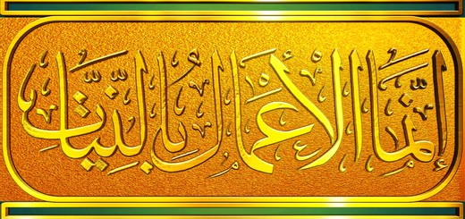
Reason for Ottoman’s Quick Expansion
They were located at the doorstep and frontiers of non-Muslim lands
The intentions of the early Sultans was sincere: they only wanted to protect their subjects from potential threat, to liberate the ones oppressed by tyrannical rulers and to spread the message of Islam into non-Muslim lands
They did not focus on expanding into Muslim lands, just for territory and riches, and so avoided the wrath of the people
The Muslim dynasties in the East struggled more as they fought against fellow Muslims
Intentions of Ottoman Sultans was pure and so victories were easy

Slide 16
Murad’s Legacy
Key Developments
  Imaret: Soup Kitchens for the poor in each city
  Tekke: Religious Lodges, Masjids and Madrassas,
  Cultural and scientific centers
Tolerance
  Non-Muslims experience tolerance, with many communities prospering more under Muslim rule than under previous Christian rulers; They even wrote to the Pope about the improvement
  Many non-Muslims chose to migrate to Muslim lands as they could live in peace
  Murad was so loved by his Christian subjects that many converted to Islam thanks to his good behaviour and attitude
  Timars (military fiefdoms) were distributed among the native Christian soldiers; the Balkan Ottoman army had Muslim and Christian soldiers
Development of both financial, governmental and military institutions
  Reorganization of tax collection and use of fund for construction and development
  Turks, Arabs, Persian and other ethnicities came to fight in the Ottoman service; the institution of the Kapikulu Sipahis (Cavalry of the Porte) was established
  They were the cavalry equivalent of the Janissary household infantry force which was also formed
  A new law forbade princes from becoming wazir; later only those from the Devshirme system could

Slide 17
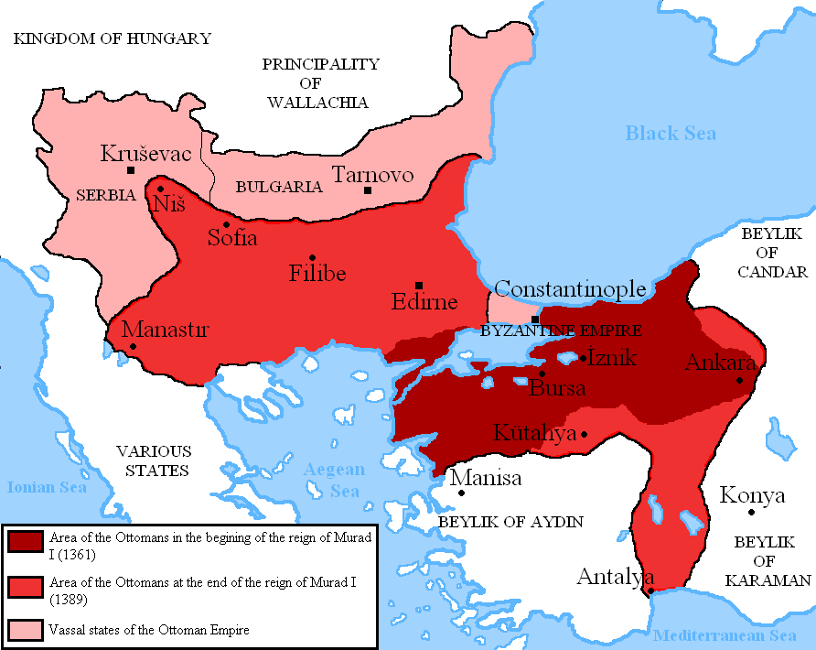
Murad expanded Ottoman territory by over 400,000 Sq kms
95,000 Sq kms when Orhan died
500,000 Sq kms when Murad died
He was at the forefront of bringing Islam into Europe
Albania and Bosnia still remain majority Muslims as a result of this Ottoman expansion

Slide 18
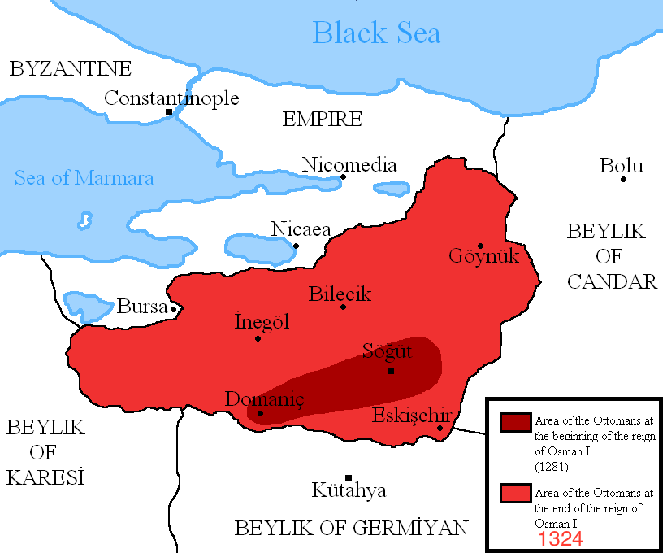
Osman (1281-1326)
Orhan (1326-1362)
Murad (1362-1389)

Slide 19
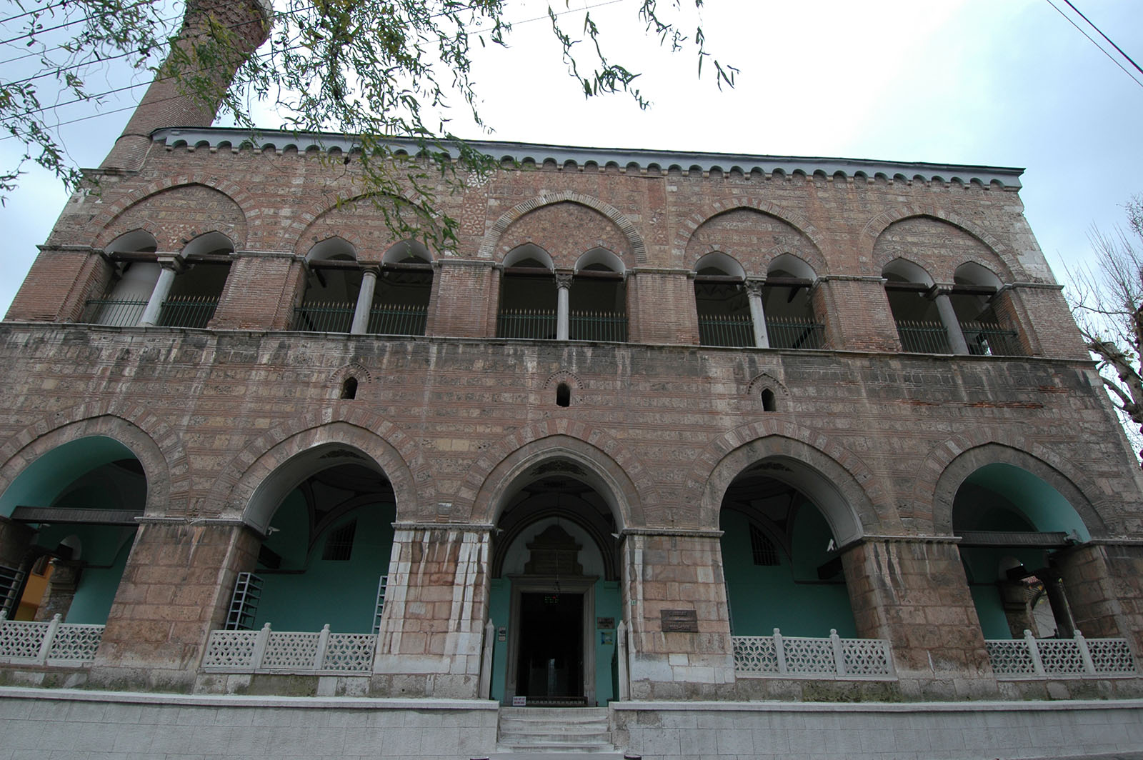
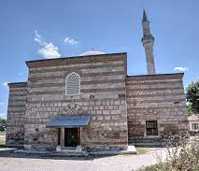
Hudavendigar Mosque
Notes:
These mosques were constructed in many places such as Bursa, Ayvacik, Bilecik, Yenisehir. It included a complex of buildings constructed around the mosque for public good.

Slide 20
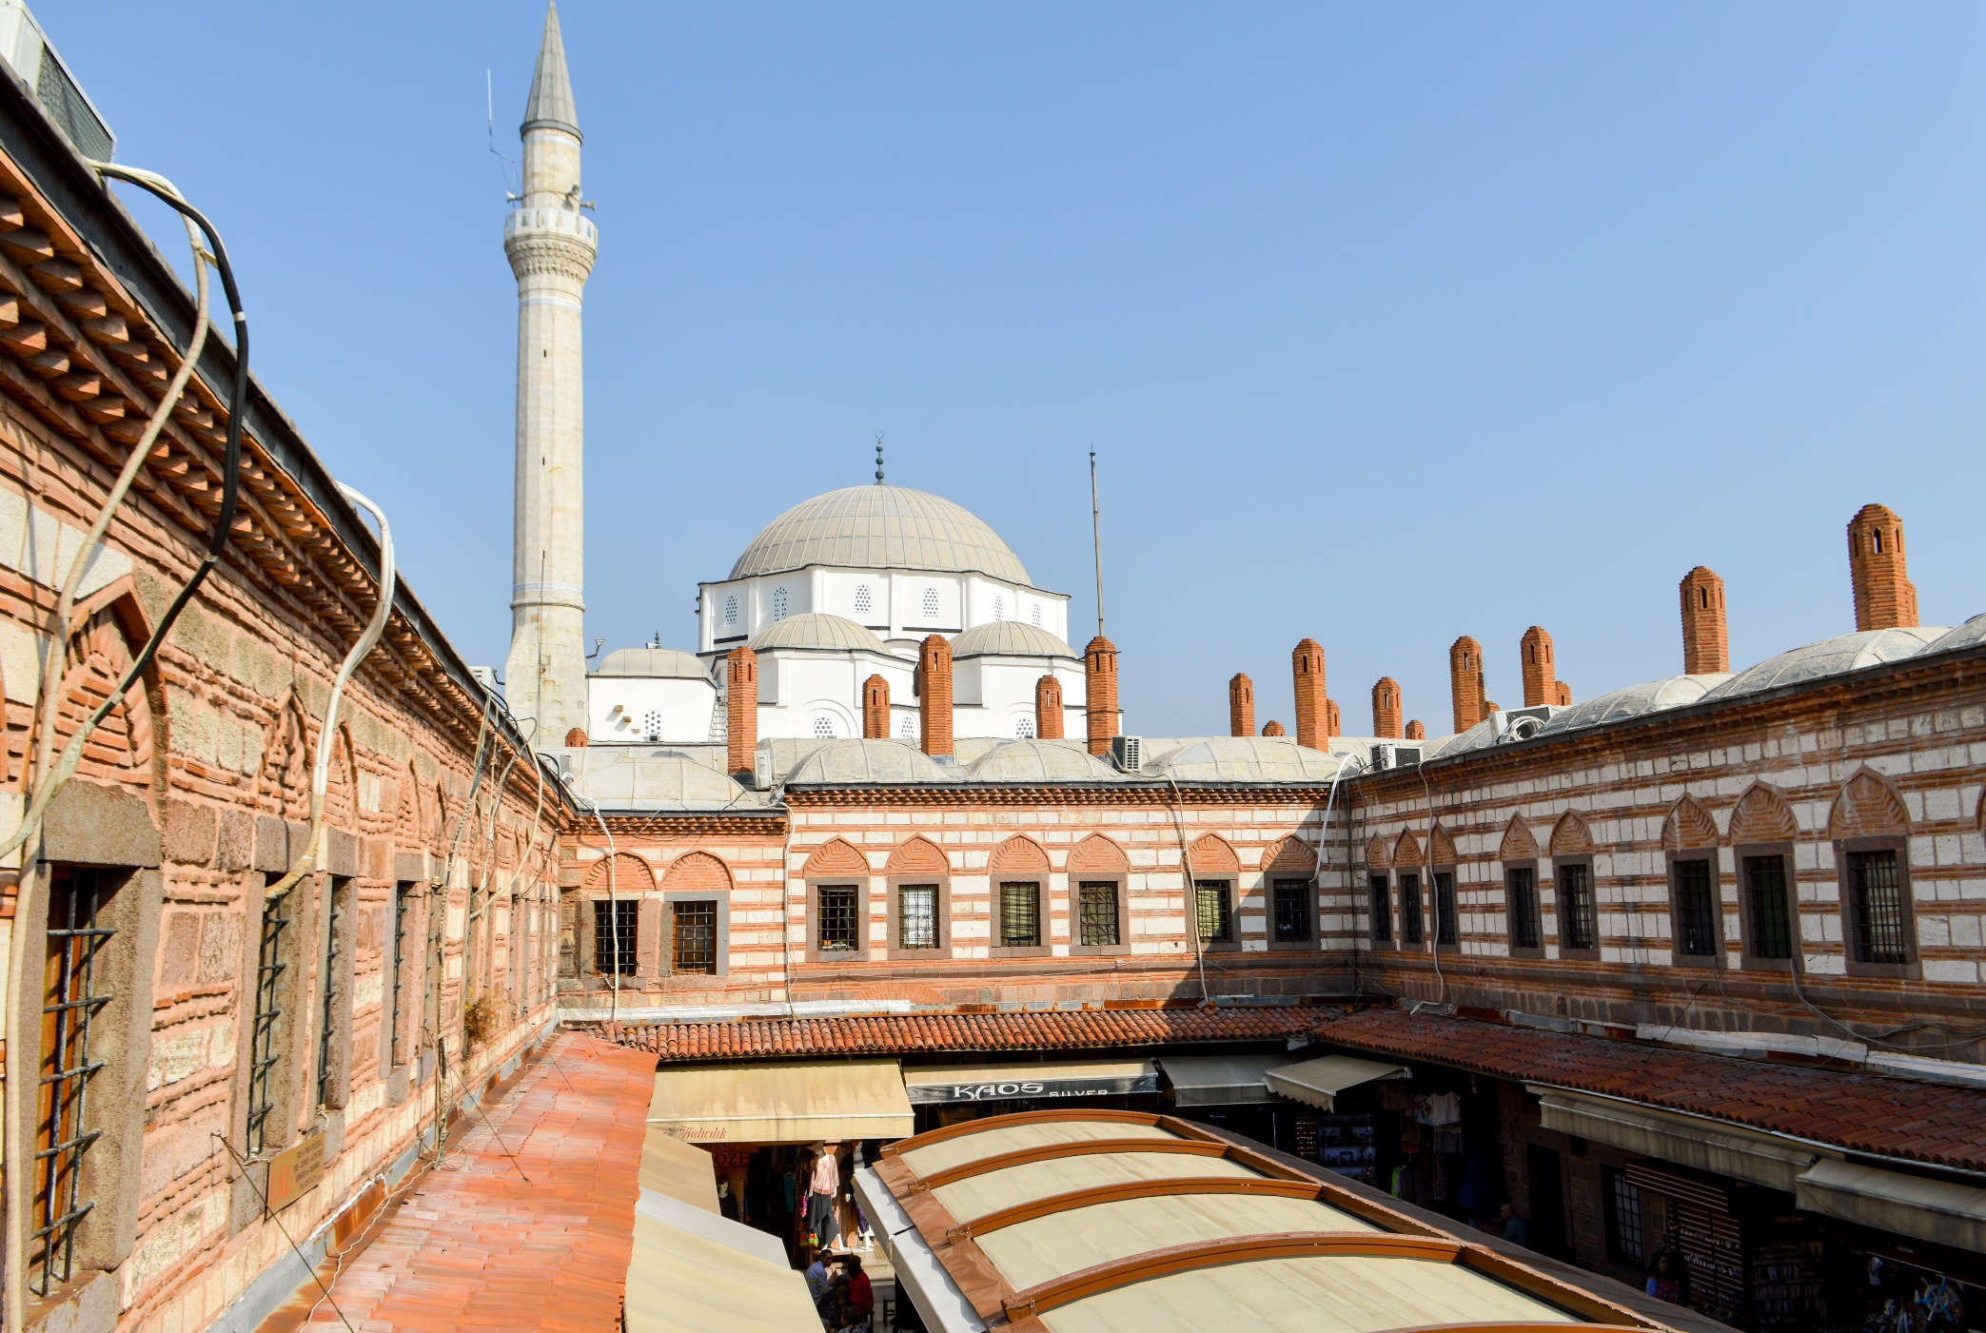
Hisar Mosque, Bursa

Slide 21
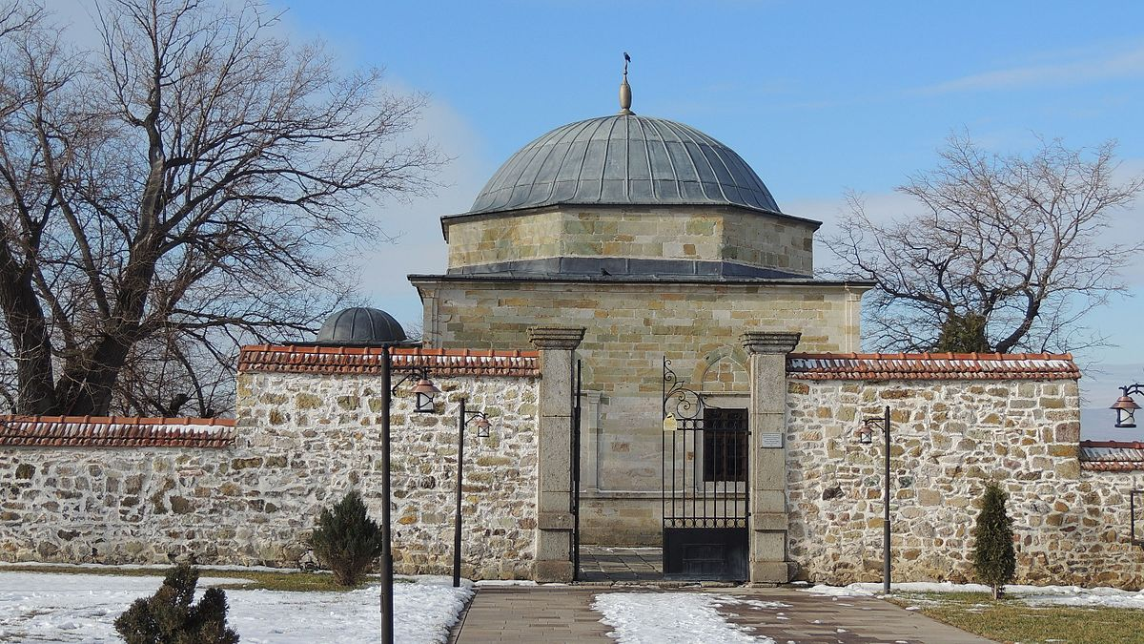
Tomb of Murad I in Kosovo
Notes:
After the Balkan wars (1912-1913), it lay in ruins and has been recently restored

Slide 22
Timelime
1326: Murad was born in Bursa to Nilufar Hatun and Orhan Bey.
1357: He began taking control of state affairs as Orhan's health declined.
1362: After Orhan's death, he ascended to the throne
1363: Murad recaptured Tzouroulos, Arkadiapolis, and Malgara.
1363: The Byzantine Empire signed a treaty recognizing Ottoman conquests in Thrace.
1364: Battle of Sirpsindigi, where Ottomans defeated a Crusader army.
1365: Edirne became the capital.
1366: Temporary loss of Gallipoli.
1371: Battle of Maritsa, where Ottomans defeated Bulgarian and Serbian forces.
1374: Sons Savci Bey rebelled.
1368: Bulgaria became a vassal state.
1373: Constantinople (Byzantine Empire) became a vassal state.
1382: Through marriage, Murad gained territory from Germiyanids.
1385: Sofia was conquered.
1386: Battle of Frenk Yazisi against Karamanids.
1389: Battle of Kosovo against Crusader armies, Murad was martyred at the age of 63 after ruling for 27 years; Bayezid I succeeded him.

Slide 23
Major Battles
Year | Name of Battle | Sultan | Against | Impact
1371 | Battle of Maritsa | Murad I | A coalition of Balkan states including Serbia, Bulgaria, and their allies. | The Ottoman victory at the Battle of Maritsa enabled them to further penetrate into the Balkans, marking a significant step in their expansion. It showcased the Ottoman military prowess and led to increased Ottoman influence in the region.
1389 | Battle of Kosovo | Murad I | The combined forces of the Serbian Kingdom and other Christian allies. | While Murad I was martyred after the battle, his successor, Bayezid I, continued the Ottoman expansion. The battle left both sides weakened, and while the Ottomans held the field, some say that they did not achieve a decisive victory. The battle is more renowned for its symbolism and the sacrifices made.

Slide 24
What was happening elsewhere (1360-1389)
1360: Treaty of Brétigny between England and France, pausing the Hundred Years' War.
1361: Second wave of the Black Death strikes Europe.
1368: Ming Dynasty founded in China, ending Mongol Yuan rule.
1369: Timur begins his military campaigns, founding the Timurid Empire.
1370: Timurid Empire formally established in Central Asia.
1373: England and Portugal form a lasting military alliance.
1375: Fall of the Armenian Kingdom of Cilicia to the Mamluks.
1380: Battle of Kulikovo – Russian forces defeat the Mongol-Tatar army, a step toward ending Mongol dominance in Russia.
1381: Peasants' Revolt in England, a major uprising due to socio-economic tensions.
1385: Portugal defeats Castile at the Battle of Aljubarrota, ensuring its independence.
1386: Treaty of Windsor strengthens Anglo-Portuguese relations.

Slide 25
Videos to Watch
Maritsa 1371 - End of the Serbian Empire
Ottoman Expansion in Anatolia – Frenkiyazisi 1387
Battle of Kosovo 1389 - Rise of Ottoman Empire
Battle of Kosovo 1389 - Serbian-Ottoman Wars

