Slide 1
The Ottoman Sultans of Edirne
Murad I and Bayezid I
(1362-1402)

Slide 2
Let’s Recap…
Notes:
Let’s Recap…

Slide 3
Timeline of Ertugrul, Osman, Orhan and Murad I
1237: Alaeddin Keyqubad I awards Ertugrul title of Ghazi and Karacadag, Sogut, Domanic
1285-88: Osman conquers Kulaca Hisar, Karaca Hisar, Bilekoma and Melangia, which is renamed Yenisehir, the new capital
1326: Orhan comes to power, Bursa is taken, becomes new capital
1329-37: Conquest of Nicaea, Gemlik, Nicomedia.
1345: Annexation of the Karasids' lands.
1352-54: Ottoman expansion into Thrace: Battle of Demotika against Serbians and Bulgarias, Capture of Gallipoli.
1360: Orhan dies, and his son Murad I ascends to the throne.
1363: Murad takes Tzouroulos, Arkadiapolis, Malgara; Byzantines recognize conquests 1364-65: Battle of Sirpsindigi: Ottomans defeated a Crusader army; Edirne became capital.
1371: Battle of Maritsa, where Ottomans defeated Bulgarian and Serbian forces.
1368-73: Bulgaria and Constantinople (Byzantine Empire) became a vassal state
1382: Murad gained territory from Germiyanids and Karamanids.
1389: Battle of Kosovo against Crusader armies, Murad was martyred at the age of 63 after ruling for 27 years; Bayezid I succeeded him.

Slide 4
Challenges and Conflict
Bayezid I (r1389–1402)

Slide 5
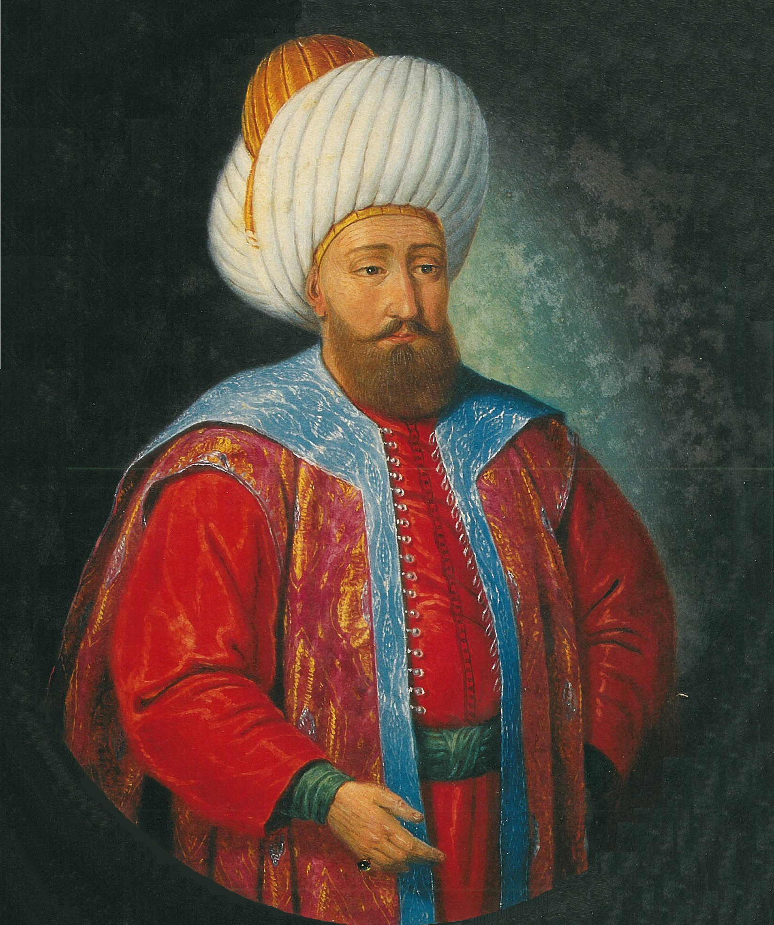

Slide 6
Bayezid I (r1389–1402)
(Abu Yazid) Bayezid was a brave, fierce, smart and efficient commander, he had perfect conduct, was a just ruler and a man of good repute
He welcomed the devoted and the devout, and honored scholars, supporting them financially
He was Murad’s eldest son and was born around 1360; from the age of five years he received training in Islamic and administrative education
As a teenager he was assigned governorship of Kutayha (Germiyanid lands which the received from his father in law – Suleyman Celebi) and joined his father’s campaigns (Battle of Frank Yazisi, Battle of Kosovo)
Bayezid came to power after the Battle of Kosovo in 1389 at the age of 35
He was called Yildirim which means Thunderbolt, due to the speed of his assaults
After the victory in Nicopolis, he was also given the title of Sultan i Rum by Abbasid Caliph Mutawakkil, now based in Egypt
Bayezid had a very brazen character, he did not shy away from punishing those who received bribe or committed injustices
He doubled the size of the state before the Battle of Ankara
Notes:
Mother was Gulcicek Hatun
He wrote to the Emperor of Constantinople about the affairs of Muslims in Constantinople – A Qadi/Masjid was set up
He gets his name from Sheikh Edebali who was also called Abu Yazid

Slide 7
Unifying Anatolia
After the Battle of Kosovo in 1389, he received the submission of the Serbians, as the King of Serbia (Lazar Hrebeljanović) had been killed in the battle; Bayezid appointed Lazar’s son (Stefan Lazarević) who was his brother in law (Olivera Despina’s brother) as the ruler of Serbia
He returned back to Anatolia as the beys had risen up in revolt; he wanted to unify Anatolia
In two campaigns from 1389 to 1390, he overran the Beyliks of Aydin, Sarukhan, Hamid, Metese, Germiyan, Candarids and Teke in Anatolia while also taking Philadelphia (Alasehir) from the Byzantines
1391: City of Konya was taken from the Karamanids and they accepted his proposal for peace; soon he had taken almost all Karamanid lands (Battle of Akcay in 1397)
In one of the battles with Qazi Ahmad Burhan Ad Din, the lord of Eretnids, the Ottomans were defeated and one of Bayezid’s sons, Prince Ertugrul was martyred. Burhan Ad Din was later killed and his lands were taken; Candars were defeated in 1392
Bayezid quickly took cities such as Kastamonu (Isfendiyarids), Samsun (Kubadoglu Cuneyd Bey)
Cities such as Amasya and Sivas invited Bayezid and he also took Tokat, Kayseri, Kirsehir, Aksaray
Dulkadirid and Mamluk cities such as Elbistan, Malayta, Behisni, Hisni Mansur, Kahta and Divrigi submitted to the Ottomans
Bayezid now controlled more regions along the Black Sea and as far as Malayta and Erzurum to the East
Anatolia was now under one single ruler
Due to the peace, Muslims, Jews and Christians in Anatolia prospered
Notes:
Fatwas permitted him to fight against fellow Muslims
Jews and Christians were not relegated as being second class citizens and privileges were given to non Muslim citizens. They were invited to Islam and many converted sincerely or for more benefits.

Slide 8
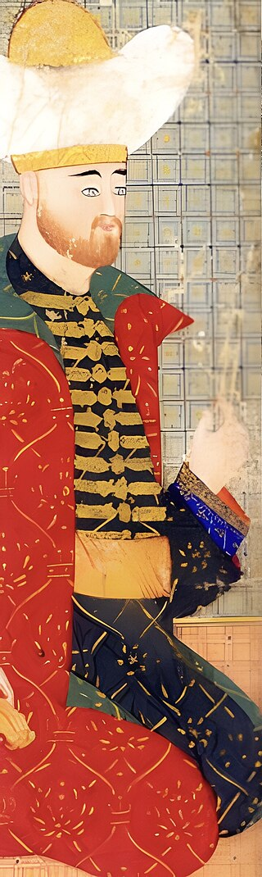
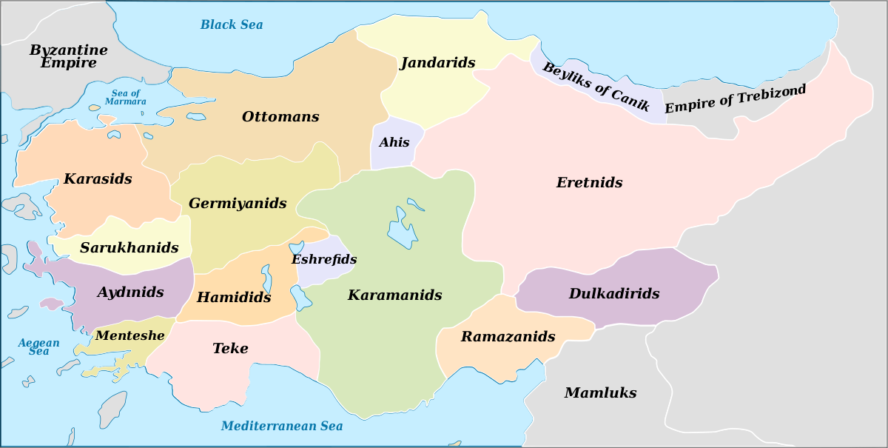
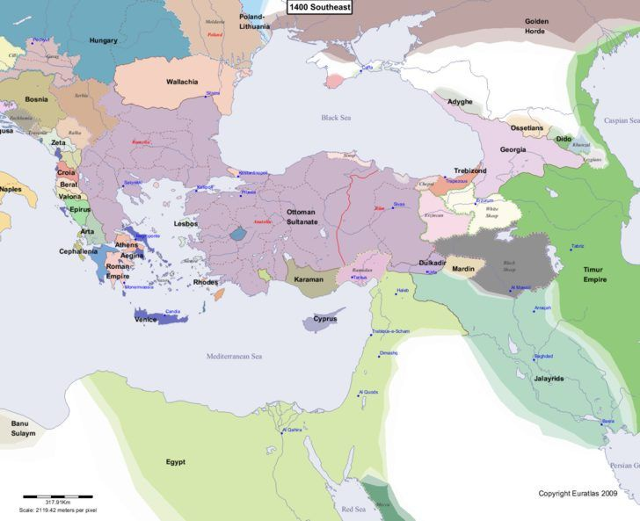
Unifying Anatolia
1300
1400

Slide 9
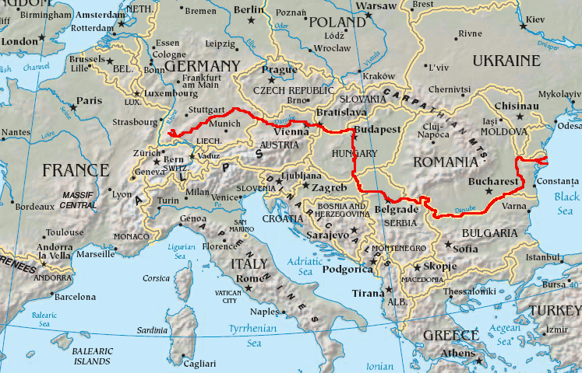
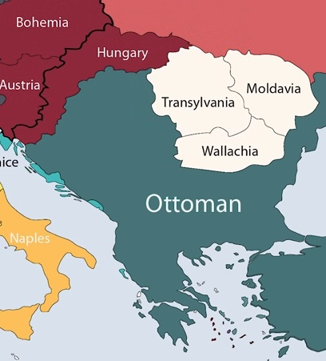
Further into Europe
While Bayezid was in Anatolia, his representatives in Rumelia conquered Skopje (Uskup) in 1391 and entered Wallachia
Bayezid was the first Ottoman Sultan to besiege Constantinople in 1391, when Manouel II Palaiglogos refused Bayezid’s conditions.
A long bloackade was planned, but the city failed to fall, though he tried four times
Constant attacks by Hungarians in 1393 forced Bayezid to lift the siege and return to Rumelia
After defeating the Hungarians, he continued to advance into Greece and Albania and retook Salonika
Soon Kruje (Akcasehir) and Scutary (Iskenderiye) in Albania also fell to the Ottomans, followed by Tarnova in 1393
In 1395 he defeated the ruler of Walachia Mircea the Elder and installed Vlad I
He then entered Nicopolis, where he had the Bulgarian TsarIvan Shishman executed
Notes:
He wrote to the Emperor of Constantinople about the affairs of Muslims in Constantinople – A Qadi/Masjid was set up
The Ottomans set siege to Constantinople when the Byzantine emperor refused his conditions

Slide 10
1396 Battle of Nicopolis (Third Crusade)
Pope Boniface IX called for a new crusade, against Ottomans to stop the advance into Europe
European propaganda machine: Terrible turks, infidels, heathens, demon worshippers
Crusader army started marching along the Danube towards Ottoman held territories
The army was composed of Hungarians, Croatians, Byzantines, French, Germans, Burgundians, Wallachians, Bohemians, Genoese and Swiss troops; They pillaged and destroyed every settlement
The Hungarian king Sigismund blockaded Nicopolis, but the crusader army faced poor planning, infighting, jealousy, disobedience, over-confidence, arrogance
They made ladders not catapults, trebuchet and battering rams; They did not protect their rear
Bayezid had gathered his forces – elite Janissaries, provincial troops, Turkmen horsemen, 1500 heavy cavalry (knights from Serbia), their strength was half of the crusader army
He rushed back from Istanbul, met the Crusaders outside Nicopolis and sealed them in
The Crusader army were very heavily armored, while the Ottoman army wasn’t. They were also twice the size of the Ottoman army
The Crusader army was over confident and a French commander led the vanguard of French knights in the first charge, they just went ahead ahead without a plan
The Ottomans were disciplined, Janissaries in the front, light cavalry on the flanks; the crusader army were quickly surrounded and overwhelmed; Many jumped into the Danube to escape, but drowned due to the heavy armour; Other knights were held for ransom
Notes:
Battle of Sirpsindigi: first crusade
Battle of Maritsa: second crusade
Battle of Nicopolis: third crusade
Pope Boniface IX called for a new crusade, not for Jerusalem which was with the Mamluks, but simply against the Ottomans so that they could stop their advance into Europe
At the same time, literature started coming out from Europe about the “Terrible Turks” – that they were infidels, heathens, monsters, demon worshippers
The idea was to rile up the nations against the Turks so they would go join the ‘holy war’
Crusaders were not really saintly or noble warriors, and maybe they were defeated as they committed many unholy acts on the way.
One of the things they did was massacring innocent Muslims whom they had taken as prisoners before the war. Due to this, Bayezid ordered many of the crusaders to be killed.
The Battle of Nicopolis completely crushed the European unity and they were not keen to send troops again
Bayezid tightened his control over the Balkans further and even greater pressure was on the Romans in Constantinople who were sandwiched between the Ottomans
Bayezid tried to besiege Constantinople, but was forced to withdraw due to a new threat from the East
6 hours? If you drive from Constantinople to Nicopolis: 7.5 hrs (The gallop averages 40 to 48 kilometres per hour)
Conditions: establishment of a Turkish quarter, construction of a mosque, assignment of a Muslim judge in Constantinople

Slide 11
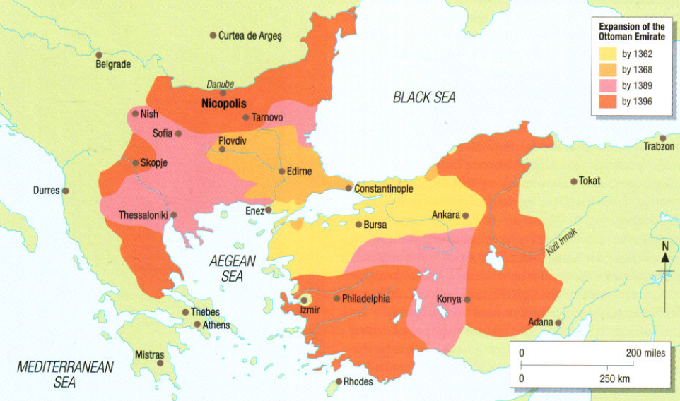

Slide 12
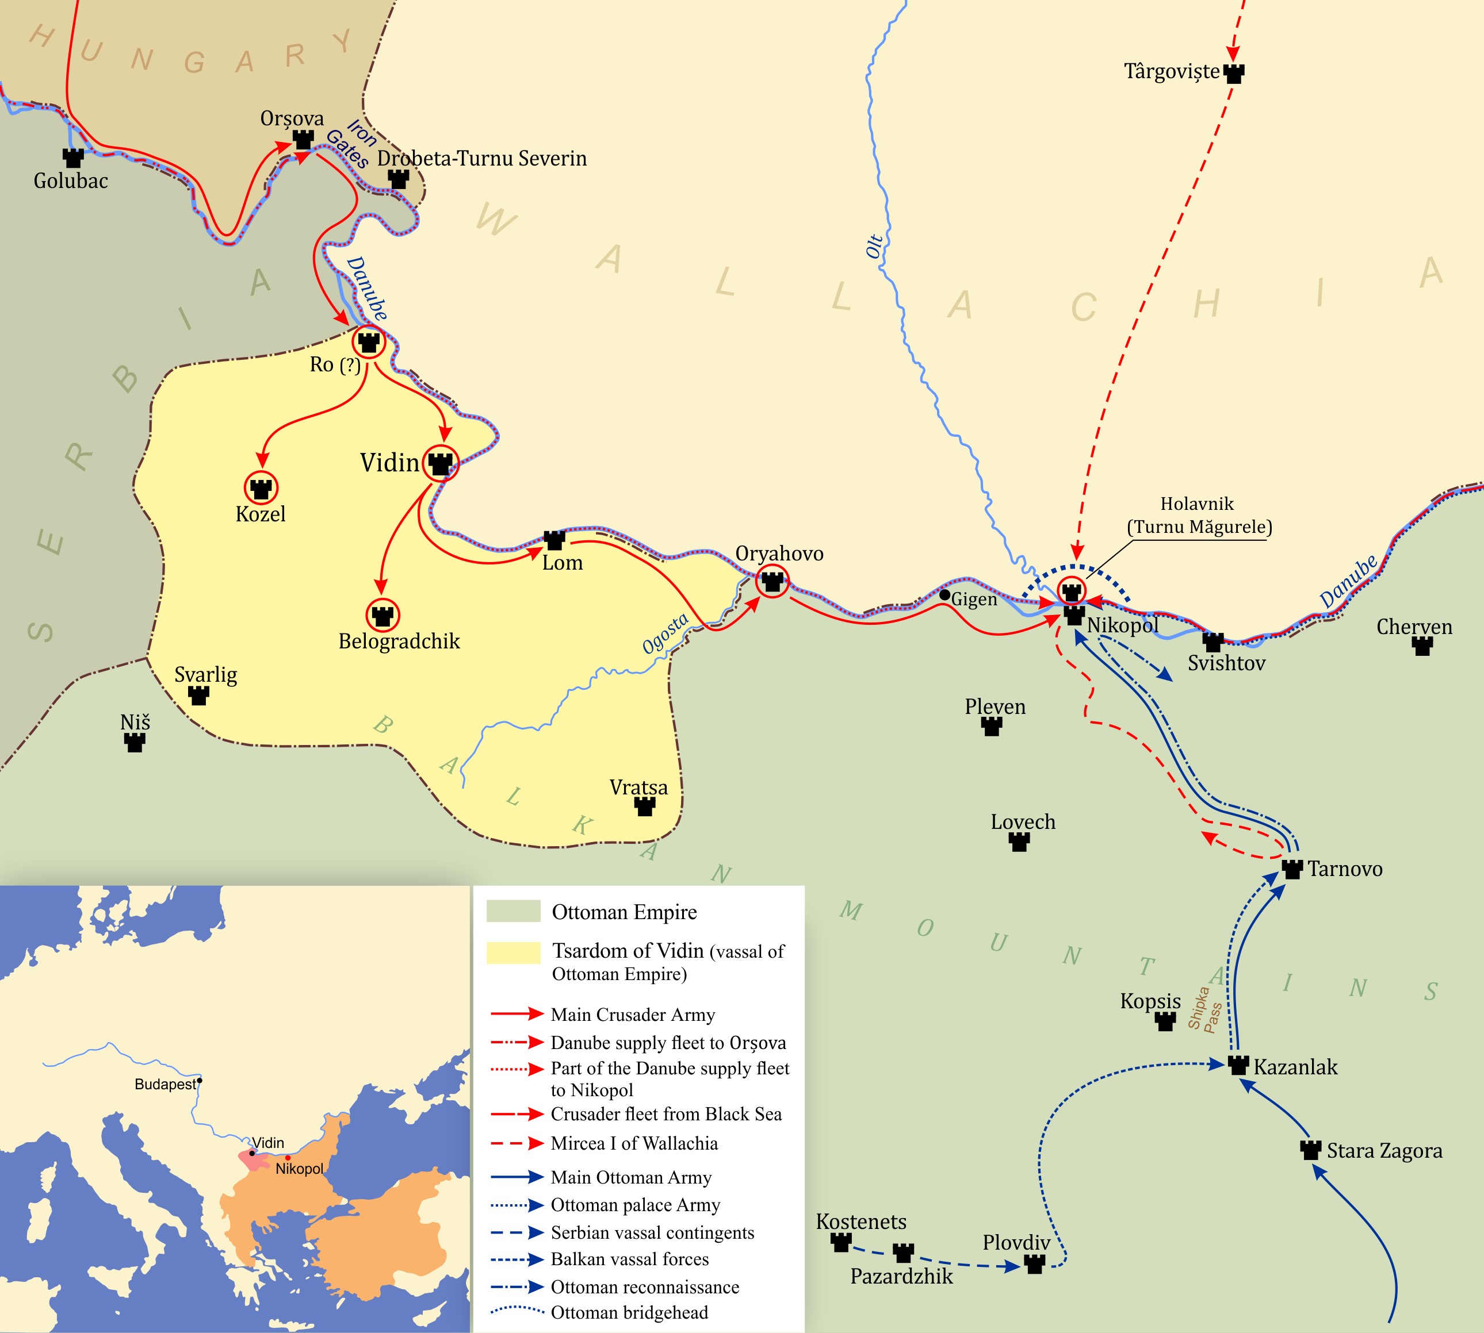
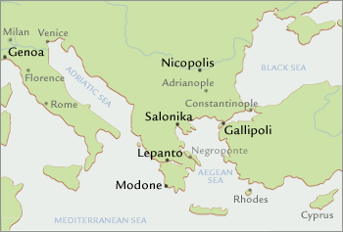

Slide 13
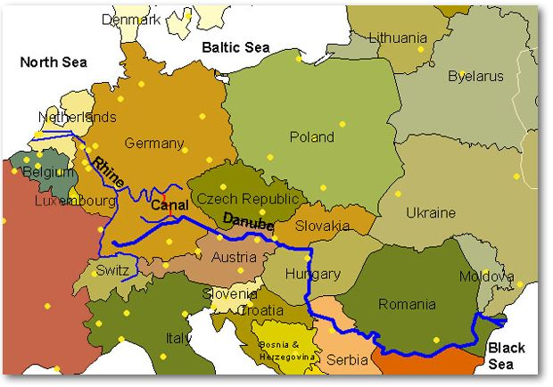
Danube River
Notes:
Map of danube river – it cuts through Hungary, Austria, Vienna

Slide 15
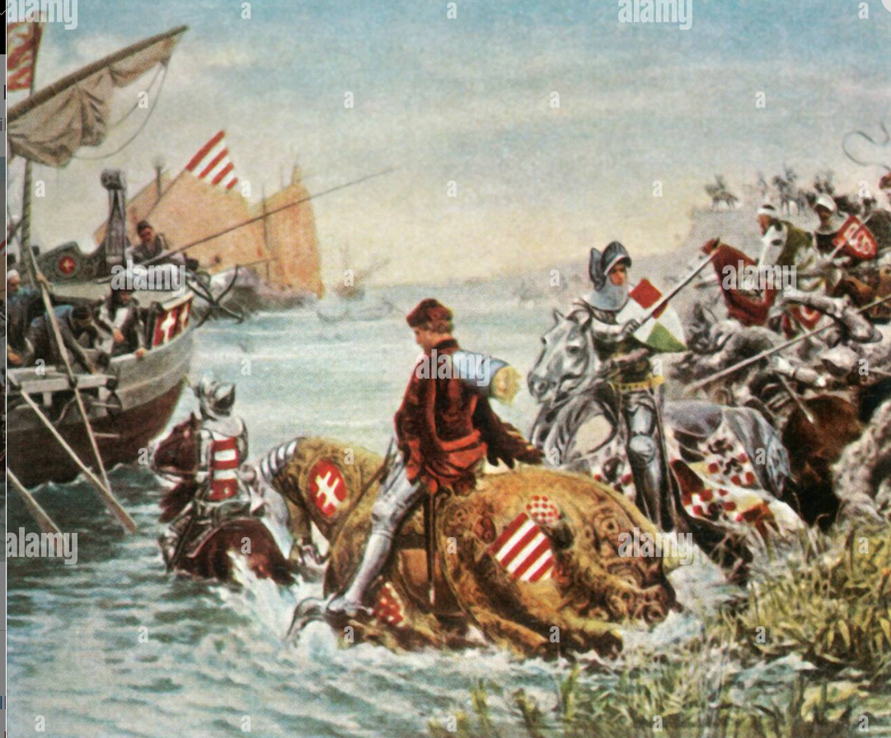
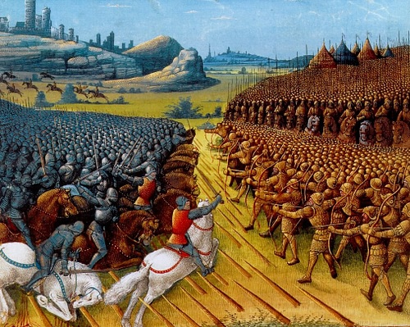

Slide 16
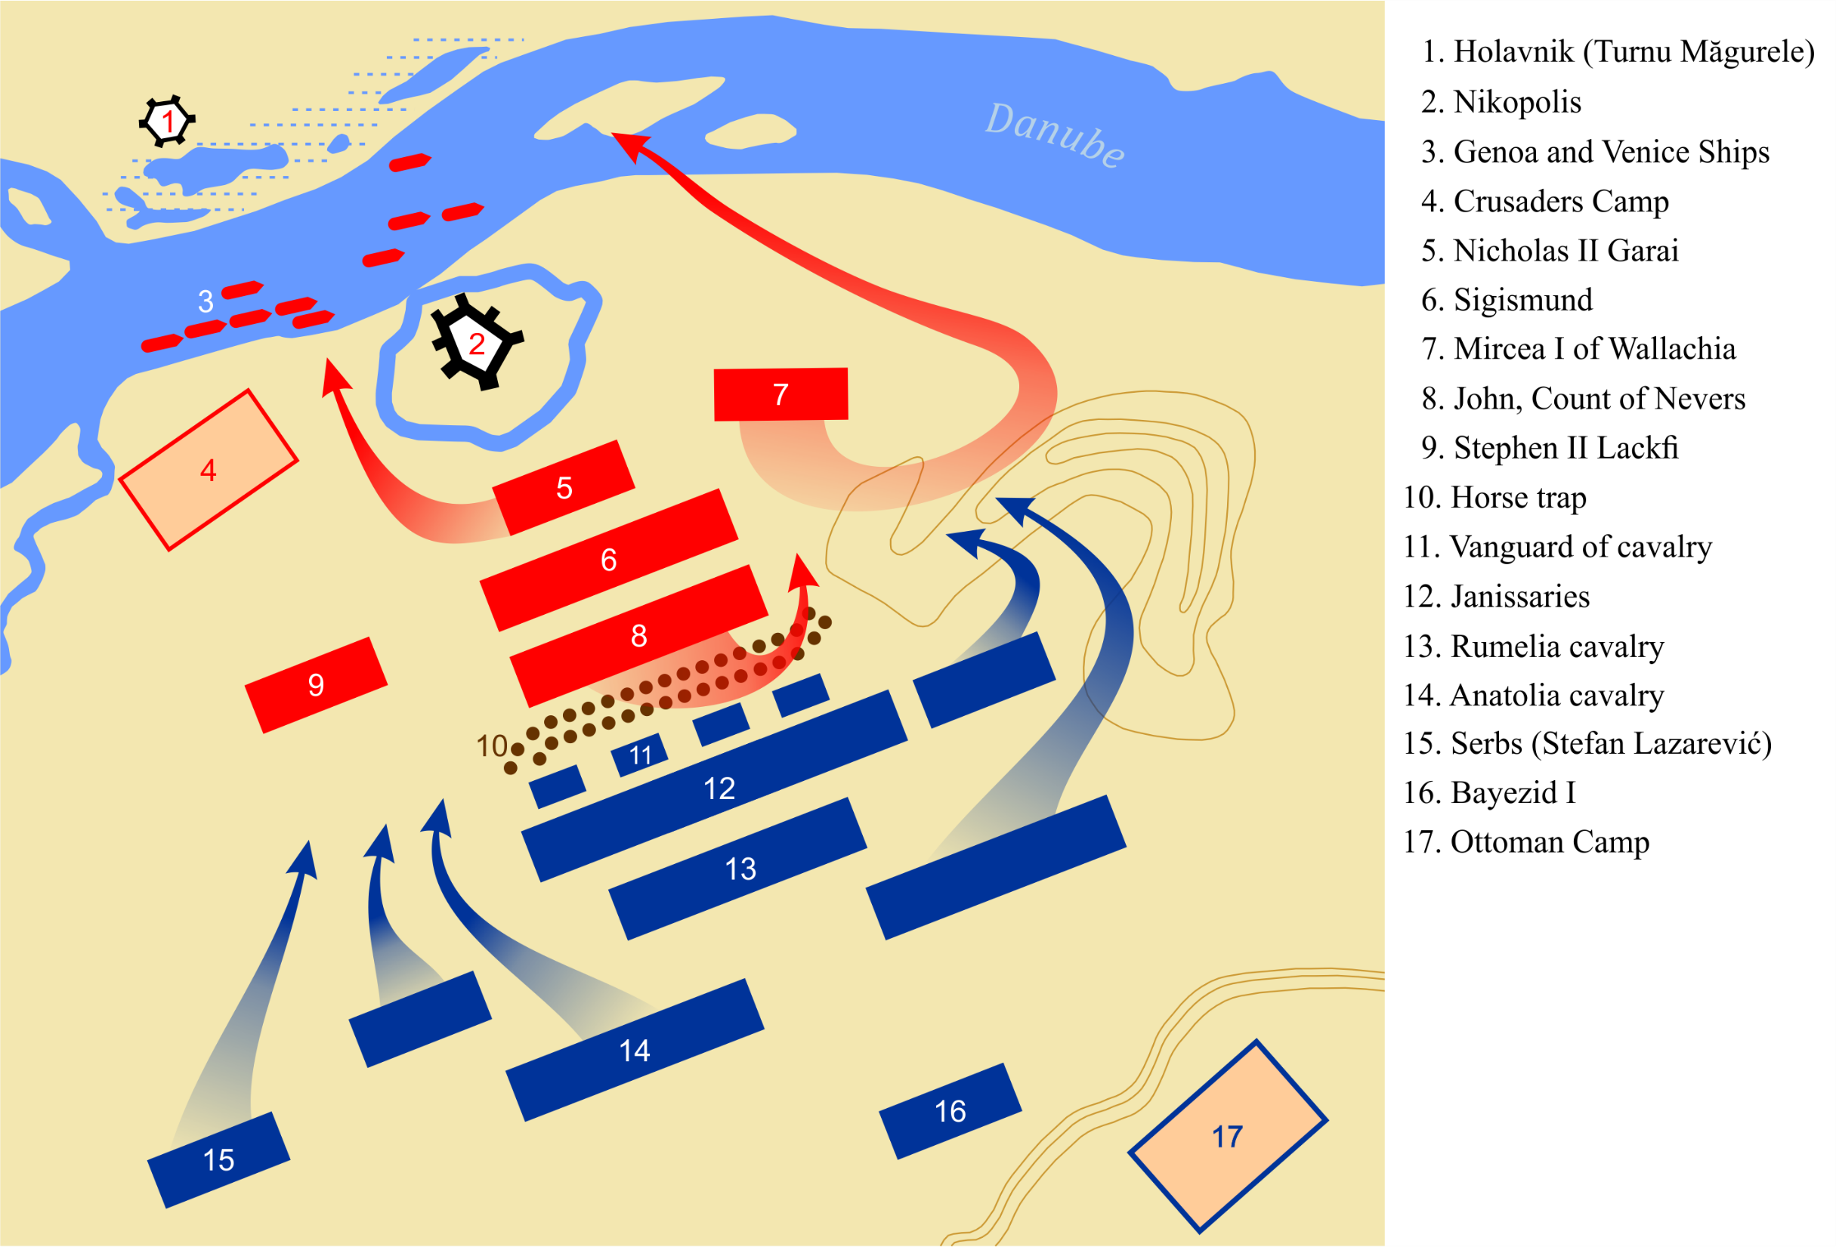

Slide 17
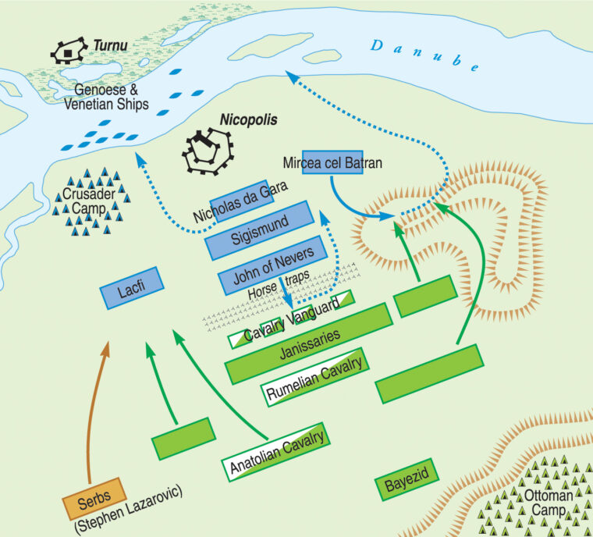

Slide 19
After the Battle of Nicopolis
The European unity was completely crushed, they were not keen to send troops again.
Bayezid’s conditions were accepted by Byzantine Emperor Manuel
  Establishment of a Turkish quarter in Constantinople
  Construction of a mosque
  Assignment of a Muslim judge in Constantinople
He took Vidin on the southern bank of the Danube, Athens was added to Ottoman lands
Bayezid tried to besiege Constantinople again…
But a new threat emerged in Anatolia…
?

Slide 20
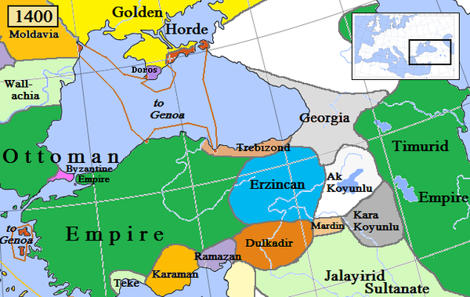

Slide 21
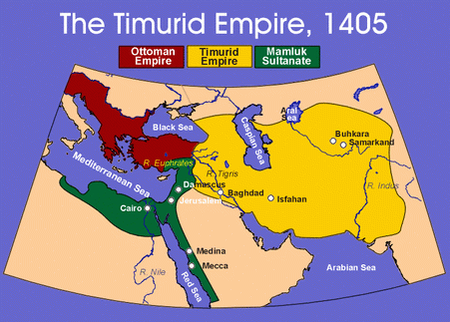

Slide 22
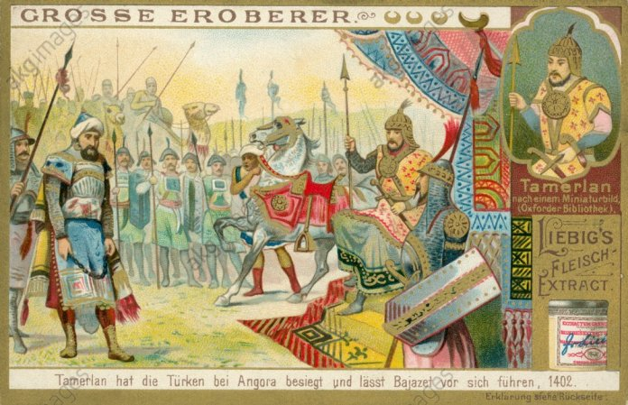
Why did Tamerlane attack the Ottomans?
Desire for Power and Territory
Rivalry and Competition
Prestige and Reputation
Defiance and Disrespect
Religious Justification
Opportunistic Timing
Battle of Ankara
Notes:
Desire for Power and Territory: Tamerlane was a conqueror who aimed to expand his empire's territory. The Ottoman Empire, under Bayezid's rule, was a growing power that controlled significant territories in Anatolia, the Balkans, and the Middle East. Tamerlane's ambition for territorial expansion likely played a significant role in his decision to attack the Ottomans.
Rivalry and Competition: Tamerlane and Bayezid were both ambitious rulers with expansive ambitions. This led to a rivalry for dominance in the region. Tamerlane saw Bayezid as a potential threat and competitor, which contributed to the tense relations between the two empires.
Prestige and Reputation: Tamerlane was known for his military conquests and his desire to establish a legacy as a great conqueror. Defeating a powerful ruler like Bayezid would have added to Tamerlane's prestige and reputation as a formidable military leader.
Defiance and Disrespect: There were instances of perceived defiance and disrespect between Tamerlane and Bayezid. Bayezid allegedly imprisoned Tamerlane's envoys and questioned Tamerlane's legitimacy as a ruler. These actions may have fueled Tamerlane's desire to assert his authority and seek retribution.
Religious Justification: Tamerlane often used religious rhetoric to justify his military campaigns. He portrayed himself as a defender of Islam and claimed that he was fighting against non-Muslim rulers. Bayezid was a Sunni Muslim ruler, and Tamerlane may have used this religious narrative to gain support and legitimacy for his attack.
Opportunistic Timing: Bayezid was engaged in conflicts in Europe and Anatolia when Tamerlane launched his attack. Tamerlane might have viewed this as an opportune moment to strike while Bayezid was preoccupied.

Slide 23
Bayezid and Tamerlane
Bayezid came to the attention of Timur, the founder and leader of the Chagatai Timurids
Tamerlane regarded himself as the heir of the Seljuks and Ilkhanids, wanted to occupy the whole of Anatolia, but he hesitated to fight Bayezid who fought in the name of Allah
One of the towns in Anatolia that Bayezid took over was governed by Timur’s officers; Bayezid asked for tribute, and Timur responded by invading Anatolia with his armies
Also, some notables* who had challenged Bayezid took refuse with Tamerlane and some who had opposed Tamerlane asked for Bayezid’s protection
It is reported that Bayezid did send a delegation to apologize and make peace, but this did not make a difference to Timur; he had already been fighting against Muslims – Uzbeks, Mamluks
The invasion and plundering of Sivas by Tamerlane in 1400, capturing of Malayta, and the exchange of harsh letters between the two rulers eventually brought the two states face to face against each other
*Jalayir Sultan Ahmad and Qara Qoyunlu lord, Qara Yusuf sought refuge with the Ottomans when Timur seized Baghdad and continued west
*Lords of the beyliks that Ottomans had conquered took refuge with Timur
*Lord of the Erzincan beylic, Mutahhareten, who paid the Ottoman’s tribute, came under Timur’s protection and caused further trouble between Ottomans and Timur
Notes:
It was also reported that Bayezid was sheltering one of Timur’s enemies
It is also reported that Tamerlane in a polite manner sent a letter to Bayezid to release those beys and that Bayezid submit to his rule. And then he would helo the Ottomans against the non-Muslims.
Timur addressed Bayezid as Kaiser, The Sovereign of Anatolia, Bayezid replied O the fierce dof name Tamerlane who is more unbelieving than the Tekfurs, Bayezid seemed over confident to Timur and a lesson needed to be taught to him.

Slide 24
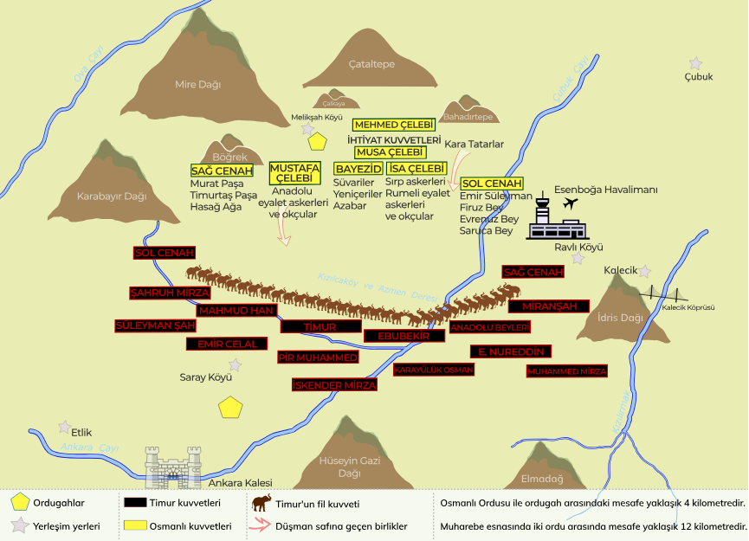
1402: Battle of Ankara
On 20th July 1402, the two armies faced each other on the plains outside Ankara
Timur’s army arrived first and was able to rest and take control of the water resources
The Timurid army was 120,000 strong, composed of cavalry (war horses) and 32 war elephants
The Ottoman army was 85,000 strong which included Janissaries and vassal troops
There was a rain of arrows from the Timurid horse archers; the Ottomans were not heavily armoured; only the Serbian knights with heavy armour were able to escape
Some of the Qarai Tatars in the army defected to Timur’s side and some of Bayezid’s forces including some of his sons retreated
Bayezid refused to withdraw, was captured, imprisoned and would later die in captivity (1403) at the age of 49
Notes:
Some reports say Timur’s army was 135000 strong and had veterans from campaigns in India, Iran and Syria
There are differing viewpoints about how he was treated when in captivity; some say he was treated well, but he died at a young age which leads others to think that he probably wasn’t. Some say he drank poison. It is reported that Timur cried when he died.
When Mehmed Celebi tried to rescue his father, the security was increased and he was placed in a dungeon.
Musa Celebi who was also captured was released and he brought his father’s corpse to Bursa where he was buried in the mosque he had commissioned.
Some say he died of several diseases caused by deep grief – severe malaria, asthma
Absolute slander to attribute the sin of suicide to such a religious sultan

Slide 25
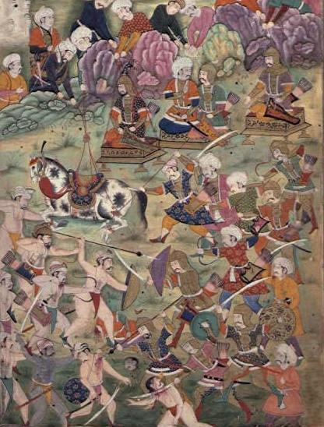

Slide 26
The Impact of the Battle of Ankara
Sultan Bayezid was captured, and this led to internal strife and confusion regarding the succession to the throne
This weakened the unity of the Ottoman state and contributed to a fragmentation of power, this period is known as the Interregnum Era (10 years)
A power vacuum was created in the region, allowing other neighboring states and factions to challenge Ottoman dominance and expand their own influence
The Ottoman trajectory of territorial expansion in Europe and Asia Minor, was temporarily halted and retreated all the way back to the borders drawn by Murad I
The reputation of Timur (d. 1406) as a fearsome conqueror and military strategist was boosted, they took Bursa, sacked Anatolia but didn’t expand into other Ottoman lands
He had devastated the land and ceded it back to the Anatolian beyliks and three of Bayezid’s sons were given charge of the areas where they lived
Ottomans sought to regroup and stabilize their empire; period of introspection led to reforms and changes in governance, and reevaluation of strategies for dealing with external threats
While the Ottomans faced significant challenges after the battle, they eventually managed to overcome internal divisions and regain their strength
Notes:
The Battle of Ankara, also known as the Battle of Angora, took place on July 20, 1402, between the Ottoman Empire and the Timurid Empire, led by the Central Asian conqueror Timur (Tamerlane). This battle had a significant impact on the Ottoman Empire and the wider region. Here are some key effects of the Battle of Ankara:
Capture of Sultan Bayezid I: The most immediate impact of the battle was the capture of Ottoman Sultan Bayezid I by Timur's forces. This was a major blow to the Ottoman Empire, as it led to a period of internal strife and confusion regarding the succession to the throne.
Division of the Ottoman Empire: Following Bayezid I's capture, his sons fought among themselves for control of the empire. This internal conflict weakened the unity of the Ottoman state and contributed to a fragmentation of power.
Regional Instability: The defeat at Ankara and the subsequent power struggle within the Ottoman Empire created a power vacuum in the region. This instability allowed other neighboring states and factions to challenge Ottoman dominance and expand their own influence.
Temporary Decline of Ottoman Expansion: The Ottomans, who had been on a trajectory of territorial expansion in Europe and Asia Minor, were temporarily halted in their expansion efforts due to the chaos caused by the defeat and the internal strife.
Timurid Influence: The Battle of Ankara bolstered the reputation of Timur as a fearsome conqueror and military strategist. While Timur did not seek to annex Ottoman territories, his victory had an impact on the political dynamics of the region and influenced the balance of power.
Redirection of Ottoman Policies: In the aftermath of the battle, the Ottomans sought to regroup and stabilize their empire. This period of introspection led to some reforms and changes in governance, as well as a reevaluation of their strategies for dealing with external threats.
Resurgence of the Ottoman Empire: While the Ottomans faced significant challenges after the battle, they eventually managed to overcome internal divisions and regain their strength. Under the leadership of Mehmed I, the Ottomans managed to reunify the empire and continue their expansionist policies.
In the long term, the Ottoman Empire recovered from the setback at the Battle of Ankara and went on to become one of the most powerful and enduring empires in history. However, the battle's impact was significant at the time, leading to a period of upheaval and reshaping the geopolitical landscape of the region.
• Some mention that fratricide became common after the Ottoman 20yr civil war to avoid internal feuds

Slide 27
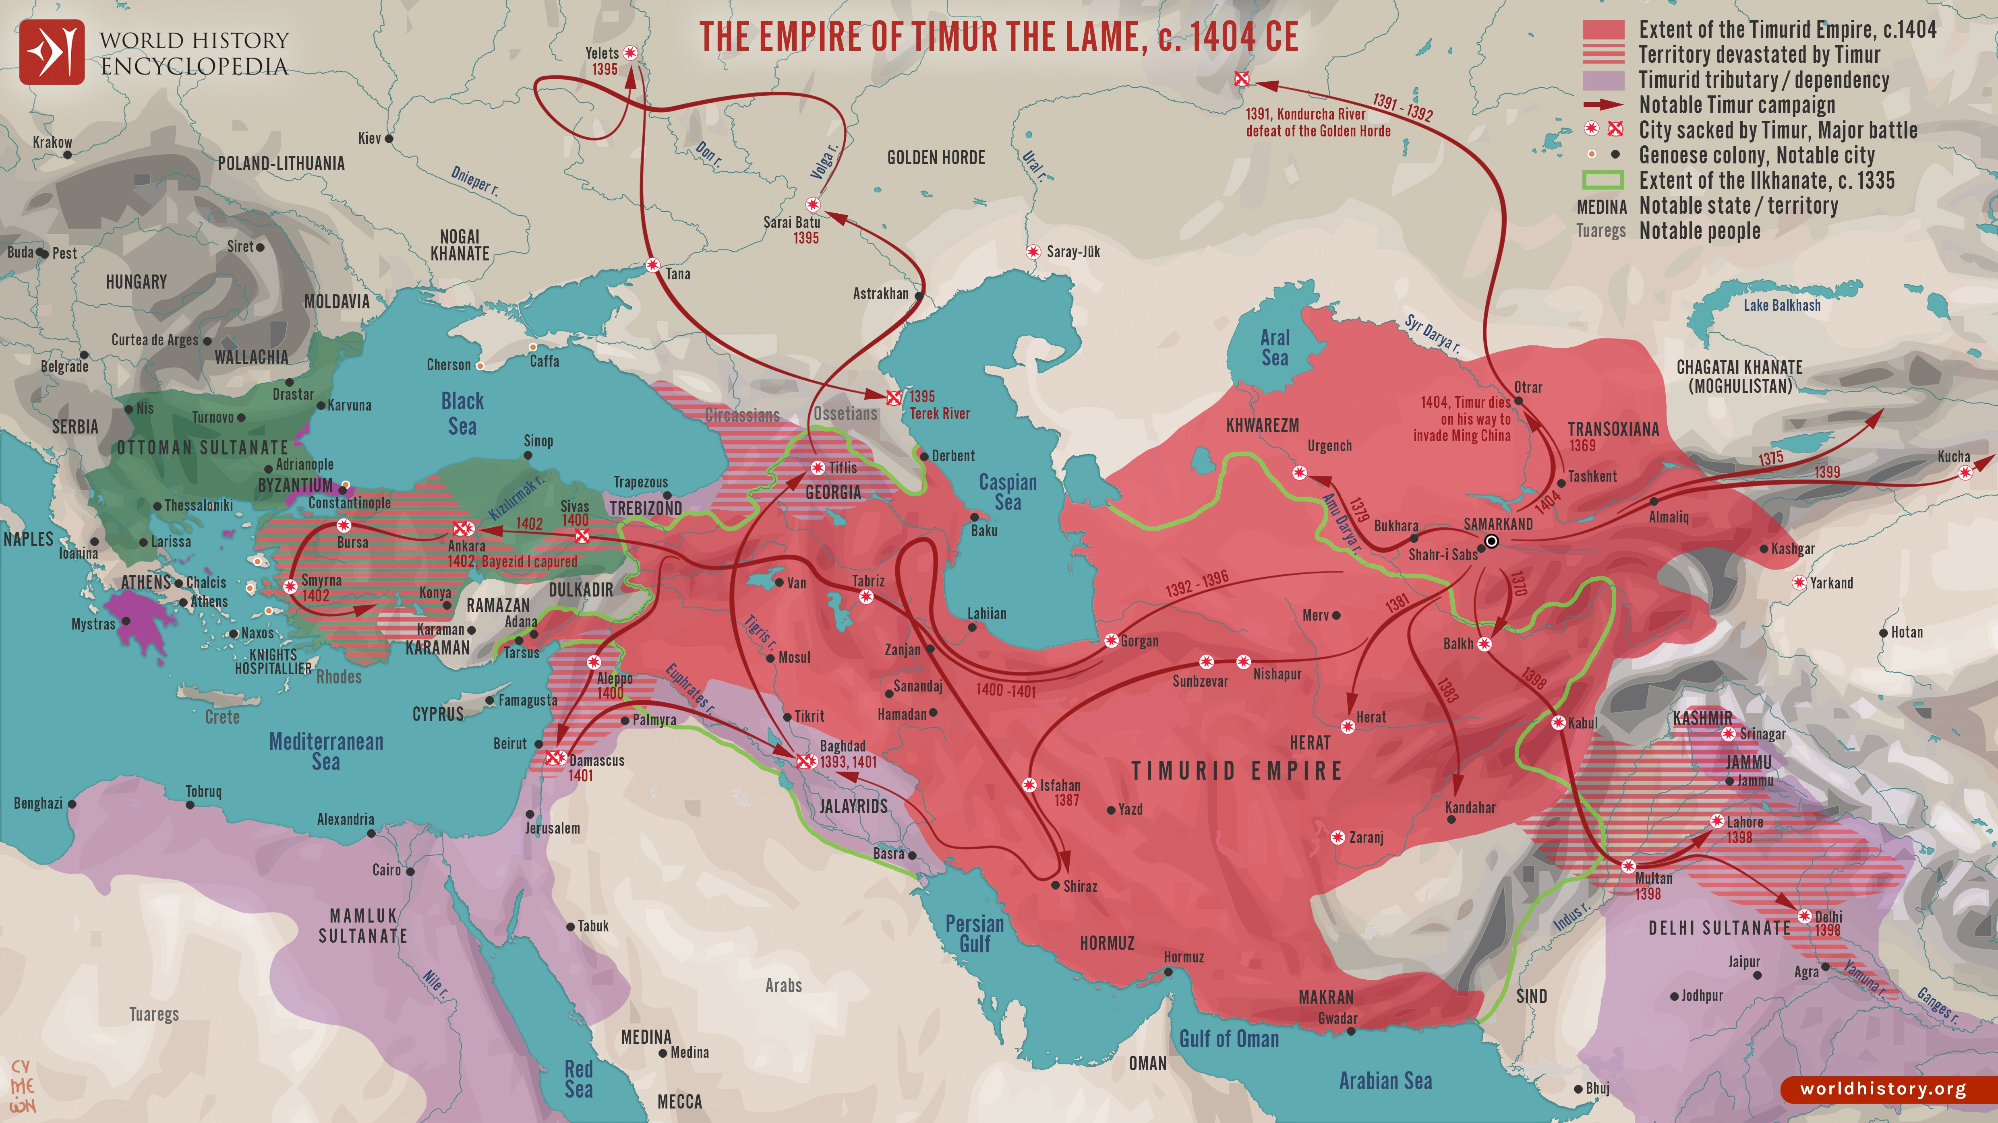

Slide 28
Bayezid’s Reign
1400
1405

Slide 29
Bayezid’s Legacy
Construction projects
  He constructed numerous dervish lodges, medreses, almshouses, and travelers and medical hospices
  He built the Ulu Camii (the Grand Mosque) in Bursa in 1400, a prestigious exhibition of a distinct Ottoman calligraphy
  Guzelhisar – Anatolian Fortress
Bayezid wanted to create a centralized empire from the state that his father Murad had formed through vassalages in Anatolia and Rumelia
A central bureaucracy was designed and developed based on Islamic principles
Bayezid’s reign was also a remarkable period for the development of Ottoman seafaring
Tradition of the annual procession with the imperial gifts to meet the needs of the Haramain and to pay the salaries of the officials there
Clarification about the allegation that Bayezid consumed alcohol
  After he got married to Maria Despina, daughter of King of Serbia, he consumed alcohol for some time, could be a plot to weaken him
  He soon repented and built the Ulu Jami (Grand Mosque) in Bursa
  People trying to find fault in his laxity in religious, political or financial affairs
Notes:
Ottoman historians say that the defeat at Ankara was a punishment as he would mistreat the community of Islamic scholars and other influential groups due to his centralist policies.
Previous Ottoman sultans expanded gradually and did not invade lands of other Anatolian beys unless the conditions were favorable or they did not have a choice
Hostility to fellow Muslim beyliks damaged their reputation of being gazis or fighters of holy war
This also caused a rift with he Mamluks and got Timur to march on Anatolia.
Alcohol words:
Aish U Ishrah – Drinking and carousing – Happy life and social enjoyment – can be halal
Saqi – person who serves wine/sherbet – can be any drink, not necessarily alcohol
Sharab/Hamr – wine, but also any drink
Specific laws about not consuming alcohol – Hadd and Tazir penatlies
The tradition of the annual procession continued until the reign of Mehmed Vahdeddin, the last Ottoman Sultan

Slide 30
Timeline of Bayezid’s Reign
1360: Bayezid is born around 1360 and received training in Islamic and administrative education from a young age.
1389: Bayezid came to power after the Battle of Kosovo at the age of 35.
1389-1393: Bayezid takes Philadelphia from the Byzantines, overruns several Beyliks in Anatolia such as the Karamanids and Candarids
1391: Bayezid's representatives in Rumelia conquer Skopje in 1391 and enter Wallachia. Bayezid becomes the first Ottoman Sultan to besiege Constantinople in 1391.
1393-1396: After defeating the Hungarians, Bayezid continued to advance into Greece and Albania, and took Salonika, Kruje, Scutary, and Tarnova.
In 1396, a crusader army consisting of various European nations is defeated by Bayezid at the Battle of Nicopolis.
1400: Bayezid initiated numerous construction projects, including dervish lodges, medreses, almshouses, and the Ulu Camii in Bursa.
1402: The Ottomans are defeated by Timur at the Battle of Ankara

Slide 31
Major Battles
Year | Name of Battle | Sultan | Against | Impact
1396 | Battle of Nicopolis | Bayezid I | A coalition of European Christian states, known as the Crusader army. | The Ottoman victory at the Battle of Nicopolis solidified their dominance in the Balkans and southeastern Europe. Bayezid's success reinforced the Ottoman reputation as a formidable power in the region.
1402 | Battle of Ankara | Bayezid I | Forces of Timur (Tamerlane) | The Ottoman defeat at the Battle of Ankara was a major setback. Bayezid was captured by Timur, marking a significant humiliation for the Ottoman Empire. This battle weakened the Ottoman state and led to a period of internal strife known as the Ottoman Interregnum, during which Bayezid's sons fought for control of the empire.

Slide 32
What was happening elsewhere (1360-1403)
1347-1378: Emperor Charles IV was ruling the Holy Roman Empire, on his death his son Wenceslaus succeeded him. His reign was marked by internal strife and a lack of strong central authority.
1368-1399: The Ming Dynasty overthrew the Mongol-led Yuan Dynasty, establishing Chinese rule once again. The Hongwu Emperor became the founding emperor of the Ming Dynasty.
1377-1381: The Peasants' Revolt in England took place, a major uprising against social and economic injustices, including high taxes and feudal oppression. Also, the Jacquerie, a massive peasant uprising, occured in northern France in response to harsh taxation and exploitation.
1380: The Battle of Kulikovo was fought between the Grand Duchy of Moscow and the Golden Horde; the victory marked the beginning of Russain resistance against Mongol rule.
1386: The Union of Krewo was signed, creating a union between the Kingdom of Poland and the Grand Duchy of Lithuania, a step toward the formation of the Polish-Lithuanian Commonwealth.
1392: King Taejo established the Joseon Dynasty in Korea, replacing the Goryeo Dynasty. This dynasty would last until the late 19th century.
1396: Wenceslaus's sister, Anne of Bohemia got married to King Richard II of England forming an alliance between England and parts of the Holy Roman Empire.
1399: Henry IV of England deposed Richard II in a power struggle, leading to the beginning of the Lancastrian era in the Wars of the Roses.
1403: The Welsh uprising known as the Glyndŵr Rising, led by Owain Glyndŵr, continued in its struggle for Welsh independence against English rule.
Notes:
1392: King Taejo established the Joseon Dynasty in Korea, replacing the Goryeo Dynasty. This dynasty would last until the late 19th century.
1396: Wenceslaus's sister, Anne of Bohemia got married to King Richard II of England forming an alliance between England and parts of the Holy Roman Empire.
1399: Henry IV of England deposed Richard II in a power struggle, leading to the beginning of the Lancastrian era in the Wars of the Roses.
1403: The Welsh uprising known as the Glyndŵr Rising, led by Owain Glyndŵr, continued in its struggle for Welsh independence against English rule.
1397: Union of Kalmar: The Union of Kalmar was established, uniting the kingdoms of Denmark, Norway, and Sweden under the rule of Queen Margaret I. This union would last until 1523.
1399: Henry IV becomes King of England after usurping the English throne from Richard II, becoming the first monarch of the House of Lancaster.
1400: Rebellion of Owain Glyndŵr, a Welsh nobleman, against English rule in Wales, establishing an independent Welsh state for a time.
1405: Death of Timur

Slide 33
Videos to Watch
How the Ottomans Became Sultans of Rum – Kirkdilim 1391
First Major Ottoman Defeat - Battle of Rovine 1395
Battle of Nicopolis 1396 Hungarian Crusade
Battle of Ankara 1402 Ottoman - Timurid War

Slide 34
Recap of the Key Sultans and Their Contributions
Osman I: Founder of the Ottoman Empire
Orhan: Consolidation and administrative reforms
Murad I: Expansion and centralization
Bayezid I: Challenges and conflict

