Slide 1
Defeat and Recovery
Interegnum and Mehmet I (1403-1421)

Slide 2
Let’s Recap…
Notes:
Let’s Recap…

Slide 3
Timeline of Ertugrul, Osman, Orhan, Murad I, Bayezid I
1237: Alaeddin Keyqubad I awards Ertugrul title of Ghazi and Karacadag, Sogut, Domanic
1285-88: Osman conquers Byzantine territories, Yenisehir is the new capital
1326: Orhan comes to power, Bursa is taken, becomes new capital
1329-45: Conquest of Nicaea, Gemlik, Nicomedia; Annexation of the Karasids' lands.
1352-54: Ottoman expansion into Thrace; Gallipoli taken
1360: Orhan dies, and his son Murad I ascends to the throne.
1363-65: Murad takes Tzouroulos, Arkadiapolis, Malgara and others; Edirne became capital.
1368-73: Bulgaria and Constantinople (Byzantine Empire) became vassals.
1382: Murad gained territory from Germiyanids and Karamanids.
1389: Murad was martyred after victory at the Battle of Kosovo; Bayezid I succeeded him.
1389-93: Bayezid took Philadelphia and Beyliks in Anatolia (Karamanids and Candarids)
1391-96: Skopje, Salonika, Kruje, Scutary, and Tarnova were conquered; Siege on Constantinople; the Holy League is defeated by Bayezid at the Battle of Nicopolis.
1400: Bayezid initiated numerous construction projects, including dervish lodges, medreses, almshouses, and the Ulu Camii in Bursa.
1402: The Ottomans are defeated by Timur at the Battle of Ankara

Slide 4
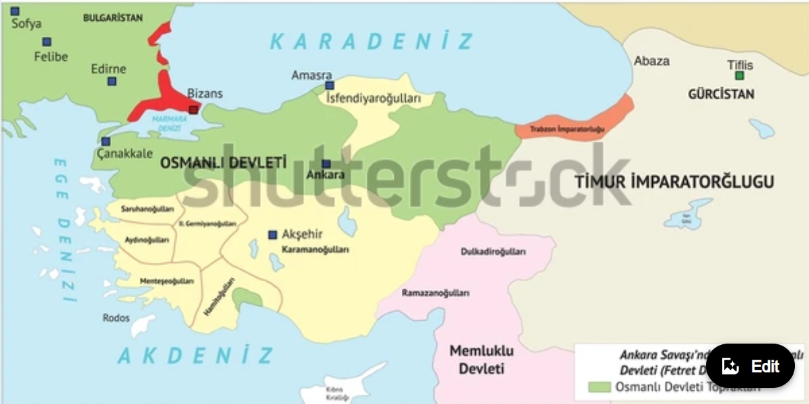
Ottoman Empire Territories After Ankara

Slide 5
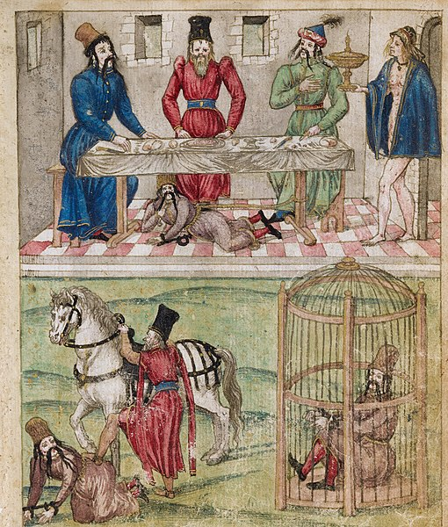

Slide 6
The Impact of the Battle of Ankara
Sultan Bayezid was captured, and this led to internal strife and confusion regarding the succession to the throne
This weakened the unity of the Ottoman state and contributed to a fragmentation of power, this period is known as the Interregnum Era (10 years)
A power vacuum was created in the region, allowing other neighboring states and factions to challenge Ottoman dominance and expand their own influence
The Ottoman trajectory of territorial expansion in Europe and Asia Minor, was temporarily halted and retreated all the way back to the borders drawn by Murad I
The reputation of Timur (d. 1406) as a fearsome conqueror and military strategist was boosted, they took Bursa, sacked Anatolia but didn’t expand into other Ottoman lands
He had devastated the land and ceded it back to the Anatolian beyliks and three of Bayezid’s sons were given charge of the areas where they lived
Ottomans sought to regroup and stabilize their empire; period of introspection led to reforms and changes in governance, and reevaluation of strategies for dealing with external threats
While the Ottomans faced significant challenges after the battle, they eventually managed to overcome internal divisions and regain their strength
Notes:
The Battle of Ankara, also known as the Battle of Angora, took place on July 20, 1402, between the Ottoman Empire and the Timurid Empire, led by the Central Asian conqueror Timur (Tamerlane). This battle had a significant impact on the Ottoman Empire and the wider region. Here are some key effects of the Battle of Ankara:
Capture of Sultan Bayezid I: The most immediate impact of the battle was the capture of Ottoman Sultan Bayezid I by Timur's forces. This was a major blow to the Ottoman Empire, as it led to a period of internal strife and confusion regarding the succession to the throne.
Division of the Ottoman Empire: Following Bayezid I's capture, his sons fought among themselves for control of the empire. This internal conflict weakened the unity of the Ottoman state and contributed to a fragmentation of power.
Regional Instability: The defeat at Ankara and the subsequent power struggle within the Ottoman Empire created a power vacuum in the region. This instability allowed other neighboring states and factions to challenge Ottoman dominance and expand their own influence.
Temporary Decline of Ottoman Expansion: The Ottomans, who had been on a trajectory of territorial expansion in Europe and Asia Minor, were temporarily halted in their expansion efforts due to the chaos caused by the defeat and the internal strife.
Timurid Influence: The Battle of Ankara bolstered the reputation of Timur as a fearsome conqueror and military strategist. While Timur did not seek to annex Ottoman territories, his victory had an impact on the political dynamics of the region and influenced the balance of power.
Redirection of Ottoman Policies: In the aftermath of the battle, the Ottomans sought to regroup and stabilize their empire. This period of introspection led to some reforms and changes in governance, as well as a reevaluation of their strategies for dealing with external threats.
Resurgence of the Ottoman Empire: While the Ottomans faced significant challenges after the battle, they eventually managed to overcome internal divisions and regain their strength. Under the leadership of Mehmed I, the Ottomans managed to reunify the empire and continue their expansionist policies.
In the long term, the Ottoman Empire recovered from the setback at the Battle of Ankara and went on to become one of the most powerful and enduring empires in history. However, the battle's impact was significant at the time, leading to a period of upheaval and reshaping the geopolitical landscape of the region.
• Some mention that fratricide became common after the Ottoman 20yr civil war to avoid internal feuds

Slide 7
Faasila i Sultanat
The Interregnum Period (1403-1413)

Slide 8
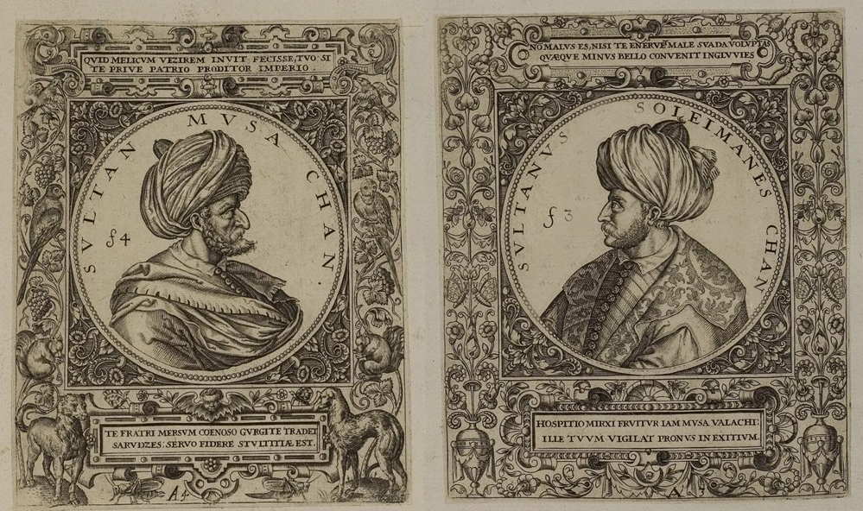

Slide 9
Aftermath of the Battle of Ankara (1402)
Succession Problems: Bayezid’s sons turn on each other, as there is no heir apparent, this hampers Ottoman progress and stunts growth. From 1403 to 1413, no real Ottoman ruler, they were all de facto leaders of provinces
Unscrupulous Old Enemies: Byzantines, Karamanids resurface and grab the opportunity to unseat Ottoman power
Loss of Manpower: During the battle and due to the civil war thereafter, many Muslims lives were lost. The civil war proved very costly
Timurid Threat: The Timurids charged into Anatolia all the way to the Aegean Sea, caused widespread devastation, sacked many cities such as Bursa
Beyliks Reinstated: Beyliks were reestablished by Timur and placed under his protection
The Ottoman Empire nearly ceased to exist
Notes:
Timurid perspective is different – they say Bayezid needed to be put in his place.

Slide 10
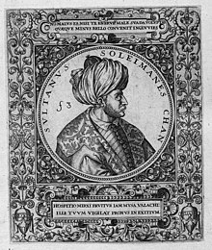
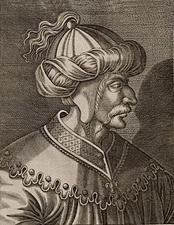
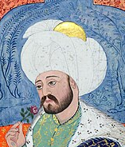
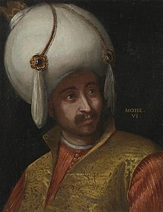
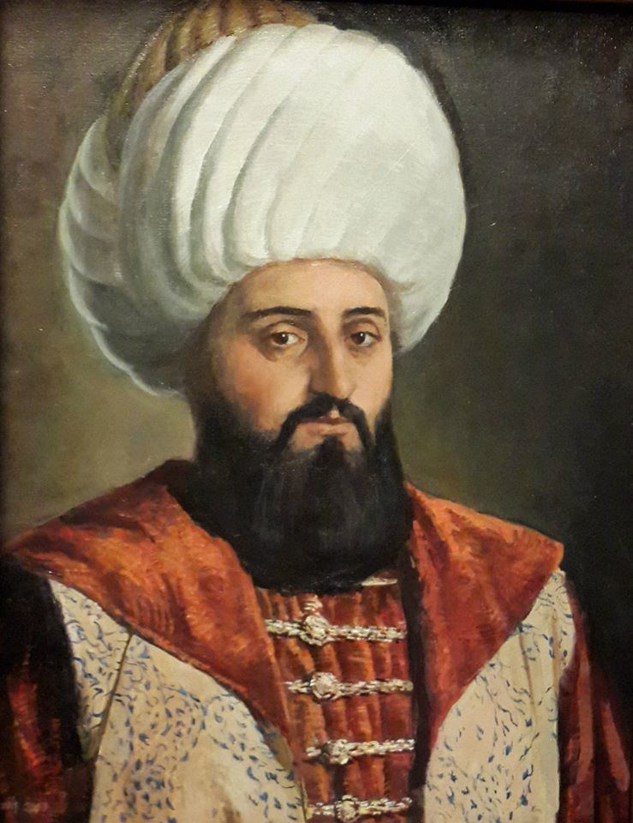
The Sehzade – Princes
Suleyman
1402 − 1411
Isa
1403 − 1406
Mehmed I
1413 –1421
Musa
1411 − 1413
Mustafa
1419 – 1422
Escaped to…
Captured
Edirne
Aegean
Amasya
Released in 1411
Released in 1419
Sought help from Romans and declared himself Sultan, After Isa‘s death, captures Bursa, Aegean and Ankara. He comes back to Rumelia, and defeats Musa, but his own men murder him.
Got support from Suleyman to recapture Anatolia, gets defeated by Mehmed I
Amasya soon came under Timurids. When Musa was released, they consolidate in Asia. He defeats Musa and becomes Sultan. Later he defeats Mustafa as well.
Musa goes to Rumelia and threatens Suleyman’s rear, Suleyman returns to Rumelia. After Suleyman dies, he controls Rumelia and starts making demands, executions
He was imprisoned in Samarkhand. Timur’s son Shahrukh released to break the Ottomans. He lands in Rumelia and gets support from Venetians. Mehmed defeats him and sends him to exile
Notes:
Suleyman was the commander of the right wing in the Battle of Ankara while Mehmed I (teenager) commanded the rear guard
Suleyman was given a certificate by Timur assuring his sovereignty in Anatolia, Timur had also asked Mehmed to come, Mehmed had left his call unanswered
Mehmed I let Suleyman recapture West Anatolia, and withdrew his forces to the east
Suleyman is murdered by his own men as he starts living a life of luxury, focusing on Dunya
Musa demands tribute, asks Mehmed to share power, their friendship comes to an end
One of the reasons why the Interregnum period was so long was due to the instigation, polarization and interference from the Balkan states, primarily Byzantium and the Anatolian principalities.

Slide 11
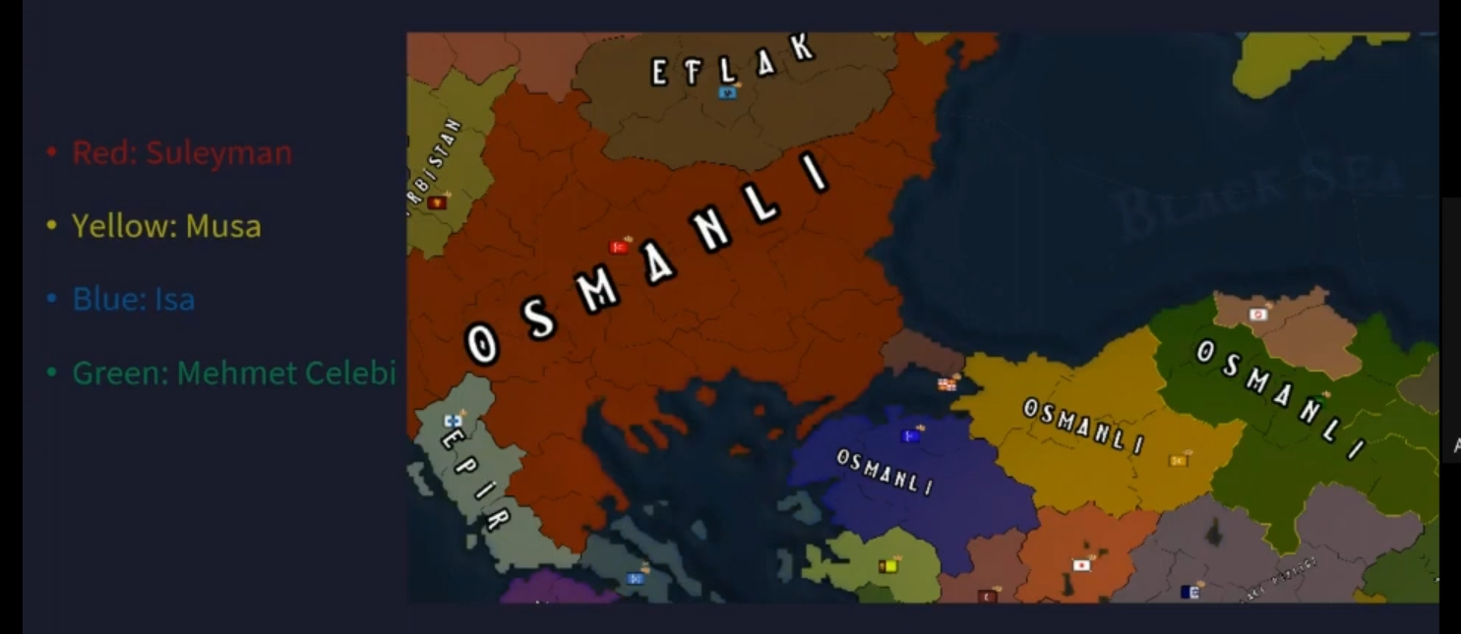
Notes:
Not a proper map

Slide 12
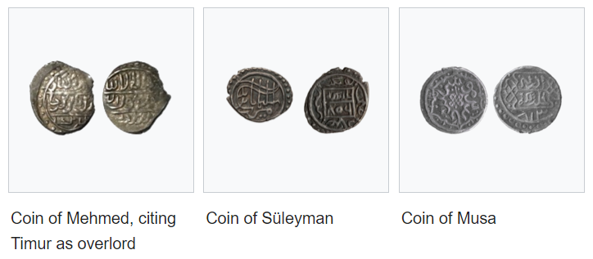

Slide 13
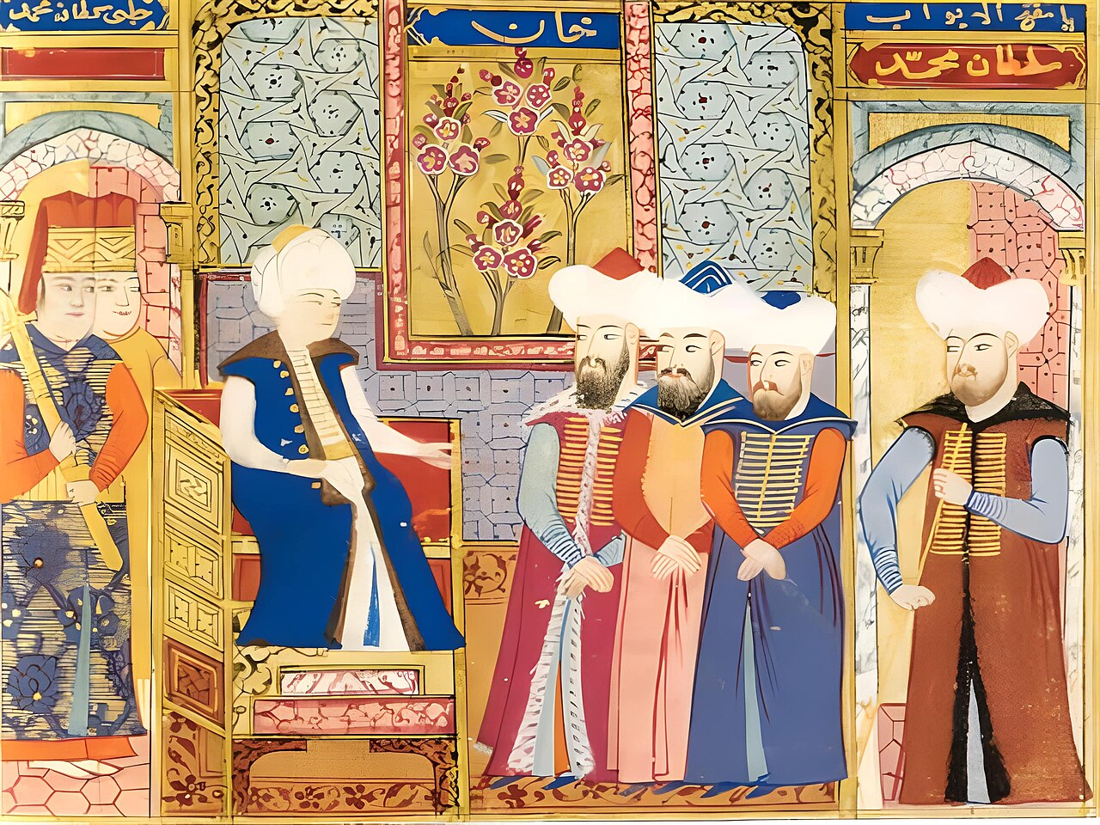
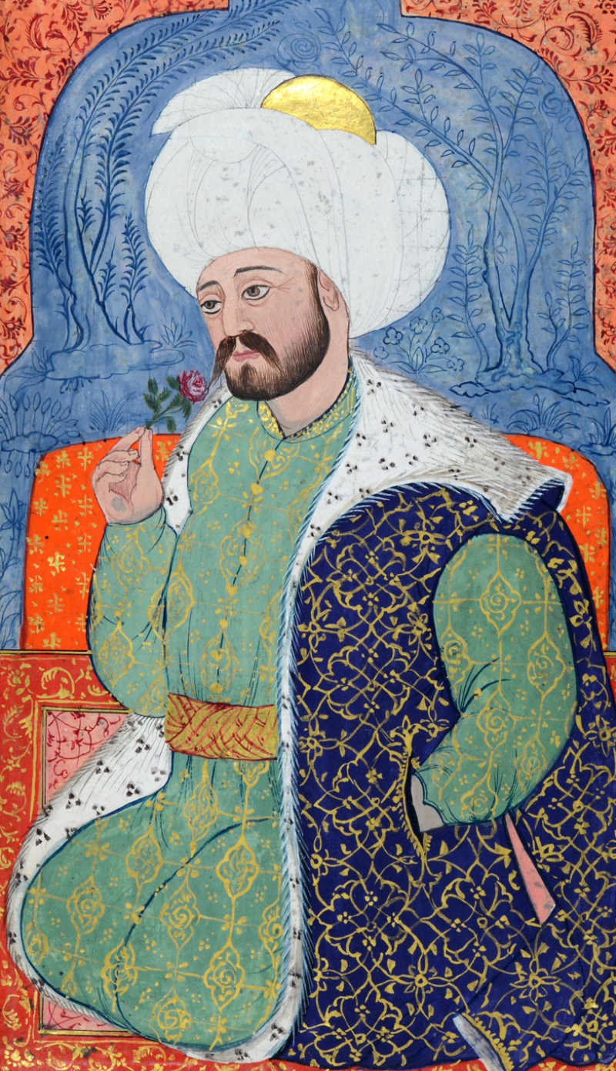
The Restoration Begins Mehmed I (r1413–1421)

Slide 14


Slide 15
Mehmed I (r1413–1421)
Known as Celebi (cultured) and Kirisci (young master or archer with extraordinary strength)
He was a calm, serious and determined person who knew how to control his anger
He was very good at using weapons and bold enough to fight in the front lines.
Mehmed was a philanthropist
  Vast building projects in Bursa, Edirne: mosques, madrassas, almshouses, his own tomb
  Eskicami (Old mosque) in Edirne
  Yesil (green) mosque in Bursa
He treated his subjects – Muslim, and non-Muslim, fairly
He continued the tradition of the surre procession, and sent caravans of imperial donations in cash and kind to the Haramain
Inspite of a choppy start, opposing forces in Anatolia and Rumelia and a short reign, Mehmed was able to fortify the Ottoman domain
By his tactics which worked even after his death, he was able to prevent another Ottoman interregnum and so he is known as the second founder of the Ottoman imperial state
Notes:
Italy was made of various city states – Rome, Sicily (Spanish Aragon), Genoa, Venice, Milan, Florence
There were many Venetian trading ports in the Mediterranean, up and down the Dardanelles and in the Black Sea
The Venetians had a powerful navy
Ottoman navy was still developing
Mustafa will resurface at the time of Murad II, Mehmed I’s son. He was given the name duzne or duzmece wihich means the imposter (Court historians claimed that he was not really Bayezid’s son0

Slide 16
Restoring the Empire's Strength in Anatolia
While his father was still alive in 1399 Mehmed had been sent to be the governor of the area that included Amasya, Tokat and Sivas
He returned to the area after the Battle of Ankara and waged war against the Turkomans in and around the area and defeated them
He sent armies out on campaigns to regions in Anatolia (Central, Aegean)
In 1414, he defeated Cuneyd Bey, the lord of the Aydin Beylik and Smryrna (Izmir) which reestablished Ottoman domination over all of western Anatolia (Timur had taken Izmir from the Knights Hospitallers and had handed it over to the Aydinids)
Sheikh Badreddin was appointed as Qadi Asker by Musa, he had some questionable beliefs and was another thorn that had to be eliminated
In 1415, Mehmed seized Konya and the Karamanids called for peace, through which Saidilil and Isparta were ceded
He also challenged Venetian naval control of the Aegean Sea, he sent a fleet of ships to Cyclades, but a Venetian fleet destroyed them off Gallipoli
Timur’s son Shahrukh began preparations for a military campaign to Anatolia, and then Mehmed sought help from the Qara Qoyunlu and Mamluks
Notes:
Mehmed secured his Balkan holdings while also moving to re-subjugate the Anatolian Beyliks that had regained their independence

Slide 17
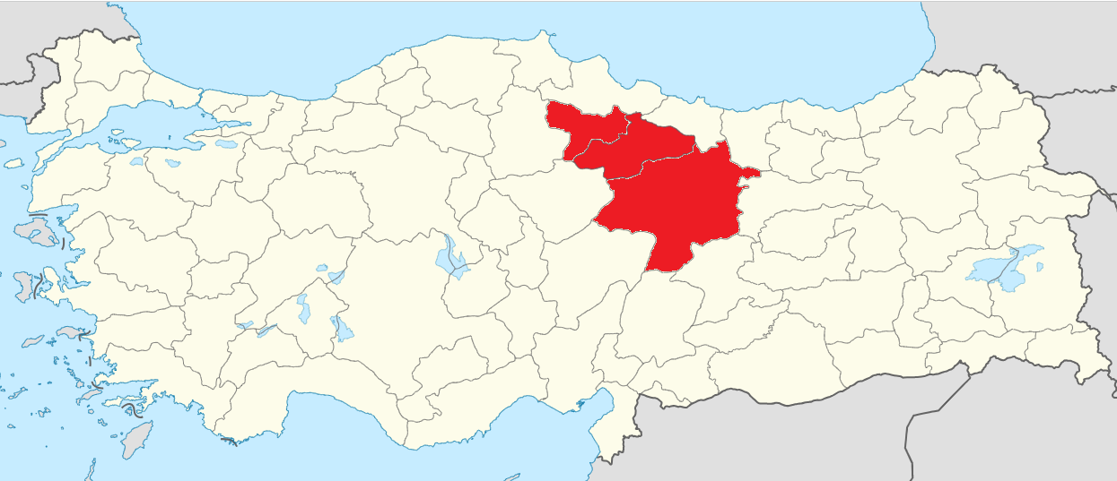
Amasya
Tokat
Sivas

Slide 18
Restoring the Empire's Strength in Rumelia
After the threat from Isa (1406), Suleyman (1411) and Musa (1413) was eliminated, Mehmed started consolidating power
He sent armies out on campaigns to parts of Albania and Bosnia
Mustafa was released by the Timurids and supported by the Byzantines inorder to destabilize the Ottoman empire once again; however he was sent into exile in 1419 by Mehmed I
Now there was peace and prosperity in Ottoman lands
His nephew Orhan (Suleyman’s son) was caught plotting for the throne
The Byzantine empire, Serbian Despotate, Principality of Wallachia and the Despotate of the Morea agreed to pay the Ottomans tribute
In 1419, Mehmed set off on a campaign against Voivode Mihail I of Wallachia who was threatening Ottoman control of the Balkans and receiving support from King Sigismund of Hungary and Croatia. Mihail surrendered and the Ottomans captured the city of Drobeta-Turnu Severin from the Hungarians. Sigismund sent his army in retaliation and defeated the Ottomans at Nis and Nicopolis
Mehmed organized a successful campaign on behalf of the Bosnians who had asked for his protection from the Hungarian oppression
Notes:
Mehmed I's efforts for recovery
Military campaigns and territorial consolidation
Rebuilding administrative structures
Diplomatic efforts and alliances
(Mehmed had written to Shahrukh that the partition of the Ottoman empire would serve no one but the enemies of Islam)
For Mustafa to remain in exile until Mehmed’s death, he had to pay the Byzantines 300,000 akce in gold annually
Rumour that the actual Mustafa had died and the one in Byzantium was an imposter

Slide 19
Mehmed I’s Death
While Mehmed was able to recover lost Ottoman territory, the civil war and subsequent struggles to consolidate power had taken a terrible toll on the Sultan, he had over 40 wounds on his body as a reminder of 24 major battles that he fought
In 1421, at the young age of 34, he fell off his horse, his wounds opened and he became bedridden
He called Shehzade Murad II (d.1451) from Edirne to take up the throne
Fearing that news of his death might cause infighting, he had asked that his death be kept a secret until Shehzade Murad arrived.
For 42 days, no one knew that the Sultan had died, and officials even dress up the corpse to show the people
His will also stated that the second son Kucuk Mustafa, who was the governor of Hamidila (Isparta) would administer Anatolia and the youngest two sons would be sent to Constantinople and a ransom would be paid to maintain them there so they would not be killed
Eventually, Murad II arrived and took the throne
Notes:
Key achievements and contributions of Mehmed I
Strengthening of central authority
Laying the foundation for future successes
Some historians call him the second founder of the ottoman state and the Mujaddid of the ninth century

Slide 20
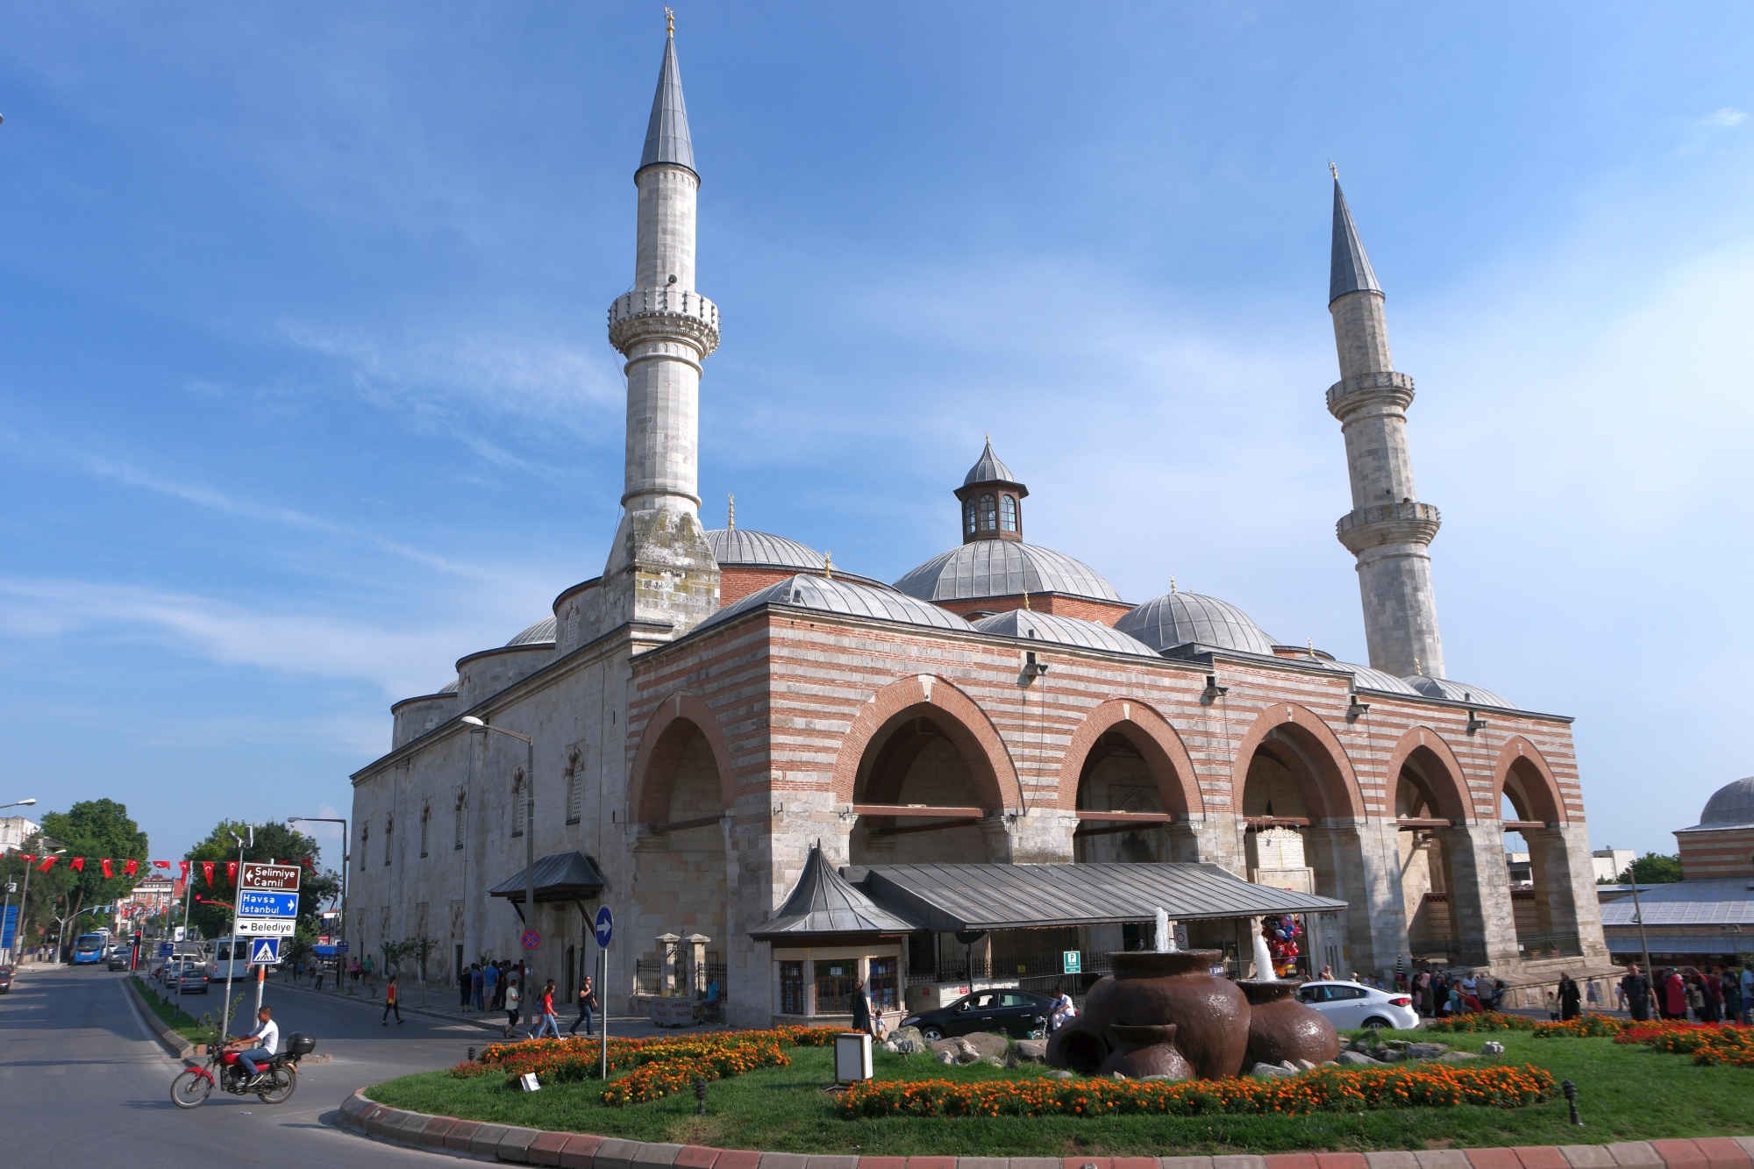
Eskicami (Old Mosque) in Edirne
Notes:
Eskicami (Old Mosque) in Edirne

Slide 21
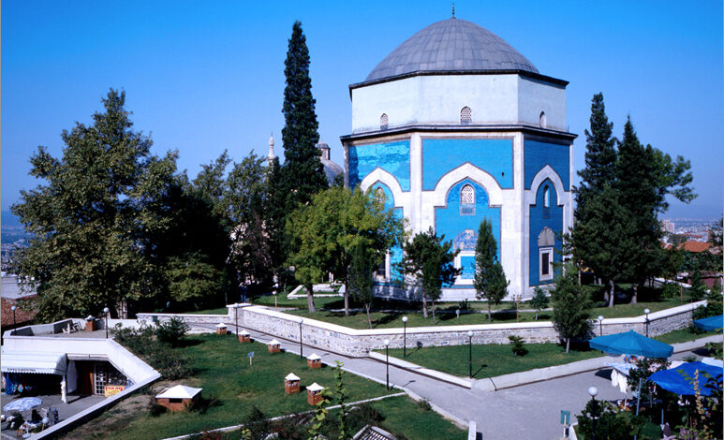
Yesil (Green) Mosque in Bursa
Notes:
Eskicami (Old Mosque) in Edirne

Slide 22
Timeline of Mehmed I’s Reign
1403: Two sons of Bayezid I (Musa and Mustafa) are captured, three sons escape: Suleyman to Edirne, Isa to Aegean, Mehmet to Amasya and start ruling there
1403-1411: Suleyman rules Rumelia from Edirne
1403-1406: Isa gets support from Suleyman to recapture Anatolia, gets defeated by Mehmed I, Some sources say he challenges Suleymen and is killed; Suleyman takes west Anatolia
1410-1411: Musa is released, with Mehmet’s support he attacks Suleyman in Rumelia
1411: Suleyman is killed by Musa or by his own troops, Musa takes Rumelia
1413: Musa starts challenging Mehmed I, is executed. Mehmed I becomes the Sultan
1414-1415: Mehmed defeats Cuneyd Bey and seizes Konya from the Karamanids
1419: Mehmed launches a campaign against Voivode Mihail I of Wallachia and captures the city of Drobeta-Turnu Severin from the Hungarians.
1419: Mustafa, a potential rival, is sent into exile by Mehmed I
1419: The Byzantine Empire, Serbian Despotate, Principality of Wallachia, and Despotate of the Morea agree to pay tribute to the Ottomans.
1421: Mehmed I falls off his horse, succumbs to his wounds, and dies at the age of 34.

Slide 23
What was Happening Elsewhere (1400-1421)
1401: Tamerlane sacks Baghdad, killing tens of thousands and devastating the region.
1402: The Mali Empire, one of the richest and largest empires in Africa, reaches its zenith under Emperor Mansa Musa.
1405: Death of Tamerlane.
1405-1433: The Chinese explorer Zheng He embarks on a series of voyages to Southeast Asia, India, the Middle East, and Africa, known as the Treasure Voyages, to demonstrate Chinese power and establish diplomatic relations.
1415: The Portuguese capture the Moroccan city of Ceuta, marking the beginning of European exploration of Africa.
1415: The Hundred Years' War continues, with the English capturing the French city of Harfleur and King Henry V's victory at the Battle of Agincourt.
1417: The Council of Constance ends the Western Schism by deposing all rival claimants to the papacy and electing Pope Martin V, restoring unity to the Catholic Church.
1431: The Khmer Empire's capital, Angkor, is captured by the Thai Ayutthaya

Slide 24
Videos
Mehmed I - Ottoman Rulers #6

