Slide 1
Defeat and Recovery
Murad II
(1403-1421)

Slide 2
Let’s Recap…
Notes:
Let’s Recap…

Slide 3
Timeline of the First 5 Sultans
1237: Alaeddin Keyqubad I awards Ertugrul title of Ghazi and Karacadag, Sogut, Domanic
1285-88: Osman conquers Byzantine territories, Yenisehir is the new capital
1326: Orhan comes to power, Bursa is taken, becomes new capital
1329-54: Conquest of Nicaea, Gemlik, Nicomedia, Gallipoli; Annexation of the Karasids' lands.
1360: Orhan dies, and his son Murad I ascends to the throne.
1363-65: Murad takes Tzouroulos, Arkadiapolis, Malgara and others; Edirne became capital.
1368-73: Bulgaria and Constantinople (Byzantine Empire) became vassals.
1382: Murad gained territory from Germiyanids and Karamanids.
1389: Murad was martyred after victory at the Battle of Kosovo; Bayezid I succeeded him.
1389-93: Bayezid took Philadelphia and Beyliks in Anatolia (Karamanids and Candarids)
1391-96: Skopje, Salonika, Kruje, Scutary, and Tarnova were conquered; Siege on Constantinople; the Holy League is defeated by Bayezid at the Battle of Nicopolis.
1402: Ottomans were defeated by Timur at the Battle of Ankara, resulting in a 10 year Interregnum period and massive loss of territory
1413-19: Mehmed I becomes the Sultan, seizes Konya and territories in Wallachia and Hungary
1419: Byzantines, Serbians, Wallachian, Moreans agree to pay tribute to the Ottomans.
1421: Mehmed I falls off his horse, succumbs to his wounds, and dies at the age of 34.

Slide 4
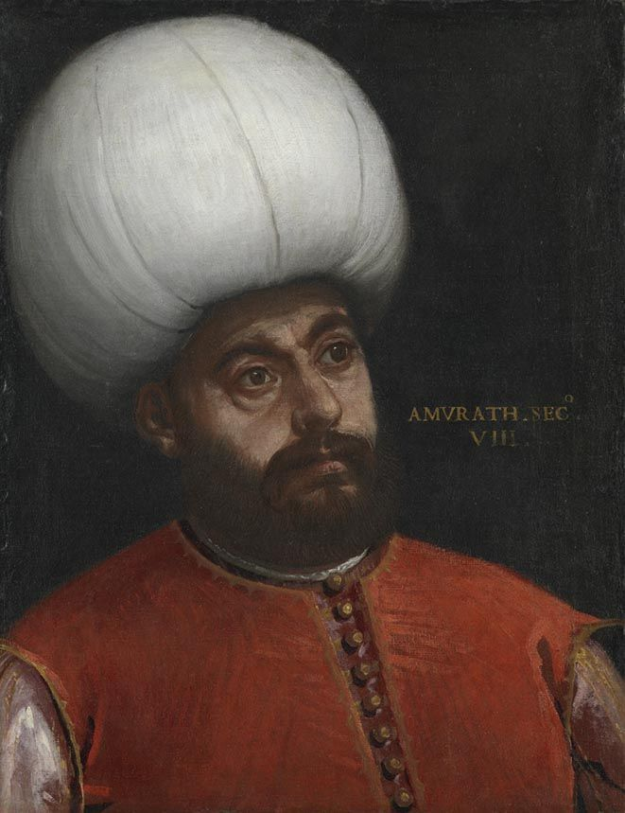
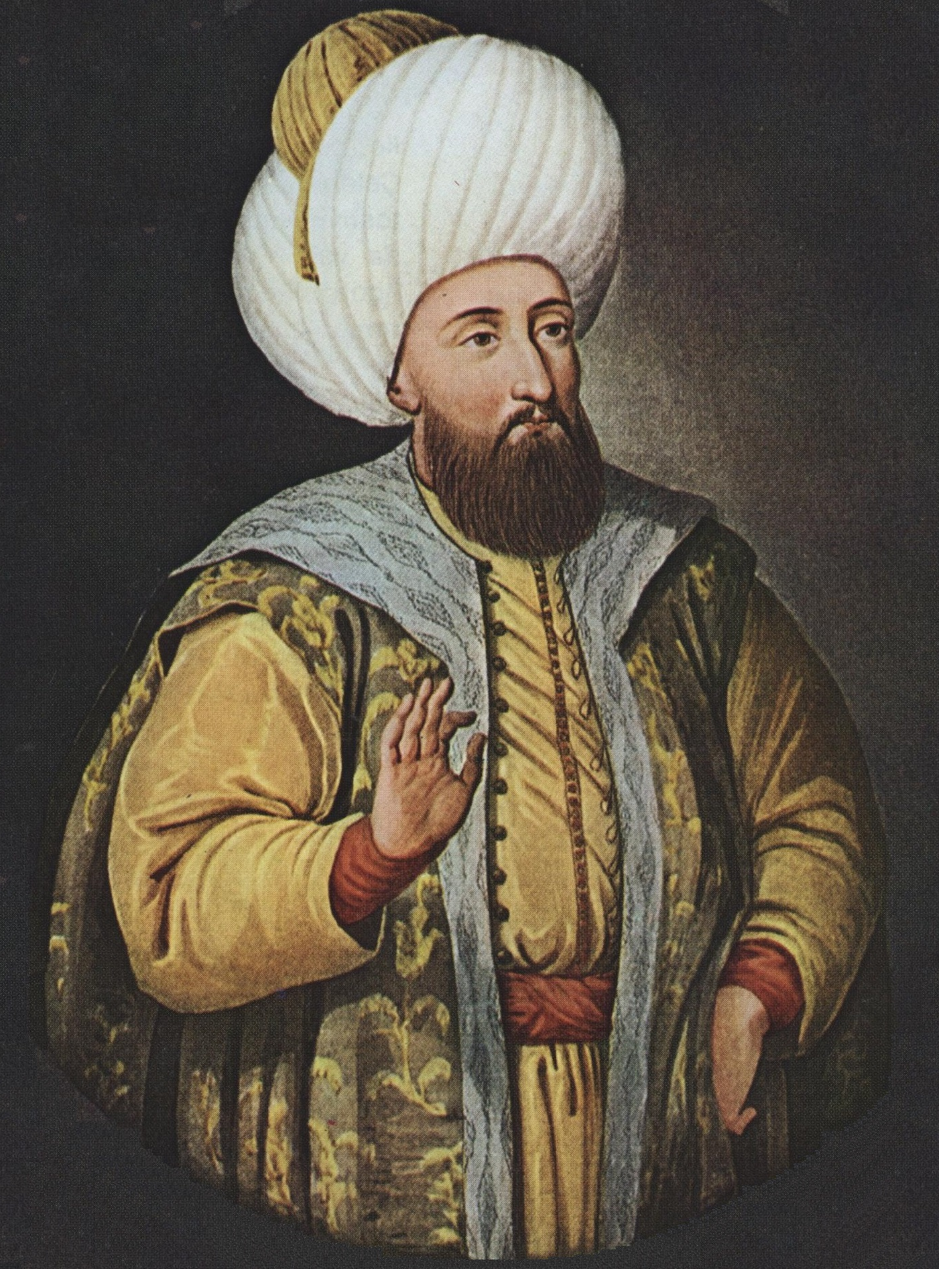
Continuing the Recovery Murad II (r1421–1451)

Slide 5
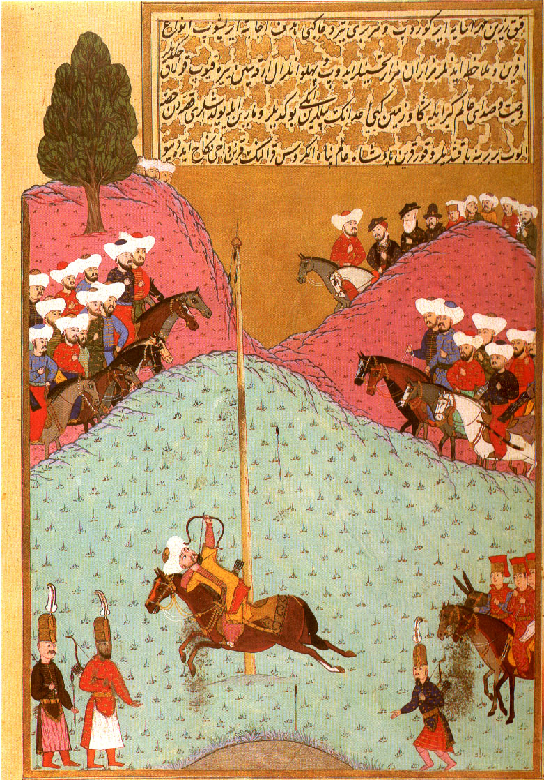
Murad II (r1421–1451)
Born in 1404 in Amasya, where his father Mehmed governed following the defeat at Ankara.
He was born into the Interregnum period
As the eldest son, he was bring trained and was appointed as the governor of Amasya
He participated in a number of local campaigns against local Beyliks
42 days after the death of his father Murad II, at the age of 17 he took over the throne
On the death of Mehmed I, the Romans released Shahzade Mustafa (d 1422), Murad’s uncle who seizes Edirne and with support from Constantinople, declares himself Sultan.
He raises an army (supported by Byzantium, naval fleet, Beyliks) and has some initial victories against Murad’s forces; he then marches on Bursa, but most of his troops disperse
He is chased by Murad, goes to Edirne, takes the treasures and tries to escape, but Murad has him executed for treason
Notes:
Few primary sources available which were written at the time of Sultan Murad.
Why was the death kept secret – impetus to enemies to attack an empire without a ruler.
He accompanied his father’s funeral to Bursa where he was laid to rest at the Green Mosque.
Amasya was an important town – eastern – strategic – gateway to the east – where Timur had come from – it was a cultural center, religious institutions, center of Turkish culture – embracing Turkish culture instead of Persian
Murad and his close confidantes are able to convince them (Mustafa’s forces) to join their side
Treason is Bagi, punishable by Islamic law and other laws. Different from fratricide
Sultan Murad’s brothers: Mustafa was 12 located at Hamidili, Yusuf was 8, Mahmud was 7.
Mehmet I knew the problems: He had willed that Murad would take over, Mustafa would administer Anatolia, Yusuf and Mahmud would live in Constantinople,
Mehmet didn’t send his brothers, some say they were blinded and died in the plague of 1429
Mustafa the Uncle was also in Constantinople - agreement

Slide 6
Expanding the Empire - West
Murad besieged Constantinople; victory was just around the corner, when his 13 year old brother Shehzade Mustafa (d.1422) rebelled, with the support of the Romans
Mustafa marched out of Iznik and threatened Murad’s rear lines; Murad had to leave the siege and fight Mustafa, who was easily defeated and then executed; but the siege had been lifted
In one year the dangerous Romans had instigated two rebellions (2 Mustafas – Uncle and Brother)
For almost 10 years (1423-1433), he worked to suppress local rebellions in Anatolia
Then focused on Rumelia as the Hungarians and Venetians had been taking advantage of Ottoman internal conflicts and had gotten Serbia to break relations with the Ottomans
Murad took Thessalonica (North Macedonia) from the Venetians, advanced into Albania and placed Bulgaria under Ottoman control
In 1437, the Orthodox and Catholic Church made an alliance
In 1438, he ventured out for the first campaign against Hungary and Serbia, he had several victories, and then returned to Edirne as constant campaigning was taking a toll on him
In 1441, the Hungarians were led to victories by a charismatic nobleman, John Hunyadi (d.1456) and Murad was unable to achieve victory over the Hungarians
In 1443, Murad’s eldest son Shezade Allaudin, fell off a horse and died, Murad was heartbroken
He negotiated for peace; 10 year peace treaty. Murad had to reestablish the Kingdom of Serbia and was forbidden from crossing the Danube; in return Hungary gave up its claims on Bulgaria.
Notes:
This kind of division, anarchy, infighting instigated by external forces have kept the Muslims fighting Muslims, even today. The enemy stays curtailed as we continue our internal struggles.
Murad II’s son Mehmet Fatih is watching these Fitnas and it will affect what he does when he is the Sultan
Syria's Civil War (2011-present): The Syrian conflict began as a result of domestic grievances against the authoritarian government of Bashar al-Assad. However, various external actors have exacerbated the conflict by supporting different factions. Saudi Arabia and Qatar backed certain rebel groups, while Iran and Russia supported the Syrian government. This external involvement has prolonged the war and deepened divisions among different Muslim groups, turning the conflict into a proxy war.
Yemen's Civil War (2014-present): Yemen's conflict originated from internal political and economic issues. However, the involvement of external actors has intensified the conflict. Saudi Arabia and Iran are often seen as backing opposing sides, thereby exacerbating the divisions between Sunni and Shia Muslims. This has led to a humanitarian catastrophe and a deepening of intra-Muslim animosities.
Iraq after the 2003 Invasion: The US-led invasion of Iraq in 2003 led to the toppling of Saddam Hussein's regime. The subsequent power vacuum and sectarian tensions between Sunni and Shia Muslims erupted into violence, including acts of terrorism. While external intervention played a role in destabilizing the country, internal factors like historical tensions and political power struggles were key drivers of the conflict.
Bahrain's Unrest (2011): The Arab Spring protests in Bahrain highlighted tensions between the Sunni ruling monarchy and the Shia-majority population. Iran was accused of supporting the Shia protesters, leading to further polarization. External involvement aside, the conflict stemmed from long-standing domestic inequalities and political repression.
Pakistan and Sectarian Violence: Pakistan has witnessed numerous instances of sectarian violence between Sunni and Shia Muslims. While some of this violence can be attributed to external influences, such as ideological support from certain countries, much of it also arises from historical differences, economic disparities, and local power struggles.
Ethnic and Sectarian Tensions in Myanmar: While not a predominantly Muslim country, Myanmar has a significant Muslim minority known as the Rohingya. Their persecution and displacement have garnered international attention. While internal factors like ethnic and religious tensions are primary drivers, external narratives and influences have exacerbated the situation, framing it as a religious conflict rather than a complex ethnic and political issue.
Geopolitical Rivalries in the Middle East: The broader geopolitical rivalry between Iran and Saudi Arabia has often been framed along sectarian lines, with Iran being predominantly Shia and Saudi Arabia being predominantly Sunni. This rivalry has played out in various conflicts across the region and has contributed to sectarian divisions among Muslims.

Slide 7
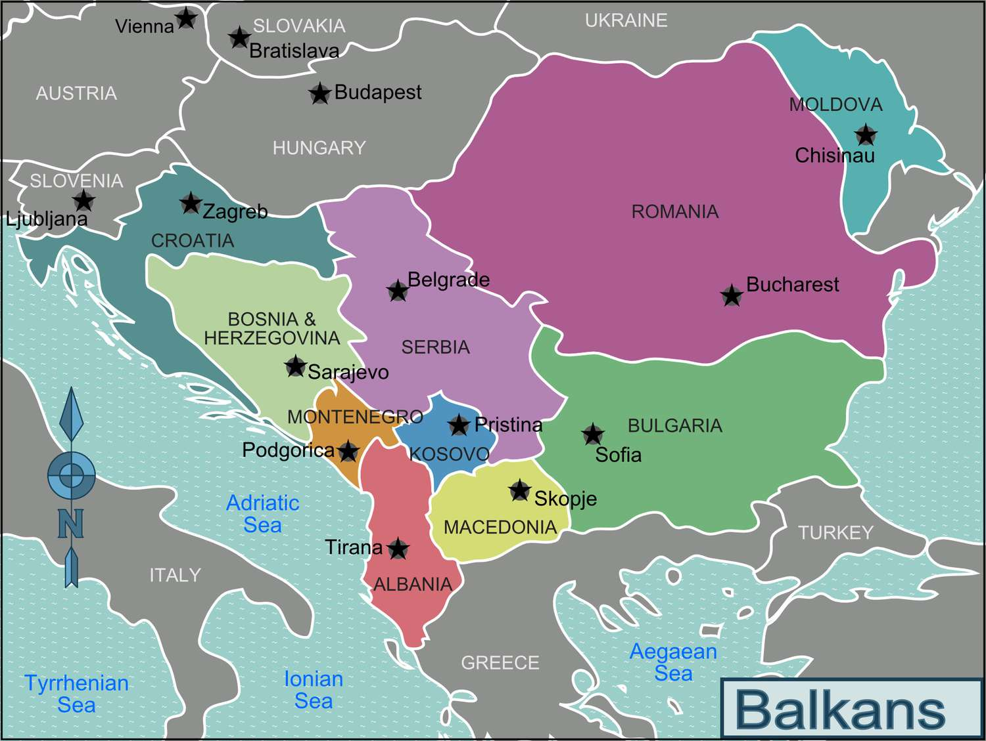
A Look at the Balkans once again
Balkan is a Turkish word that means something similar to “mountain.” This makes it an appropriate name for the region, as mountains are plentiful in the Balkans. The Balkan Mountains that run through Bulgaria to its border with Serbia also contribute to the name of the region.
Notes:
Balkan is a Turkish word that means something similar to “mountain.” This makes it an appropriate name for the region, as mountains are plentiful in the Balkans. The Balkan Mountains that run through Bulgaria to its border with Serbia also contribute to the name of the region.

Slide 8
Expanding the Empire – East: 1423-1433
The western Beyliks, along the Aegean sea, such as the Karamanids and Germiyanids, had also aided Mustafa
They also took over Ottoman Anatolian provinces, creating a civil strife
Murad turned his attention towards them and took their territories such as Konya and Larende
While most of Anatolia was under his control, in the east, the Karamanids and Candarids continued to pose a threat as they were supported by the Timurids
In 1443, Murad entered into a peace treaty with the Karamanids
Finally Murad had some peace after fighting battle after battle since 21 years
In 1444, he abdicated in favour of his 12 year old son Mehmet (d.1481), moved to Manisa and lived a life in worship
Khalwa – religious seclusion; he went from the lesser jihad to the greater jihad (battles against enemies fi sabilillah o the fight against nafs)
Notes:
Only Sultan to abdicate
Khalwa – religious seclusion
He went from the lesser jihad to the greater jihad (battles against enemies fi sabilillah o the fight against nafs)

Slide 9
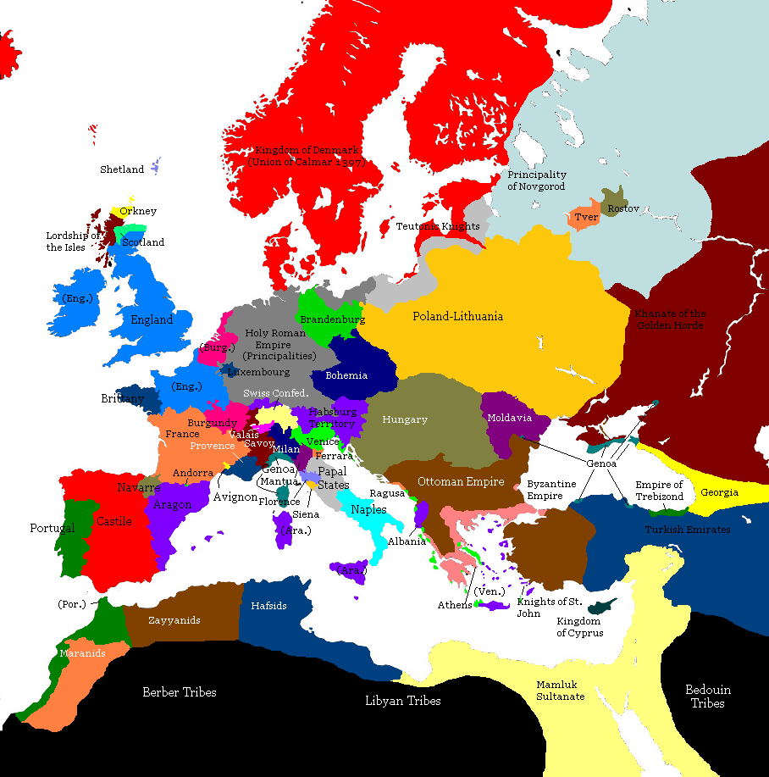

Slide 10
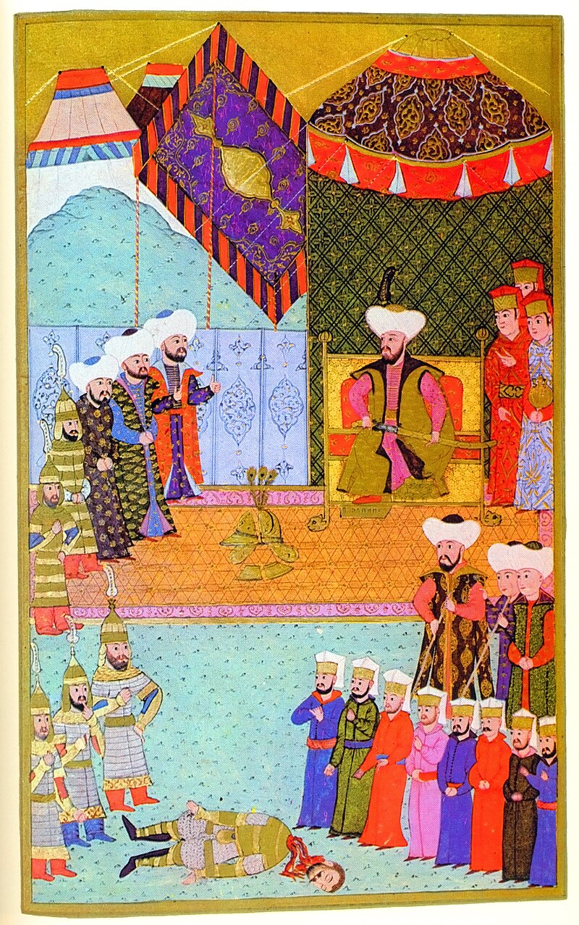
New Crusade – Battle of Varna, 1444
On Murad’s abdication, Christian states saw an opportunity, they could easily defeat a 12 year old Sultan
Pope Eugene IV (d.1447) announced a new Crusade: Papal states, Transylvania, Poland, Wallachia, Bohemia, Albania, Constantinople came together
Hungary had a peace treaty; they broke it and joined
Smaller detachments of Teutonic Knights, Czechs, Bosnians, Croats, Bulgarians, Lithuanians, and Ruthenians also joined
80000 troops, marched through Bulgaria and started ravaging Ottoman lands
They were commanded by King Wladyslaw III of Poland and Hungary, John Hunyadi and Mircea II (son of Vlad II) of Wallachia.
Mehmet and his viziers called back his father to lead the armies against the Crusaders
The crusader army was annihilated even though the Ottoman army was half the size
The Ottomans only had 150 martyrs
Notes:
In 1395 Bayezid defeated the ruler of Walachia Mircea the Elder and installed Vlad I
Pope said that an Oath with disbelieving infidels doesn’t mean anything, you are forgiven if you break it.
Broken treaties with Native American tribes
Muslims have to follow Shariah, even truce with non Muslims have to be abided by.

Slide 11
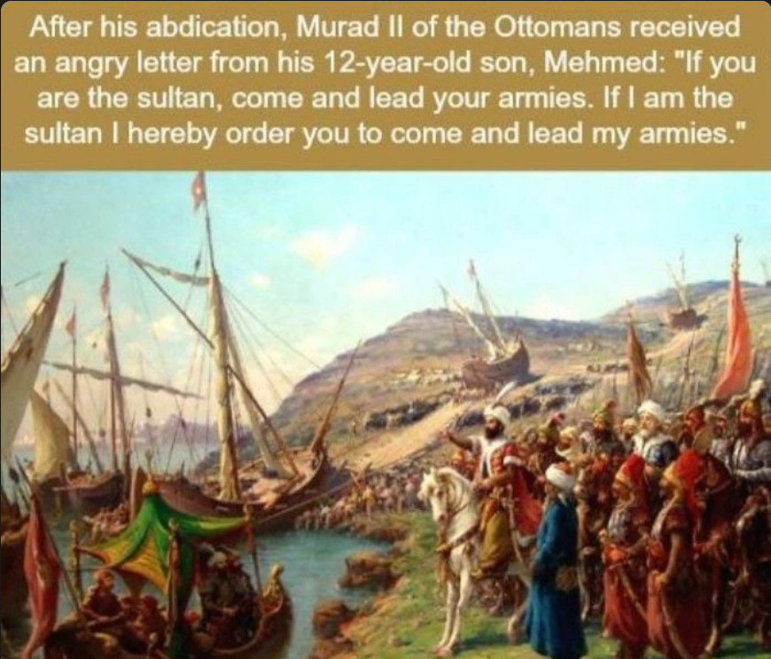

Slide 12
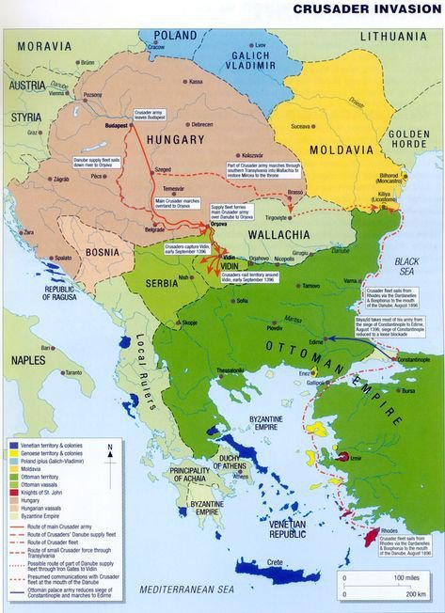

Slide 13
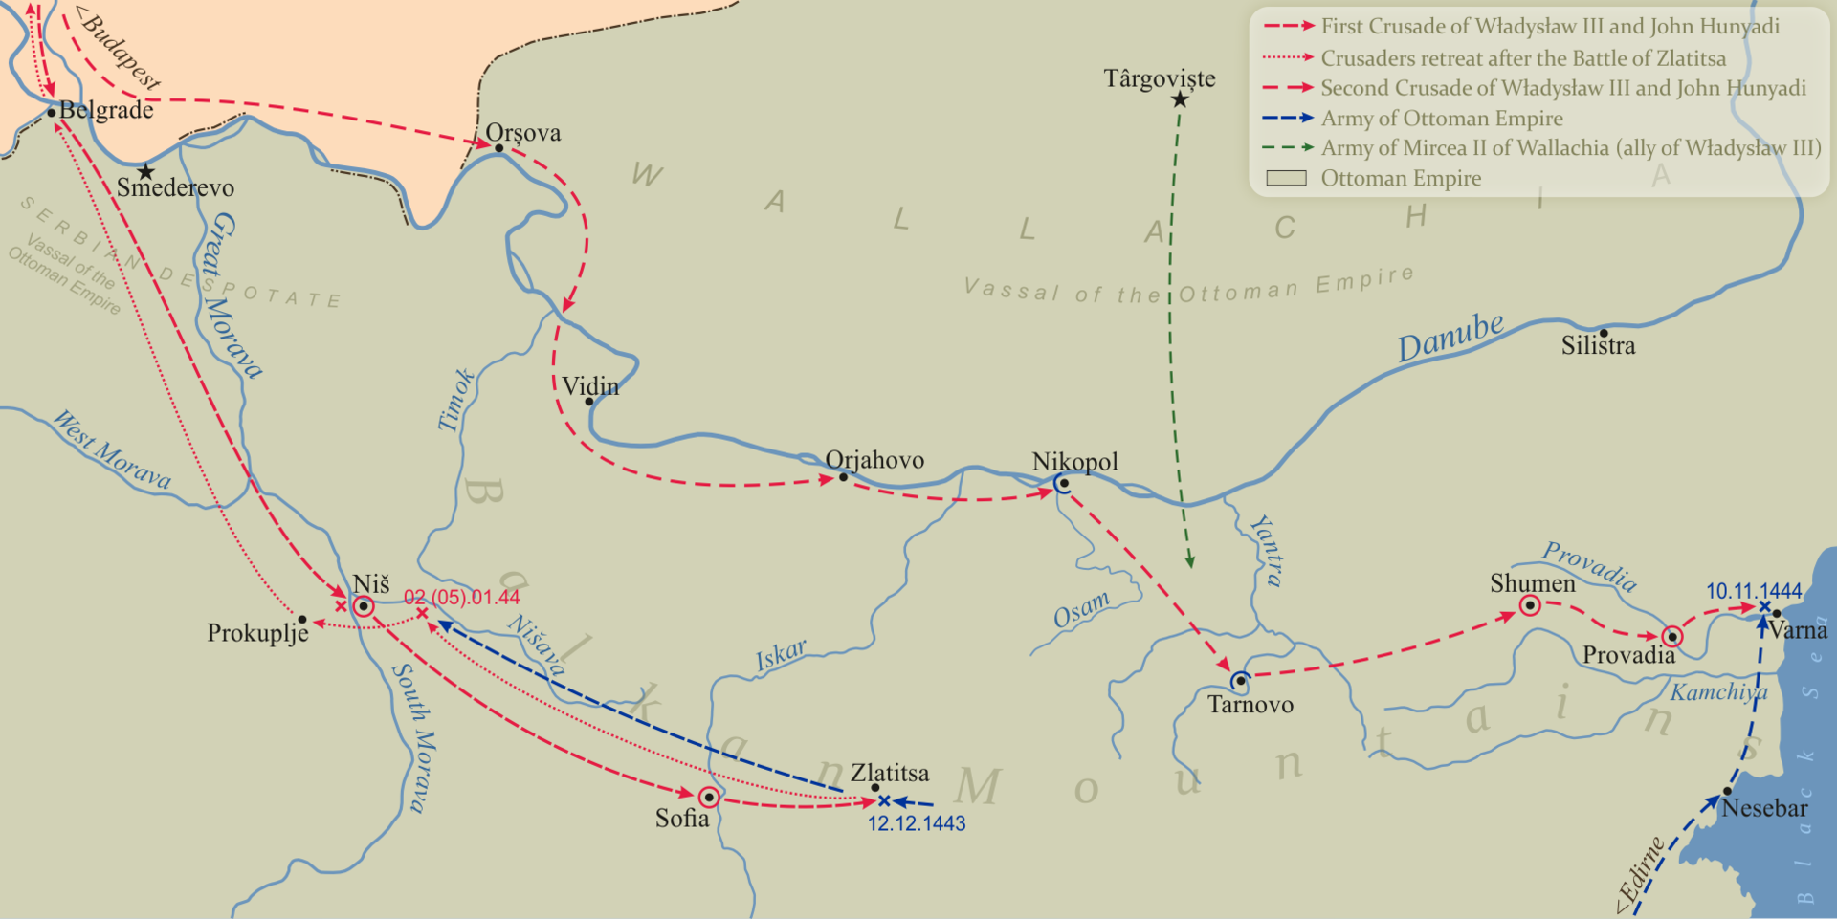

Slide 14
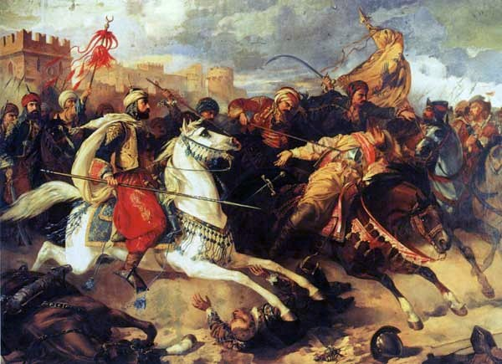
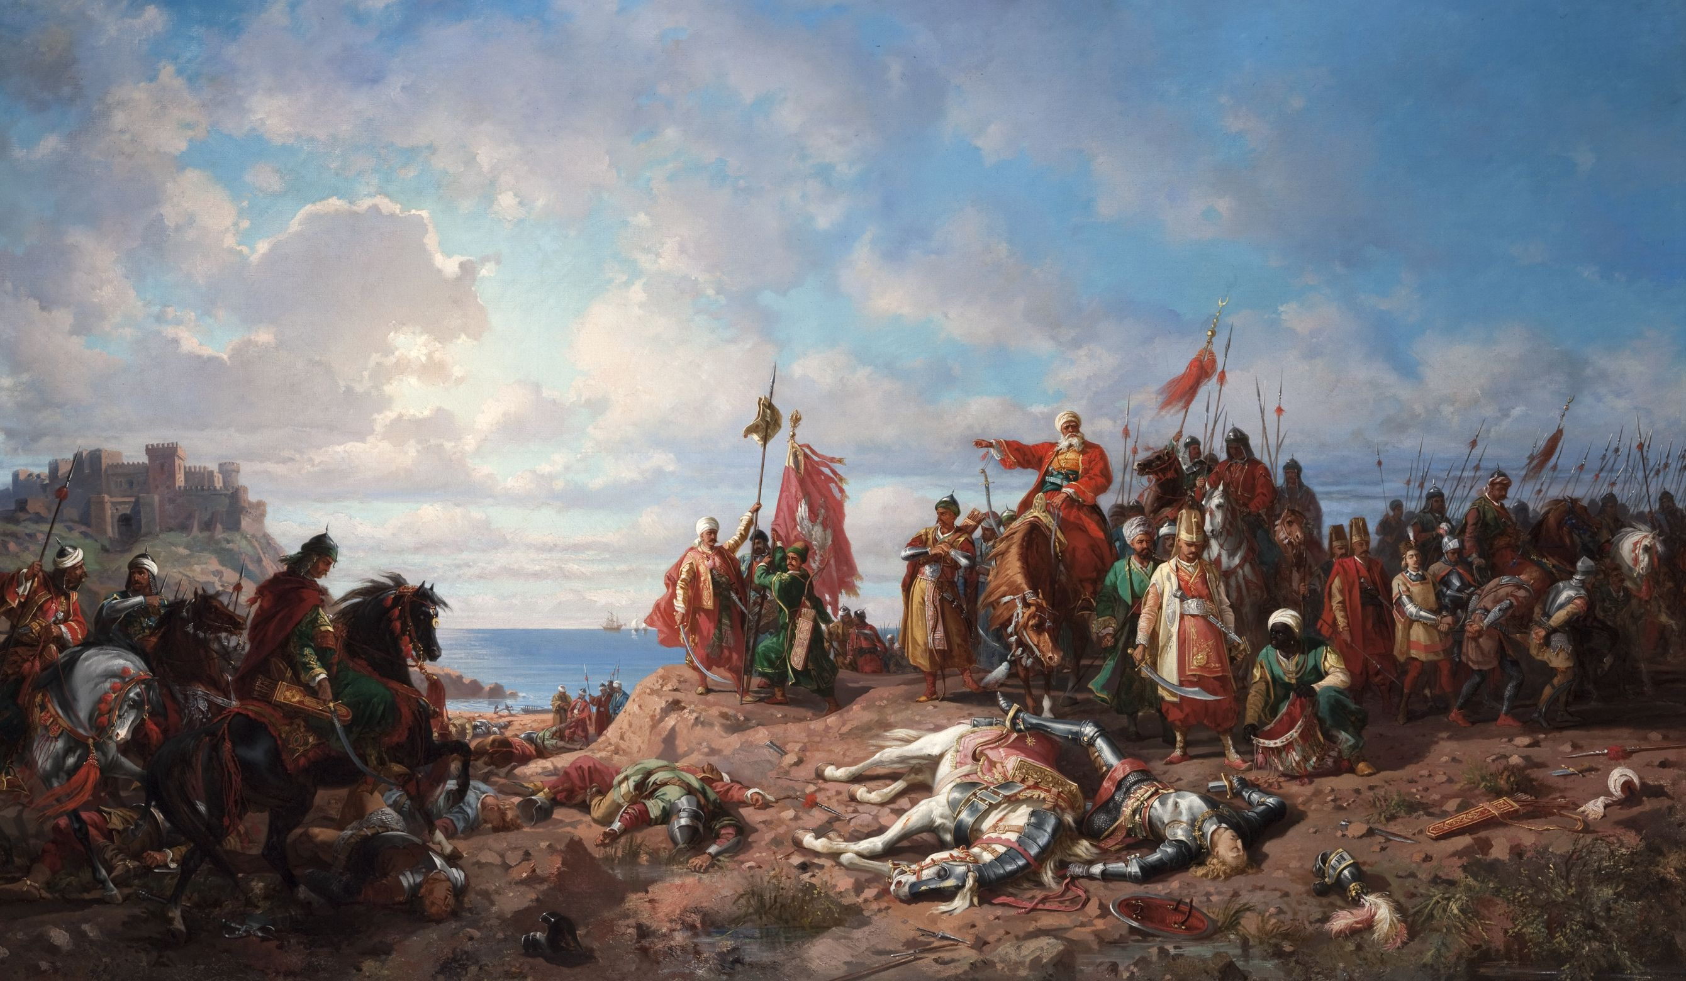

Slide 15
Last Crusade – Second Battle of Kosovo, 1448
After the Battle of Varna, Sultan Murad II retired to Manisa
The Hungarians and Wallachians reawakened
There was a also Janissary revolt in Edirne, forcing the Sultan to come back to the throne in 1446 for a third term (they wanted him back and also asked for a raise)
Sultan Murad marched on the Morea (Peloponnese peninsula in southern Greece) and then against the Albanian Skabderbey
Composed on Wallachian, Hungarian, Polish, and German soldiers, the crusaders now invaded Serbia and moved into Ottoman domain
Sultan Murad confronted them in Kosovo, 3 day long battle, Karamanids also sent military reinforcements as promised
The Ottoman victory in Varna, followed by the Ottoman victory in the Second Battle of Kosovo in 1448, deterred the European states from sending any substantial military assistance to the Byzantines during the Ottoman siege of Constantinople in 1453.
Hunyadi was humiliated and he signed a three-year truce in 1451.
Murad II was able to finally bring the Balkans truly under Ottoman control

Slide 16
Murad II’s Legacy
Murad returned to Edirne, attended Mehmet’s wedding; He fell ill and passed away in 1451 at the age of 48 years; He was buried in Bursa, next to his son Allaudin, in an open topped tomb
During his reign state revenues increased by 2.5 million gold coins
He was given the title – Ebul Hayrat – the Father of Good Works
  He built many mosques, madrassas and other Islamic Institutions – in Bursa, Edirne, Salonika, Skopje, Alacahisar, Merzifon
  He raised scholars such as Molla Gurani, Ataeddin Et Tusi, Serefeddin Kirimi, Seydi Ahmed Kirimi from Arabia, Turkistan and Crimea
  Many of the scholars and intellectuals of Sultan Mehmed’s time were educated during this time
  Sufi orders were expanded; Books were written and translated, First Turkish translation of the Quran
  Murad continued the tradition of sending surre to Haramain and distributed gold annually to the descendants of Prophet Mohammad (saw)
1299-1451: 150 years of ups and downs
1451 onwards – one century of ups!
Notes:
Haci Bayram Veli – Turkish poet, Sufi, founder of the Bayrami Sufi tariqa, scholar of Islam
Aksemsuddin: Bayram Veli’s student, he became Mehmed’s teacher

Slide 17
Sultan Murad’s reign and his abdication was the preparation…
Haci Bayram Veli gave Murad the good news that Aksemsuddin and his son Mehmed would be granted the honor, so he abdicated in the hope that he would be able to witness the realization

Slide 18
Timeline of Murad II’s Reign
1404: Murad II is born in Amasya, during the Interregnum period.
1421: Murad II takes the throne at the age of 17.
1422: Sultan Murad II laid siege to Constantinople
1422: His Uncle Mustafa and his Brother Mustafa rebel against him with Byzantine support
1423-1433: Murad consolidates his rule in Anatolia and suppresses local rebellions.
1437: The Orthodox and Catholic Church form an alliance.
1438: Several victories against the Hungarians and Serbians.
1441: Hungarians have victories against Murad under the command of John Hunyadi 1443: Peace treaty with Hungarians and Karamanids
1444: Murad abdicates in favor of his 12-year-old son Mehmet and moves to Manisa for a life of religious seclusion (khalwa).
1444: A new Crusade (Poland and Hungary) is announced, culminating in the Battle of Varna. Ottomans are victorious.
1448: The Second Battle of Kosovo takes place as Murad returns to the throne due to Janissary revolt and other challenges.
1451: Murad II passes away at the age of 48 and is buried in Bursa.

Slide 19
Major Battles
Year | Name of Battle | Sultan | Against | Impact
1444 | Battle of Varna | Murad II | A coalition of European Christian states, known as the Crusader army. | Resulted in a decisive Ottoman victory, consolidating their dominance in the Balkans and dealing a severe setback to the European Crusade against the Ottoman Empire.
1448 | Second Battle of Kosovo | Murad II | A coalition of European Christian states, known as the Crusader army. | Solidified Ottoman control over the Balkans, humiliating European forces and marking a significant step toward the completion of Ottoman dominance in the region. The Europeans avoided forming alliances against the Ottomans after this battle.

Slide 20
What was Happening Elsewhere (1421-1451)
1421: Portuguese explorers begin settling the Madeira Islands.
1422: Henry VI becomes king of England, succeeding his father, Henry V.
1429: Joan of Arc leads the French army to lift the siege of Orléans, turning the tide of the Hundred Years' War in favor of France.
1430: Admiral Zheng He embarks on his seventh and final maritime voyage.
1430-31: Joan of Arc is captured by Burgundian forces and handed over to the English; she is executed by burning in Rouen, France.
1431: The Council of Basel begins, aiming to reform the church and heal the schism with the Eastern Orthodox Church.
1434: Cosimo de' Medici rises to power in Florence, marking the dominance of the Medici family and the flourishing of the Renaissance.
1440: Frederick III is elected Holy Roman Emperor and later becomes the first emperor of the Habsburg dynasty.
1441: Portuguese sailors explore the west coast of Africa and begin the Atlantic slave trade.
1447: Pope Nicholas V ascends to the papacy; becomes a patron of Renaissance art and culture.
1449: The Timurid ruler Shah Rukh dies, leading to instability in the empire, especially in Central Asia.
1451: Moctezuma I becomes emperor of the Aztecs, expanding their empire's territory and influence.

Slide 21
Videos
Battle of Varna 1444 - Ottoman Civil War

