Slide 1
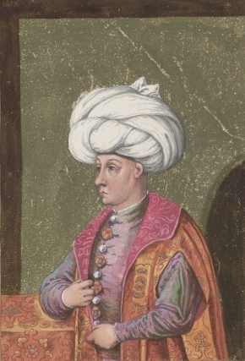
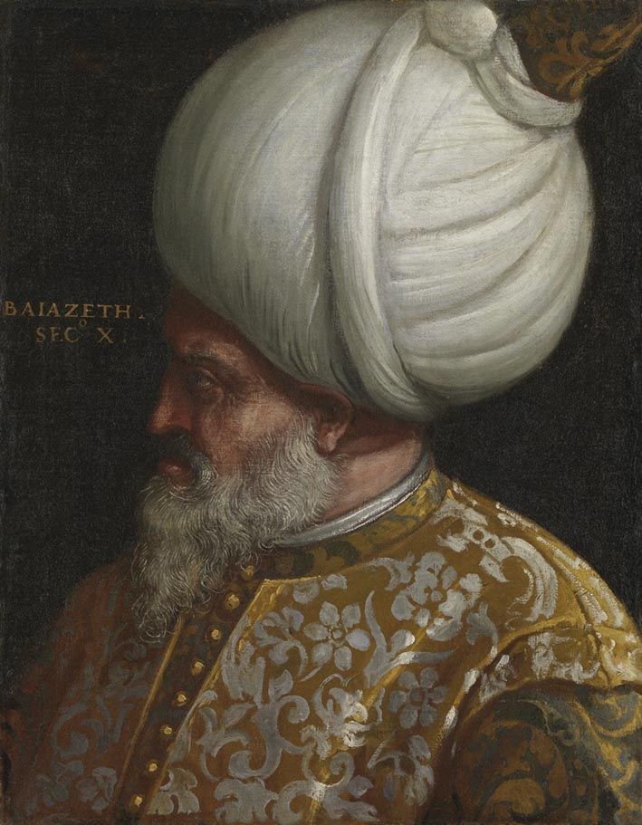
Consolidation and Stability
Bayezid II (r1481-1512)

Slide 2
Let’s Recap…
Notes:
Let’s Recap…

Slide 3
Timeline of the First 7 Sultans
1237: Alaeddin Keyqubad I awards Ertugrul (d.1289) title of Ghazi and Karacadag, Sogut, Domanic
1285-88: Osman (d.1326)conquers Byzantine territories, Yenisehir is the new capital
1326: Orhan (d.1360) comes to power, Bursa is taken, becomes new capital
1329-54: Conquest of Nicaea and Gallipoli; Annexation of the Karasids lands.
1363-65: Murad I 9d. 1389) takes Tzouroulos, Arkadiapolis, Malgara and others; Edirne became capital.
1368-82: Bulgaria and Constantinople (Byzantine Empire) became vassals, Germiyanids, Karamanids lands taken.
1389: Murad was martyred after victory at the Battle of Kosovo; Bayezid I (d.1403) succeeded him.
1389-93: Bayezid took Philadelphia and Beyliks in Anatolia (Karamanids and Candarids)
1391-96: Bayezid besieged Constantinople and defeated the Holy League at the Battle of Nicopolis.
1402: Defeat at the Battle of Ankara, resulted in a 10 year Interregnum period
1413-19: Mehmed I (d. 1421) becomes the Sultan, seizes Konya and territories in Wallachia and Hungary
1419: Byzantines, Serbians, Wallachian, Moreans agree to pay tribute to the Ottomans.
1423-1433: Murad II (d.1453) consolidates his rule in Anatolia and suppresses local rebellions.
1443-44: After signing peace treaties with Hungarians and Karamanids, Murad II abdicates
1444-48: Murad returns and wins at the Battle of Varna and the Second Battle of Kosovo
1451: Murad II passes away, Mehmet II (d.1481) comes to power.
1453: Conquest of Constantinople
1459-1479: Mehmet took Serbia (1459), Morea (1460), Trebizond (1461), Bosnia (1463), Crimea (1475), Albania (1479)

Slide 4
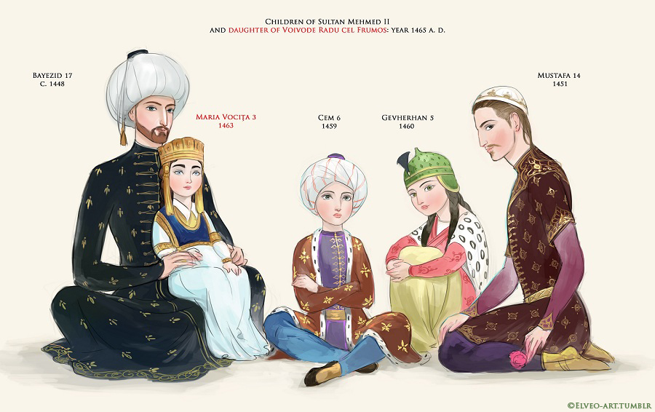
Mehmed II’s Children

Slide 5
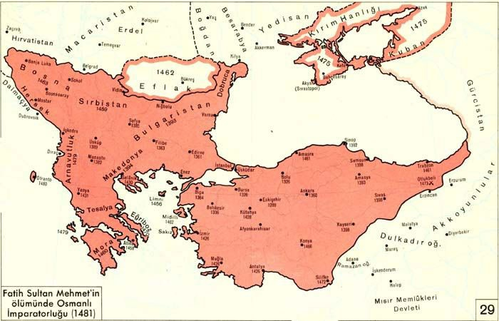

Slide 6
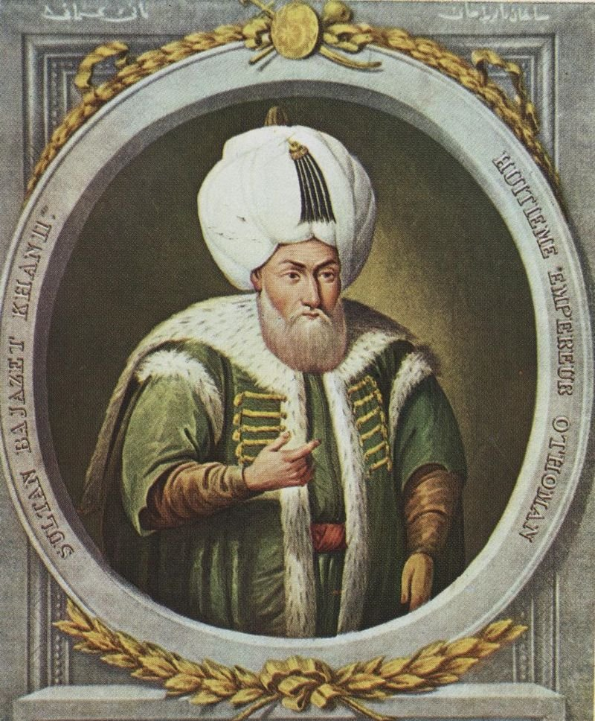
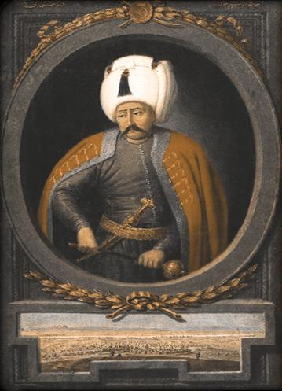
The Classical Age (1481-1520)
Consolidation and Stability
Bayezid II (r1481-1512)
The Caliphate
Selim I (r1512-1520)

Slide 7
Bayezid II (r1481-1512)
Bayezid – Abu Yezid – Edebali, Eldest son of Mehmet Fatih, born in 1448
Governor of Amasya from the age of 7, governed it for 27 years
Amasya – well-known for training and development – literary center, religious center
Received religious and administrative education
Tutors, advisors, veterans were overseeing his rule and giving advice – training for the future Sultan
Excelled in calligraphy – Arabic, Persian, Chagatai Turkic (Turko-Mongol language)
He wrote poetry, mainly ghazals under the penname Adli
He patronized and supported all kinds of scientific and literary research, rise of many distinguished scholars and artists
Used to go hunting, great warrior, not weak, but preferred peace
In his mid twenties, he commanded the right wing of the Ottoman army during the Battle of Otlukbeli in 1473
He was a kind and just ruler – listened carefully to the subjects, sacrificed for the people who were mainly non-Muslims – people loved him
He was a devout Muslim (he was called Veli – God’s friend) due to his focus on religious duties and charities
Passed away in 1512 due to gout or poisoning
Notes:
Mughals also used Chagatai Turkic before shifting to Persian. The Baburnama and Humayunama were in Chagatai
Also artists in Europe – Leonardo, Michelangelo

Slide 8
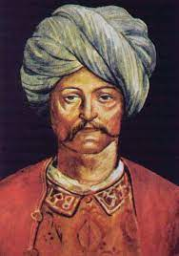
Brother Against Brother – Bayezid II vs Cem
Mehmet Fatih passed away in 1481 at the age of around 50
Bayezid was in Amasya, Cem was in Konya, both raced to the capital, Bayezid reached first
Tradition – whoever reaches Constantinople first becomes the Sultan
Bayezid distributed wealth among Janissaries, secured their loyalty and was received as Sultan
Cem arrived, his forces defeated Bayezid’s army before they could mobilize, he occupied the former capital of Bursa, with the support of the Karamanids
Cem proposed to Bayezid to divide the Ottoman territories – Bayezid: Rumelia and Cem: Anatolia
This proposal of a split was supported by the Europeans and by the Mamluks
Bayezid knew that all the enemies wanted the empire to split – divide and get weak
He organized his forces and defeated Cem in the ensuing battle at Yenisehir
Strongest one survives!

Slide 9
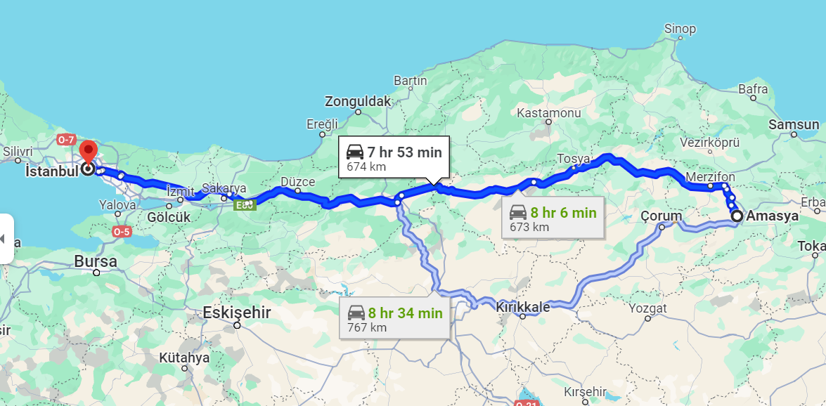
Notes:
Amasya to Istanbul today takes 7hr 53 min

Slide 10
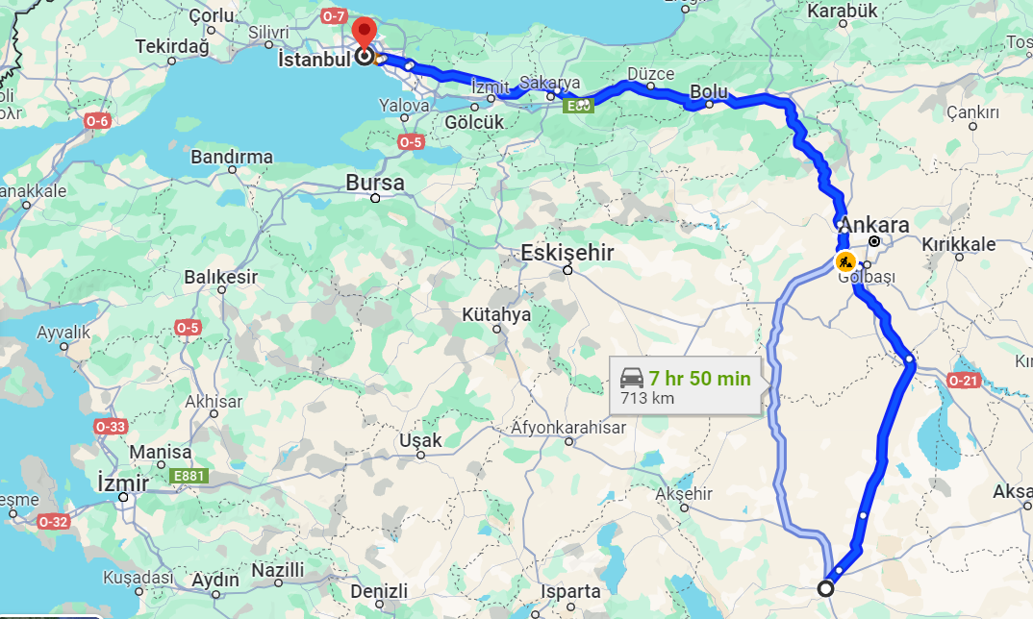
Notes:
Konya to Istanbul today takes 7hr 50 min

Slide 11
Cem Sultan’s Fate
Cem withdrew to Konya, but didn’t get support there, so he went east to the Mamluks
Qaitbay welcomed him and brought him to Cairo, he also visited Jerusalem and went on pilgrimage to Makkah
Bayezid sent a letter with a proposal: give up the claim, save the Sultanate, accept 1 million silver coins
In 1482, Cem, with the backing of the Mamluks and the Karamanid Bey, returned to Anatolia and threatened to take over Konya
He was defeated, and fled to Rhodes (Greek – Knights Hospitaler), he tried to seek the support of the knights, but they betrayed him and made an agreement with Bayezid to keep him in Rhodes in return for 40,000 ducats annually
He was taken to France and then to the Pope in Rome
He was a captive and hostage, a potential pawn, considered useful to create turmoil in Ottoman lands, believed to be a deterrent to Ottoman aggression in Europe
Pope tried to use Cem to begin a new crusade and whenever Bayezid intended to launch a campaign, he would threaten to release Cem
Bayezid paid Pope Innocent VIII ransom to keep Cem in Rome (or was it Pope Alexander VI)
In 1494, Charles VIII, the French King took Cem with him following the French expedition to Italy
Cem Sultan was poisoned to death in 1495, (Pope ordered his death), his body was held for ransom for 4 years and later he was buried in Bursa
Notes:
His first son Shehzade Oguzhan had already been killed by Bayezid in 1482, his second son Sehzade Murad converted to Christianity (Pierre Mehmed Sayd) and was killed by Sultan Suleiman when he conquered Rhodes

Slide 12
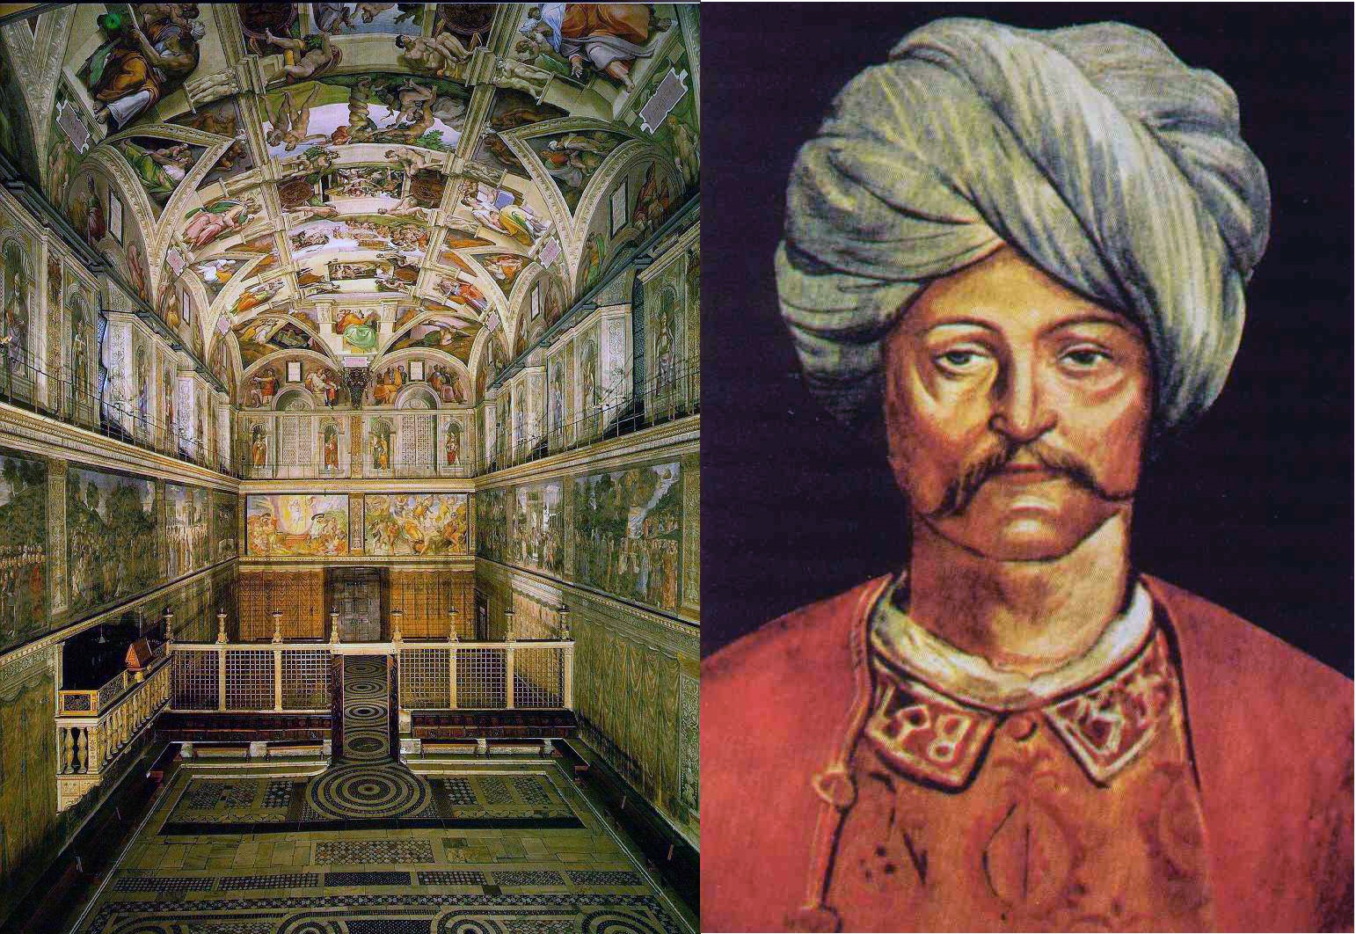
CEM SULTAN’s RANSOM TAKEN BY THE POPE
120,000 crowns
100 Moorish slaves
Holy Lance
40000 ducats every year
Sistine Chapel built with these ransoms

Slide 13
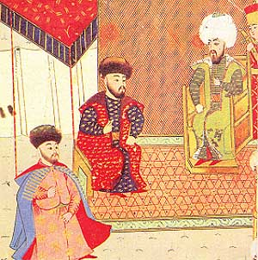
Expansion
Karamanid state was abolished due to the chaos it instigated
Herzegovina was attached to Ottoman territory in 1483
Kilia and Akkerman forts which were part of Moldavia, had obstructed the
Ottoman land route from Crimea; Mehmed II had been unable to defeat
Voivode Stefan III of Moldavia; these were were conquered in 1484; the
Ottomans now dominated the western shores of the Black Sea
After a host of naval battles against Venice, the Ottomans captured Naupactus (Lepanto), Methoni, Koroni and Navarino in 1494; the Ottomans now had a strategically vital base in the Adriatic
Ottoman forces then entered Croatia and Dalmatia, Venice was worn down defending its territories and signed an armistice in 1502 with mediation by the Kingdom of Poland
The Mamluks had protected Cem, increased the pressure on the Dulkardid principality and taxed Turkish pilgrims
A series of battles began in 1485 between the Ottomans and Mamluks and lasted about six years
In 1491, The Tunisian Sultan arbitrated and helped to end the war and the Ottomans returned the Adana and Tarsus regions
1509: Powerful earthquake in Constantinople – thousands died and more than 10,000 were injured
With the Crimean Khan

Slide 14
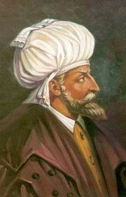
Refugees from Al Andalus
2nd Jan 1492: The last Muslim held city (Granada) fell to the Catholic Kingdom of Castile ending almost 800 years of Islamic rule in Iberia
The Muslims in Al Andalus sought help from Ottomans and Mamluks
Kemal Reis (d1511) was sent by Sultan Bayezid to help Muslims and Jews
In 1505, Kemal reis moved the Muslims of Spain to North Africa and the Jews to Istanbul and Salonica
These Jews later settled in Palestine and Thessalonica; by 1550, 10% of the population in Constantinople was Sephardic Jews (40,000)
"You venture to call Ferdinand a wise ruler", he said to his courtiers — "he who has impoverished his own country and enriched mine!".
Notes:
Sephardic Jews are Spanish Jews who were forced to convert to Catholicism or face expulsion from Spain after 1492. In this great diasporic movement, 100,000-300,000 Spanish Jews (estimates vary) left Spain and settled in different parts of Europe and the Middle East. Many settled in the Ottoman Empire after they were welcomed by the Ottoman Sultan. The name "Sephardic" comes from the Hebrew word for Spain, "Sefarad."

Slide 15
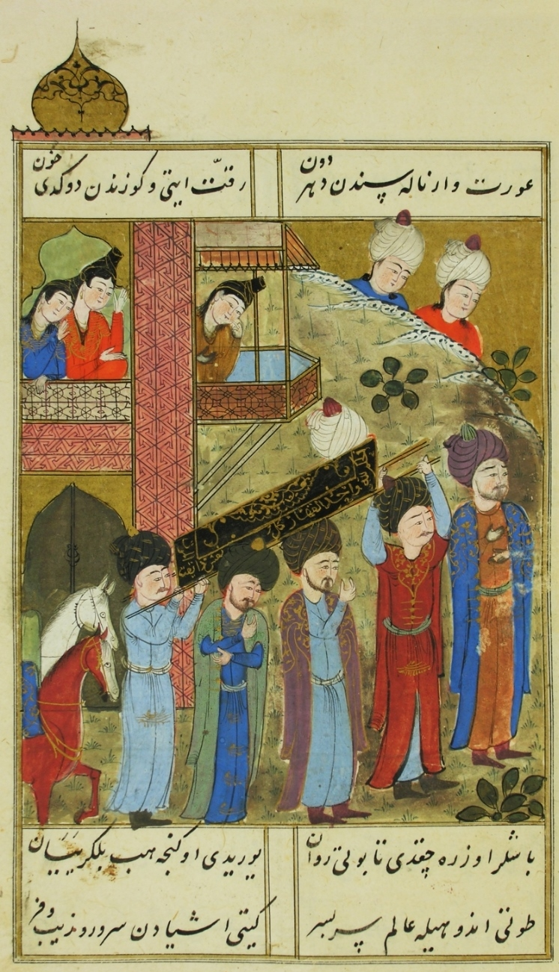
Bayezid’s Reign
After Cem died in 1495, Bayezid could pay attention to governance
His focus was on maintaining stability and consolidation of the empire and he paid attention to internal affairs
Peaceful relations with foreign powers – he kept the borders his father established – neither losing or gaining any territories
A place of refuge; artists and scientists were supported
85 law codes were published – regulations on food, consumer rights and environment
Construction Projects
  The Galata mosque was developed in the Andalusian style
  Bayezid Masjid near Grand Bazaar was constructed – a replica of the Faith mosque
  He explored possibility of building a bridge over the Golden Horn from Constantinople to Galata (Leonardo Da Vinci)
  He built many social works like the kulliyes in Istanbul and Edirne and the Pirinc Han, the inn in Bursa which was rented out to support charitable organizations
The navy was transformed from merely a means of transport to a fully-fledged power of war
Notes:
Cooks should prepare clen food
Wash pots with clean water
Naver serve pork
Barbers shouldn’t share utensils
Horses without horse shoes
Do not overburden their loads
By decree of Sultan Bayezid II of the Ottoman Empire in 1484 Turks were prohibited from operating a printing press.

Slide 16
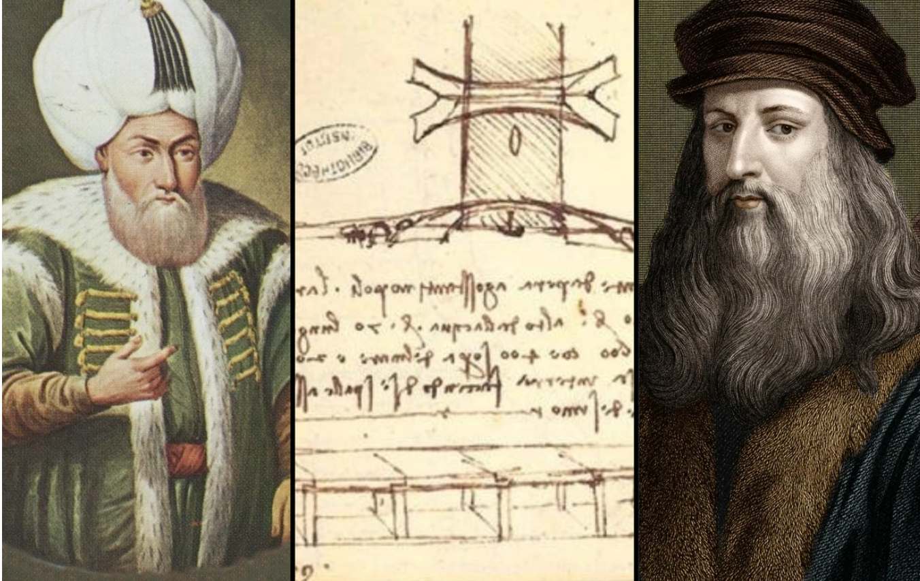

Slide 17
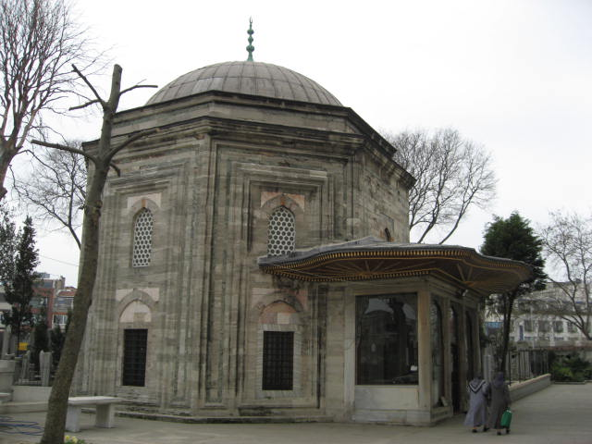
Tomb of Bayezid II in Istanbul

Slide 18
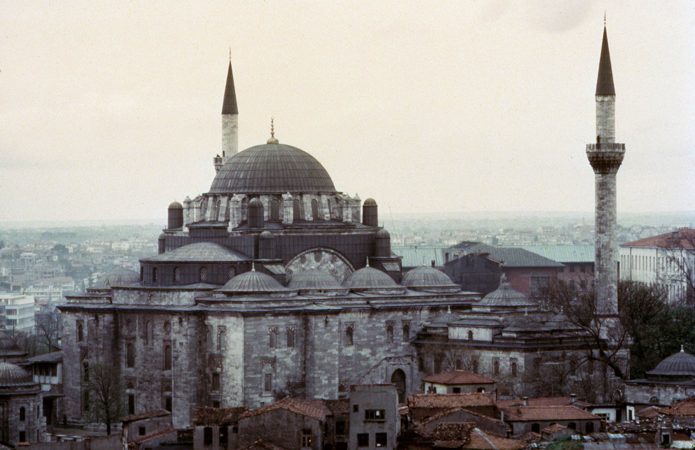
Sultan Bayezid II Complex, Sultan Bayezid II Mosque

Slide 19
Timeline of the Reign of Bayezid II (r1481-1512)
1448: Bayezid II (Abu Yezid) is born, the eldest son of Mehmet Fatih.
1455: Becomes the Governor of Amasya at the age of 7, ruling for 27 years.
1473: Commands the right wing in the Battle of Otlukbeli in his mid-twenties.
1481: Bayezid II becomes Sultan after the death of Mehmet Fatih.
1485-1491: Engages in battles against the Mamluks, ending with peace treaty
1494: Capture of Lepanto and other islands from the Venetians
1495: Cem Sultan dies in captivity, ending a potential threat.
1501: Rise of Safavid Empire poses a threat; Bayezid focuses on internal affairs.
1502: Peace treaty with Venice
1505: Kemal Reis (d1511) was sent by Sultan Bayezid to help Muslims and Jews in Spain
1509: Earthquake in Constantinople causes significant damage.
1512: Bayezid II passes away, possibly due to gout or poisoning.

Slide 20
What was Happening in the World (1481-1512)
1485: Wars of the Roses in England concludes, Henry Tudor (King Henry VII) establishes Tudor dynasty.
1488: Sheikh Haydar, the spiritual leader of the Safavids, was killed in battle.
1492: The Catholic Monarchs complete the Reconquista by capturing Granada
1492: Christopher Columbus, sponsored by Spain, reaches the Americas
1494: Pope Alexander VI drew an arbitrary line around the globe, dividing up the world
1497-1498: Vasco da Gama, a Portuguese explorer, sails around the Cape of Good Hope, reaching Calicut in India, establishing a sea route to Asia.
1502: The "Second Italian War" begins, involving various European powers including France, the Holy Roman Empire and Spain.
1503: Leonardo da Vinci completes his painting “Mona Lisa.”
1505-1511: Parts of North Africa were taken by the Spanish and Portuguese. (Mars al Kabir (Algeria) in 1505, Oran (Algeria) in 1509, Bogie (Tunisia) in 1510, Tripoli (Libya) in 1511, Agadir in 1505, Safi in 1507, Azemour in 1513)
1509: In India, the Battle of Diu takes place between the Portuguese and a joint fleet of the Sultan of Gujarat, the Mamluks, and the Ottomans.

