Slide 1
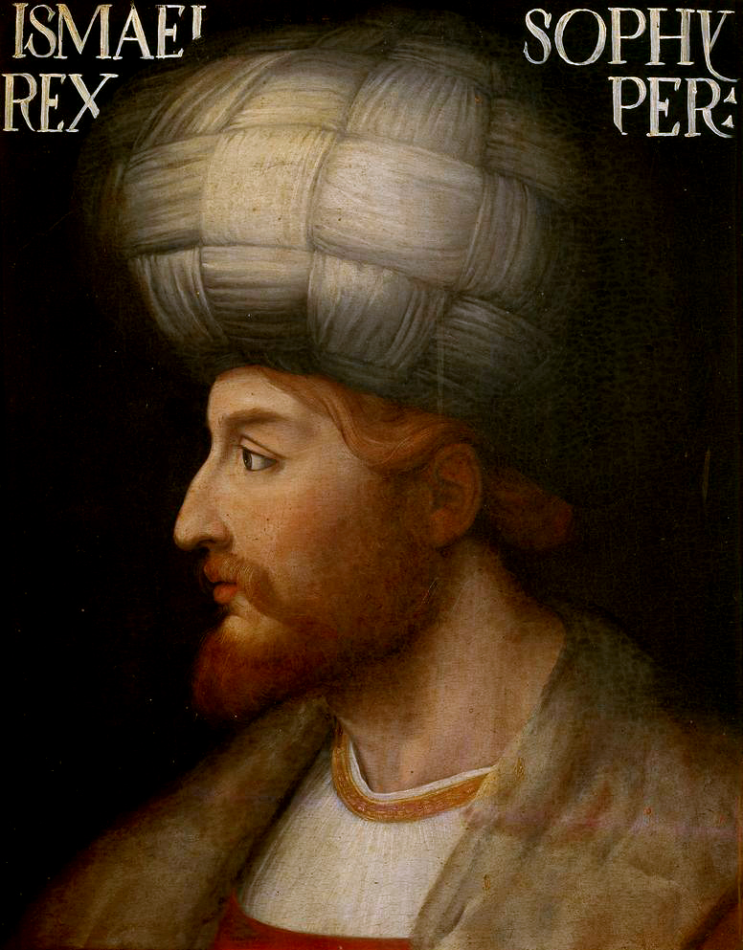
The Safavids
(1501-1722)

Slide 2
Persia before the Safavids
1220s: The Mongol Empire, under Genghis Khan, begins its westward expansion, reaching Persia
1258: Hulagu Khan, Genghis Khan's grandson, leads the Mongol conquest of the Abbasid Caliphate in Baghdad, the Ilkhanate is established, rules over Persia, the Caucasus, and parts of modern-day Iraq.
1295: Ghazan Khan (r. 1295-1304), a ruler of the Ilkhanate, converts to Islam and declares it the state religion
1335: The death of Abu Sa'id, the last strong Ilkhan ruler, leads to the fragmentation of the Ilkhanate, Persia becomes a battleground for various regional dynasties and rulers.
1353-1387: The Jalayirid Dynasty, a Mongol successor state, controls parts of western Persia, including Baghdad and Tabriz. In central Persia, the Muzaffarid Dynasty rules from cities like Yazd and Isfahan.
1380-1405: Timur (Tamerlane), a Turco-Mongol conqueror, rises to power in Central Asia and embarks on conquests that include Persia. His descendants (the Timurids) continue to control parts of Persia.
1252-1334: Sheikh Safi al-Din Ardabili, a spiritual leader in Ardabil (in modern-day northwestern Iran), founds the Sunni Safaviyya Sufi order. Sheikh Safi’s followers, known as murids, spread the teachings of the order, and it gains influence, especially among the Turkmen tribes of the region. Over time, the Safaviyya order would become increasingly militaristic and political.
14th-15th C.: The Safaviyya order begins to shift from Sunni to Twelver Shi’a Islam under the leadership of Sheikh Junayd (d. 1460) and his successor Sheikh Haydar.

Slide 3
This shift toward Shi’ism differentiates the Safaviyya from other Sufi orders and sets the stage for their later rise to power.
The order increasingly becomes a political force, gaining military followers among the Qizilbash, a group of Turkmen tribes who were loyal to the Safavid leadership.
The Qizilbash would later form the backbone of the Safavid military.
The Safavids wanted to separate the Arabs from the Persians, objective was to bring back Persian culture

Slide 4
The Safavids (1502-1736)
In 1488, Sheikh Haydar, the spiritual leader of the Safavids, was killed in battle with the Aq Qoyunlu Ismail, the son of Sheikh Haydar, goes into hiding after his father’s death, but the Safaviyya order continues to grow in influence.
Ismail came out of hiding at the age of 14, claimed to be of Sassanian blood and also that he descended from Nabi saw thru Ali and Fatima and represented the Twelfth of hidden Imam
In 1501, Shah Ismail (d.1524) and his forces of Qizilbash Turkoman tribesmen defeated the ruler of Azerbaijain and had secured the city of Tabriz. Conquests continued in Khorasan and Armenia.
In 1502, fourteen year old Ismail was proclaimed the first Safavid Shah of Iran
1514: Ismail took Baghdad but died a sad death after the loss to Selim I in the Battle of Chaldiran 1588-1629: Shah Abbas, 5th ruler from 1588-1629 made Isfahan beautiful and great
The Safavids practiced a violent form of Shi'ism: large scale massacres of Sunnis in Tabriz, Herat, Persia, Azebaijan; They forced people to become Shia
They sent eminent disciples to Anatolia to propagate Shi’ism and followers started mushrooming in Anatolia; Ulemas declared the Safavids to be a heretical group
Ottoman Sultans became the protectors of Sunni Islam in the Muslim world. Through a series of letters, Bayezid II had warned Shah Ismail to stop destroying Sunni mosques and graveyards in Safavid territory.
Notes:
Political Rivalries and the Fall of the Aq Qoyunlu (1467 – 1501)
1467: The Aq Qoyunlu, under Uzun Hasan, defeat their rivals, the Kara Qoyunlu (Black Sheep Turkmen), and consolidate power over much of Persia.
1473: The Aq Qoyunlu face off against the Ottomans in the Battle of Otlukbeli, where they suffer a significant defeat. This weakens their power and opens up space for new factions to rise.
Late 15th Century: The Aq Qoyunlu experience internal strife and a series of weak rulers, allowing the Safaviyya order, now led by a young Ismail I, to build military power with the support of the Qizilbash.

Slide 5
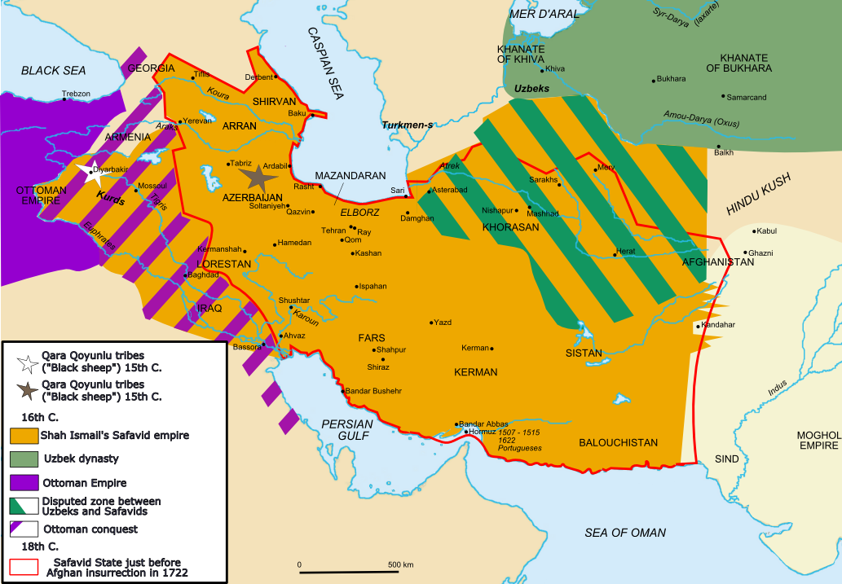

Slide 6
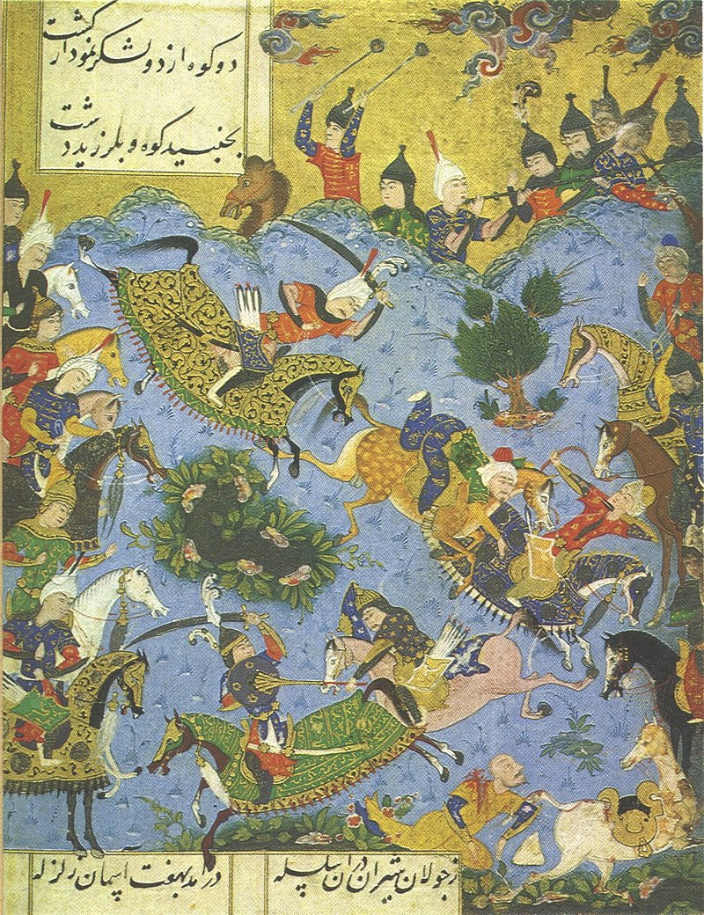
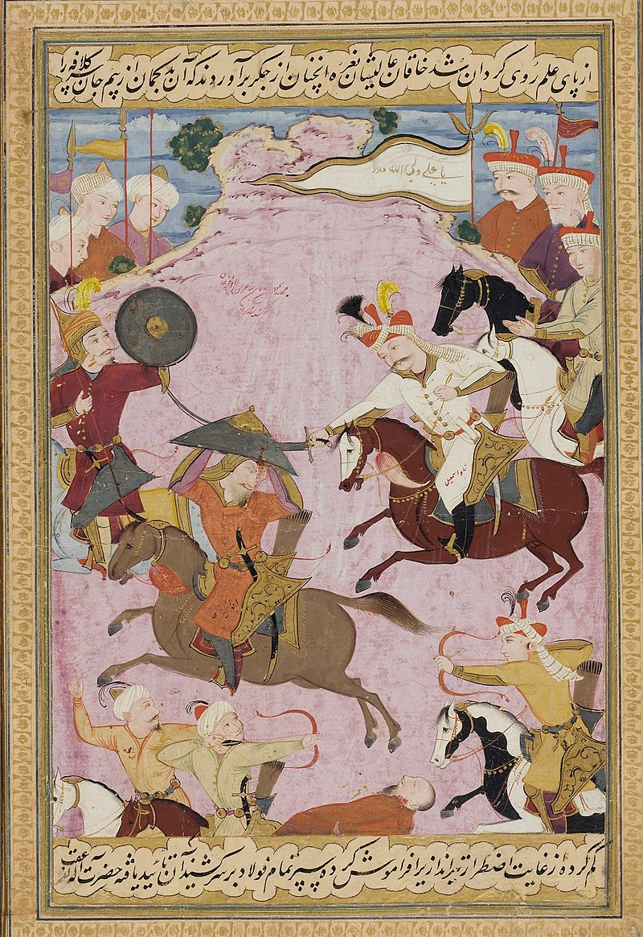
The battle between the young Ismā'īl and Shah Farrukh Yassar of Shirvan
The battle between Ismail I and Muhammad Shaybani

Slide 7
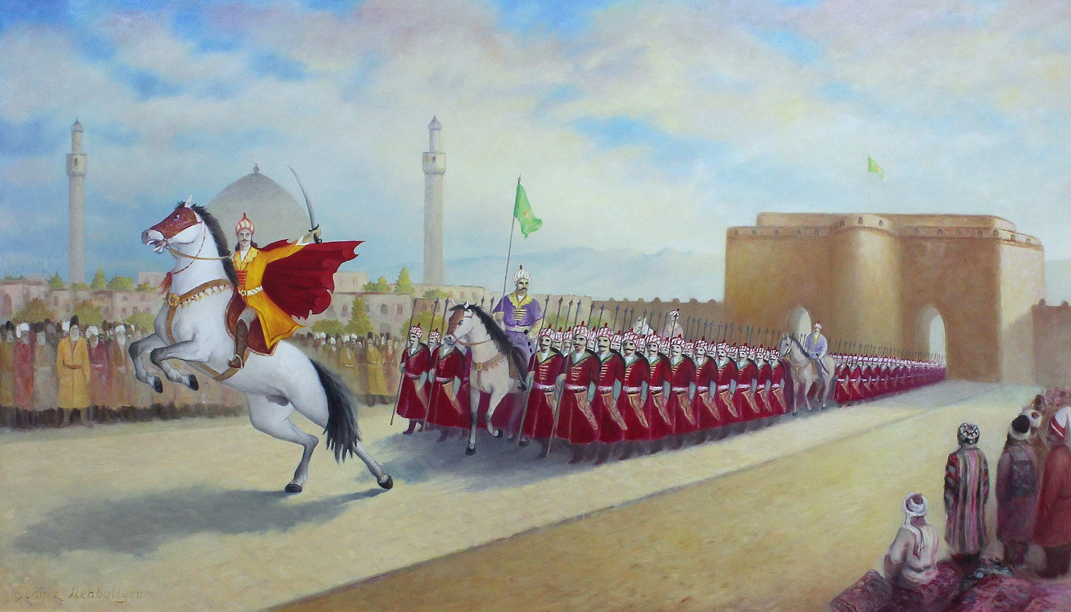
Ismail declares himself shah by entering Tabriz

