Slide 1
The Caliphate
Selim I (r1512-1520)

Slide 2
Let’s Recap…
Notes:
Let’s Recap…

Slide 3
Timeline of the First 8 Sultans
1237: Alaeddin Keyqubad I awards Ertugrul (d.1289) title of Ghazi and Karacadag, Sogut, Domanic
1285-88: Osman (d.1326)conquers Byzantine territories, Yenisehir is the new capital
1326: Orhan (d.1360) comes to power, Bursa is taken, becomes new capital
1329-54: Conquest of Nicaea and Gallipoli; Annexation of the Karasids lands.
1363-65: Murad I 9d. 1389) takes Tzouroulos, Arkadiapolis, Malgara and others; Edirne became capital.
1368-82: Bulgaria and Constantinople (Byzantine Empire) became vassals, Germiyanids, Karamanids lands taken.
1389: Murad was martyred after victory at the Battle of Kosovo; Bayezid I (d.1403) succeeded him.
1389-93: Bayezid took Philadelphia and Beyliks in Anatolia (Karamanids and Candarids)
1391-96: Bayezid besieged Constantinople and defeated the Holy League at the Battle of Nicopolis.
1402: Defeat at the Battle of Ankara, resulted in a 10 year Interregnum period
1413-19: Mehmed I (d. 1421) becomes the Sultan, seizes Konya and territories in Wallachia and Hungary
1419: Byzantines, Serbians, Wallachian, Moreans agree to pay tribute to the Ottomans.
1423-1433: Murad II (d.1453) consolidates his rule in Anatolia and suppresses local rebellions.
1443-44: After signing peace treaties with Hungarians and Karamanids, Murad II abdicates
1444-48: Murad returns and wins at the Battle of Varna and the Second Battle of Kosovo
1451: Murad II passes away, Mehmet II (d.1481) comes to power.
1453: Conquest of Constantinople
1459-1479: Mehmet took Serbia (1459), Morea (1460), Trebizond (1461), Bosnia (1463), Crimea (1475), Albania (1479)
1495: Capture of Lepanto and other islands from the Venetians by Bayezid II (d.1512)
1502: Ismail was proclaimed the first Safavid Shah of Iran
1505: Kemal Reis (d1511) was sent by Bayezid II to help Muslims and Jews in Spain

Slide 4
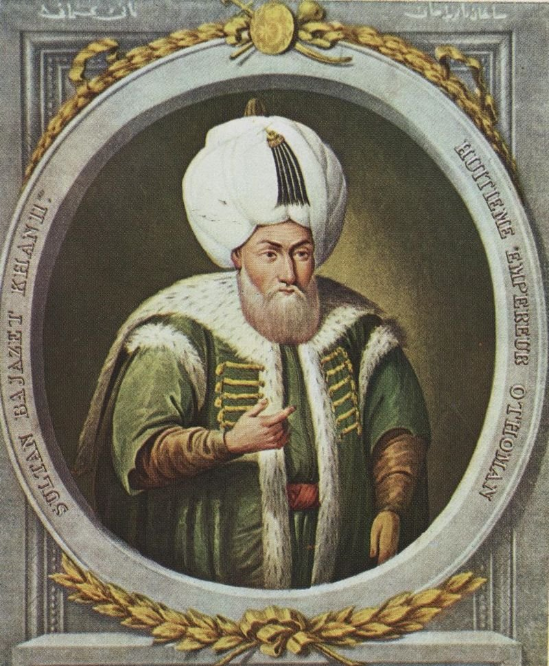
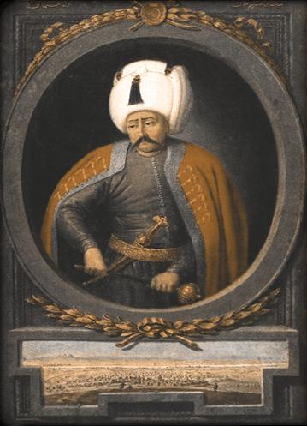
The Classical Age (1481-1520)
Consolidation and Stability
Bayezid II (r1481-1512)
The Caliphate
Selim I (r1512-1520)

Slide 5
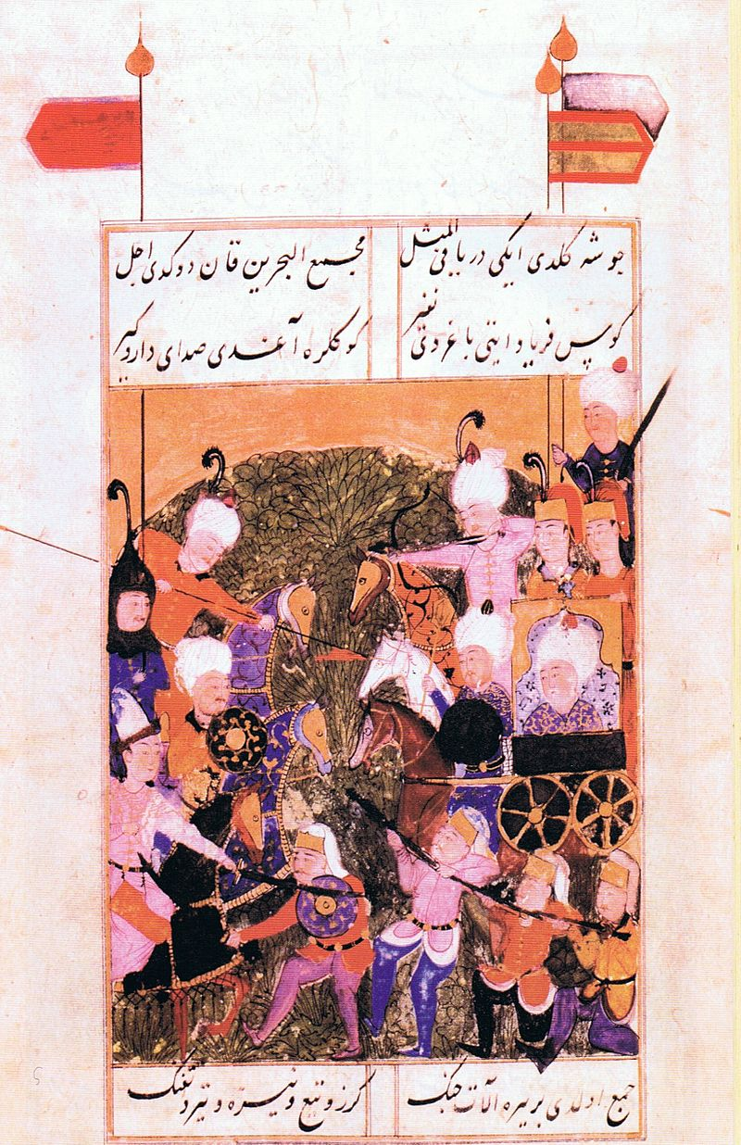
Transition
Bayezid II to Selim I

Slide 6
Changing Dynamics
Young Sehzade Selim, the then governor of Trabzon was the first to recognize the Safavid infiltration, he applied preventive measures to counter it
In 1511, civil unrest broke out in Teke; Shah Kulu was sent by Shah Ismail along with other perpetrators; He defeated the military forces sent to catch him, moved through the vicinity of Bursa up to Sivas; In Tokat, even khutbahs were read in the name of Shah Ismail
Sehzade Ahmed’s failure in thwarting this revolt was the main reason that Sehzade Selim would become the next Sultan
Bayezid II had also not been concerned with leading the army or taking the Safavid threat seriously, so he was under pressure to abdicate by the Janissaries (even though 21 years earlier, they were the ones who had brought him to power)
The Janissaries loved Selim, he got support from military, high officials and Ulema; as he was seen as a war hero
He had also fought with the Georgians
Trabzon was furthest from Constantinople, so he asked Bayezid to transfer him to Silistra on the southern banks of the lower Danube river as it was closer, but his father did not accept the proposal
Selim moved with his forces towards Edirne, Bayezid transferred Selim to Semendria and said he would not let Sehzade Ahmed access the throne
However, when Ahmed was called to Constantinople in Sept 1511, the Janissaries revolted and insisted that they wanted Sultan Selim to be their commander; Selim came and kissed his father’s hand; Bayezid abdicated and relinquished his throne in April 1512
On his way to Didymoteicho where he was going to retire, he fell ill and passed away in May 1512

Slide 7
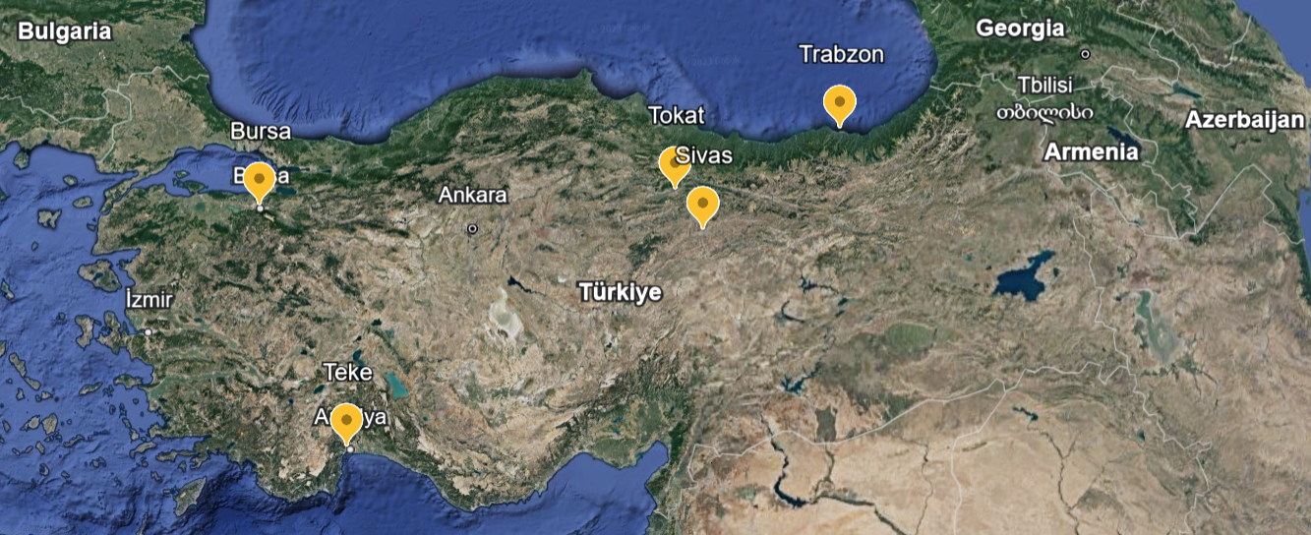

Slide 8
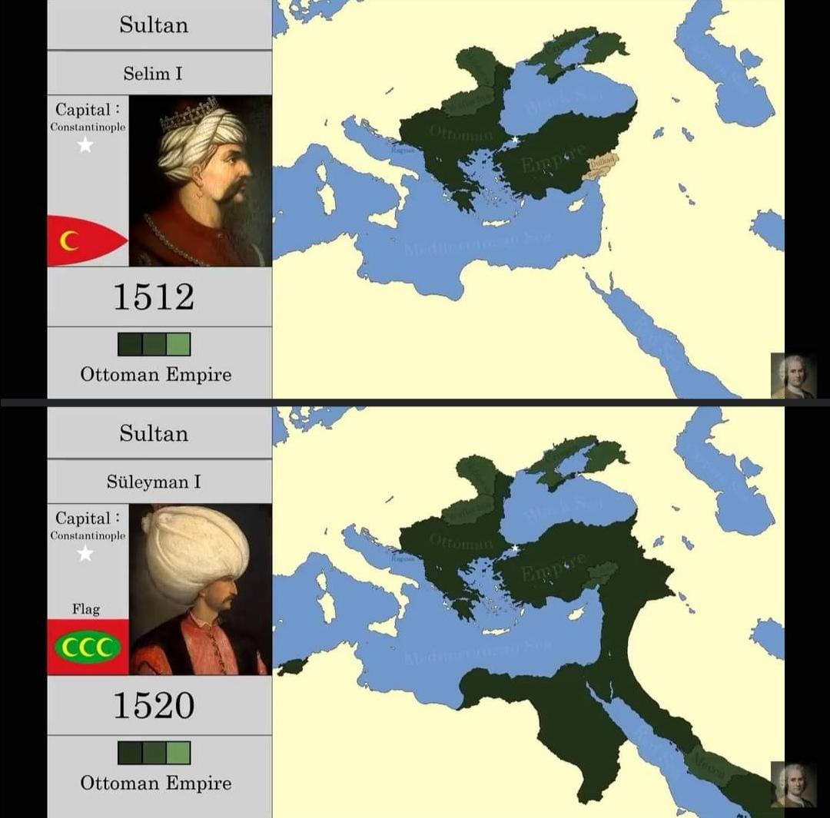

Slide 9
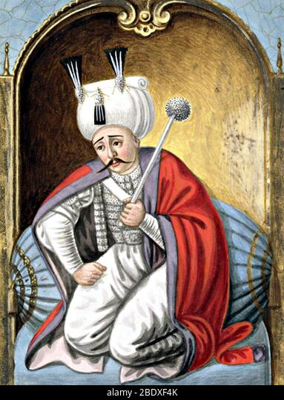
Selim I (the Grim) (r1512-1520)
Born in 1470, youngest of 3 surviving sons (8 sons of Bayezid, some die)
Nicknamed – Abul Futhu (Father of Victories), Yavuz (The Excellent), Khadim I Haramain I Sharifain (Servant of the Holy Mosques)
Governor of Trabzon from the age of 7 years
He came to power in 1512
Objective: the maintain unity in the Turkish and Muslim world
Made peace agreements with European powers and directed his full force to the East during his initial years of reign
Selim I took Egypt from the Mamluks and adopted the title of Caliph
He wrote poems in Arabic and Persian under the pseudonym Selimi
He was supportive of scientific research and highly respectful of the scholars
He espoused freedom of expression and listened to all available ideas
He stayed away from wastefulness, luxury and flamboyance; he preferred to have one dish at a meal and liked to use wooden objects
He spoke little and smiled little and when he spoke, he was articulate
He loved to read and took books on his campaign
Notes:
• He was the 9th ruler • His brother was chosen over him & he rebelled against his father and brother • Ruled for 8 short years but achieved alot • He prepared the road to glory for Suliman his son • He said "A carpet is large enough to accommodate two Sufis, but the world is not large enough for two kings“

Slide 10
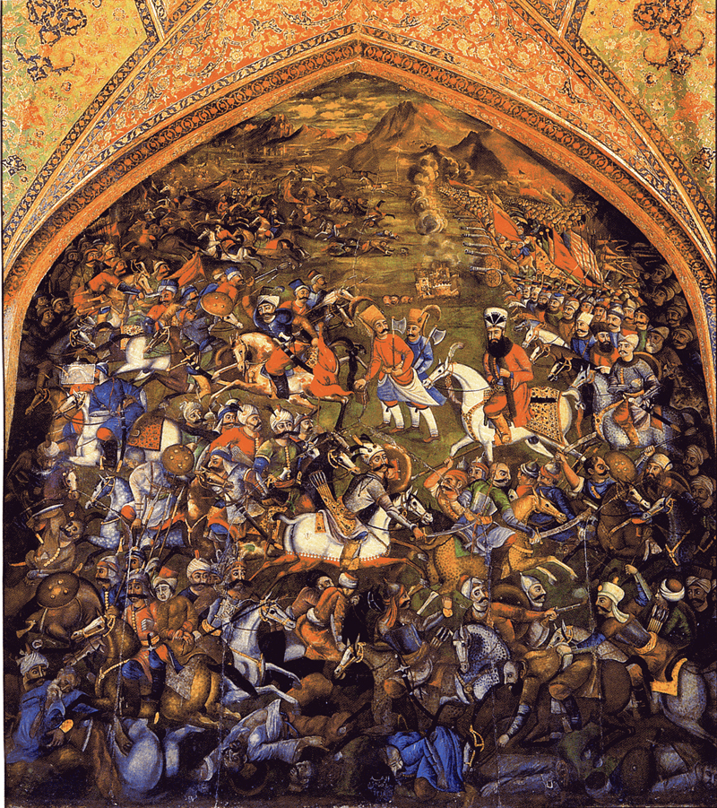
Fighting the Safavids
Selim closed the Ottoman border gates to the Safavid state, commercial relations were affected
Safavid Shah Ismail allied with the Mamluks and Venice against The Ottomans
Finally in 1514, Selim 1 led the army against Shah Ismail
Inspite of revolts within the Janissaries en route, Selim was able to control the army and get their obedience
Confident of victory, the Safavids attacked on the Plains of Chaldiran
The Ottoman army was well developed and used gun powder, while the Safavids were still using old methods
Shah Ismail escaped from the battlefield leaving his belongings which the Ottoman victors paraded in the Safavid capital of Tabriz
This decisive Ottoman victory slowed down the spread of Shi’ism and the Safavids
It brought eastern Anatolia and northern Mesopotamia as well as the stations of the Silk Road between Tabriz-Aleppo and Tabriz-Bursa under Ottoman control

Slide 11
The Mamluks
Selim sent envoys, asking that the Mamluks and the Ottomans should form a coalition against the Safavids
Mamluks saw them as regional rivals, and instead formed an alliance with the Safavids (Mamluk ruler Qanush Al Ghawri)
This was considered treason, also the Mamluks had started treating their subjects poorly and were engaging in sinful acts
The Mamluks lost their standing as the protectors of the Muslim world and the protectors of Haj
Ulema passed legal rulings designating the Mamluks as rebels of Islam
The Sherif of Makkah who was charged with protecting the Holy Lands and ensuring safety of pilgrims proposed that Qabush Al Ghawri request the assistance of Selim Yavuz to defend the Arab world from the Portuguese attacks on the Red Sea; he disagreed
The Arabs had their hopes on Selim to save the Holy cities from the Portuguese who were on the Red Sea and the Indian Ocean
Selim consulted with the Ulema and obtained their consent to fight the Mamluks

Slide 12
Fighting the Mamluks
Dulkadirids, the last independent Turkic Beylik was taken over by Selim after the Battle of Turnadag in 1515
These lands bordered Mamluk territory – direct access to Syria and Egypt
He then marched to Syria, which was part of Mamluk territory; he sent his navy to the shores of Syria to reinforce his march on land
The Ramazanid beylik and the Kurdish beys of eastern Anatolia too waved the Ottoman flag
The cities in Sham rebelled and closed their doors to the Mamluks
The confrontation took place at the Battle of Marj Dabiq in 1516 and the Ottomans crushed the Mamluks
In 1516, Syria came under Ottoman control; soon he took Lebanon and Palestine and paved open the way to Egypt
Tomanbey took over as the last Mamluk Sultan, Selim urged him to recognize Ottoman domination, but he opposed it
The Ottomans passed through the Sinai Desert, marched into Cairo and won against the Mamluks at the Battle of Ridaniya in Jan 1517
Egypt and Hijaz also came under Ottoman control
Notes:
Selim met the Abbasid Caliph Al Mutawakkil (D1543) in the Ulu Mosque in Aleppo and preferred to be called servant of the holy mosques instead of the ruler
Tamerlane and Genghis khan had returned from Palestine, and didn’t venture toward Egypt
Impassable Sinai desert – Divine grace – rain falling on the desert

Slide 13
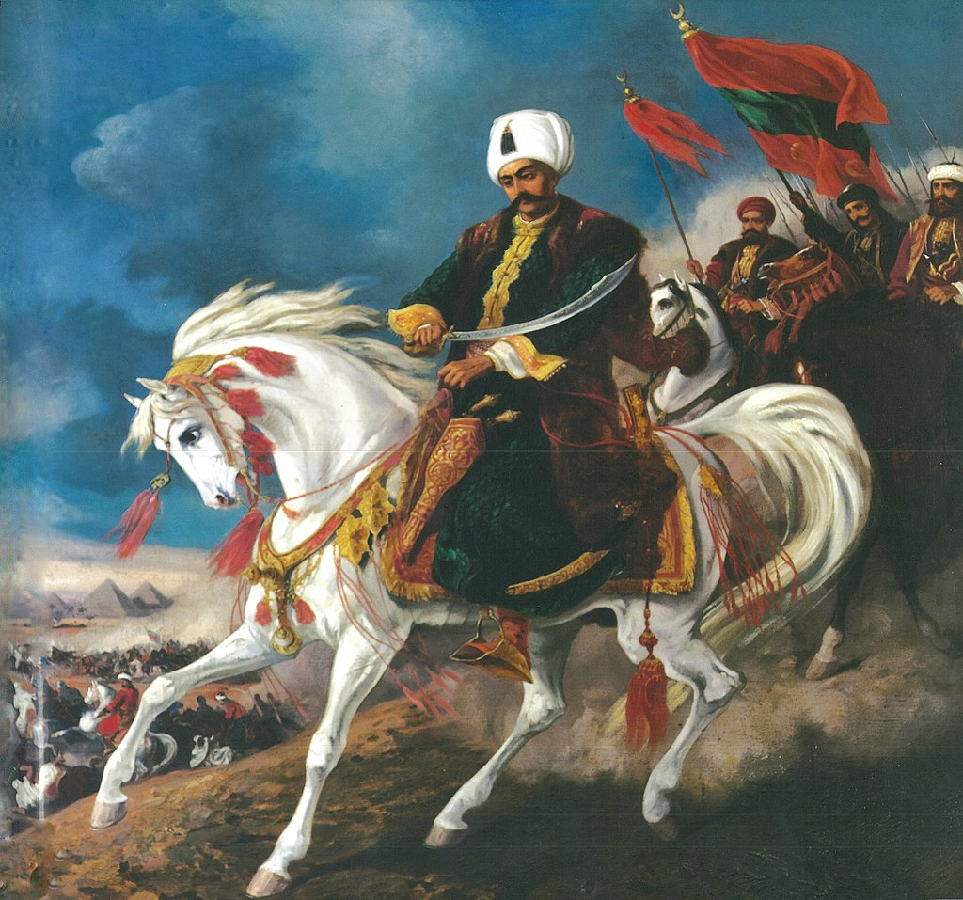

Slide 14
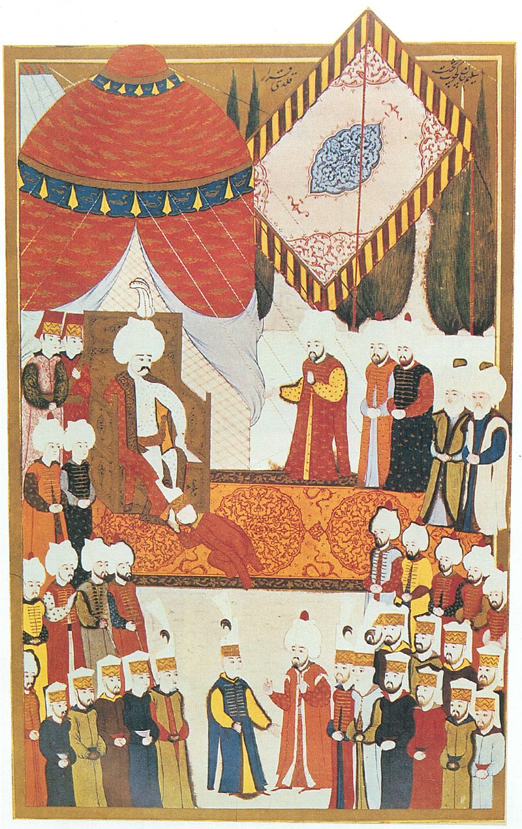
The Ottoman Caliphate
Ottoman territories had doubled, Muslims now made the majority
The Sherif of Makkah sent a delegation to proclaim his allegiance to the Ottoman sultan, with keys to the Kabbah and the sacred relics of Prophet Mohammad (saw)
Selim send them abundant provisions 200,000 golden duchies to be distributed to the residents of the Holy cities
The last Abbasid Khalifa, Al Mutawakkil III, transferred the office of Khalifa to Selim I; he was sent to Constantinople along with his family and Muslim scholars and Shiekhs as a precaution; they became teachers and scholars in the Ottoman medreses
Sultan Selim I thus became the first official Ottoman Khalifa
Treasury of Khilafa was passed to him: noble hairs (beard and head), cloak, sword, banner; tradition of recitation of Quran twenty four hours everyday was started
Selim was recognized as the Khadim I Haramain I Sharifain
He was not from the Quraish, but the Ulema did not challenge his claim
Islamic law started playing an even more profound role and Ottomans took responsibility of protection of the Muslims of the entire world

Slide 15
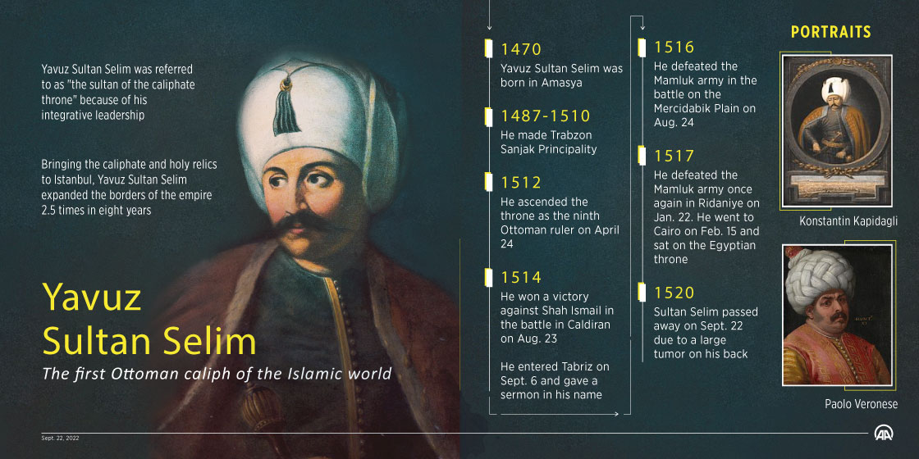

Slide 16
Selim’s Legacy
During this period, the Portuguese had penetrated into the Red Sea, had closed off the trade routes from India and there was news that they would strike Makkah and Madina
An enormous fleet was commissioned in the Suez to face this threat and Admiral Selman Reis was dispatched
When the Portuguese attached Jeddah the principal gateway to Makkah on the coast of the Red Sea, Selman Reis protected Makkah
The Spice Road passing through the Red Sea came under Ottoman control
Financial gains secured from the Spice Road, the gains of war and the tribute from Cyprus (which was earlier paid to the Mamluks) filled up the Ottoman treasury
Revenue in 1525 and 1526 was 9.5 million ducats (Spanish 9, France 5, Venice 4)
When he returned from Egypt, he ordered preparation of his navy for a new campaign; an enormous naval fleet of about 250 ships was ready for war, probably to Sicily, Italy or Rhodes – He had secured the East and South and now wanted to go West, he understood that war with the European nations would not be fought on land alone.
However, he fell ill with a large boil on his back; unable to move, he wrote in his will that his death should be kept secret until his son Suleyman reached Constantinople
On Sept 1520, Selim I passed away near Corlu after just 7.5 years on the throne and was succeeded by his only son Suleyman
Notes:
the Topkapi Palace Chamber of Treasures was full and the surplus had to be moved to repositories
During this time, the Safavids destroyed the graves of Abdul Kadir Jilani and Abu Hanifa in Baghdad

Slide 17
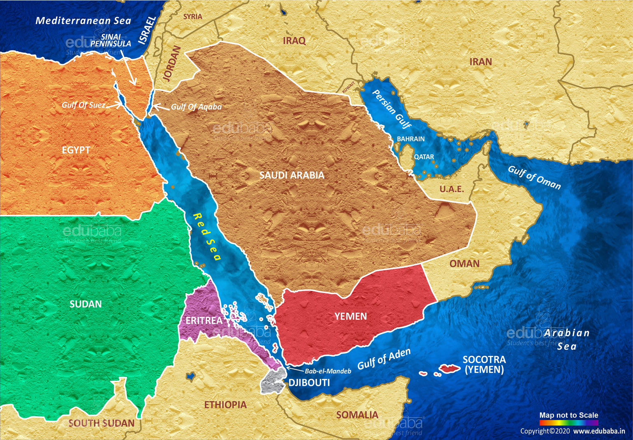
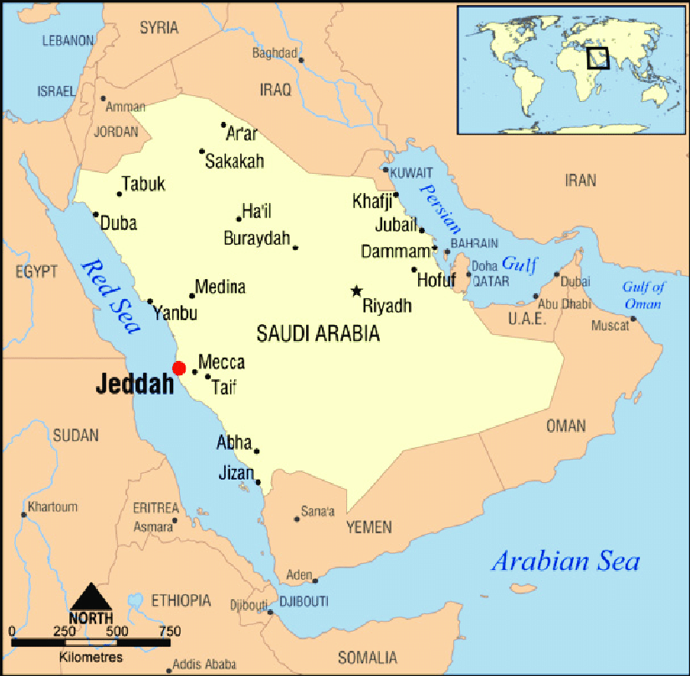

Slide 18
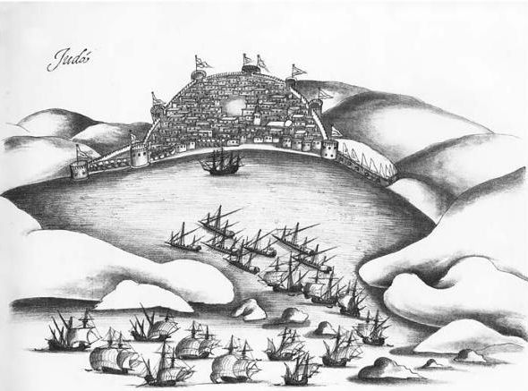
The siege of Jeddah was a naval battle that took place in the harbor of Jeddah between a Portuguese expeditionary force under Lopo Soares de Albergaria and Ottoman elements under Selman Reis. The Portuguese fleet arrived off the city’s coast on Easter day, 1517 (12 April), Hijri year 923, and moored in the channel. After a quick naval action that day with few casualties, shore artillery prevented the Portuguese from landing, and weather ultimately caused them to withdraw.
Portuguese attack on Jeddah 1517

Slide 19
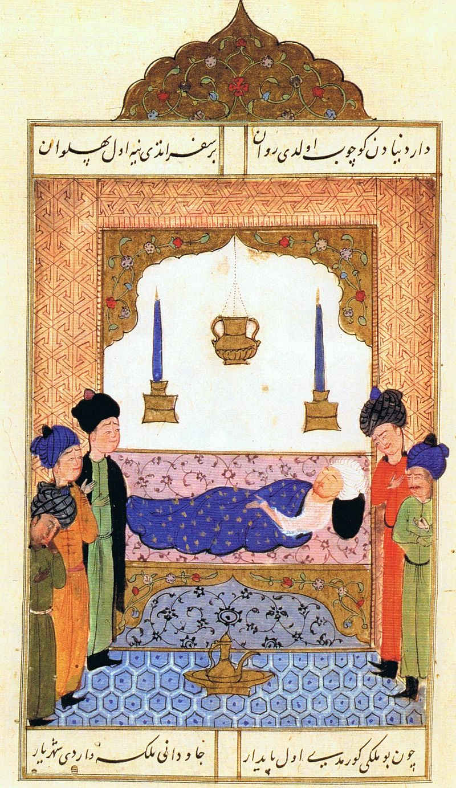
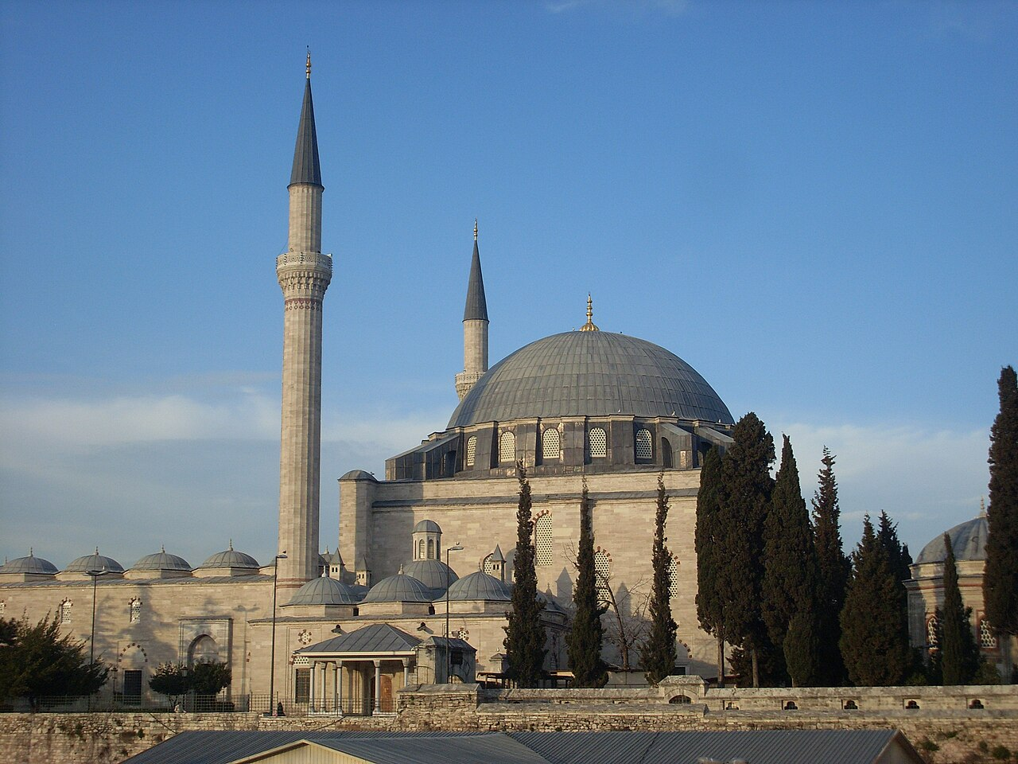
Yavuz Selim Mosque

Slide 22
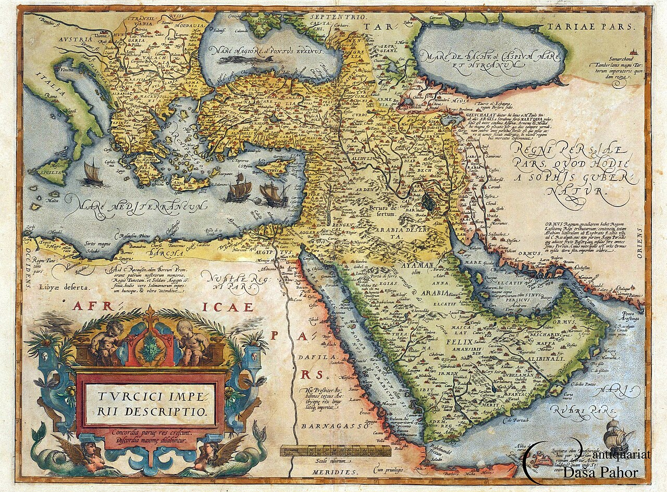

Slide 23
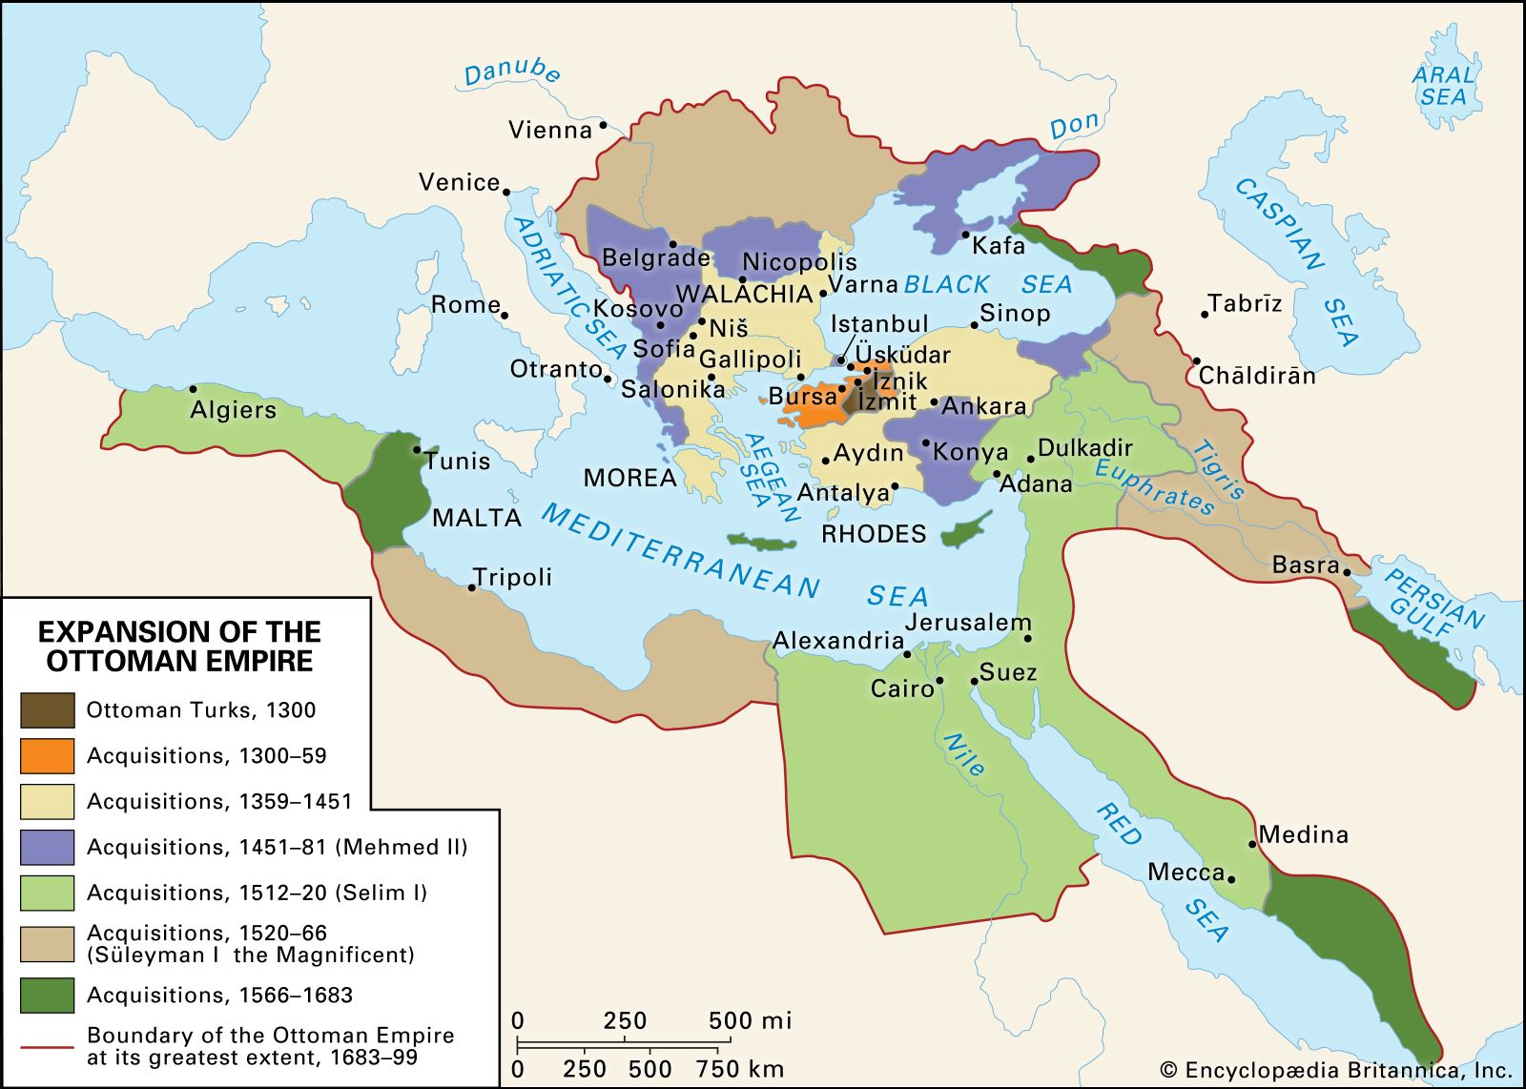

Slide 24
Timeline of the Reign of Selim I (r1512-1520)
1470: Selim I, youngest son of Bayezid II, is born.
1477-1512: Selim was the governor of Trabzon from age 7
1512: Ascends to the throne after Bayezid II abdicates
1514: Decisive victory over Shah Ismail at the Battle of Chaldiran.
1515: Takes over Dulkadirid Beylik, securing Ottoman borders.
1516: Defeats Mamluks at the Battle of Marj Dabiq, annexing Syria.
1517: Ottoman forces defeat Mamluks at the Battle of Ridaniya, taking control of Egypt and Hijaz, Selim I adopts the title of Caliph.
1520: Selim I passes away, likely due to illness, near Corlu.

Slide 25
What was Happening in the World (1512-1520)
1512: The Portuguese explorer Afonso de Albuquerque captured Malacca on the Malay Peninsula, securing a strategic point for the Portuguese in the spice trade and paving the way for Portuguese influence in Southeast Asia.
1513: Vasco Núñez de Balboa becomes the first European to see the Pacific Ocean from the Americas.
1516: Charles I of Spain inherited the Spanish throne.
1517: The Protestant Reformation began when Martin Luther nailed his 95 Theses to the church door in Wittenberg, Germany.
1519: The Holy Roman Emperor Maximilian I died, and his grandson, Charles V, became Holy Roman Emperor.
1519: Hernán Cortés landed on the coast of present-day Mexico and began his expedition to conquer the Aztec Empire.
1519: Ferdinand Magellan began his expedition to circumnavigate the globe.
1520: Babur, a descendant of Timur and Genghis Khan, was consolidating power in Central Asia.
1520: The Field of the Cloth of Gold, a meeting between Henry VIII of England and Francis I of France, takes place

