Slide 1
Holy Roman Empire: Habsburgs

Slide 2
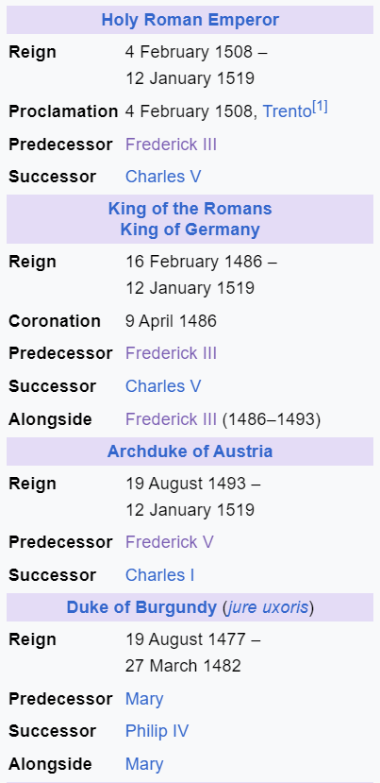
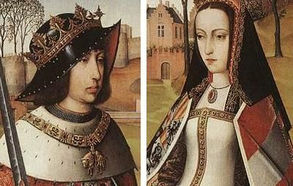
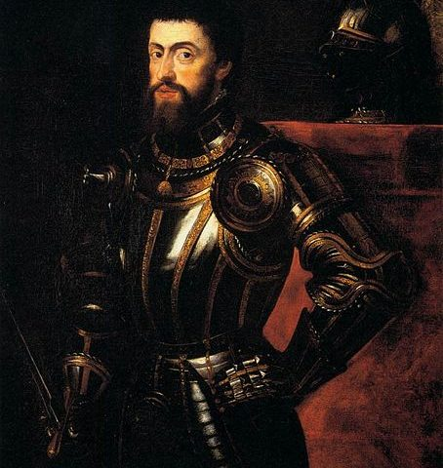
Spanish
Habsburgs
Emperor Maximilian (1490 – 1519) had a son named Philip the handsome, who ended up having one of the most important marriages in European history.
Philip I married Joanna the mad, – daughter of Queen Isabell and King Ferdinand, she ended up as the only survivor of the line of Castille, and in this way the children of Philip and Joanna inherited the Spanish crown!
Charles V (the son of Philip and Joanna) inherited both the Spanish and Austrian crowns. He ended ruling over more land in Europe than any monarch had since Charlemagne!

Slide 3
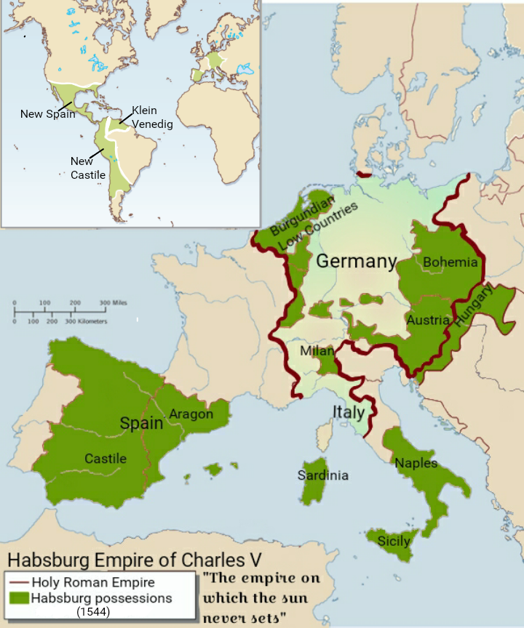
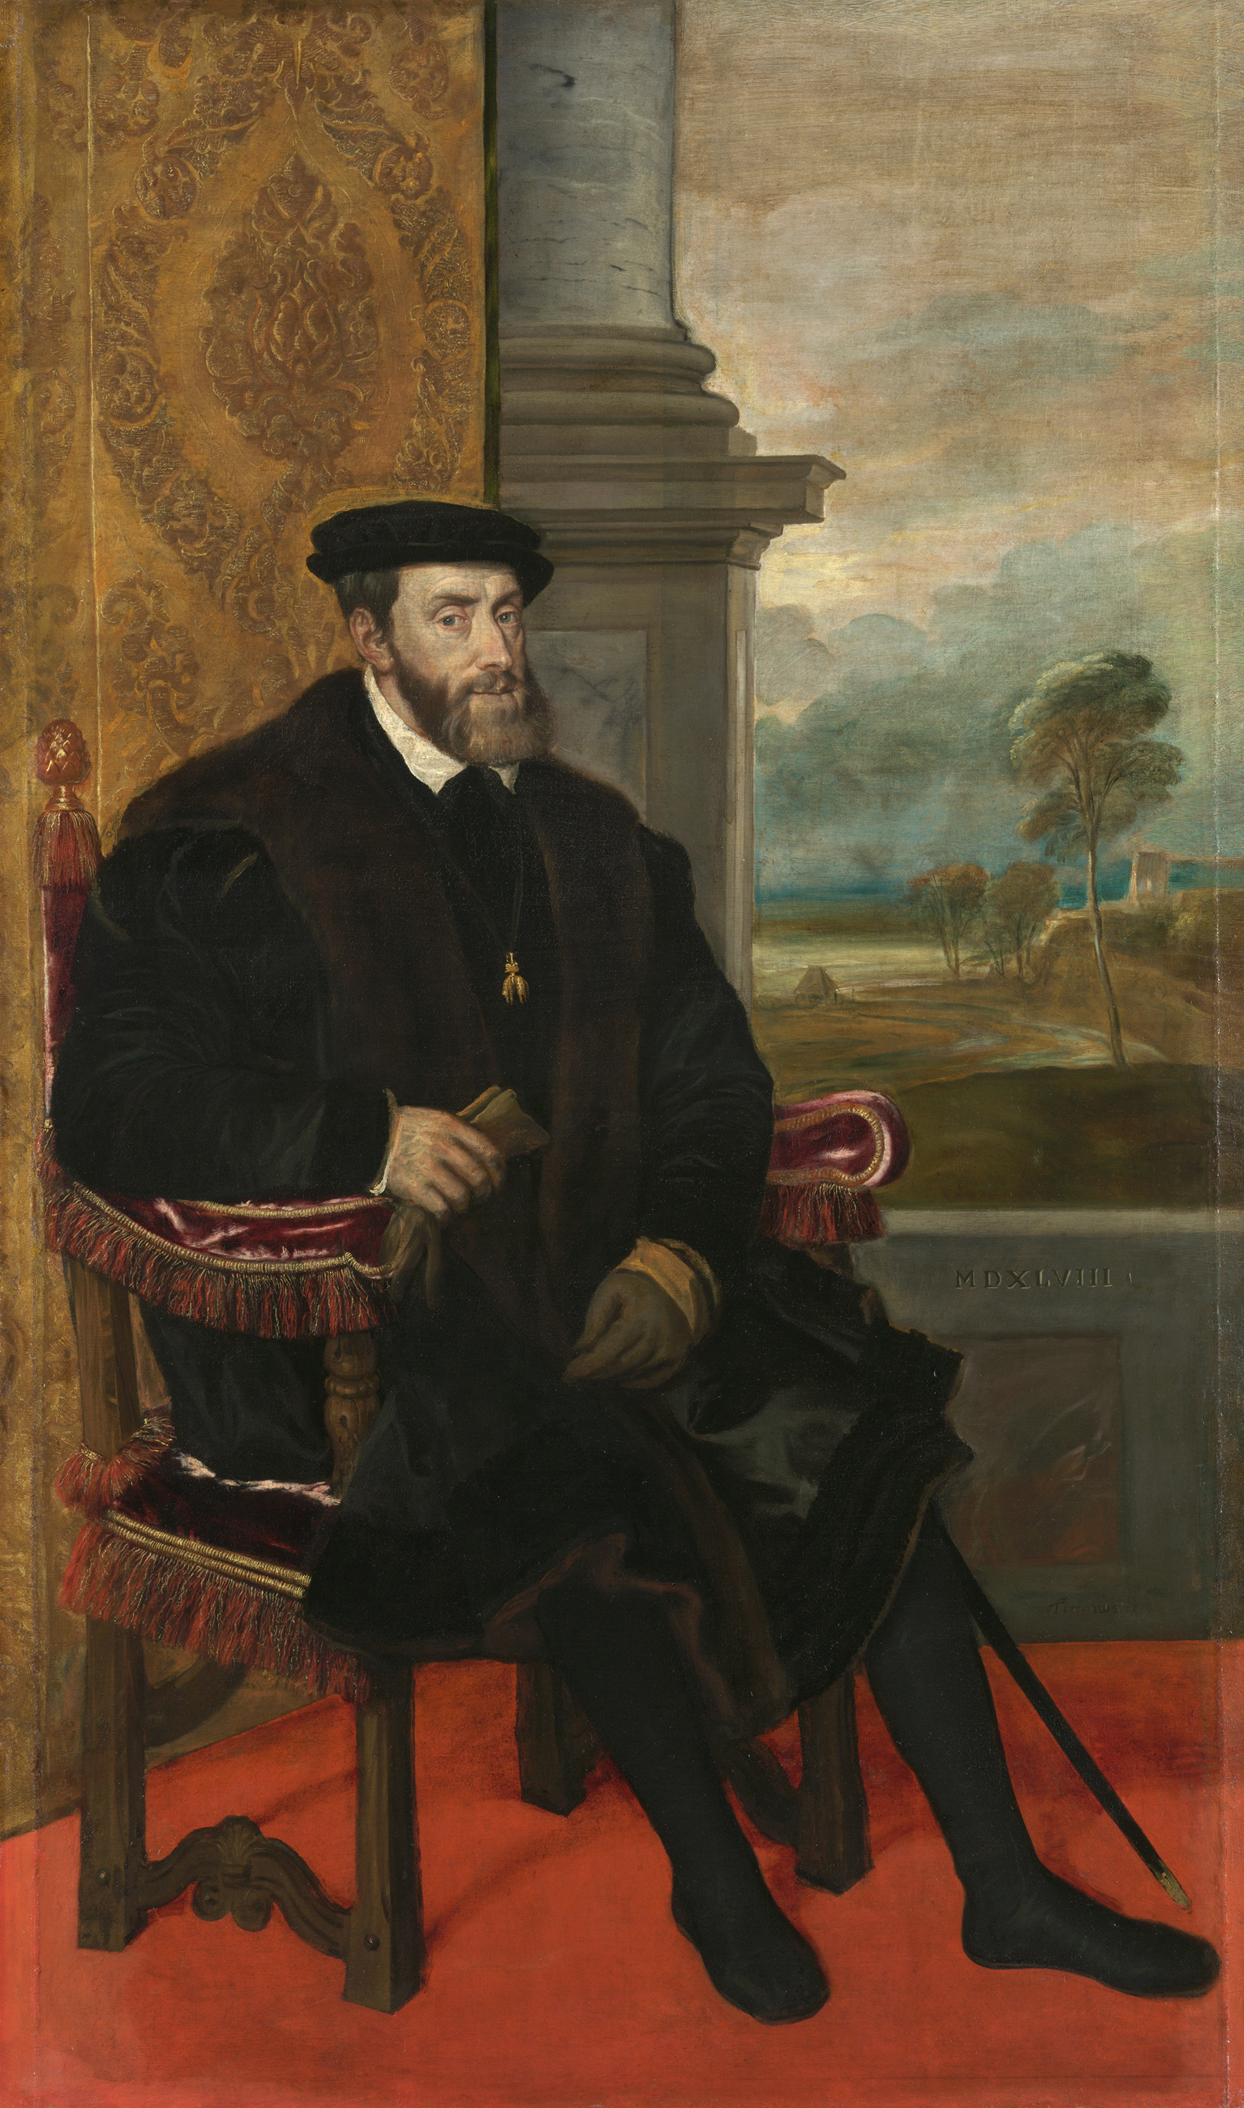
Charles V
Charles V – the son of Philip the handsome and Joanna the mad.
Charles V was a man of many titles and man of much land!
Prince of the Low Countries in 1506, King of Spain in 1516, and Holy Roman Emperor in 1519
Charles V ruled half of Europe during the age of colonial expansion, ratifying the Spanish conquests of Pizzarro and Cortes.
Allegedly said “I speak Latin to God, Italian to women, French to men and German to my horse”. ​

Slide 4
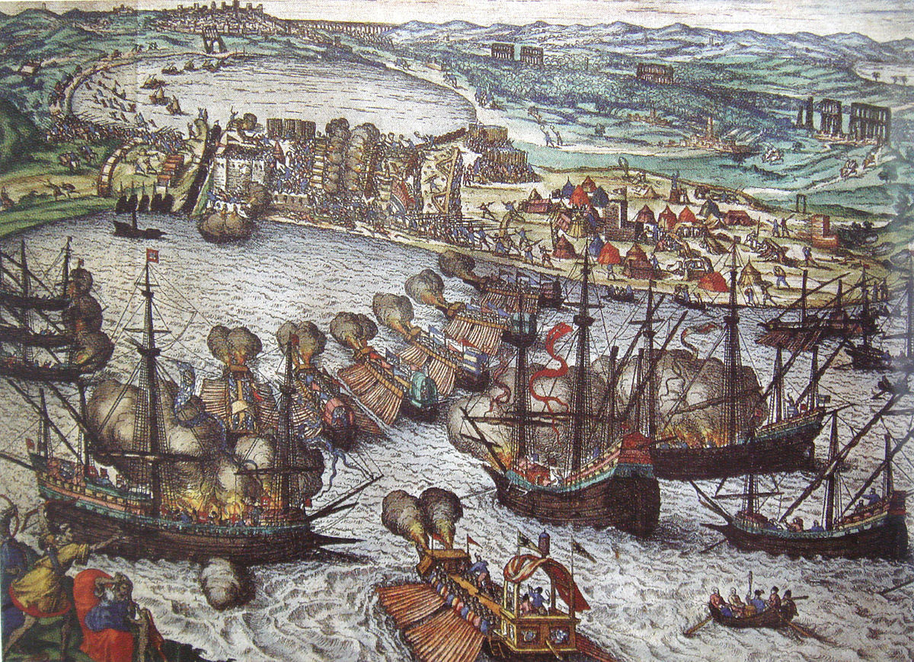
Spanish Habsburgs and the Ottomans
Charles V spent a large part of his life fighting against the Ottomans.
He fought them in the Mediterranean. In 1538, Hayreddin Barbaroosa defeated the holy League, a alliance of Spain, France and the papal states.
Charles V continued to deal with the Ottomans in North Africa.

Slide 5
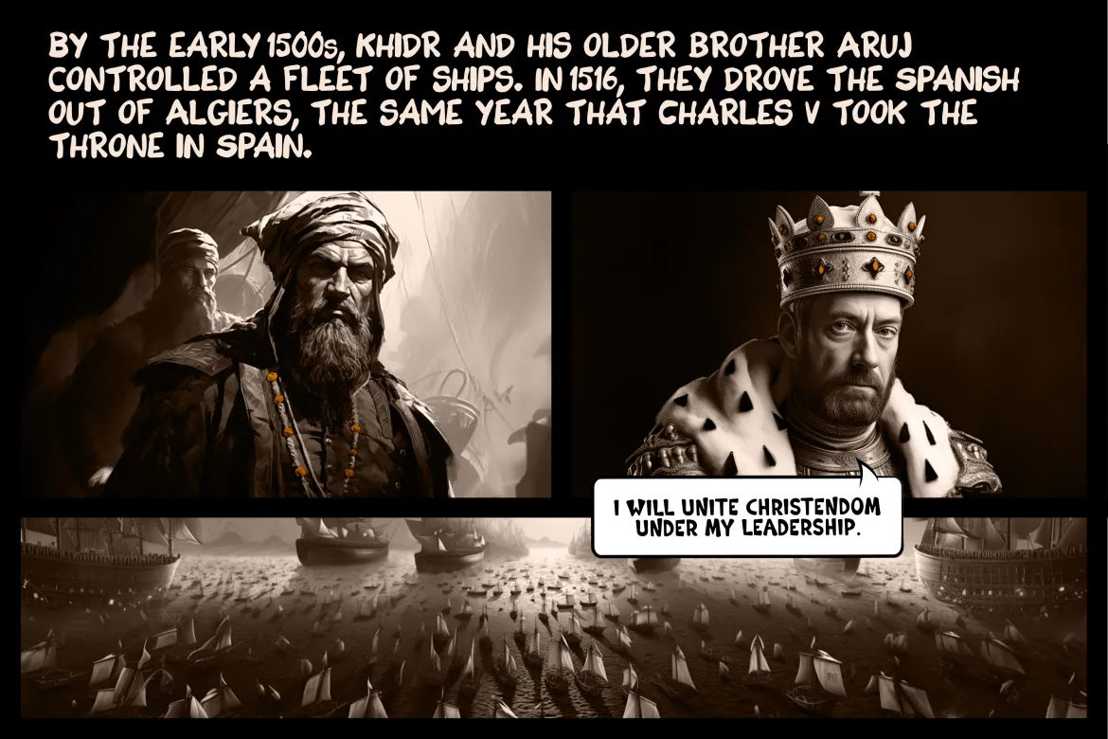
Barbarosa Brothers
Notes:
Barbarosa Brothers

Slide 6
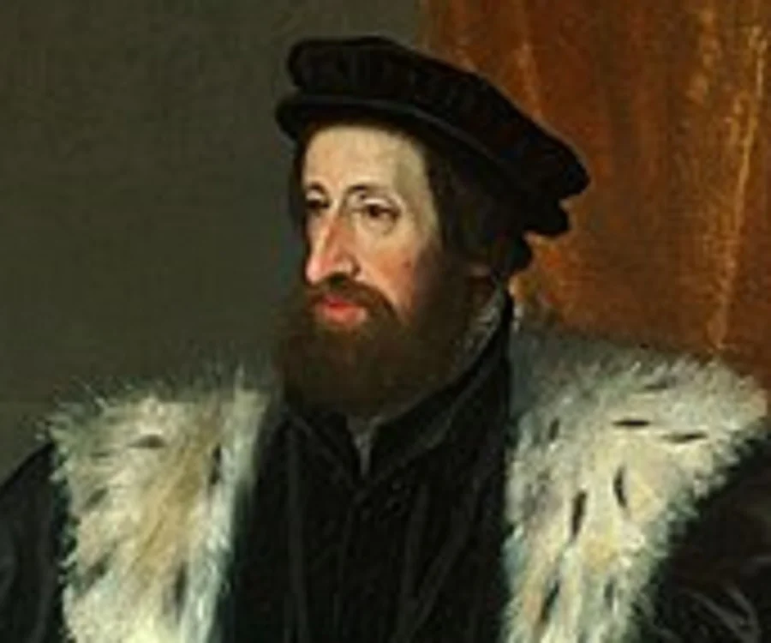
Austrian Habsburgs
Emperor Charles V gave the Austrian part of the kingdom to his younger brother Ferdinand I (1556 – 1564) who also became emperor of the HRE
Emperor Ferdinand’s wife was the daughter of the king of Hungary and through her he inherited the Hungarian crown as well.
So now the Austrian Habsburgs were also kings of Austria, Bohemia and Hungary as well as retaining the title of Emperor of the HRE.

Slide 7
European Powers (1520-1566)
Holy Roman Empire:
  Emperor Charles V (1519-1556)
  Emperor Ferdinand I (1556-1564)
Spain:
  Charles I of Spain (1516-1556) - Also known as Charles V as Holy Roman Emperor
  Philip II of Spain (1556-1598) - Son of Charles V
France:
  Francis I (1515-1547)
  Henry II (1547-1559)
England:
  Henry VIII (1509-1547)
  Edward VI (1547-1553)
  Mary I (1553-1558)
  Elizabeth I (1558-1603)
Hungary, Croatia and Bohemia:
  King Vladislaus II (his daughter Anne Jagiellonica married Ferdinand I)
  King Louis II (married Anna, sister of Charles V)
Portugal:
  John III (1521-1557)
Scotland:
  James V (1513-1542)
  Mary, Queen of Scots (1542-1567)
Denmark and Norway:
  Christian II (1513-1523)
  Frederick I (1523-1533)
  Christian III (1534-1559)
Sweden:
  Gustav I (1523-1560)
Poland-Lithuania:
  Sigismund I (1506-1548)
  Sigismund II Augustus (1548-1572)
Ottoman Empire (Serbia. Bosnia, Wallachia, Moldavia, Greece):
  Suleiman the Magnificent (1520-1566)
Russia (Tsardom of Moscow):
  Ivan IV (Ivan the Terrible) (1533-1584)
Notes:
Charles V took Francis I prisoner at Battle of Pavia in 1525, Francis I asked for Ottoman assistance
Suleyman’s main target was Europe - Only France was not in HRE
Ottomans helped them against Habsburgs – money and trade
If Ottomans would fight the Hungarians, the pressure on France would reduce
Ottomans in Europe in 1520
Serbia: Serbia had been under Ottoman control since the late 14th century, and it continued to be part of the Ottoman Empire in 1517.
Bosnia: Bosnia was also under Ottoman rule by 1517.
Wallachia and Moldavia: These two principalities, situated in present-day Romania, were under Ottoman suzerainty, meaning they acknowledged the Ottoman sultan as their overlord. The Ottomans exerted significant influence in these regions.
Greece: The Ottoman Empire had extended its control over various Greek territories by 1517, including the Peloponnese and parts of mainland Greece.
Ottomans in Europe by 1566 - Additions
Hungary: The Ottoman Empire made significant advances into Hungary, culminating in the Battle of Mohács in 1526. Following this battle, a portion of Hungary came under Ottoman control.
Transylvania: While not directly under Ottoman control, Transylvania, a region in present-day Romania, was influenced by the Ottoman Empire and was often a battleground between the Ottomans and the Habsburgs.
Albania: Ottoman control extended into Albania, with parts of the region coming under Ottoman rule during this period.
The Peloponnese: The Ottoman Empire continued to expand its control over various Greek territories, including the Peloponnese.
Cyprus: The Ottoman Empire captured Cyprus from the Republic of Venice in 1570, which is after the specified period, but it's worth noting the ongoing expansion into the Mediterranean.

Slide 8
Holy Roman Empire – Countries (1520-1566)
Spanish Kingdoms
Kingdom of Germany: The heartland of the Holy Roman Empire, consisting of various territories and principalities within the borders of modern Germany.
Kingdom of Italy: Northern Italy, including cities such as Milan, Florence, and Venice; Also Naples, Sicily, Sardenia
Kingdom of Bohemia: Present-day Czech Republic.
Kingdom of Hungary: Although not fully integrated into the Holy Roman Empire, the Habsburgs, who were often Holy Roman Emperors, had significant influence over Hungary.
Kingdom of Burgundy: Parts of modern-day France, Belgium, Luxembourg, and the Netherlands.
Austrian Habsburg Territories: Including Austria, Styria, Carinthia, and Carniola.
Switzerland: While not officially part of the Holy Roman Empire, certain Swiss regions were associated with it in various ways.
Bavaria: A significant region within the Holy Roman Empire.
Alsace: A region between France and Germany.
Lorraine: Located in present-day eastern France.
Silesia: A region in Central Europe, part of which is now in Poland and the Czech Republic.
Tyrol: A region in the Alps, part of modern Austria and Italy.
Notes:
England, France, Papal states, Venice and Milan – Alliance against Habsburgs
Louis II (Hungary) against Suleyman

