Slide 1
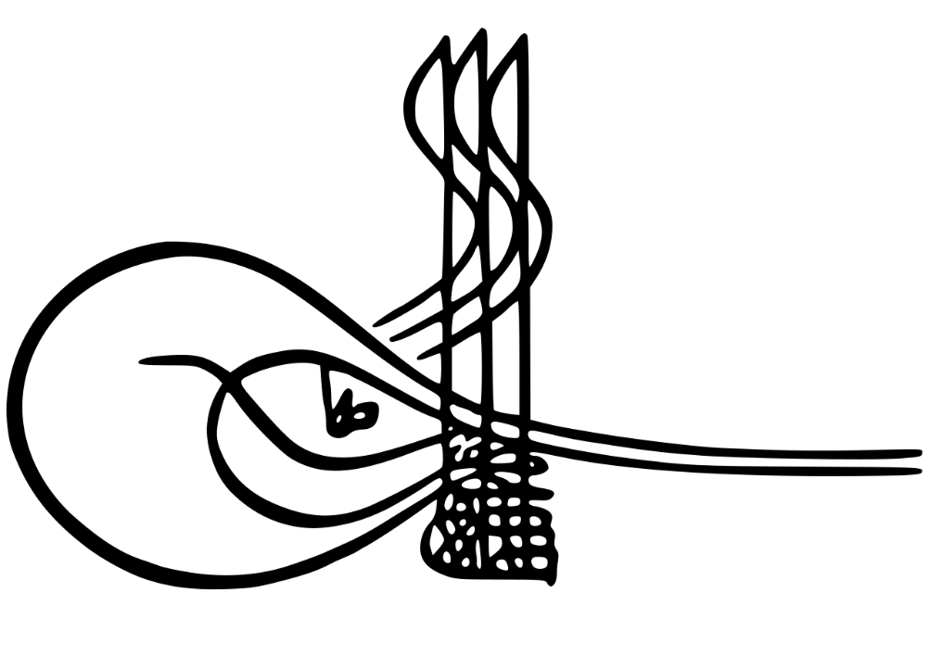
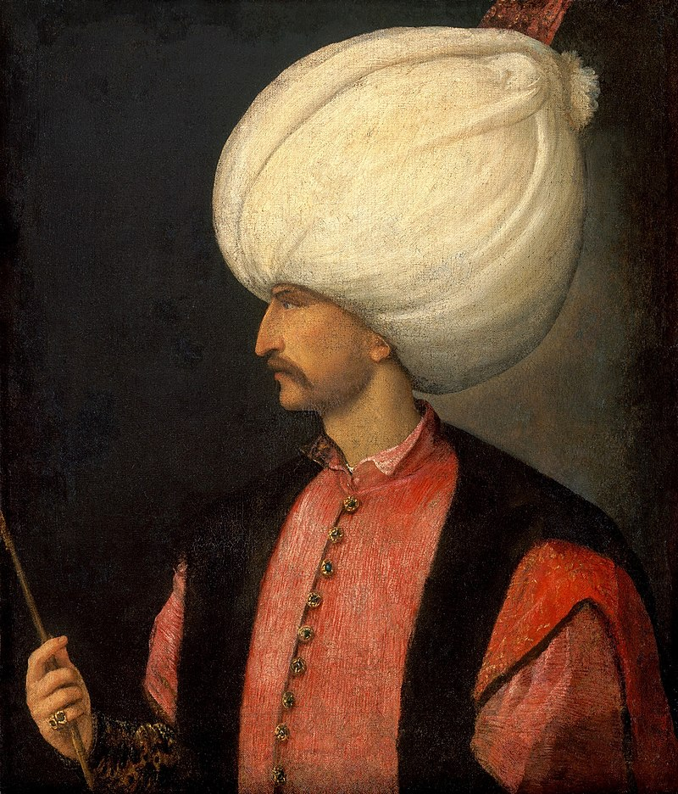
Universal Empire
Qanuni Suleyman The Magnificient
(1520-1566)

Slide 2
Let’s Recap…
Notes:
Let’s Recap…

Slide 3
Timeline of the First 9 Sultans
1237: Alaeddin Keyqubad I awards Ertugrul (d.1289) title of Ghazi and Karacadag, Sogut, Domanic
1285-88: Osman (d.1326)conquers Byzantine territories, Yenisehir is the new capital
1326: Orhan (d.1360) comes to power, Bursa is taken, becomes new capital, later Nicaea and Gallipoli are taken
1363-65: Murad I (d. 1389) takes Tzouroulos, Arkadiapolis, Malgara and others; Edirne became capital.
1368-82: Bulgaria and Constantinople (Byzantine Empire) became vassals, Karasid, Germiyanid, Karamanid land taken.
1389: Murad was martyred after victory at the Battle of Kosovo; Bayezid I (d.1403) succeeded him.
1389-93: Bayezid took Philadelphia and Beyliks in Anatolia (Karamanids and Candarids)
1391-96: Bayezid besieged Constantinople and defeated the Holy League at the Battle of Nicopolis.
1402: Defeat at the Battle of Ankara, resulted in a 10 year Interregnum period
1413-19: Mehmed I (d. 1421) becomes the Sultan, seizes Konya and territories in Wallachia and Hungary
1419: Byzantines, Serbians, Wallachian, Moreans agree to pay tribute to the Ottomans.
1423-1433: Murad II (d.1453) consolidates his rule in Anatolia and suppresses local rebellions.
1443-44: After signing peace treaties with Hungarians and Karamanids, Murad II abdicates
1444-48: Murad returns and wins at the Battle of Varna and the Second Battle of Kosovo
1451: Murad II passes away, Mehmet II (d.1481) comes to power.
1453: Conquest of Constantinople
1459-1479: Mehmet took Serbia (1459), Morea (1460), Trebizond (1461), Bosnia (1463), Crimea (1475), Albania (1479)
1495: Capture of Lepanto and other islands from the Venetians by Bayezid II (d.1512)
1505: Kemal Reis (d1511) was sent by Bayezid II to help Muslims and Jews in Spain
1516-1517: Selim (d.1520) defeats the Mamluks at Marj Dabiq and Ridaniya and takes control of Syria, Egypt and Hijaz, Adopts the title of Caliph

Slide 4
About Suleyman (r1520-1566)
Born in 1494, he was tall, thin and had faint facial hair, he still struck fear in his enemies
He was raised in Trabzon (his father was the governor there)
Typical studies of a Shahzade under saintly scholar, Shaykh Yahya Effendi – emphasis on a state and military administration and Islamic sciences
Learned jewelry making
He was made the governor of Manisa, which was a province close to the capital and was often reserved for the favorite Shahzade
30 Sept 1520: Suleyman came to power at the age of 26, he was the only son
Treasury was overflowing, powerful navy and army, additional title of a Khalifa
Longest ruler of the Ottomans, ruled for 47 years rule, spent about 30 years on campaigns
Ruled at the turn of 1000 years after the Hijrah of the Prophet (saw)
He married Roxalana/Hurrem his concubine, 14 years after meeting her (daughter of Ukranian priest) and had 6 children with her. He broke the norms by doing this
He made Constantinople beautiful by using the skills of Mimar Sinan
He died in Hungary on conquest – on the battlefield and not in the palace - 1566
Titles: Qanuni (Lawgiver), Muhtesem (Magnificent), Gazi (Warrior)
Notes:
Abdul Hamid – carpentry
Selim – calligraphy
Goldsmithing

Slide 5
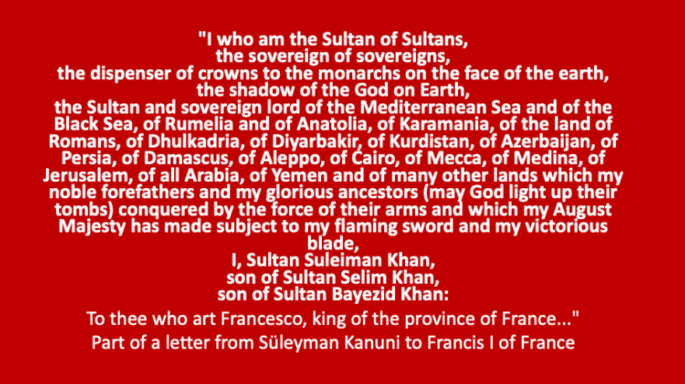

Slide 6
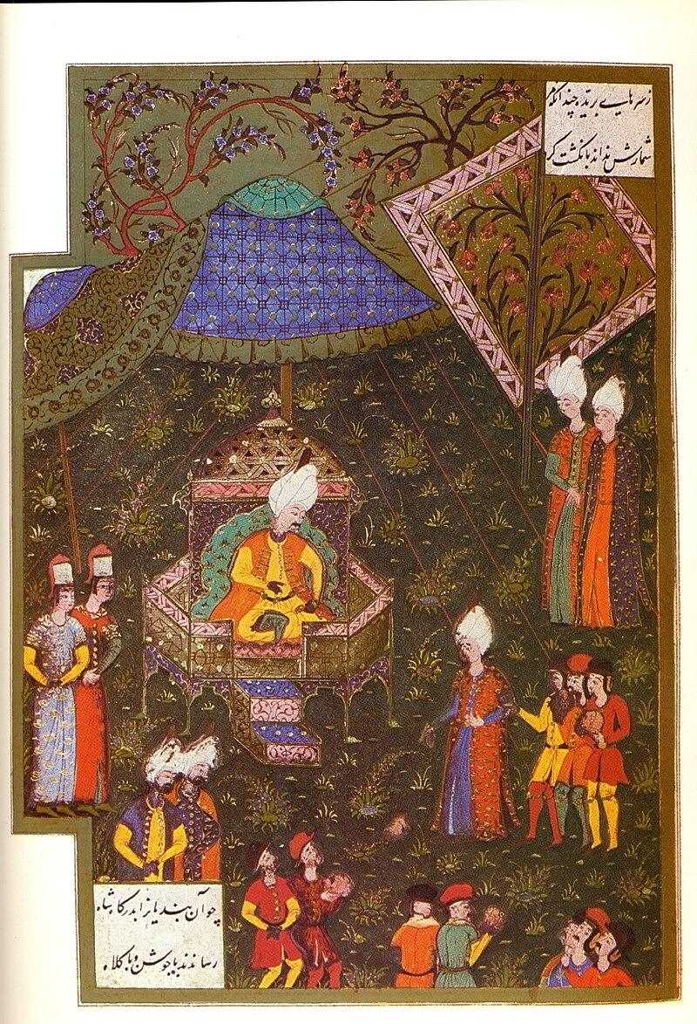
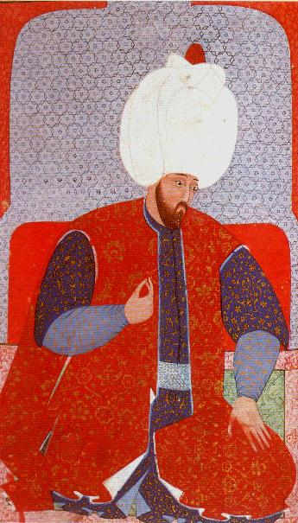
In the 16th century, the Ottomans were at their peak, One historian stated that if a traveler from Mars arrived on earth, he might think the world was about to become Muslim
Martin Luther thought Suleyman was the Anti-Christ

Slide 7
Europe
Safavids
Naval
Internal
1521: Belgrade taken
1522: Rhodes taken
1526: Alliance: Francis I of France
1526: Victory against Hungary at Battle of Mohacs
1529: First siege of Vienna
1529: Buda taken
1532: Siege of Guns
1537: Italy Campaign
1538: Moldavia Campaign
1541: Reconquest of Buda
1543: Esztergom, Pecs taken
1547: Conquest of Timisoara
1566: Conquest of Szigetvar
1533-1534: Campaign of the Two Iraqs, Baghdad taken
1538: Basra taken
1548: Second Campaign against the Safavids
1553: Nakhichevan Campaign and execution of Prince Mustafa
1554: Yerevan taken
1555: Peace of Amasya
1521: Janbirdi Al Ghazali Rebellion
1524: Hain Ahmed Pasha Rebellion
1526: Babu Zunnun revolt
1527: Kalenderoglu revolt
1515: Janissary Rebellion
1551-1558: Suleymaniye Mosque Complex
1558: Prince Bayezid Rebels
1534: Khizr Reis Barbarossa appointed as grand admiral
1538: Victory at Preveza
1546: Death of Haydreddin Barbarossa
1538: Four campaigns to India under commands of Hadim Suleyman Pasha, Piri Reis, Murad Reis, Seydi Ali Reis
1551: Tripoli taken
1560: Victory at Djerba
1565: Siege of Malta
Notes:
1533: Plans to join France, England and Germany

Slide 8
Europe
Safavids
Naval
Internal
1521: Belgrade taken
1522: Rhodes taken
1526: Alliance: Francis I of France
1526: Victory against Hungary at Battle of Mohacs
1529: First siege of Vienna
1529: Buda taken
1532: Siege of Guns
1537: Italy Campaign
1538: Moldavia Campaign
1541: Reconquest of Buda
1543: Esztergom, Pecs taken
1547: Conquest of Timisoara
1566: Conquest of Szigetvar
1533-1534: Campaign of the Two Iraqs, Baghdad taken
1538: Basra taken
1548: Second Campaign against the Safavids
1553: Nakhichevan Campaign and execution of Prince Mustafa
1554: Yerevan taken
1555: Peace of Amasya
1521: Janbirdi Al Ghazali Rebellion
1524: Hain Ahmed Pasha Rebellion
1515: Janissary Rebellion
1551-1558: Suleymaniye Mosque Complex
1558: Prince Bayezid Rebels
1534: Khizr Reis Barbarossa appointed as grand admiral
1538: Victory at Preveza
1546: Death of Haydreddin Barbarossa
1538: Four campaigns to India under commands of Hadim Suleyman Pasha, Piri Reis, Murad Reis, Seydi Ali Reis
1560: Victory at Djerba
1565: Siege of Malta
Notes:
1533: Plans to join France, England and Germany

Slide 9
Conquests in Europe
1521: Belgrade
  Attempted twice – under Murad II and Mehmed II
  Large scale preparations, 28 days siege*
  Population settled in Constantinople, Kingdom of Hungary has to pay an annual tribute
1522: Rhodes
  Rocky island, occupied by Knights Hospitaler, base to raid Muslim ships and take captives
  Large scale preparations, Attack by sea (Piri Mehmed Pasha, arrived first, surrounded the Island), Attack (Suleyman arrived in Marmaris and sailed to the Island)
  Towers with musketeers, tunnels under walls
  Knights surrendered, condition that they be allowed to leave, 6,000 Muslims were freed from dungeons
  Bodrum castle, Leros, Kos, Kalymnos, Nisyros, Tilos, Halki, Alimia and Symi also taken
1526: Battle of Mohacs
  Charles V took Francis I prisoner at Battle of Pavia in 1525, Francis I asked for Ottoman assistance
  Ottomans helped France against Habsburgs – money and trade
  If Ottomans would fight the Hungarians, the pressure on France would reduce
  King Louis II (Hungary) was allied with the Habsburgs and he stopped paying tribute
  Habsburgs were fighting the alliance of England, France, Papal states, Venice, Milan; Hungary was on its own
  Ottomans captured Petrovaradin Fortress, Ilok Castle, Osijek Castle
  At Mohacs, Ottomans annihilated the Hungarian army with cannon and musket fire
  Louis II fell off his horse and drowned while retreating; Ottomans took Buda, but left after two weeks
  Ferdinand I took back Buda in 1527
Notes:
*or 3 months
From previous lesson
When Selim I returned from Egypt, he ordered preparation of his navy for a new campaign; an enormous naval fleet of about 250 ships was ready for war, probably to Sicily, Italy or Rhodes – He had secured the East and South and now wanted to go West, he understood that war with the European nations would not be fought on land alone.
Cem was defeated, and fled to Rhodes (Greek – Knights Hospitaler), he tried to seek the support of the knights, but they betrayed him and made an agreement with Bayezid to keep him in Rhodes in return for 40,000 ducats annually
His first son Shehzade Oguzhan had already been killed by Bayezid in 1482, his second son Sehzade Murad converted to Christianity (Pierre Mehmed Sayd) and was killed by Sultan Suleiman when he conquered Rhodes

Slide 10
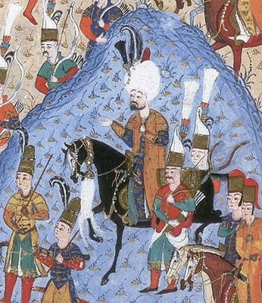
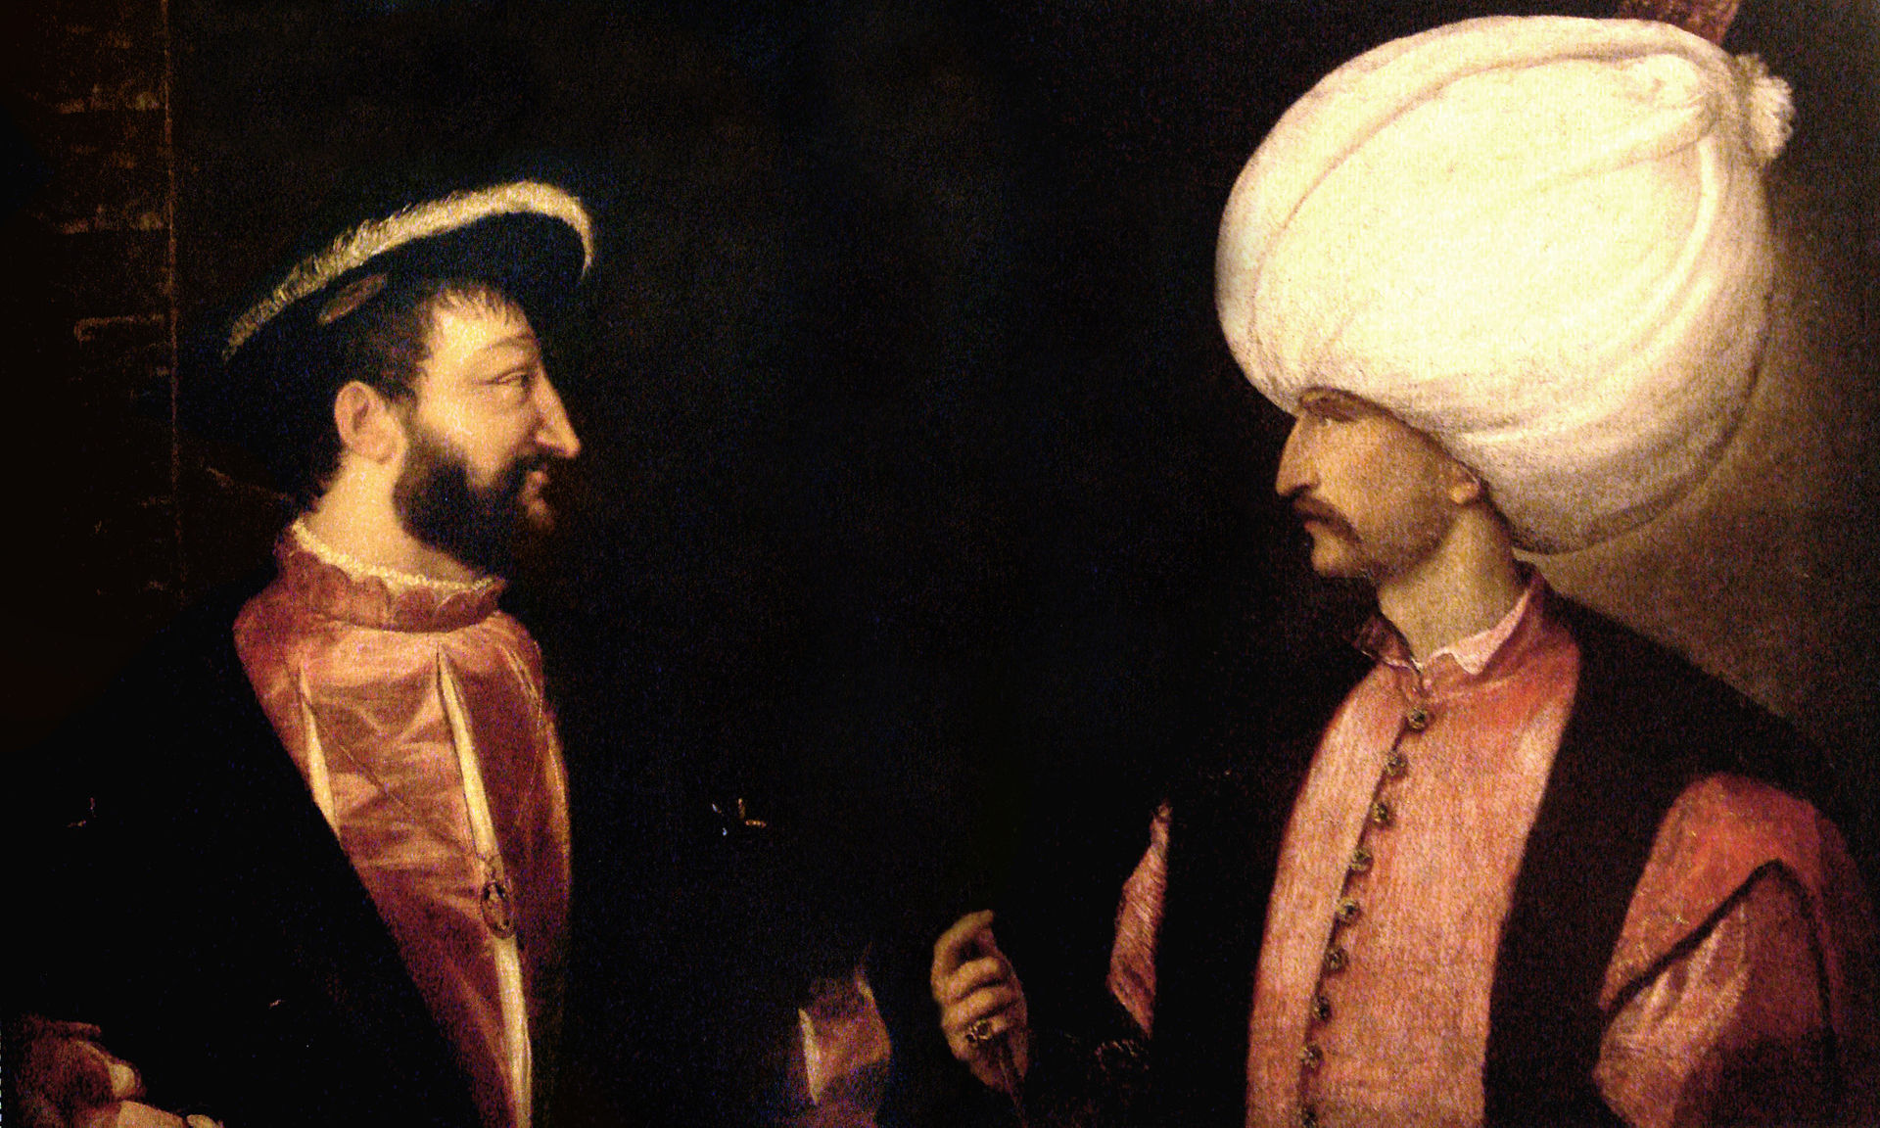
France's King Francis I never met Suleiman, but they created a Franco-Ottoman alliance from the 1530s.
Suleiman during the siege of Rhodes in 1522

Slide 11
Conquests in Europe
1529: First siege of Vienna
  Ferdinand demanded Suleyman return back Belgrade, Varadin and Szegad, Suleyman took back Buda
  With 120,000 men, he laid siege on Vienna, Siege lasted 17 days
  Cold temperatures, disease and constant pouring rain created issues; Suleyman had to withdraw
1532: Siege of Guns
  Suleyman lay siege to Guns and waited for Charles V or Ferdinand to show up, but they didn’t so he proceeded to take the castle; peace treaty in 1533, Janos king of Hungary, tribute
1537: Italy Campaign
  The siege of Corfu failed and Suleyman abandoned the campaign
1538: Moldavia Campaign
  The Voivode was rebelling, but on seeing the Ottoman army, he fled
1541: Reconquest of Buda
  The Voivode of Transylvania had been placed as the King of Hungary; on his death, Ferdinand besieged Buda
  They retreated when they saw the Ottoman army approaching
1543: Campaign against Ferdinand
  Nis, Esztergom, Istolni Belgrade, Pecs taken; King Istefan made King of Hungary
1547: Conquest of Timisoara
  Ferdinand continued putting pressure on Translyvania which was an Ottoman vassal
  Ottomans attached Austria and took many areas, notably Timisoara
1562: Eight year armistice was signed with Ferdinand and Charles V
Notes:
Charles V took Francis I prisoner at Battle of Pavia in 1525, Francis I asked for Ottoman assistance
Suleyman’s main target was Europe - Only France was not in HRE
Ottomans helped them against Habsburgs – money and trade
If Ottomans would fight the Hungarians, the pressure on France would reduce
England, France, Papal states, Venice and Milan – Alliance against Habsburgs
Louis II (Hungary) against Suleyman

Slide 12
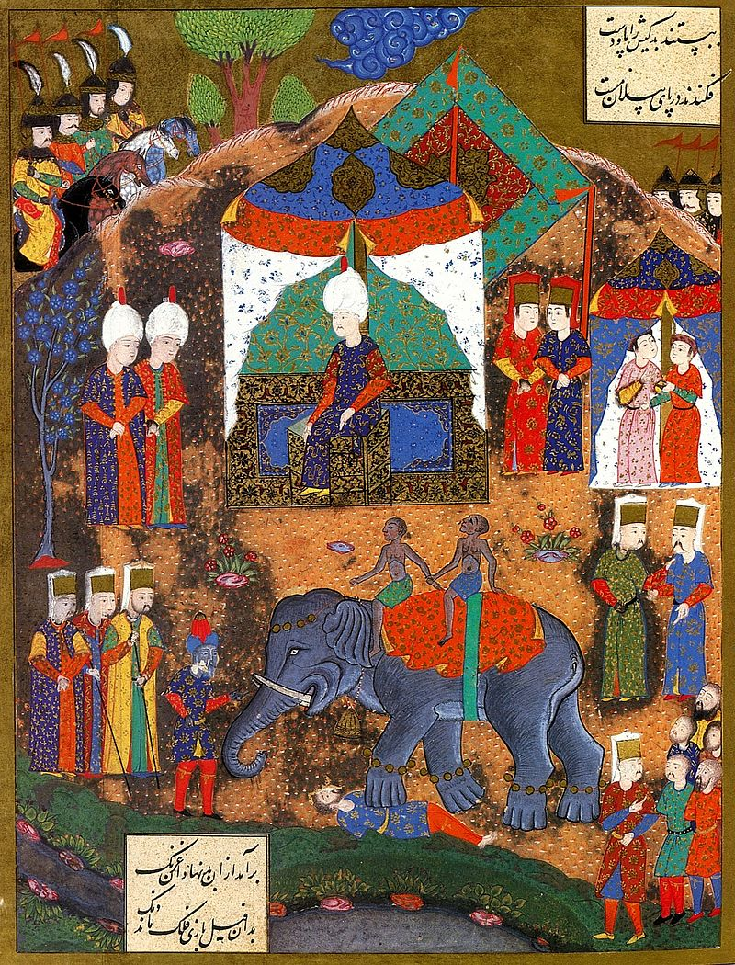
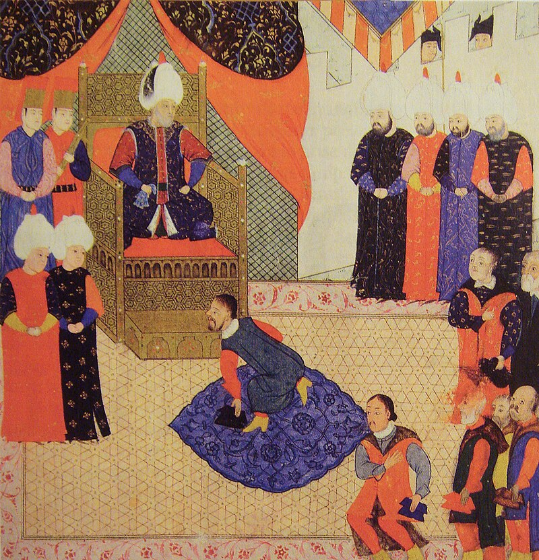
Execution by elephant of defeated enemy in Belgrade
King John Sigismund of Hungary with Suleiman in 1556

Slide 13
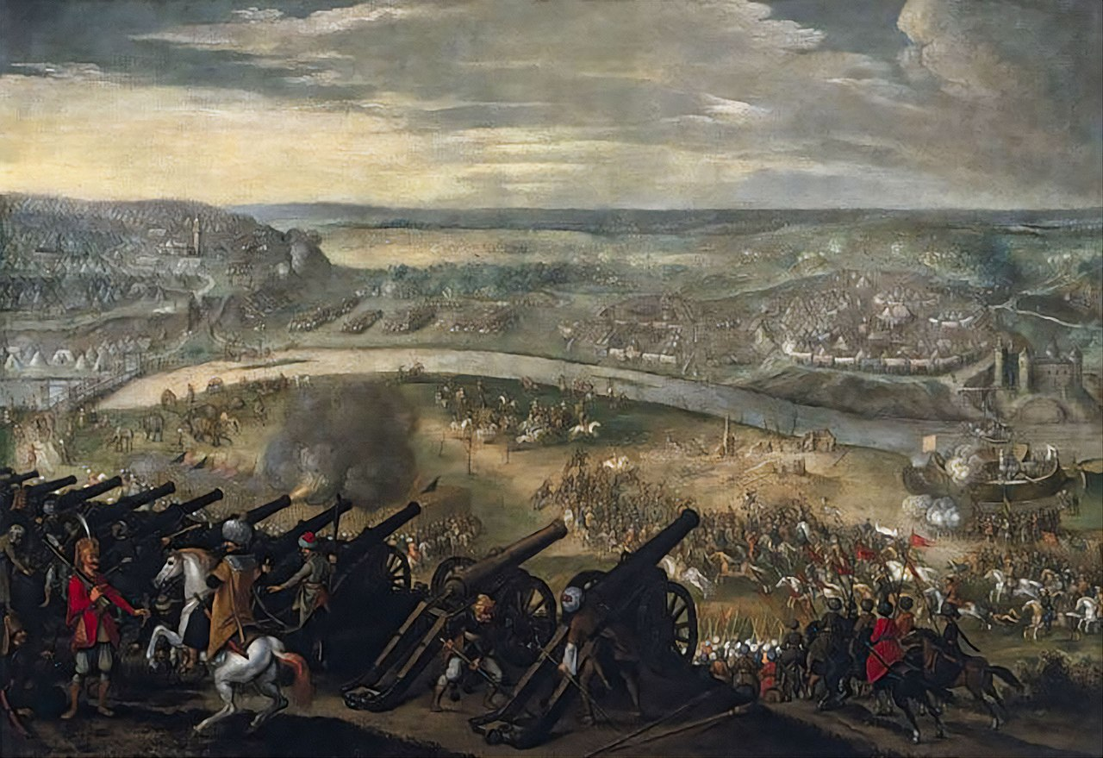
Ottoman siege of Esztergom (1543)

Slide 14
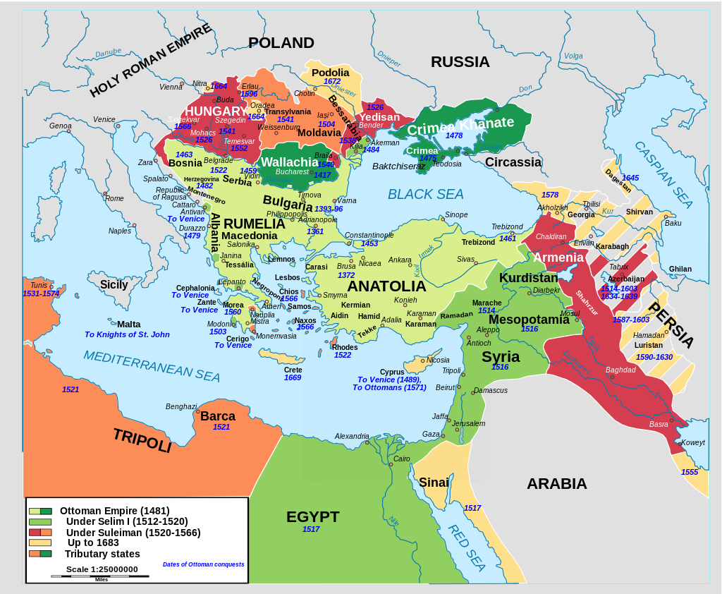

Slide 15
Europe
Safavids
Naval
Internal
1521: Belgrade taken
1522: Rhodes taken
1526: Alliance: Francis I of France
1526: Victory against Hungary at Battle of Mohacs
1529: First siege of Vienna
1529: Buda taken
1532: Siege of Guns
1537: Italy Campaign
1538: Moldavia Campaign
1541: Reconquest of Buda
1543: Esztergom, Pecs taken
1547: Conquest of Timisoara
1566: Conquest of Szigetvar
1533-1534: Campaign of the Two Iraqs, Baghdad taken
1538: Basra taken
1548: Second Campaign against the Safavids
1553: Nakhichevan Campaign and execution of Prince Mustafa
1554: Yerevan taken
1555: Peace of Amasya
1521: Janbirdi Al Ghazali Rebellion
1524: Hain Ahmed Pasha Rebellion
1515: Janissary Rebellion
1551-1558: Suleymaniye Mosque Complex
1558: Prince Bayezid Rebels
1534: Khizr Reis Barbarossa appointed as grand admiral
1538: Victory at Preveza
1546: Death of Haydreddin Barbarossa
1538: Four campaigns to India under commands of Hadim Suleyman Pasha, Piri Reis, Murad Reis, Seydi Ali Reis
1560: Victory at Djerba
1565: Siege of Malta
Notes:
1533: Plans to join France, England and Germany

Slide 16
War with the Safavids
Suleyman’s target had been Europe, he did not fight with the Safavids except when pressed for it
When Shah Islmail’s son Shah Tahmasp come to the throne, he tried to establish alliances with the HRE
He also provoked several beys against the Ottomans
1533-1534: Campaign of the Two Iraqs (Arab and Persian)
  Tabriz was taken by Ibrahim Pasha, he captured Azerbaijan and went upto Hamadan
  Suleyman joined him and Baghdad was taken, Command of Silk Road
  The destroyed tombs of Imam Abu Hanifa and Abdul Qadir Jilani were restored
  Basra was taken in 1538
  Safavids took back Tabriz soon after, Ibrahim Pasha’s mistakes were blamed for it and he was executed
1548: Second Campaign against the Safavids
  Van Citadel was taken
1553: Nakhichevan Campaign and execution of Prince Mustafa
  Campaign was portrayed as targeting Safavid land, but its true purpose was to kill Shahzade Mustafa
  Rustem Pasha had a hand in it, so he was removed as Grand Vizier
  In 1554, Yerevan and Nakhichevan were taken
1555: Peace of Amasya
  Peace treaty which lasted until 1578
  Borders between the two empires was set along the mountain range that bisects Georgia ad down the lower western slopes of the Zagroz mountains extending to the Persian Gulf
Notes:
(Makbul to Maktul)
Safavid Iran under Shah Tahmasp I:
Shah Tahmasp I (reigned 1524-1576) was a significant figure in Safavid history. He was known for his efforts to centralize power and establish a more stable administration in the empire. He also played a key role in consolidating Twelver Shia Islam as the state religion of Iran.
Under Shah Tahmasp, the Safavid Empire experienced a period of relative religious and cultural stability. He was a patron of the arts and promoted the development of Persian literature and the fine arts.
Despite the Safavid Empire's majority Shia population, it's important to note that not all of its subjects were Shia, and there were religious and ethnic diversity in the realm.

Slide 18
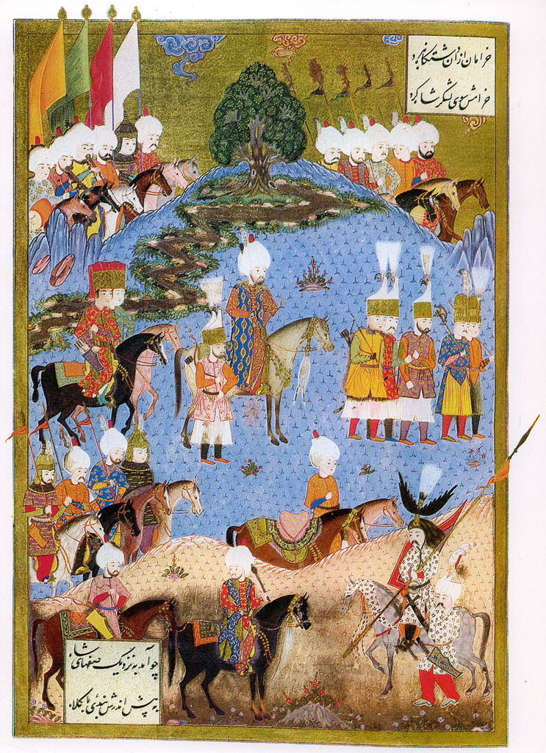
Miniature depicting Suleiman marching with an army in Nakhchivan, summer 1554

Slide 19
Europe
Safavids
Naval
Internal
1521: Belgrade taken
1522: Rhodes taken
1526: Alliance: Francis I of France
1526: Victory against Hungary at Battle of Mohacs
1529: First siege of Vienna
1529: Buda taken
1532: Siege of Guns
1537: Italy Campaign
1538: Moldavia Campaign
1541: Reconquest of Buda
1543: Esztergom, Pecs taken
1547: Conquest of Timisoara
1566: Conquest of Szigetvar
1533-1534: Campaign of the Two Iraqs, Baghdad taken
1538: Basra taken
1548: Second Campaign against the Safavids
1553: Nakhichevan Campaign and execution of Prince Mustafa
1554: Yerevan taken
1555: Peace of Amasya
1521: Janbirdi Al Ghazali Rebellion
1524: Hain Ahmed Pasha Rebellion
1515: Janissary Rebellion
1551-1558: Suleymaniye Mosque Complex
1558: Prince Bayezid Rebels
1534: Khizr Reis Barbarossa appointed as grand admiral
1538: Victory at Preveza
1546: Death of Haydreddin Barbarossa
1538: Four campaigns to India under commands of Hadim Suleyman Pasha, Piri Reis, Murad Reis, Seydi Ali Reis
1560: Victory at Djerba
1565: Siege of Malta
Notes:
1533: Plans to join France, England and Germany

Slide 20
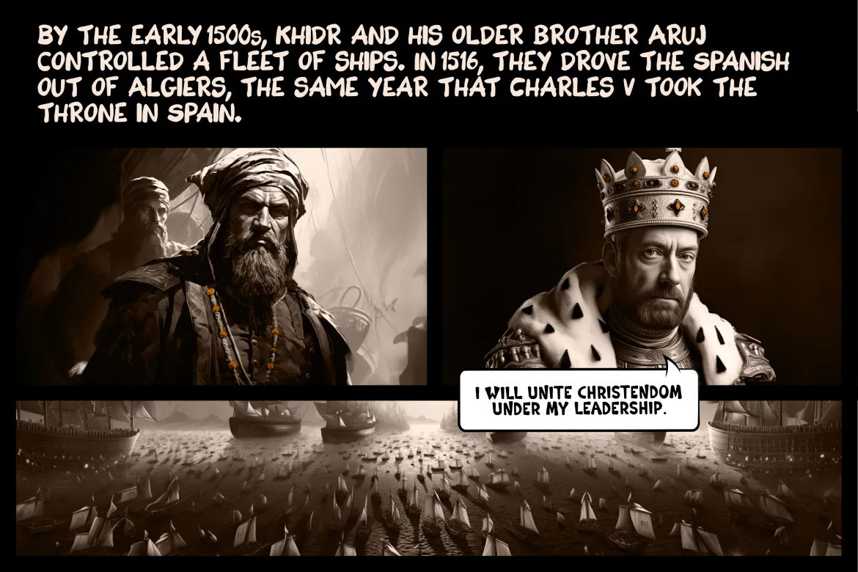
Barbarosa Brothers
Notes:
Barbarosa Brothers

Slide 21
Rise of the Barbarossa Brothers
Late 15th C: Aruj (Oruç Reis) and Hayreddin Barbarossa (Khizr Reis), from Lesbos, were involved in trade and seafaring from a young age.
1505-1510: Aruj moved his operations to the western Mediterranean, specifically along the coast of Algiers and Tunis. He freed Muslim and Jew captives from Spanish and Portuguese ships, earning him the title "Gazi" (holy warrior).
1516: Aruj was invited by the ruler of Algiers to help defend the city from the Spanish, He succeed, starts ruling Algiers.
1517: Aruj expanded control along the Algerian coast, taking control of towns like Tlemcen, he was later martyred in battle.
1518: After Aruj's death, Hayreddin Barbarossa took over leadership of the fleet and the territories
1518: Sultan Selim granted Hayreddin official recognition as the ruler of Algiers and the title of Beylerbey (Governor-General) of the region.
1519: Allied attack on Algiers, a great victory for Hayreddin
1529: Capture of Admiral Portudo fleet
1529: Capture of Penon

Slide 22
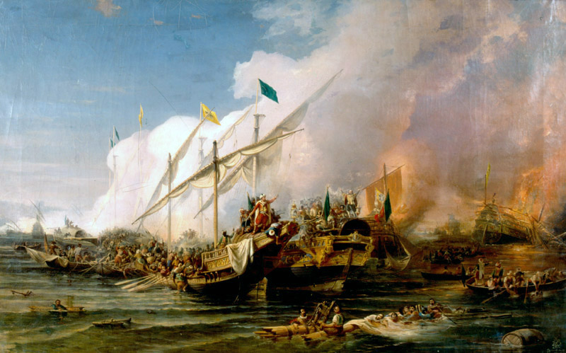
Naval Campaigns
1534: Haydreddin Barbarossa
  Unable to counter the Ottoman army on land, Spain sent a fleet under Genoese Admiral Andrea Doria to attack Ottoman fortifications in the Morea
  Khizr Reis had already proven himself with his capture of Algiers
  Sultan Suleiman appointed him as “Kapudan Pasha”, Grand Admiral, to establish power on the seas with a farsighted strategy of battling Europe
  He left Istanbul with a total of 84 ships, which included 24,000 rovers and warriors
1538: Victory at Preveza
  King Francis I of France signed the Truce of Nice with Holy Roman Emperor Charles V
  Pope Paul II formed the Holy League – an alliance between Republic of Venice, Genoa, Papal states, Knights of Malta, Spain and its vassals of Naples and Sicily, under Andrea Doria
  The Ottomans emerged victorious having suffered few deaths or casualties
  Later, Tunis was captured, though they lost it in a short time
  1546: Death of Haydreddin Barbarossa
Notes:
Siyaz Ali Pasha: Our pashas reckon the Maltese fort is made of halva and want to eat it. I do not agree with their behavior or actions, I do not consider it well and there is nothing left for me to say. I understand that they did not heed my counsel. May God surprise in the result. May I not chance to see their misery. God knows I will. May you see how they end this.

Slide 23
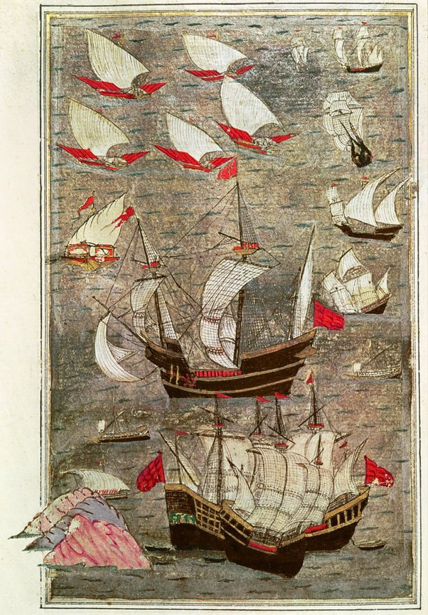
Naval Campaigns
1538: Campaign to India
  Trade on the Mediterranean took a hit due to Portugal’s domination of the Indian trade routes
  Selim’s conquest of Egypt was mainly for this reason
  Four campaigns to India under Hadim Suleyman Pasha, Piri Reis, Murad Reis, Seydi Ali Reis - to expel Portuguese from the trade routes and to aid the Muslim rulers in India (Mughals, Delhi Sultanate)
  Mediterranean trade returned to previous levels; Yemen, Aden, Sudan, Abyssinia (Ethiopia), Qatif and Bahrain taken
1551: Tripoli taken by Turgut Reis (Dragut)
1560: Victory at Djerba
  An island off the coast of Tunisia – taken by Grand Admiral Piyale Pasha/Turgut Reis
1565: Siege of Malta
  Mustafa Pasha, Piyale Pasha, Siyaz Ali Pasha, Turgut Reis, Idea of invincible Turk began to unravel with this failure
  1566: Chios island waved the Ottoman flag
Notes:
Siyaz Ali Pasha: Our pashas reckon the Maltese fort is made of halva and want to eat it. I do not agree with their behavior or actions, I do not consider it well and there is nothing left for me to say. I understand that they did not heed my counsel. May God surprise in the result. May I not chance to see their misery. God knows I will. May you see how they end this.

Slide 24
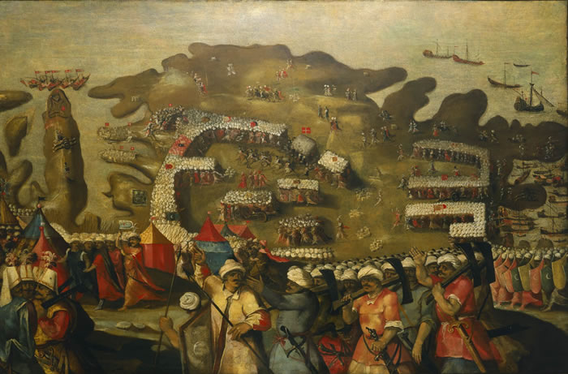
The siege of Malta in 1565: arrival of the Turkish fleet

Slide 25
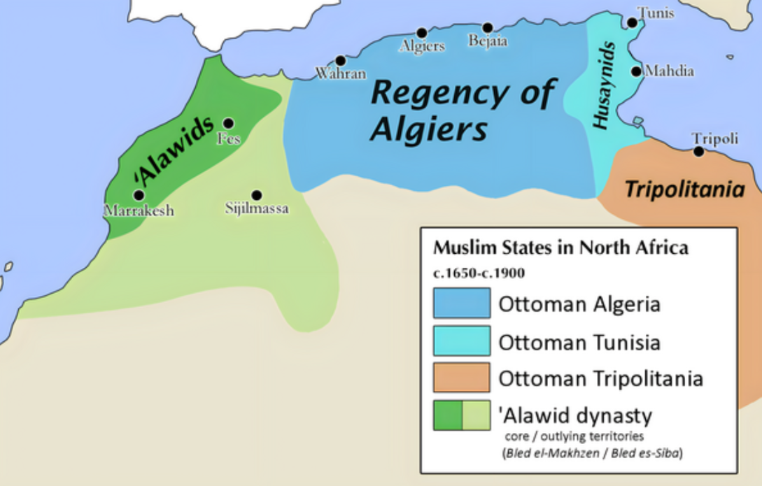

Slide 27
Europe
Safavids
Naval
Internal
1521: Belgrade taken
1522: Rhodes taken
1526: Alliance: Francis I of France
1526: Victory against Hungary at Battle of Mohacs
1529: First siege of Vienna
1529: Buda taken
1532: Siege of Guns
1537: Italy Campaign
1538: Moldavia Campaign
1541: Reconquest of Buda
1543: Esztergom, Pecs taken
1547: Conquest of Timisoara
1566: Conquest of Szigetvar
1533-1534: Campaign of the Two Iraqs, Baghdad taken
1538: Basra taken
1548: Second Campaign against the Safavids
1553: Nakhichevan Campaign and execution of Prince Mustafa
1554: Yerevan taken
1555: Peace of Amasya
1521: Janbirdi Al Ghazali Rebellion
1524: Hain Ahmed Pasha Rebellion
1515: Janissary Rebellion
1551-1558: Suleymaniye Mosque Complex
1558: Prince Bayezid Rebels
1534: Khizr Reis Barbarossa appointed as grand admiral
1538: Victory at Preveza
1546: Death of Haydreddin Barbarossa
1538: Four campaigns to India under commands of Hadim Suleyman Pasha, Piri Reis, Murad Reis, Seydi Ali Reis
1560: Victory at Djerba
1565: Siege of Malta

Slide 28
Rebellions
1521: Janbirdi Al Ghazali Rebellion
  Governor of Damascus – former Mamluk Emir
  Friday sermons in his name and coins struck
  Got assistance from Knights of Rhodes and Shah Ismail
  He was captured in executed
1524: Hain Ahmed Pasha Rebellion
  He wasn’t made Grand Vizier, but instead was appointed as Governor of Egypt
  He declared himself Sultan of Egypt, he came to be known as Hain or the Traitor
  Ibrahim Pasha restored the Ottoman regime in Egypt
1515: Janissary Rebellion
  The Janissaries in Constantinople rebelled ad sacked part of the city
  Suleyman returned from Kagithane and countered the rebellion before it spread

Slide 29
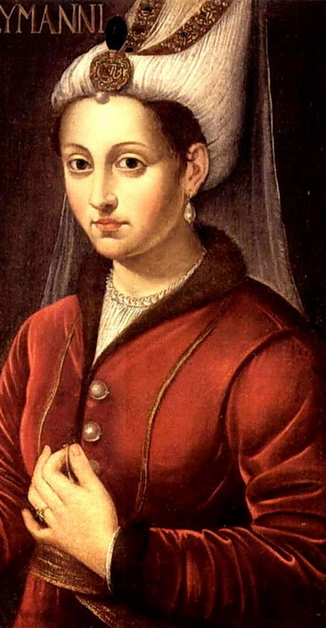
Suleiman’s Sons
Shahzade Mehmed (1521-1543)
Eldest son of Sultan Suleiman the Magnificent.
Heir apparent to the Ottoman throne, well-educated in military and statecraft.
Tragically died of small pox at 22, impacting Ottoman succession plans.
Shahzade Mustafa (Executed in 1553)
Eldest son of Suleiman and Mahidevran, much loved
Involved in a political struggle with stepmother Hürrem Sultan for the throne.
Plot hatched that he was planning to overthrow his father
Executed by order of Suleiman to secure succession for Selim II.
Cihangir (Illness and Death in 1553)
Youngest son of Suleiman, hunchback, suffered from mental illness.
Death opened the path for the succession struggle between Selim II and Bayezid.
Bayezid (Executed in 1559)
Elder son of Suleiman, involved in a power struggle with Selim II.
Flees to Safavids, considered treachery
Defeated at the Battle of Konya in 1559, captured, and executed.
Selim II (Reign 1566-1574)
Last choice, succeeded Suleiman as Sultan
Notes:
Yahya Effendi wrote – Why did you do it, should have looked at evidence

Slide 30
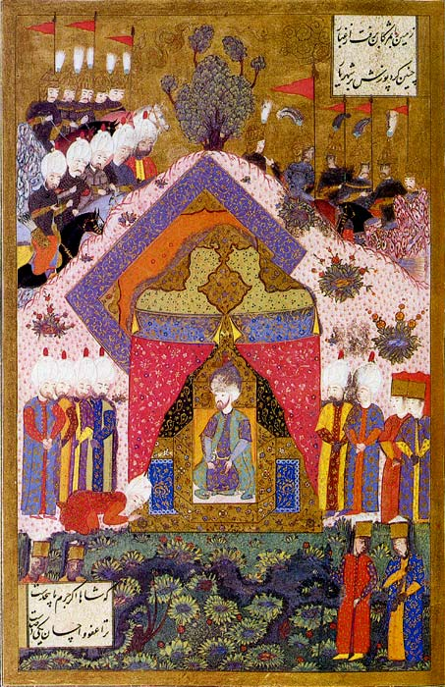
Final two Campaigns
1565: Siege of Malta
  Failure
1566: Conquest of Szigetvar
  In 1562 an eight year armistice was signed with Ferdinand and Charles V
  But problems along the borders did not cease and the HRE would often refuse to pay the tribute due
  They broke the treaty by attacking the principality of Transylvania
  In 1566, an Austrian envoy arrived in Constantinople without the overdue tribute, Suleyman declared war of Austria
  The objective was capturing the city of Szigetvar as it had been causing damage to Ottoman lands
  Fortress was difficult to capture – it had four interconnected castles all surrounded by a moat
  The siege began but Suleiman became ill and followed the progress from his tent
  He died on 6 Sept 1566 and his dead was kept a secret
  His army conquered the city on 7 Sept
Notes:
Yahya Effendi wrote – Why did you do it, should have looked at evidence

Slide 31
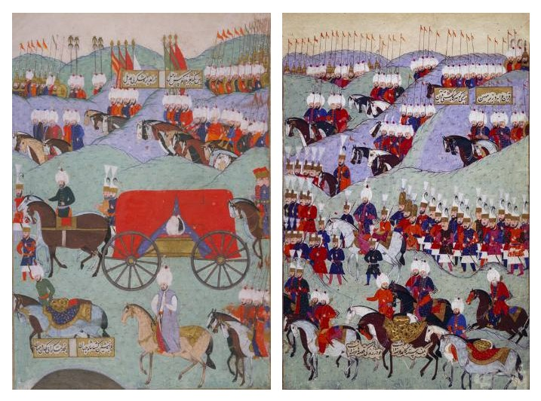
Funeral of Sultan Suleyman the Magnificent

Slide 32
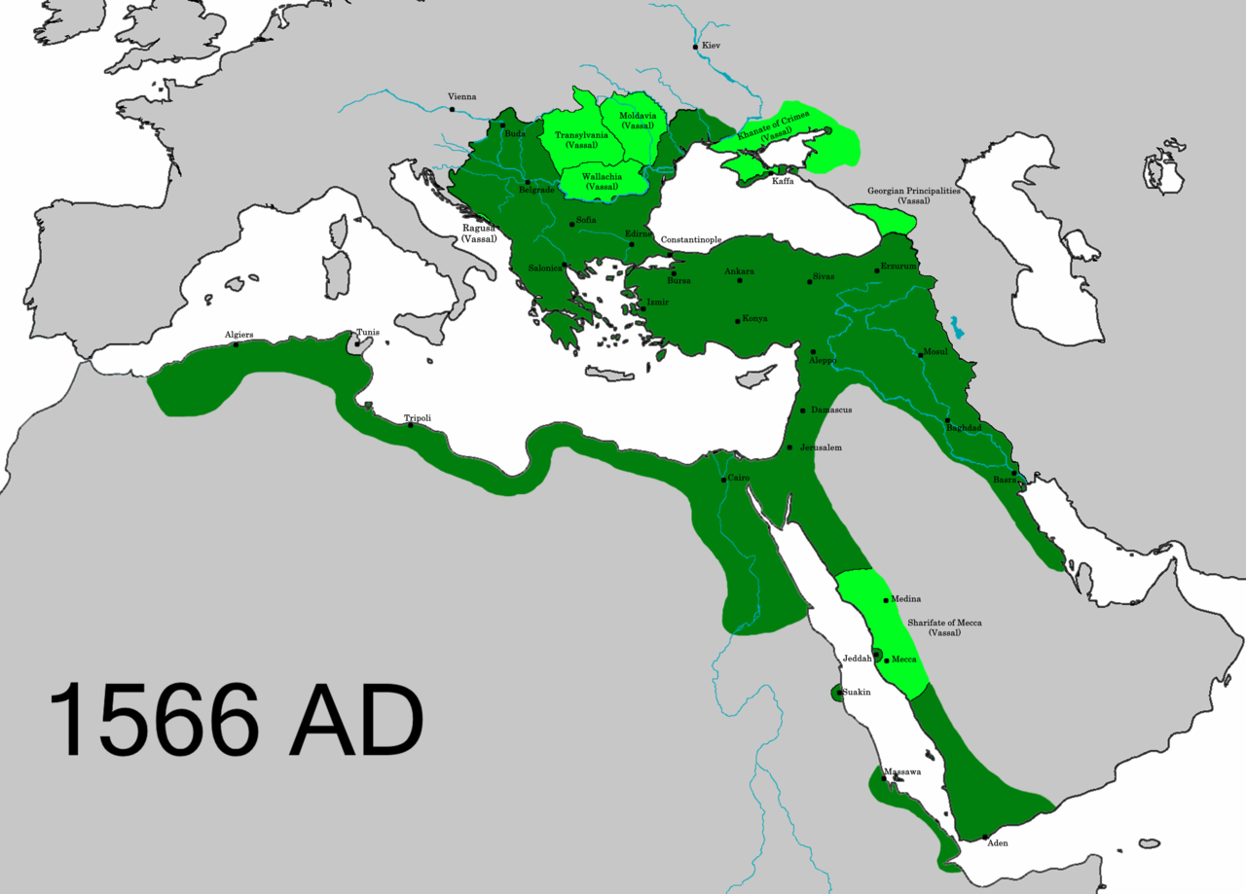

Slide 33
Europe
Safavids
Naval
Internal
1521: Belgrade taken
1522: Rhodes taken
1526: Alliance: Francis I of France
1526: Victory against Hungary at Battle of Mohacs
1529: First siege of Vienna
1529: Buda taken
1532: Siege of Guns
1537: Italy Campaign
1538: Moldavia Campaign
1541: Reconquest of Buda
1543: Esztergom, Pecs taken
1547: Conquest of Timisoara
1566: Conquest of Szigetvar
1533-1534: Campaign of the Two Iraqs, Baghdad taken
1538: Basra taken
1548: Second Campaign against the Safavids
1553: Nakhichevan Campaign and execution of Prince Mustafa
1554: Yerevan taken
1555: Peace of Amasya
1521: Janbirdi Al Ghazali Rebellion
1524: Hain Ahmed Pasha Rebellion
1515: Janissary Rebellion
1558: Prince Bayezid Rebels
1551-1558: Suleymaniye Mosque Complex
1534: Khizr Reis Barbarossa appointed as grand admiral
1538: Victory at Preveza
1546: Death of Haydreddin Barbarossa
1538: Four campaigns to India under commands of Hadim Suleyman Pasha, Piri Reis, Murad Reis, Seydi Ali Reis
1560: Victory at Djerba
1565: Siege of Malta
Notes:
1533: Plans to join France, England and Germany

Slide 34
Territorial expansion of the Ottoman Empire under Suleiman
(in red and orange)

Slide 35
Suleyman’s Legacy
Legal and administrative developments
  The establishment of the Kanun-name (Suleiman's Law)
  Rules regarding division of labour, assigning duties to the right person, training of staff
Art and Culture
  Imperial artistic societies were administered
  Suleyman personally inspected the works of the artists ad awarded them for the outstanding achievements
  Developments in fine arts and decorative arts – calligraphy, miniature painting, manuscript painting, gravures, ebru (water marbling), wood and stone carvings, ceramics, tiles and textiles
Construction
  Various projects by Sinan
  Holy Lands – Makkah: Shelters to accommodate pilgrims around Makkah, Turkish bath, Wooden roofs of portico surrounding Kaaba relaced with stone domes, Medresse established in Makkah, Kiswa preparation in Egypt
  Holy Lands – Medina: Fortifications around Medina, Reparations and renovations in Prophet's mosque, Scholars who taught in Prophet’s mosque were given permanent positions, Budget allocated for the staff serving the masjid, Renovated tomb of Aisha
  City walls encircling Jerusalem
  Fortresses with water reservoirs on the caravan route for th epilgrims – from Damascus to Makkah
  Mihrimah – spent a fortune to bring from Arafah to Makkah the reservoir of Ayn Al Zubayda

Slide 36
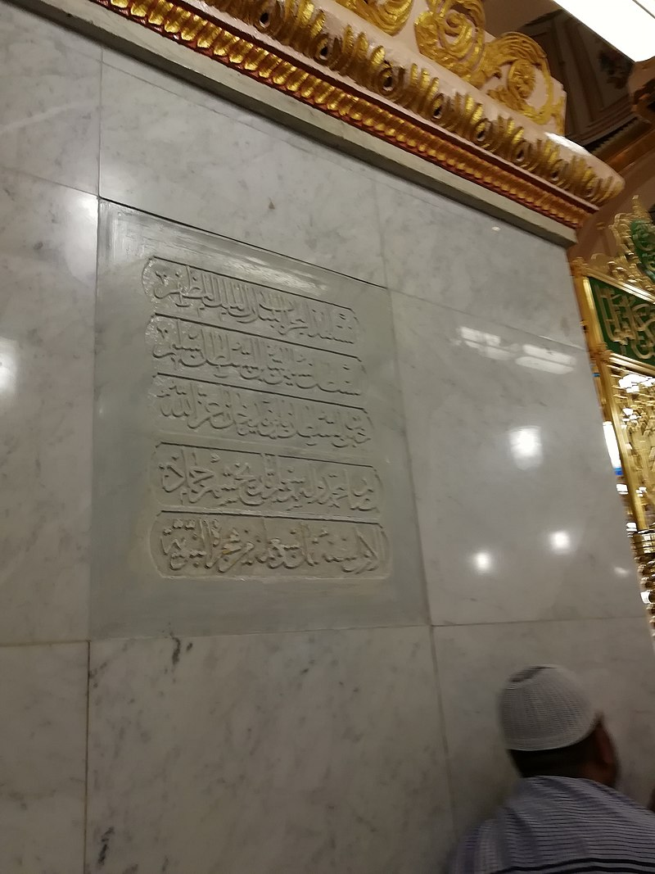
Suleiman I plate at al-Masjid al-Nabawi – Medina

Slide 37
Mimar Sinan (1489-1588)
Background
  Born in 1489 in Anatolia, Turkey
  Originally named Joseph; later took the name Sinan, meaning "the learned one."
  Apprenticed as a Janissary soldier before discovering his talent for architecture.
  Appointed Chief Royal Architect (Mimarbaşı) in 1538 at the age of 50, served during the reigns of Suleiman, Selim II and Murad III
Architectural Legacy
  Oversaw the construction of over 300 structures; over 200 survive
  135 Mosques, 57 colleges, 35 palaces and mansions, 22 tombs, 17 hospices, 3 hospitals, 8 bridges, 7 aqueducts, 42 bath houses, 46 inns, 8 granaries
  Built Mosques in Turkey, Hungary, Bulgaria, Jerusalem, Aleppo, Crimea, Damascus, Iraq, Greece
  Iconic works include the Süleymaniye Mosque, Selimiye II Mosque, Mimrihan mosques
  Emphasized functionality, aesthetics, and harmony in design.
  Influence extended to mosque, bridge, aqueduct, and palace architecture.
Innovations and Techniques
  Pioneered the use of large domes and semi-domes in mosque design.
  Developed innovative structural systems for stability and earthquake resistance.
  Incorporated natural light and ventilation for a serene interior ambiance.

Slide 38
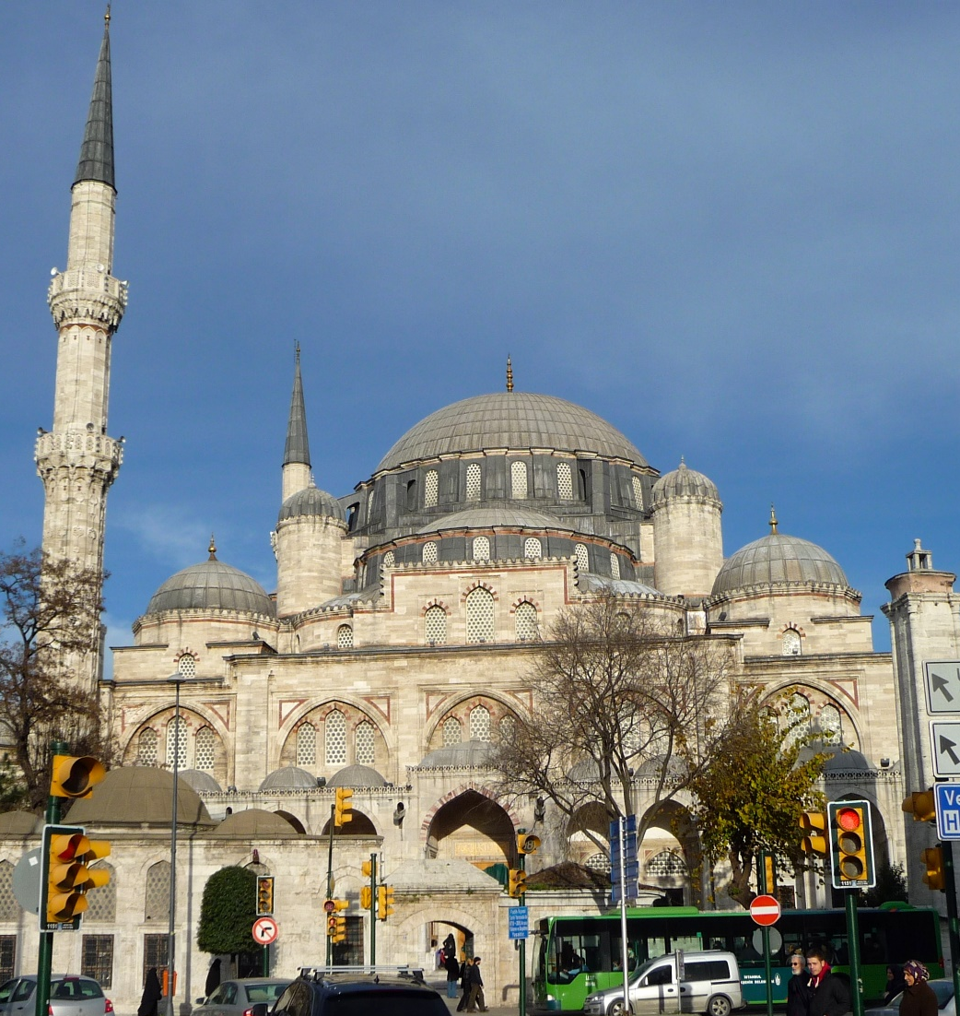
Shahzade Mosque
Notes:
Shahzade Mosque – built by Sinan, his 1st imperial mosque • Finished in 1548 • Minaret is 55m tall • Mehmed was the son of Hurrem Sultan, he died on the way back from Hungary after successful campaign • Graves of Mehmed, Rustum Pasha, Ibrahim Pasha in the complex

Slide 39
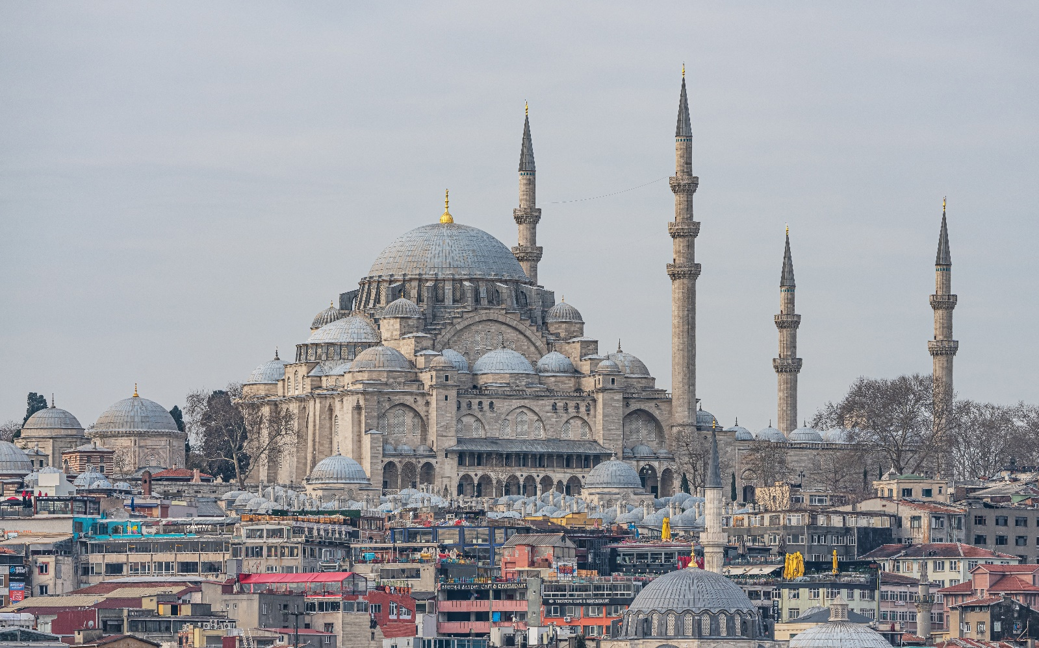
Sulemaniye Mosque
Notes:
• Sulemaniye Mosque • 2nd largest Mosque in Istanbul • Has 4 minarets • Minarets have 10 galleries indicating the 10th ruler • On the 3rd hill • Sinan's most important Mosque in Istanbul • Half the workers were Christian & finished in 1557
• Sulemaniye Mosque • Damaged by fire in 1660 and an earthquake in 1766 • Suleman I, Roxelana, Suliman II, Ahmed II, Sinan are buried in the complex • The Hamam is still in use
• Sulemaniye Mosque • Sinan's most important in Istanbul • Sinan buried next to it

Slide 40
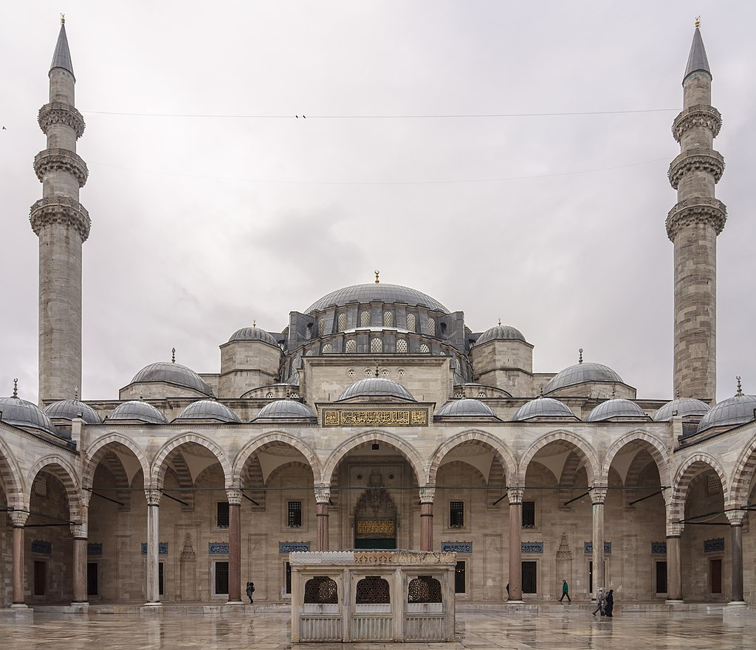

Slide 41
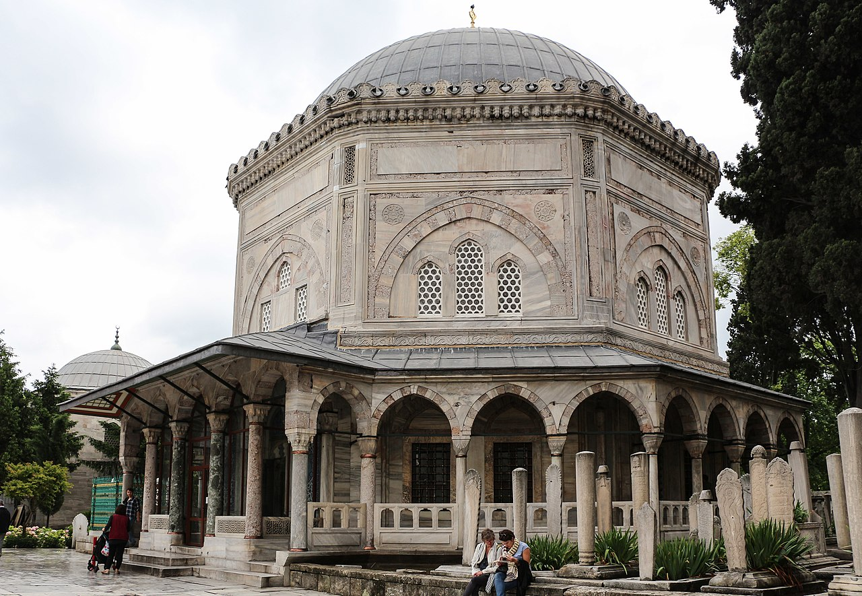

Slide 42
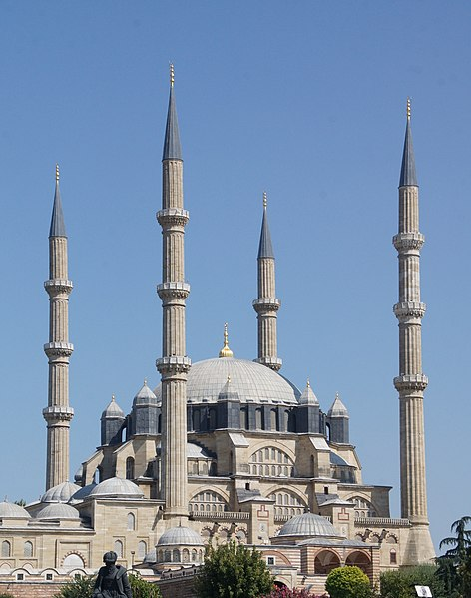
Selimiye II Mosque
Notes:
• Selim II Mosque in Edirne • Finished in 1574 and was Sinan’s Masterpiece

Slide 43
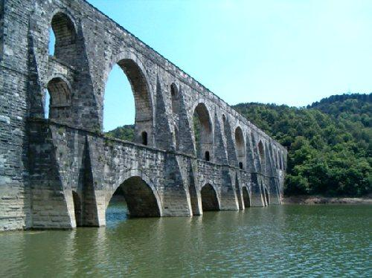
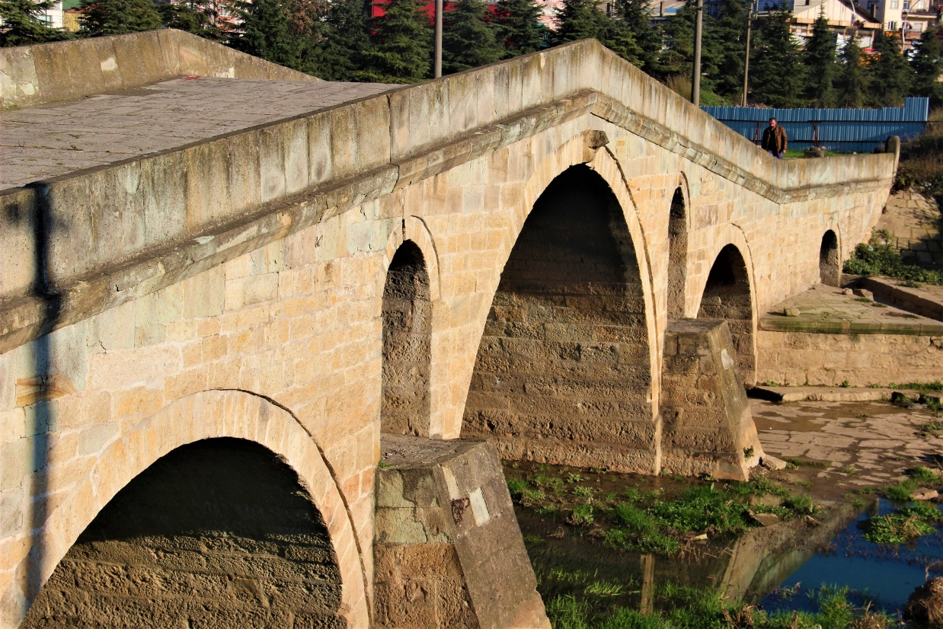
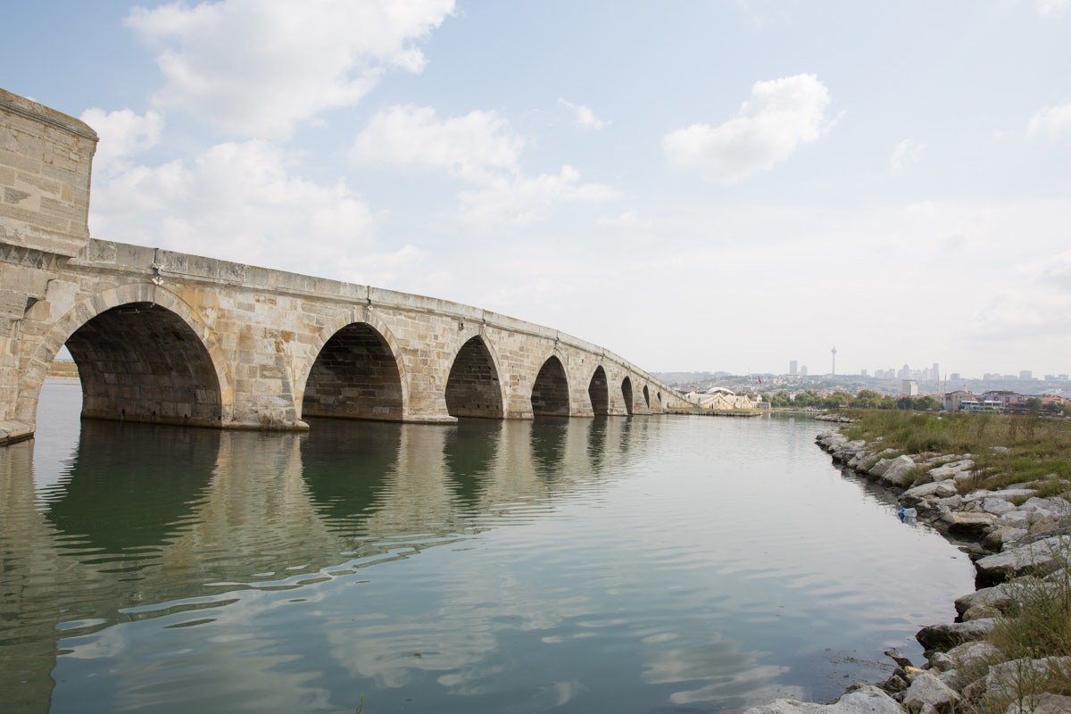
Bridges and Aqueducts

Slide 44
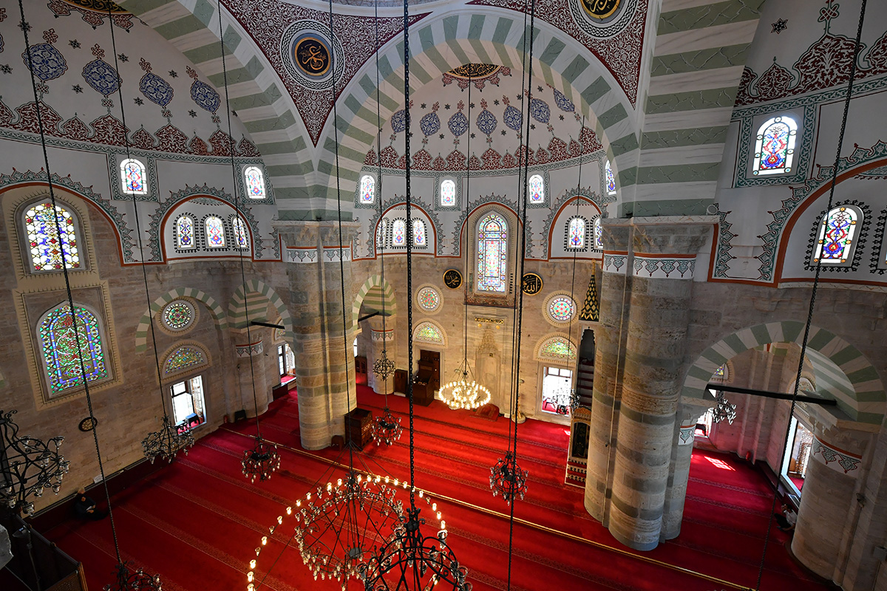
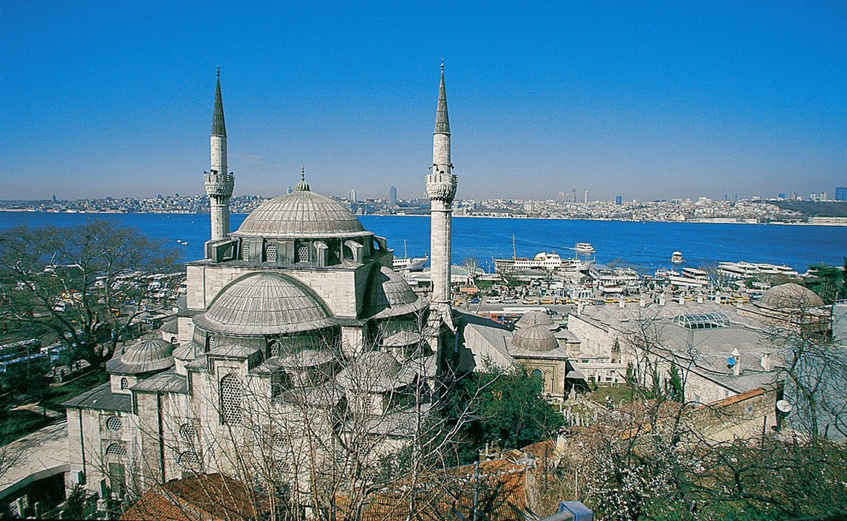
Mihrimah Mosque

Slide 45
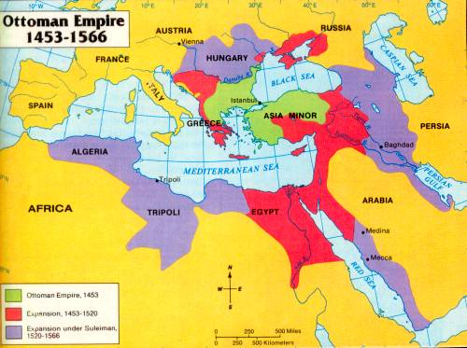

Slide 46
Timeline of Suleyman’s Reign
1494: Suleyman was born in Trabzon
1520: He became Sultan on the death of his father Selim I
1521-22: Belgrade and Rhodes taken
1526: Alliance with Francis I of France, Victory against Hungary at Battle of Mohacs
1529: First siege of Vienna, Buda taken
1533-1534: Campaign of the Two Iraqs; Baghdad, Tabriz, Azerbaijan taken
1534: Khizr Reis Barbarossa appointed as grand admiral
1538: Moldavia Campaign, Basra taken from the Safavids, Victory at Preveza, 4 campaigns to India
1541-47: Campaigns against Ferdinand I - Buda, Esztergom, Pecs, Timisoara taken
1551: Tripoli taken
1551-1558: Construction of Suleymaniye Mosque Complex
1555: Peace of Amasya with the Safavids
1560: Victory at Djerba
1562: Eight year armistice was signed with Ferdinand and Charles V
1566: Conquest of Szigetvar, death of Sultan Suleyman

Slide 47
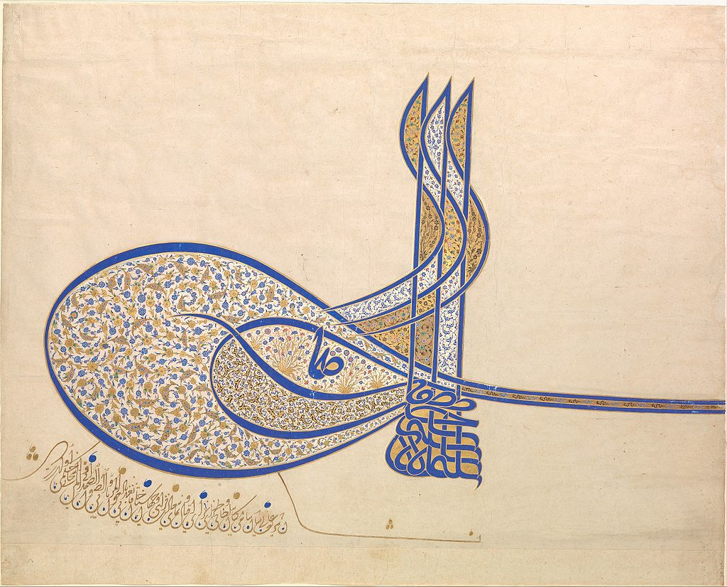

Slide 48
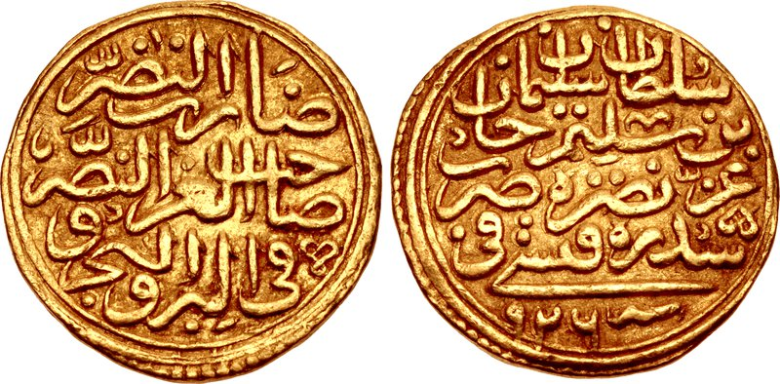

Slide 49
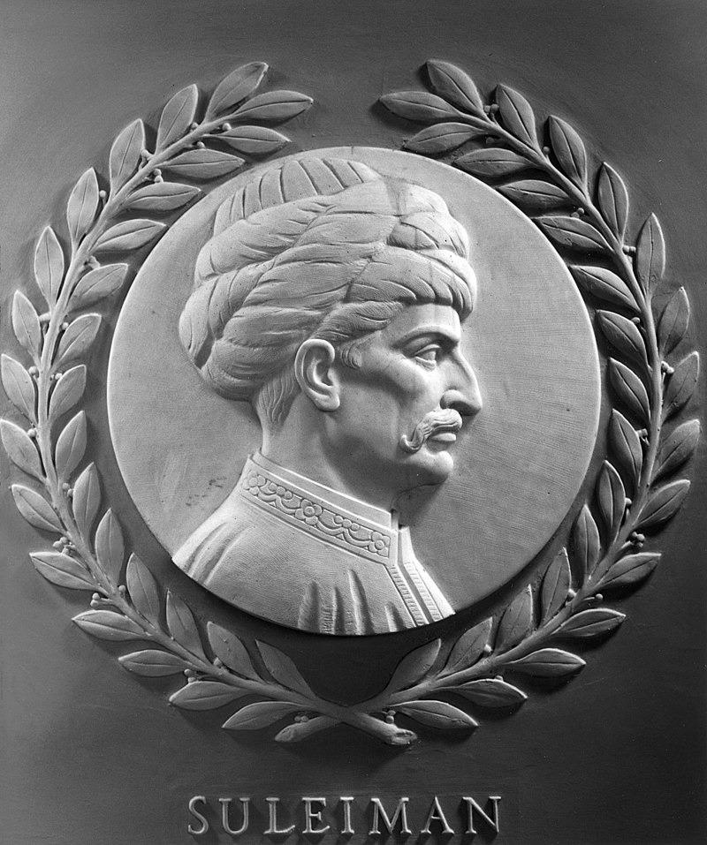
Suleiman's marble portrait in the US Capitol

Slide 50
What was Happening in the World (1520-1566)
1520: Spanish explorer Hernán Cortés captures Tenochtitlan, the capital of the Aztec Empire.
1520: Martin Luther refuses to recant his views, leading to his excommunication
1521: Ferdinand Magellan's expedition circumnavigates the globe
1526: The Mughal Empire, led by Babur, defeats the Sultan of Delhi, Ibrahim Lodi, establishing Mughal rule in India at the battle of Panipat
1527: Imperial troops, led by Charles V, sack Rome, a significant event in the Italian Wars.
1533: King Henry VIII of England marries Anne Boleyn after the English Reformation.
1534: Henry VIII is declared the supreme head of the Church of England.
1540: Sher Shah Suri, a former officer in the army defeats Humayun, he flees to the Safavids
1543: Nicolaus Copernicus publishes "De revolutionibus orbium coelestium," proposing a heliocentric model of the solar system.
1545-1563: The Catholic Church convenes the Council of Trent to address issues raised by the Protestant Reformation.
1555: Humayun regains Mughal Empire
1556: Akbar the Great becomes the ruler of the Mughal Empire in India.
1558: Elizabeth I ascends to the throne of England, marking beginning of the Elizabethan era.

Slide 51
Brief Timeline of Exploration from 1453 to 1600
1453: The fall of Constantinople to the Ottoman Empire.
1492: Christopher Columbus, funded by Spain, reaches the Americas, thinking he had reached Asia.
1497-1498: Portuguese explorer Vasco da Gama sails around the Cape of Good Hope, establishing a sea route to India.
1499-1500: Italian explorer Amerigo Vespucci suggests that the newly discovered lands are part of a separate continent, not Asia.
1519-1522: Ferdinand Magellan's expedition becomes the first to circumnavigate the globe, although Magellan himself dies during the journey.
1533: Francisco Pizarro completes the conquest of the Inca Empire in South America.
1565: Miguel López de Legazpi reaches the Philippines, leading to Spanish colonization.
1577-1580: Sir Francis Drake circumnavigates the globe, the first Englishman to do so.
1588: The Spanish Armada, a fleet sent by Spain, is defeated by the English navy, marking a significant shift in naval power.
1599-1600: Dutch navigator Willem Barentsz explores the Arctic region in search of a Northeast Passage.

Slide 52
