Slide 1
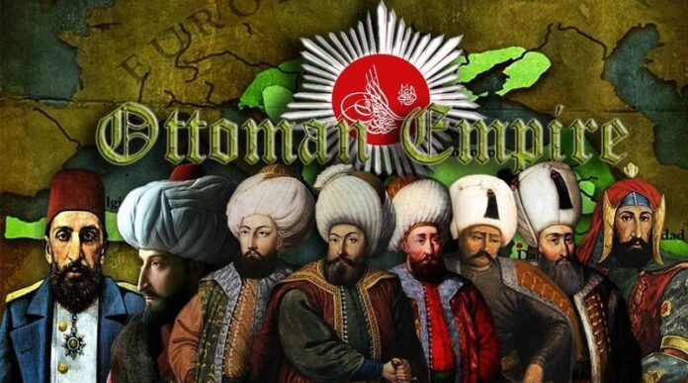
The Rise of the Ottomans
(1299-1566)

Slide 2
Let’s Recap…
Notes:
Let’s Recap…

Slide 3
Timeline of the First 10 Sultans
1237: Alaeddin Keyqubad I awards Ertugrul (d.1289) title of Ghazi and Karacadag, Sogut, Domanic
1285-88: Osman (d.1326) conquers Byzantine territories, Yenisehir is the new capital
1326: Orhan (d.1360) comes to power, Bursa is taken, becomes new capital, later Nicaea and Gallipoli are taken
1363-65: Murad I (d. 1389) takes Tzouroulos, Arkadiapolis, Malgara and others; Edirne became capital.
1368-82: Bulgaria and Constantinople (Byzantine Empire) became vassals, Karasid, Germiyanid, Karamanid land taken.
1389: Murad was martyred after victory at the Battle of Kosovo; Bayezid I (d.1403) succeeded him.
1389-93: Bayezid took Philadelphia and Beyliks in Anatolia (Karamanids and Candarids)
1391-96: Bayezid besieged Constantinople and defeated the Holy League at the Battle of Nicopolis.
1402: Defeat at the Battle of Ankara, resulted in a 10 year Interregnum period
1413-19: Mehmed I (d.1421) becomes the Sultan, seizes Konya and territories in Wallachia and Hungary
1419: Byzantines, Serbians, Wallachian, Moreans agree to pay tribute to the Ottomans.
1423-1433: Murad II (d.1453) consolidates his rule in Anatolia and suppresses local rebellions.
1444-48: Murad wins at the Battle of Varna and the Second Battle of Kosovo
1453: Mehmet II (d.1481) conquered Constantinople
1459-1479: Mehmet took Serbia (1459), Morea (1460), Trebizond (1461), Bosnia (1463), Crimea (1475), Albania (1479)
1495: Capture of Lepanto and other islands from the Venetians by Bayezid II (d.1512)
1505: Kemal Reis (d.1511) was sent by Bayezid II to help Muslims and Jews in Spain
1516-17: Selim I (d.1520) defeats the Mamluks at Marj Dabiq and Ridaniya and takes control of Syria, Egypt and Hijaz, Adopts the title of Caliph
1521-66: Suleiman the Magnificient took Belgrade (1521), Rhodes (1522), Baghdad (1533), Tabriz (1533), Azerbaijan (1534), Basra (1538), Tripoli (1551), Szigetvar (1566)

Slide 4
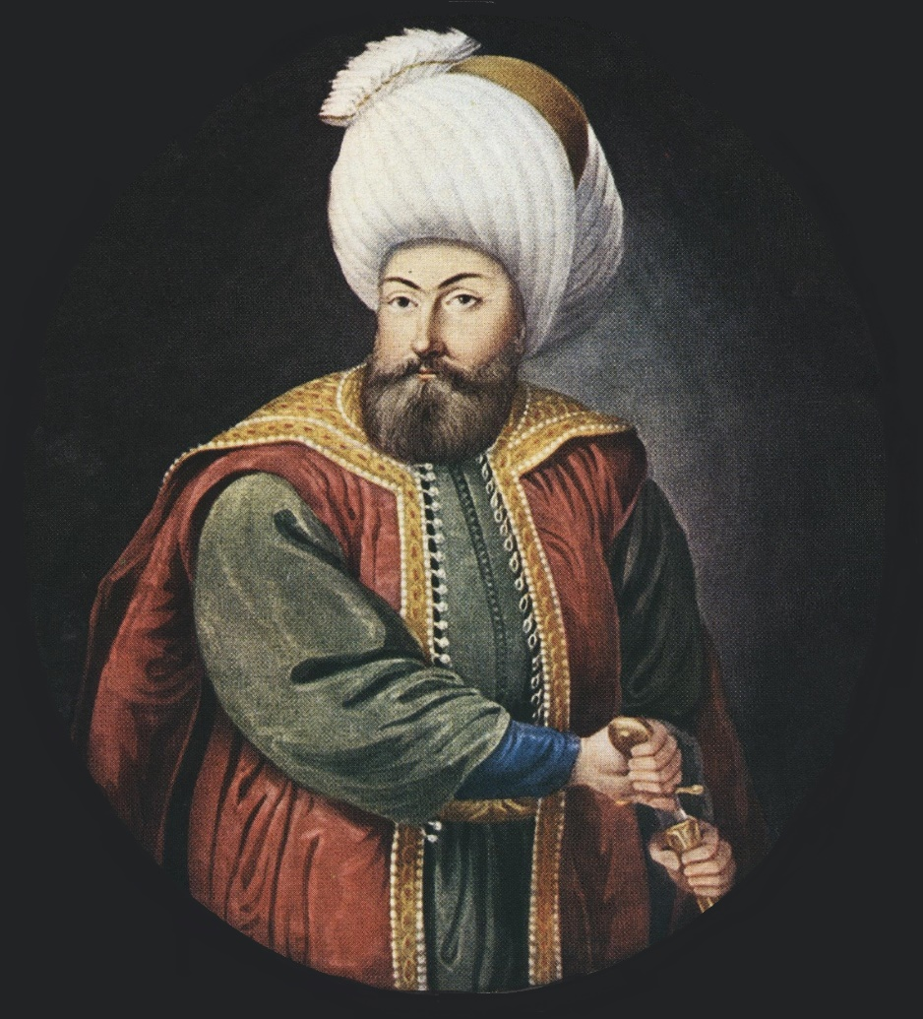
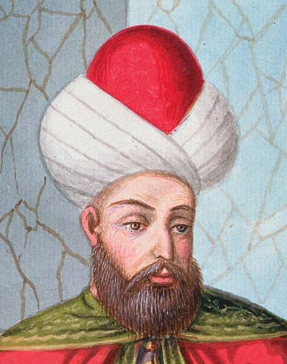
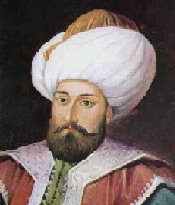
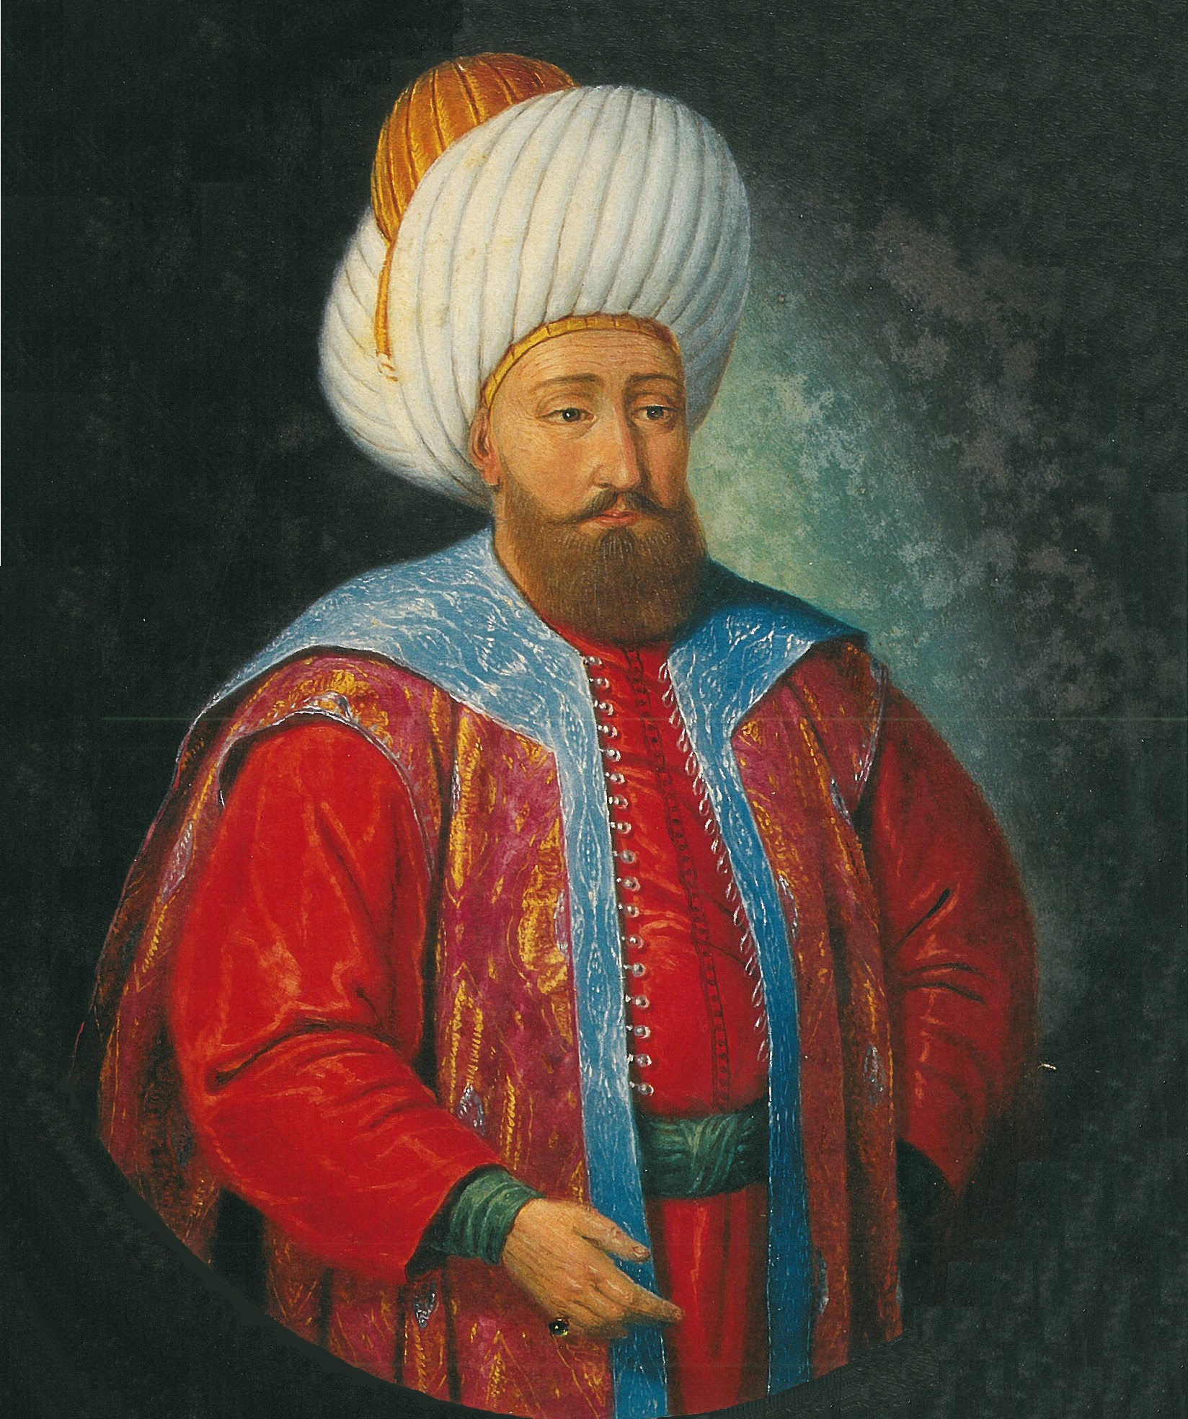
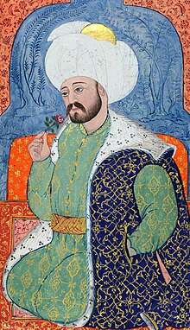
The First 5 Ottoman Sultans – Sogut and Bursa
Osman Ghazi
1299–1326
Orhan Ghazi
1326–1362
Murad Hüdavendigâr
1362–1389
Bayezid Yıldırım
1389–1402
Mehmed I Çelebi
1413–1421
Ruled From: Söğüt
Major Victories: Conquests in the Bithynian region.
Founder of the Ottoman Empire.
Osman I is the namesake of the Ottoman Empire.
Ruled From: Bursa
Major Victories: Conquest of Bursa.
Consolidation of Ottoman rule in northwest Anatolia.
Orhan was the son of Osman I.
Ruled From: Bursa
Major Victories: Battle of Kosovo (1389).
Expansion of Ottoman territories.
Murad I was the first Ottoman Sultan to die in battle.
Ruled From: Bursa
Major Victories: Battle of Nicopolis (1396).
Expansion and consolidation of the Ottoman state.
Bayezid I was the first Ottoman Sultan to be captured in battle.
Ruled From: Bursa
Major Victories: None notable during his reign.
Restored order after the Ottoman Interregnum.
Mehmed I succeeded in reuniting the Ottoman territories after the Interregnum.

Slide 5
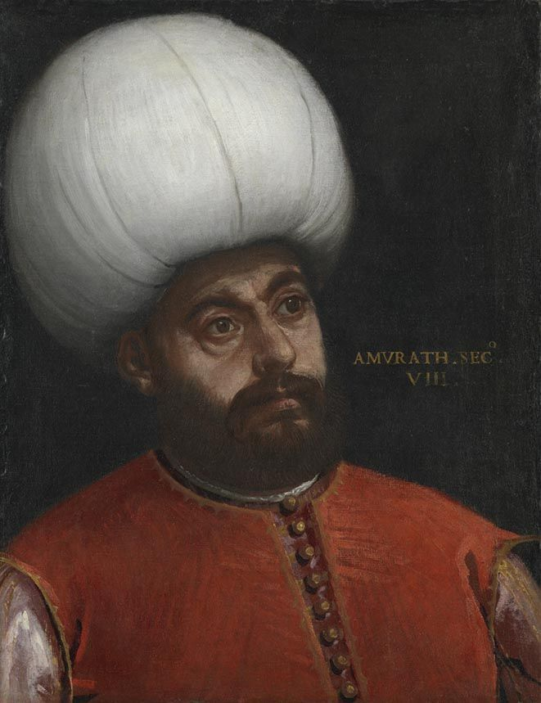
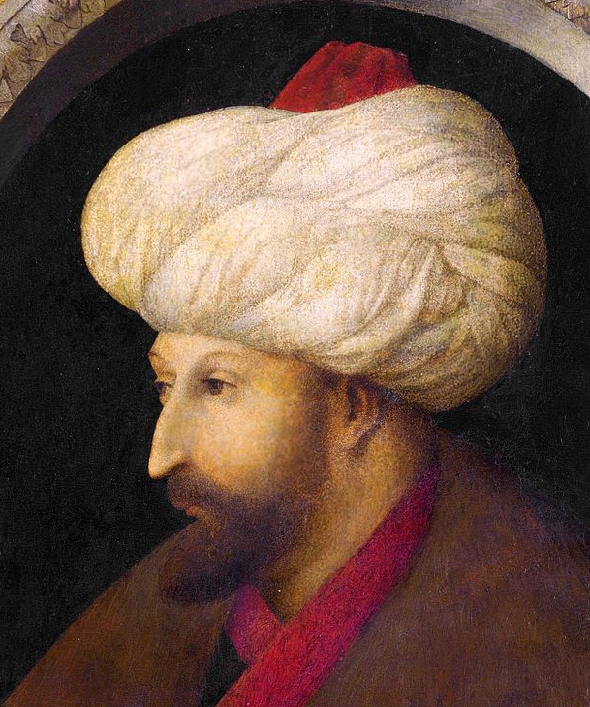
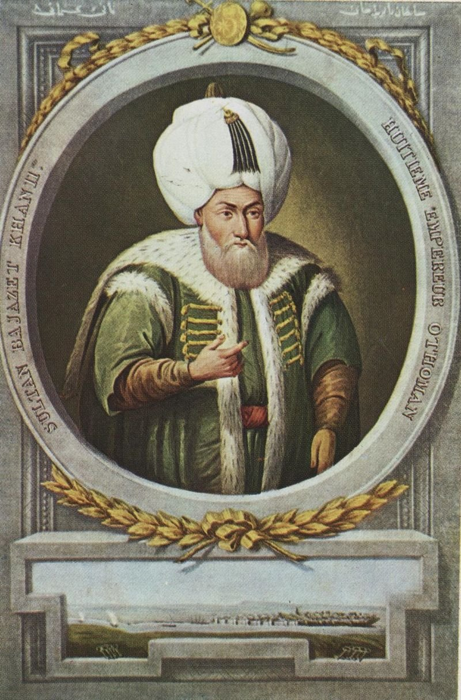
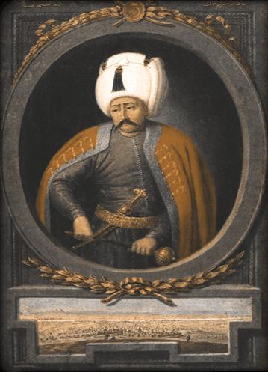
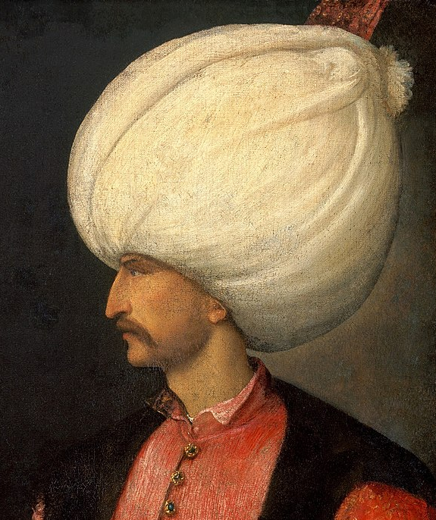
The Next 5 Ottoman – Edirne and Constantinople
Murad II
1421–1444
1446–1451
Mehmed II Fatih
1444–1446
1451–1481
Bayezid II
1481–1512
Selim I the Grim
1512-1520
Suleiman the Magnificent
1520–1566
Ruled From: Constantinople
Major Victories: None notable during his reign.
Maintained peace and stability.
Bayezid II welcomed Jewish refugees expelled from Spain.
Major Victories: Battle of Chaldiran (1514).
Expanded Ottoman territories (Syria, Egypt, Hijaz)
Selim I was the first Ottoman Sultan to assume the title of Caliph.
Major Victories: Siege of Belgrade (1521), Battle of Mohács (1526), Siege of Vienna (1529).
Considered one of the greatest Ottoman rulers; expanded the empire culturally and territorially.
Suleiman was a poet and wrote under the pen name "Muhibbi."
Ruled From: Edirne
Major Victories: Conquests in the Balkans.
Consolidation of Ottoman rule.
Murad II briefly abdicated but returned to the throne due to a crisis.
Ruled From: Edirne, later Constantinople
Major Victories: Conquest of Constantinople (1453).
Expanded the Ottoman Empire significantly.
Mehmed II ordered the construction of Topkapi Palace in Istanbul.

Slide 6
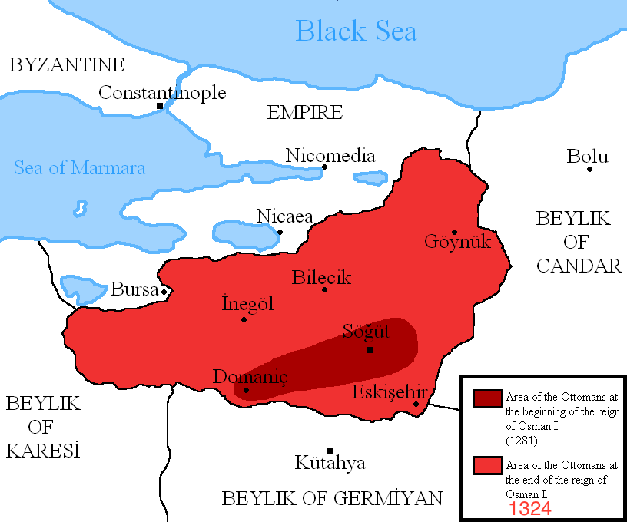
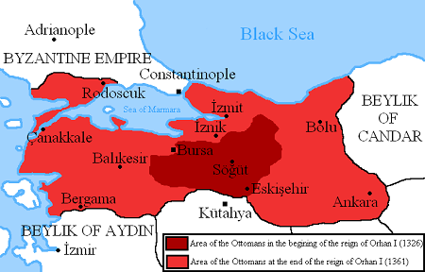
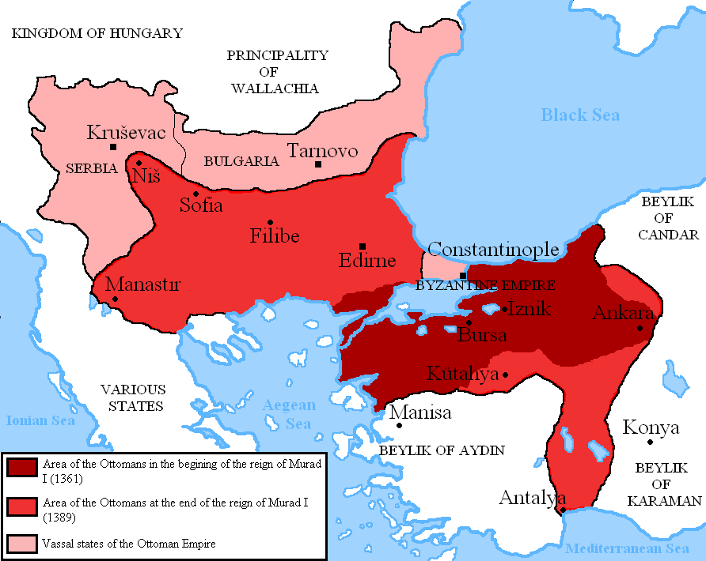
Osman (1281-1326)
Orhan (1326-1362)
Murad (1362-1389)

Slide 7
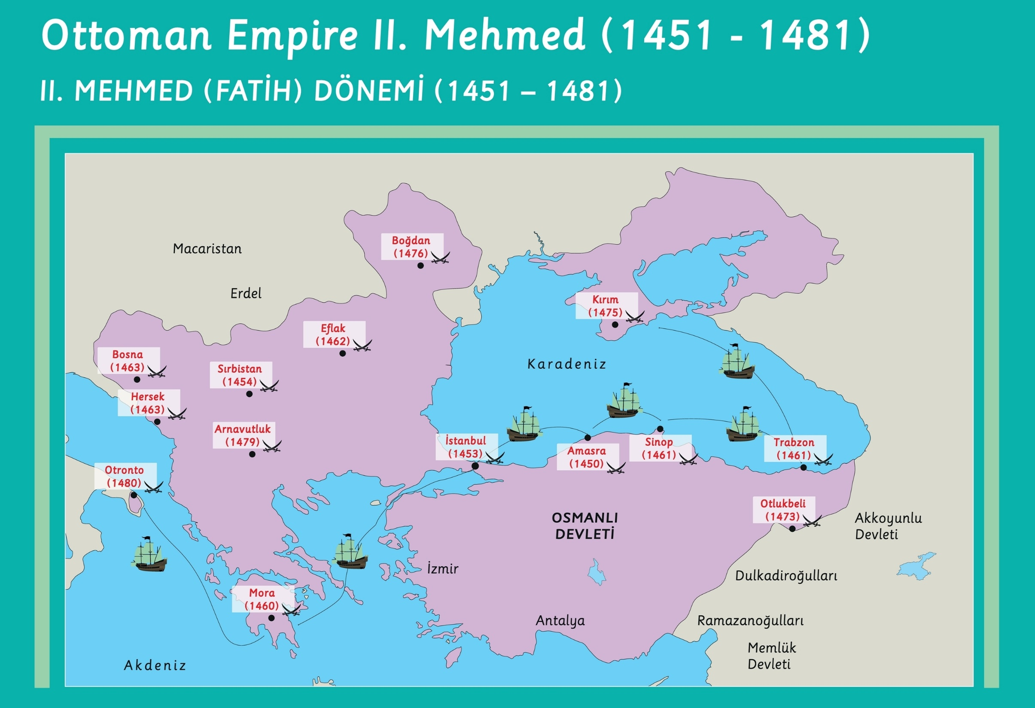

Slide 8
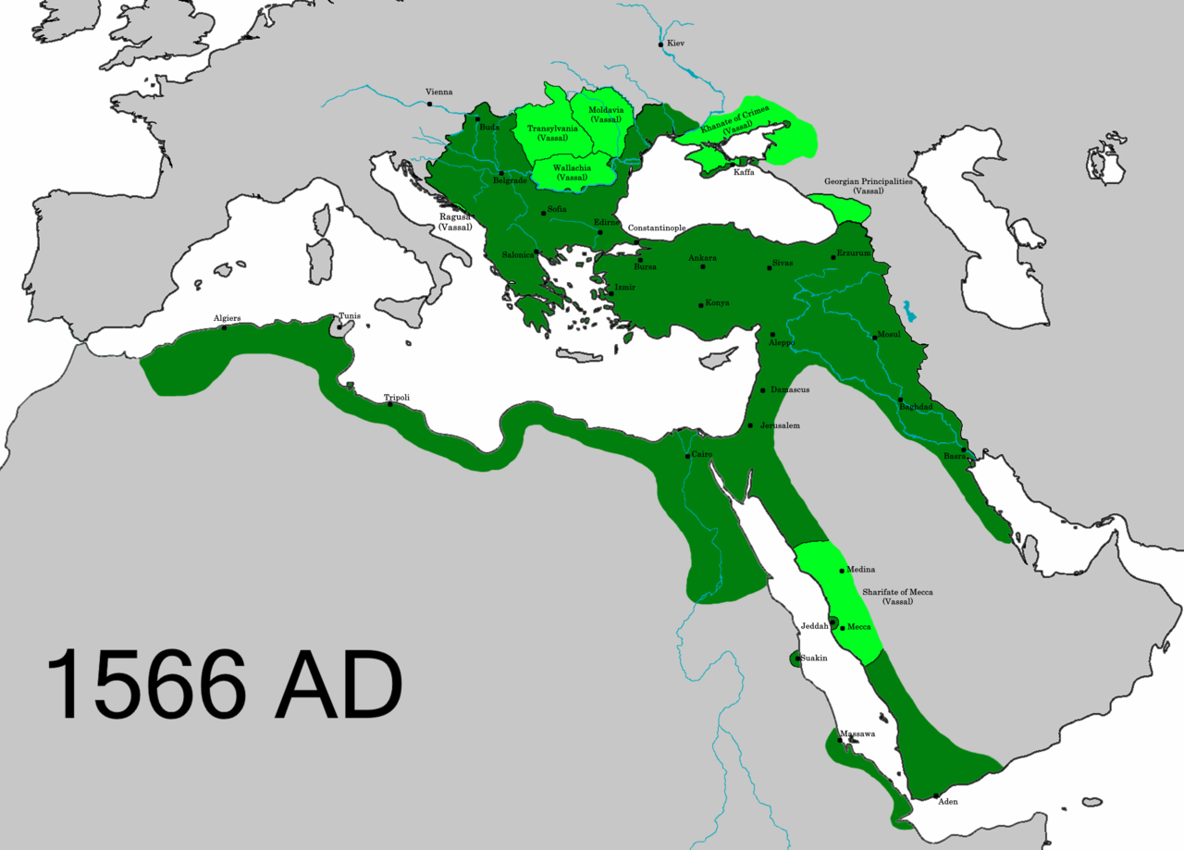

Slide 9
The Beginning – Ertugrul Ghazi
8th and 9th Century: Oghuzz Tribes migrate west
1187: Salahuddin recaptures Jerusalem from Crusaders
1196: Birth of Ertugrul Ghazi
1202-1204: The Fourth Crusade results in the sack of Constantinople by the Crusaders.
1204-1237: Seljuks of Rum Golden Age.
1206: Genghis Khan establishes the Mongol Empire.
1227: Kayi tribe cross Euphrates and enter into Anatolia
1228-1229: Sixth Crusade, Sultan al-Kamil gave Jerusalem to Fredrick II
1244: Khwarizmian Turks take back Jerusalem
1258: Fall of Baghdad to the Mongol Hulagu Khan
1258: Birth of Osman
1260: Mongols are defeated by the Mamluks at the Battle of Ain Jalut
1261: Michael VIII Palaiologos recaptured Constantinople from the Latin Empire
1271-1295: Marco Polo embarks on his journey to Asia, stays at the court of Kublai Khan
1281: Orhan, one of Osman's sons, is born.
Notes:
1299: Ilkhanate ruler Ghazan invades Syria and defeats the Mamluks

Slide 10
Osman Ghazi (1299-1326)
1284: First Holy War as Osman attempts to capture Inegol.
1285-1288: Osman conquers Kulaca Hisar, Yashisar and Karaca Hisar
1289: Ertugrul Ghazi dies and Osman (r. 1289-1326) comes to power
1299: Captures Bilekoma and Yenisehir, Ottoman Empire established.
1300: First family conflict as Osman kills his uncle Dundar Bey.
1302-1303: Battle of Bapheus and Dimbos open the Bursa Plain and Uludag Mountains
1304-1369: Ibn Batuta’s travels
1325-1337: The Aztec Empire expands its territory, they build the city of Tenochtitlan.
1325: Mansa Musa goes on Haj
1326: Capture of Prousa (Bursa)
1326: Death of Osman Ghazi
With just 400 horsemen, Osman transformed a small Beylik into a principality
He split captured lands, believed in collective governance and not a monarchy
The Seal of Kayi (Three arrows and a bow) was painted on Flags and minted on coins
He insisted on conforming to Islamic Law, protecting and accommodating his subjects, seeking consultations and remaining just

Slide 11
Orhan Ghazi (1326-1362)
1325: Muhammad bin Tughlaq ruled the Delhi Sultanate.
1326: Capture of Prousa (Bursa), Orhan takes over on the insistence of
brother Alauddin.
1329: Battle of Pelekanon - Ottomans decisively defeat Byzantine forces
1331-1337: Conquest of Nicaea (Iznik) Gemlik, Nicomedia (Izmit).
1335: End of the Ilkhanate.
1345: Annexation of the Karasids' lands.
1352-1356: Suleyman Pasa expands into Rumelia, Battle of Demotika: Serbians and Bulgarians defeated, Capture of Gallipoli
1357: Suleyman Pasa dies in an accident, Orhan is miserable and isolates himself
1359: Ottoman prince Şehzade Halil is kidnapped by Genoese pirates and later ransomed.
1360: Orhan dies, and Murad I ascends to the throne.
1360: Timur starts building his Empire
1362: Execution of Sehzade Halil and Sehzade Ibrahim due to their rebellion.
Introduced centralized administration and established a regular standing army
Ottomans entered into Europe following the conquests in Rumelia.

Slide 12
Murad I (1362-1389)
1326: Murad was born in Bursa to Nilufar Hatun and Orhan Bey.
1362: Murad ascended to the throne, tackled various rebellions
1363: Recaptured Tzouroulos, Arkadiapolis, and Malgara
1364: Battle of Sirpsindigi, where Ottomans defeated a Crusader army.
1365-1366: Edirne became the capital, Temporary loss of Gallipoli.
1368-1644: Ming Dynasty succeeded the Mongol Yuan Dynasty in China
1368-1374: Victory at Battle of Maritsa; Bulgaria, Constantinople, Serbia became vassals.
1371: 1374: Son Savci Bey rebelled, was blinded
1382: Through marriage, Murad gained territory from Germiyanids.
1386: Battle of Frenk Yazisi against Karamanids.
1389: Battle of Kosovo against Crusader armies, Murad martyred; Bayezid I succeeded him.
Soup kitchens, religious lodges, masjids, madrassas, cultural and scientific centers set up
Non-Muslims live in peace, prospering more than under previous Christian rulers
Reorganization of tax collection and use of funds for construction and development
Kapikulu and Janissary forces were established; Turks, Arabs, Persian and others joined

Slide 13
Yildirim Bayezid I (1389–1402)
1370-1380: Timur expands his empire by conquering neighboring territories
1389: Bayezid came to power after the Battle of Kosovo at the age of 35.
1389-1393: Bayezid takes Philadelphia from the Byzantines, overruns
several Beyliks in Anatolia such as the Karamanids and Candarids
1391: Skopje is conquered and forces enter Wallachia, Constantinople is besieged
1393-1396: After defeating the Hungarians, Ottomans advance into Greece and Albania, and took Salonika, Kruje, Scutary, and Tarnova.
1396: Battle of Nicopolis: Crusader army consisting of European nations is defeated
1402: The Ottomans are defeated by Timur at the Battle of Ankara
Construction of dervish lodges, madrassas, almshouses, travelers and medical hospices
Construction of Bursa’s Ulu Camii (the Grand Mosque), Guzelhisar (Anatolian Fortress)
A central bureaucracy was designed and developed based on Islamic principles
Development of Ottoman seafaring
Tradition of the annual procession with the imperial gifts to meet the needs of the Haramain and to pay the salaries of the officials there

Slide 14
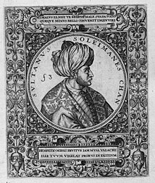
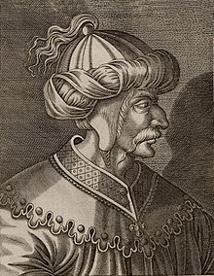
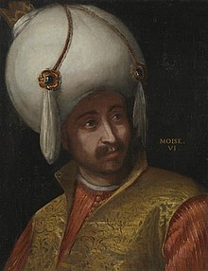
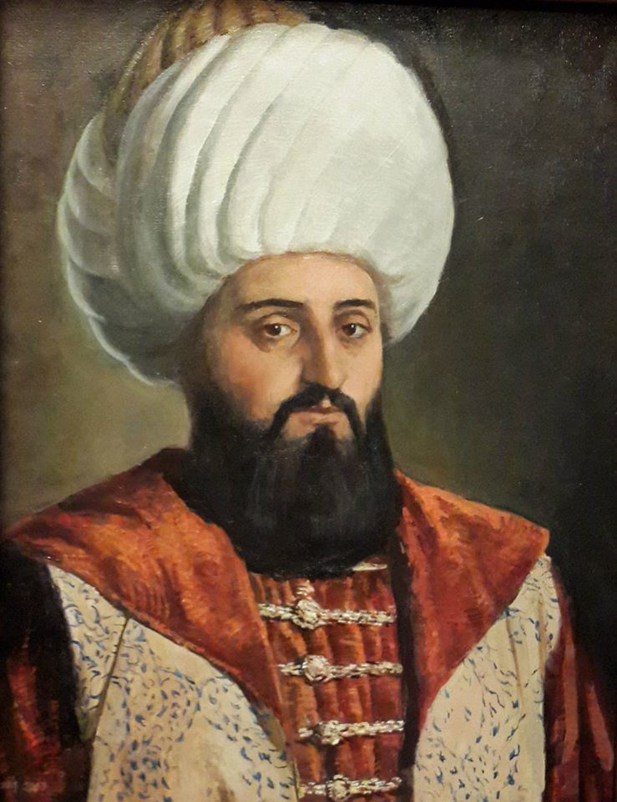
Interregnum: Aftermath of the Battle of Ankara
Succession Problems
Unscrupulous Old Enemies
Timurid Threat
Loss of Manpower and Wealth
Timurid Threat
Loss of Territory
The Ottoman Empire nearly ceased to exist…
The Shehzade – Princes
Suleyman
1402 − 1411
Isa
1403 − 1406
Mehmed I
1413 –1421
Musa
1411 − 1413
Mustafa
1419 – 1422
Notes:
Succession Problems: Bayezid’s sons turn on each other, as there is no heir apparent, this hampers Ottoman progress and stunts growth. From 1403 to 1413, no real Ottoman ruler, they were all de facto leaders of provinces
Unscrupulous Old Enemies: Byzantines, Karamanids resurface and grab the opportunity to unseat Ottoman power
Loss of Manpower: During the battle and due to the civil war thereafter, many Muslims lives were lost. The civil war proved very costly
Timurid Threat: The Timurids charged into Anatolia all the way to the Aegean Sea, caused widespread devastation, sacked many cities such as Bursa
Beyliks Reinstated: Beyliks were reestablished by Timur and placed under his protection
The Ottoman Empire nearly ceased to exist

Slide 15
Mehmed I Celebi (1413-1421)
1403: Musa and Mustafa were captured, three sons escaped: Suleyman to
Edirne, Isa to Aegean, Mehmet to Amasya and started ruling there
1403-1406: Isa gets support from Suleyman to recapture Anatolia, Mehmet
defeats him, Isa challenges Suleymen, is killed; Suleyman takes west Anatolia
1410-1411: Musa is released, and with Mehmet’s support he attacks Suleyman in Rumelia
1411: Suleyman is killed by Musa or by his own troops, Musa takes Rumelia
1413: Musa starts challenging Mehmed I, is executed. Mehmed I becomes the Sultan
1414-1415: Mehmed defeats Cuneyd Bey and seizes Konya from the Karamanids
1419: Campaign against Wallachia, capture of Drobeta-Turnu Severin from Hungarians.
1419: Mustafa, a potential rival, is sent into exile by Mehmed I
1419: Byzantines, Serbians, Wallachian, Moreans agree to pay tribute to the Ottomans.
1421: Mehmed I falls off his horse, succumbs to his wounds, and dies at the age of 34.
Mehmed was able to fortify the Ottoman domain, he is known as the second founder
Built mosques, madrassas, almshouses, own tomb, Edirne Old mosque, Bursa Green mosque
He treated his subjects – Muslim, and non-Muslim, fairly

Slide 16
Murad II (1421-1451)
1404: Murad II is born in Amasya, during the Interregnum period.
1421: He takes the throne at the age of 17.
1422-1433: Murad consolidates his rule in Anatolia and suppresses rebellions
1437: The Orthodox and Catholic Church ally.
1438: Several victories against the Hungarians and Serbians.
1443: Peace treaty with Hungarians and Karamanids
1444: Murad abdicates in favor of his 12-year-old son Mehmet and moves to Manisa
1444: New Crusade announced, culminating in the Battle of Varna. Ottomans are victorious.
1448: Second Battle of Kosovo, Murad returns to the throne due to Janissary revolt, etc.
1451: Murad II passes away at the age of 48 and is buried in Bursa.
State revenues increased by 2.5 million gold coins
He was given the title – Ebul Hayrat – the Father of Good Works
He built many mosques, madrassas in Bursa, Edirne, Salonika, Skopje, Alacahisar, Merzifon
He patronized scholars, Sufi orders were expanded, books were written and translated Turkish translation of the Quran was completed

Slide 17
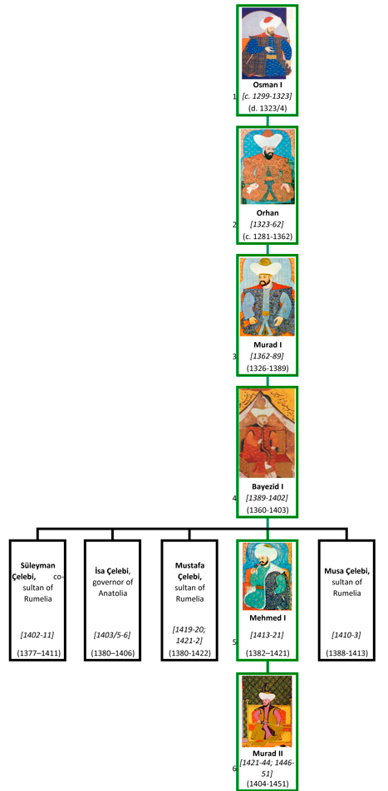
1299-1326: Osman I: Expanded from Sogut to other Byzantine provinces such as Karachahisar, Kalucahisar, Inegol in northwestern Anatolia, Fought the battle of Dimbos and Bapheaus, Capital was Sogut.
1326-1359: Orhan: Expanded further into Byzantine Bithynia including Bursa, Nicaea, Gemlik and the Karasid Beylik, Gained a foothold in Europe with the capture of Gallipoli, Capital was Bursa.
1359-1389: Murad I: Capital moved to Edirne, Won Battle of Sirpsindigi, Maritsa and Kosovo against Byzantines and Battle of Frenk Yazisi against Karamanids, Constantinople, Serbia and Bulgaria became vassals, Martyred - Battle of Kosovo.
1389-1402: Bayezid I: Unified Anatolia, expanded into the Balkans with advances into Wallachia, Greece and Albania, Besieged Constantinople, Won against crusader army at the Battle of Nicopolis, Defeated and captured by Timur at Ankara.
1402-1413: Interregnum
1413-1421: Mehmed I: Established stability after the Interregnum, Took back lost lands in Anatolia and Rumelia; Serbia, Wallachia, Constantinople, Morea become vassals.
1421-1444: Murad II: Consolidated rule in Anatolia, Several victories against the Hungarians and Serbians, Peace treaty with Hungarians and Karamanids, Won the Battle of Varna and Second Battle of Kosovo against the Holy League.

Slide 18
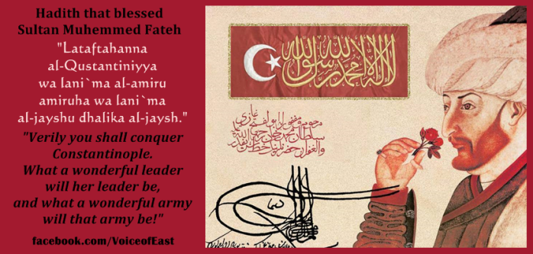
لتفتحن القسطنطينية، ولنعم الأمير أميرها، ولنعم الجيش ذلك الجيش

Slide 19
Mehmet II Fatih (1451-1481)
1444 First came to power at the age of 12 and returned in 1451 at 19 years
1450: The printing press was invented by Johannes Gutenberg
1451-1453: Preparation to conquer Constantinople: making concessions,
signing treaties, fighting off attacks and rebellions, conquering territories
around Constantinople, and establishing peace
1453: Constantinople was taken and reconstructed
1454-1480: Mehmed went on 25 campaigns, conquered 14 states and 200 towns, extended the borders of the state to 2.2 mn sq kms, uniting Anatolia and Rumelia, expanded the navy 1469: Ferdinand II of Aragon and Isabella I of Castile marry, leading to unification of Spain
1479-1481: Qaitbay becomes the Mamluk Sultan of Egypt and Syria, repels an Ottoman naval attack on Alexandria, dies in 1481
1481: Mehmed II set out with his army against the Mamluks, he died in the town of Hunkar
Many Islamic scholars consider him a Vali of Allah
Formation of state institutions –bureaucracy, palace administration, finance and military
Standardized historiography, art, literature, architecture, madrasah, education
Notes:
Haci Bayram Veli had given Murad the good news that Aksemsuddin and Mehmet would conquer Constantinople
Formation of state institutions –bureaucracy, palace administration, finance and military
Formation of an efficient team of statesmen including advisors from Florence, Genoa and Ragusa
Reconstruction of Janissaries and Uc Beys so they would pledge allegiance
He gave the permission for fratricide
Codification of laws and legal reforms, establishment of a centralized legal system
Reforms in taxation and economic policies to promote trade

Slide 20
Preparation for the Conquest: Think out of the Box
Research: Mehmed read up on siege tactics and formulated plans
Need to be swift: A long siege would mean reinforcements from Europe
Rumelia Fortress
Cannons
  Saruca Usta – intense work of casting large and small cannons, mortars, hand cannons
  Orbah – Hungarian master cannon founder – The Bear
Tunnels:
  Army of tunnelers, including 300 Serbian miners tunneled under the walls and set explosives
Golden Horn harbour side
  Weaker walls, but chain across the mouth
  Preparation to drag ships overland
  New ships – 300 large and small
Special Army
  Entire Ottoman army called except for those in the border lands
  120,000 strong – cavalry, infantry, artillery, janissaries, 1000s of Huffaz, 1000s of Ulema
  Sheikh Zindani – Prophet Mohammad’s family – Khorasan
  Sheikh Hullagurani – Student of Ibn Hajar al-Asqalani - Cairo
  Aksemsuddin – Student of Haji Bayram Vali, descendent of Abu Bakr As Siddiq – Damascus
  Sheikh Abdul Wuddud – Samakhand
  Sheikh Mohammad and Sheikh Ali Al Jilani – great greatgrandsons of Abdul Kadir Jilani – Iraq
  Naqeeb l Ashraf – with 3,000 warriors – all descendants of Hassan and Hussain

Slide 21
Bayezid II (1481-1512)
1455: Bayezid II becomes Governor of Amasya at 7 years, ruling for 27 years.
1473: Commands the right wing in the Battle of Otlukbeli in his mid-twenties.
1481: Bayezid II becomes Sultan after disputes with Cem Sultan
1485-1491: Engages in battles against the Mamluks, ending with peace treaty
1492: Reconquista is completed after Granada falls, Columbus reaches Americas
1494: Pope Alexander VI drew an arbitrary line around the globe, dividing up the world
1494: Capture of Lepanto and other islands from the Venetians
1495: Cem Sultan dies in captivity, ending a potential threat.
1497-1498: Vasco da Gama sails around the Cape of Good Hope, reaching Calicut in India
1501: 1502: Peace treaty with Venice
1503: Leonardo da Vinci completes his painting "Mona Lisa.“
1505: Kemal Reis was sent by Bayezid II to help Muslims and Jews in Spain
1505-1511: Parts of North Africa were taken by the Spanish and Portuguese
1509: Battle of Diu: Portuguese vs Sultan of Gujarat, Mamluks and Ottomans.
1512: Bayezid II passes away, possibly due to gout or poisoning.

Slide 22
Bayezid II (1481-1512)
Bayezid’s focus was on maintaining stability and consolidation of the empire and he paid attention to internal affairs
Peaceful relations with foreign powers – kept the borders his father established – neither losing or gaining any territories
A place of refuge; artists and scientists were supported
85 law codes were published – regulations on food, consumer rights and environment
Construction Projects
  The Galata mosque was developed in the Andalusian style
  Bayezid Masjid near Grand Bazaar was constructed – a replica of the Faith mosque
  He explored possibility of building a bridge over the Golden Horn from Constantinople to Galata (Leonardo Da Vinci)
  He built many social works like the kulliyes in Istanbul and Edirne and the Pirinc Han, the inn in Bursa which was rented out to support charitable organizations
The navy was transformed from merely a means of transport to a fully-fledged power of war
Notes:
Cooks should prepare clen food
Wash pots with clean water
Naver serve pork
Barbers shouldn’t share utensils
Horses without horse shoes
Do not overburden their loads
By decree of Sultan Bayezid II of the Ottoman Empire in 1484 Turks were prohibited from operating a printing press.

Slide 23
Selim I (1512-1520)
1477-1512: Selim was the governor of Trabzon from age 7
1512: Ascends to the throne after Bayezid II abdicates
1514: Decisive victory over Shah Ismail at the Battle of Chaldiran.
1515: Takes over Dulkadirid Beylik, securing Ottoman borders.
1516: Defeats Mamluks at the Battle of Marj Dabiq, annexing Syria.
1517: Martin Luther initiates the Protestant Reformation by posting his 95 Theses
1517: Ottoman forces defeat Mamluks at the Battle of Ridaniya, taking control of Egypt and Hijaz, Selim I adopts the title of Caliph
1517: Portuguese attacked Jeddah, Admiral Selman Reis defeated them and gained control of the Spice Road
1519: Hernán Cortés arrives in Mexico, initiating the Spanish conquest of the Aztecs
1519: Charles I of Spain becomes Emperor Charles V of the Holy Roman Empire.
1520: Selim I passes away, likely due to illness, near Corlu
Financial gains secured from the Spice Road, the gains of war and the tribute from Cyprus filled up the Ottoman treasury
Just before he died, he prepared a naval fleet of about 250 ships ready for war

Slide 24
Suleyman the Magnificent (1520-1566)
1520: Suleyman became Sultan on the death of his father Selim I
1520: Spanish explorer Hernán Cortés captures Tenochtitlan
1521: Ferdinand Magellan's expedition circumnavigates the globe
1521-29: Belgrade, Rhodes, Buda taken; Victory against Hungary at Mohacs
1526: Babur, defeats Ibrahim Lodi, establishing Mughal rule in India
1533-1534: Campaign of the Two Iraqs; Baghdad, Tabriz, Azerbaijan taken
1533: King Henry VIII of England marries Anne Boleyn after the English Reformation.
1534: Khizr Reis Barbarossa appointed as grand admiral
1538: Moldavia campaign, Basra taken from Safavids, Victory at Preveza, India campaigns
1540: Sher Shah Suri, a former officer in the army defeats Humayun, he flees to the Safavid
1541-51: Campaigns against Ferdinand I - Buda, Esztergom, Pecs, Timisoara, Tripoli taken
1551-1558: Construction of Suleymaniye Mosque Complex
1555: Peace of Amasya with the Safavids
1562: Eight year truce was signed with Ferdinand and Charles V
1566: Conquest of Szigetvar, death of Sultan Suleyman

Slide 25
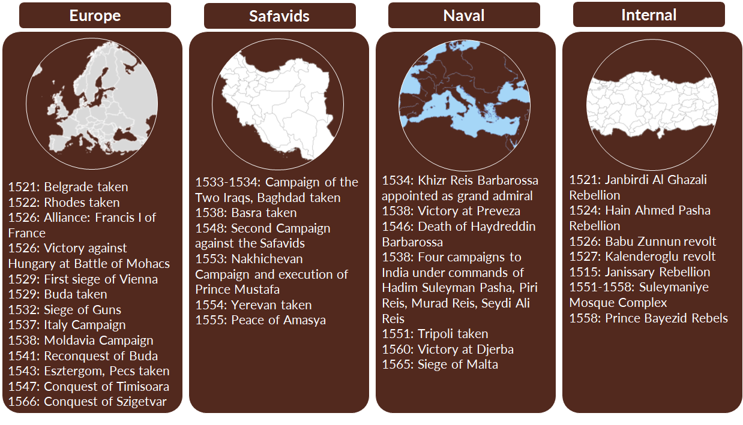
Suleyman The Magnificent (1520-1566)

Slide 26
Suleyman The Magnificent (1520-1566)
Legal and administrative developments
  The establishment of the Kanun-name (Suleiman's Law)
  Rules regarding division of labour, assigning duties to the right person, training of staff
Art and Culture
  Imperial artistic societies were administered
  Suleyman personally inspected the works of the artists ad awarded them
  Developments in fine arts and decorative arts – calligraphy, miniature painting, manuscript painting, gravures, ebru (water marbling), wood and stone carvings, ceramics, tiles, textiles
Construction
  Various projects by Sinan
  Makkah: Shelters to accommodate pilgrims, Turkish bath, Wooden roofs of portico around Kaaba relaced with stone domes, Medresse established, Kiswa preparation in Egypt
  Medina: Fortifications around Medina, Renovations in mosque, Scholars were given permanent positions, Budget allocated for staff serving masjid, Renovated tomb of Aisha
  City walls encircling Jerusalem
  Fortresses with water reservoirs on the caravan route for pilgrims
  Mihrimah spent a fortune to bring from Arafah to Makkah the reservoir of Ayn Al Zubayda

Slide 27
Suleyman’s Sons
Shahzade Mehmed (1521-1543)
Eldest son of Sultan Suleiman the Magnificent.
Heir apparent to the Ottoman throne, well-educated in military and statecraft.
Tragically died of small pox at 22, impacting Ottoman succession plans.
Shahzade Mustafa (Executed in 1553)
Eldest son of Suleiman and Mahidevran, much loved
Involved in a political struggle with stepmother Hürrem Sultan for the throne.
Plot hatched that he was planning to overthrow his father
Executed by order of Suleiman to secure succession for Selim II.
Cihangir (Illness and Death in 1553)
Youngest son of Suleiman, hunchback, suffered from mental illness.
His death opened the path for the succession struggle between Selim II and Bayezid.
Bayezid (Executed in 1559)
Elder son of Suleiman, involved in a power struggle with Selim II.
Flees to Safavids, considered treachery
Defeated at the Battle of Konya in 1559, captured, and executed.
Selim II (Reign 1566-1574)
Last choice, succeeded Suleiman as Sultan
Notes:
Yahya Effendi wrote – Why did you do it, should have looked at evidence

Slide 28
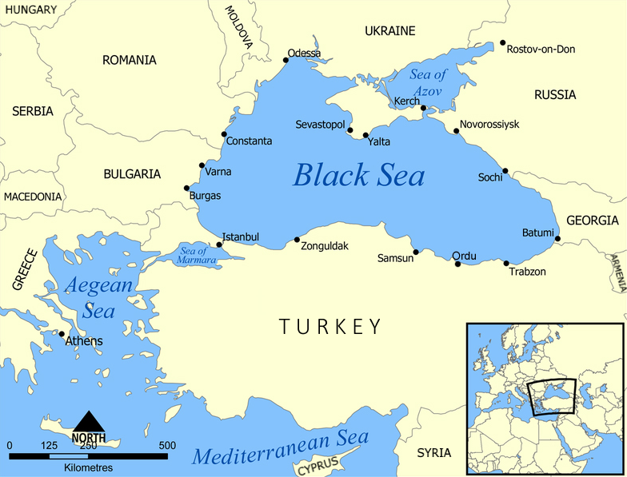
Seas
Mediterranean Sea
Black Sea
Aegean Sea
Marmara Sea

Slide 29
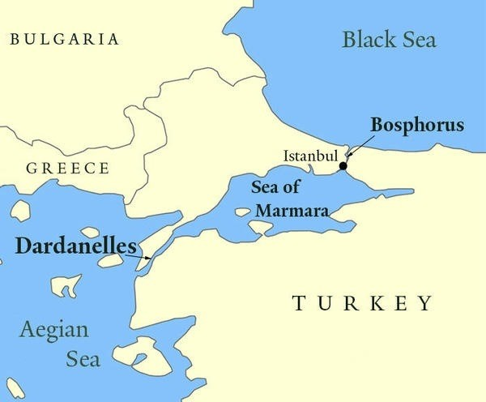

Slide 30
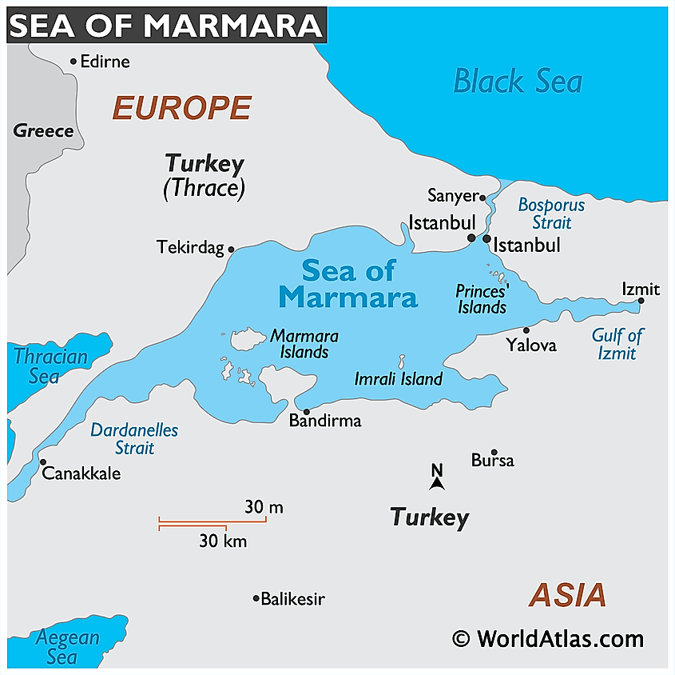
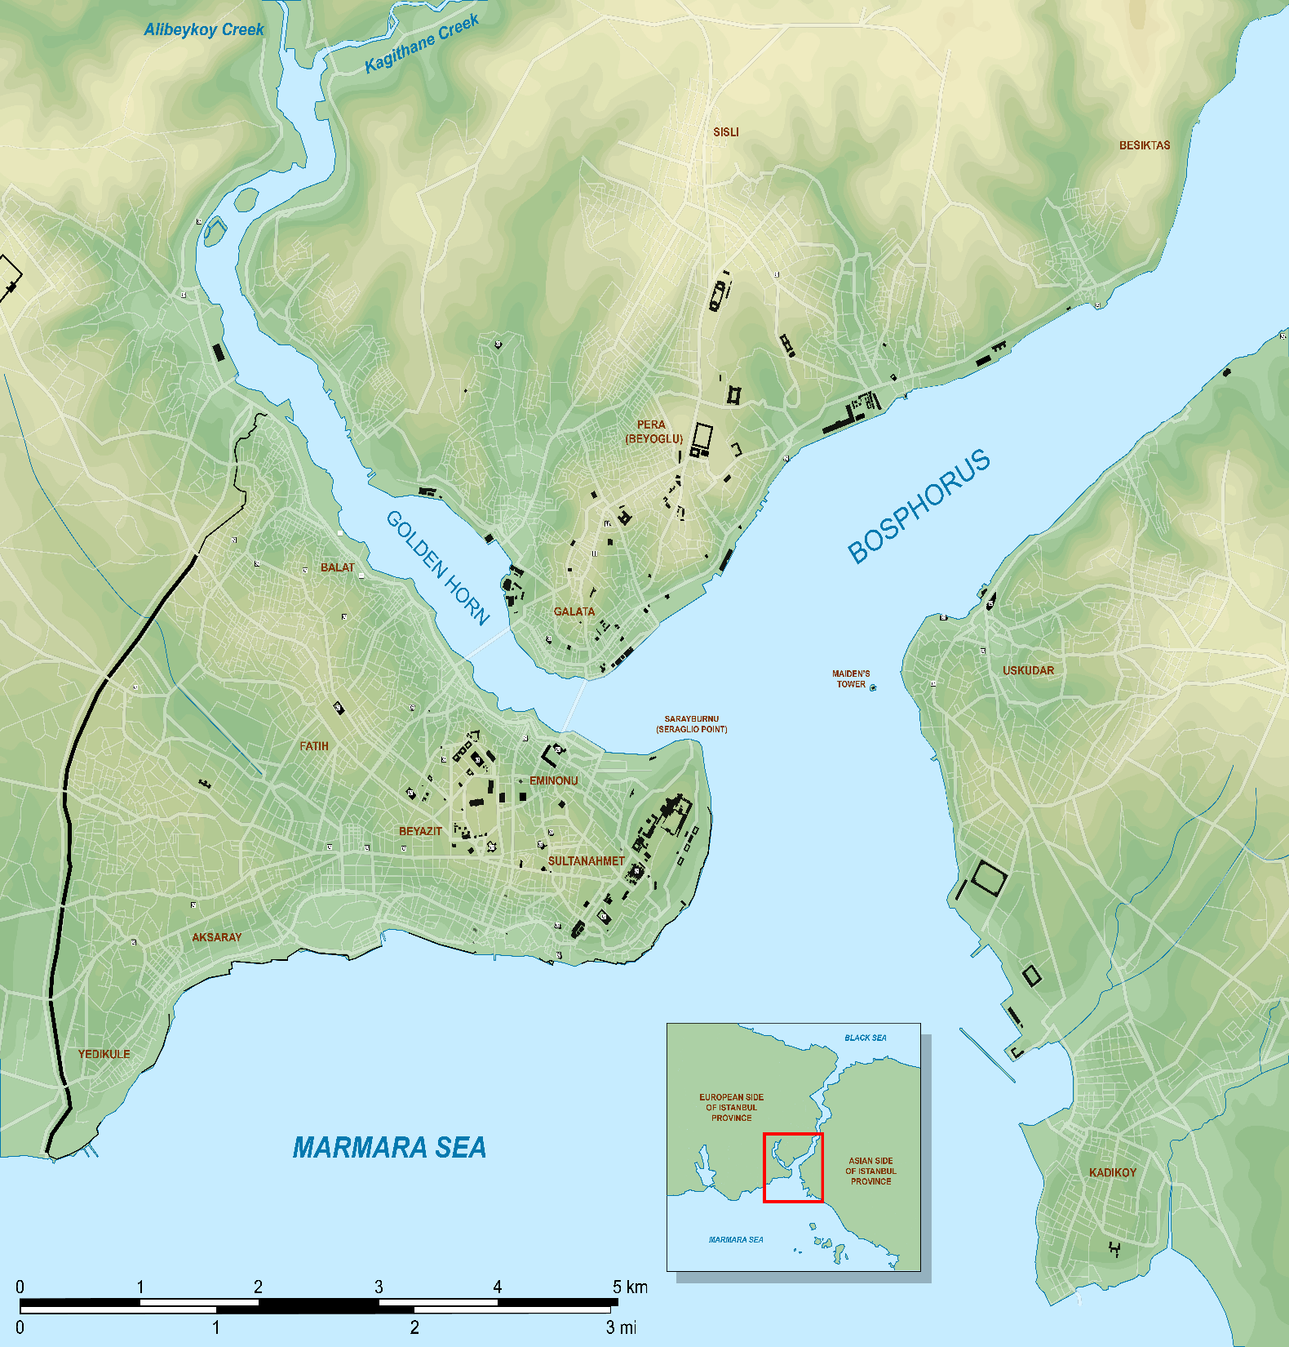

Slide 31
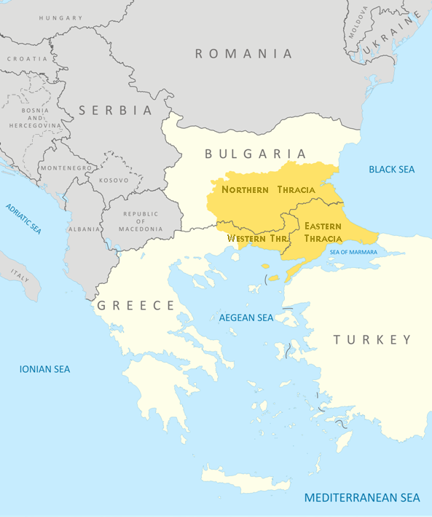
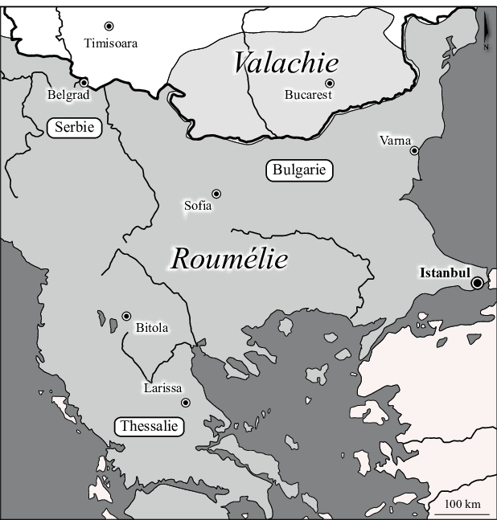
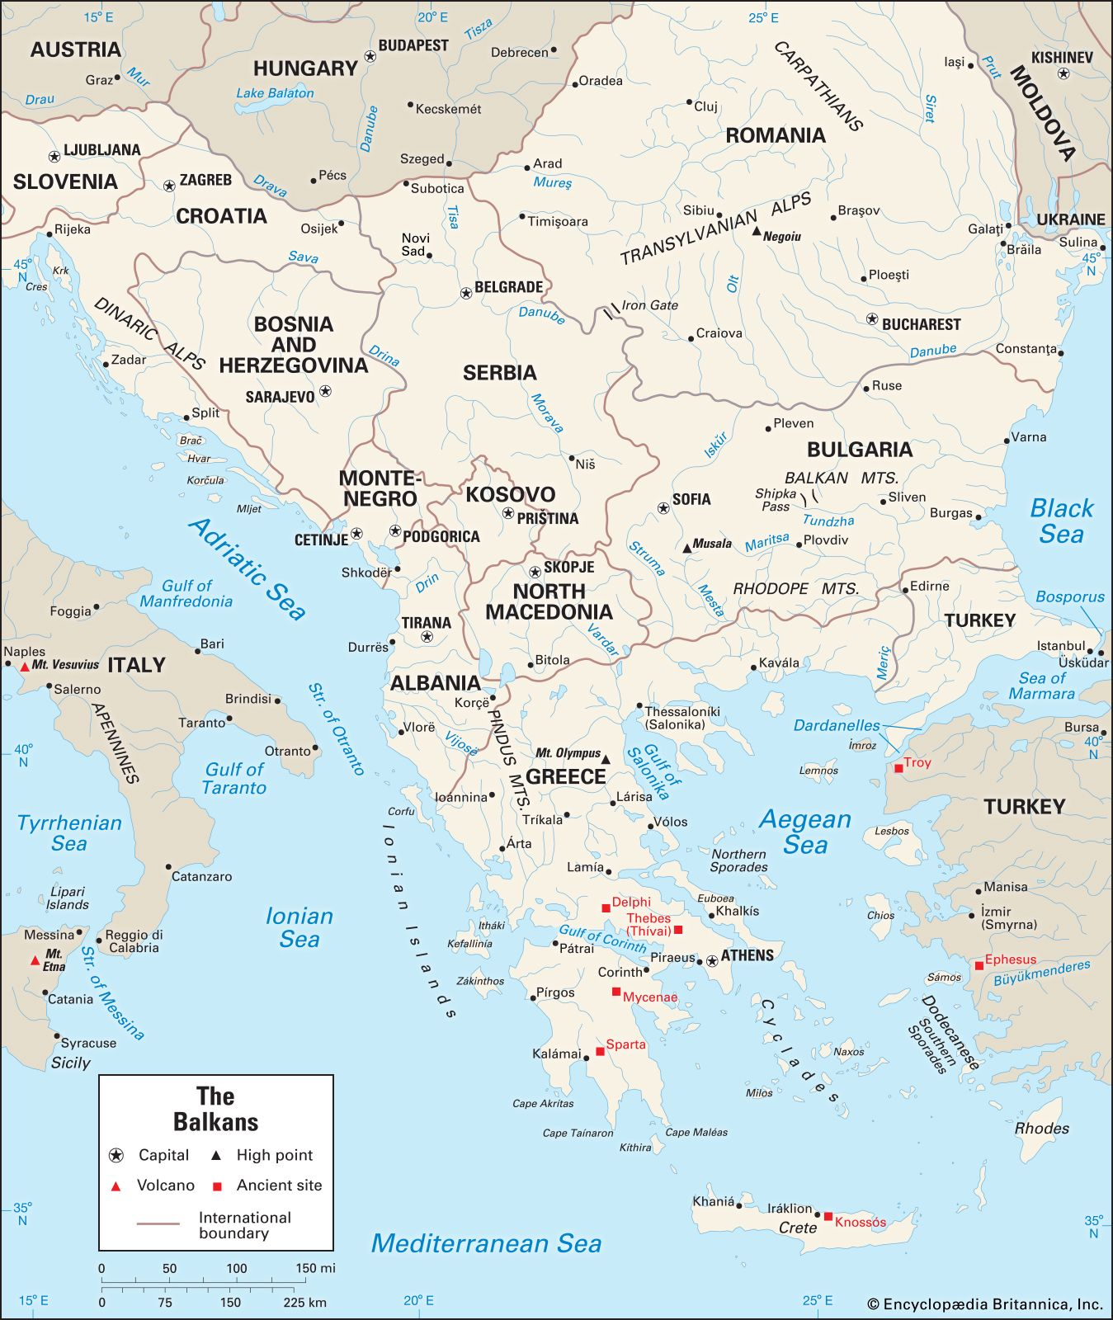
Thrace Rumelia Balkans
Balkan Mountains to the north
Aegean Sea to the south
Black Sea to the east
Southeastern Bulgaria (Northern Thrace)
Northeastern Greece (Western Thrace)
European part of Turkey (East Thrace)
Thrace plus
North Macedonia, Bulgaria, Albania, Greece, Serbia, Bosnia
Rumelia plus Slovenia, Croatia, Romania, Kosovo, Montenegro
Notes:
Thrace, Macedonia, Bulgaria, central Albania, northwestern Macedonia

Slide 33
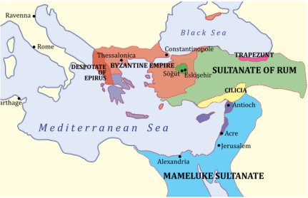

Slide 34
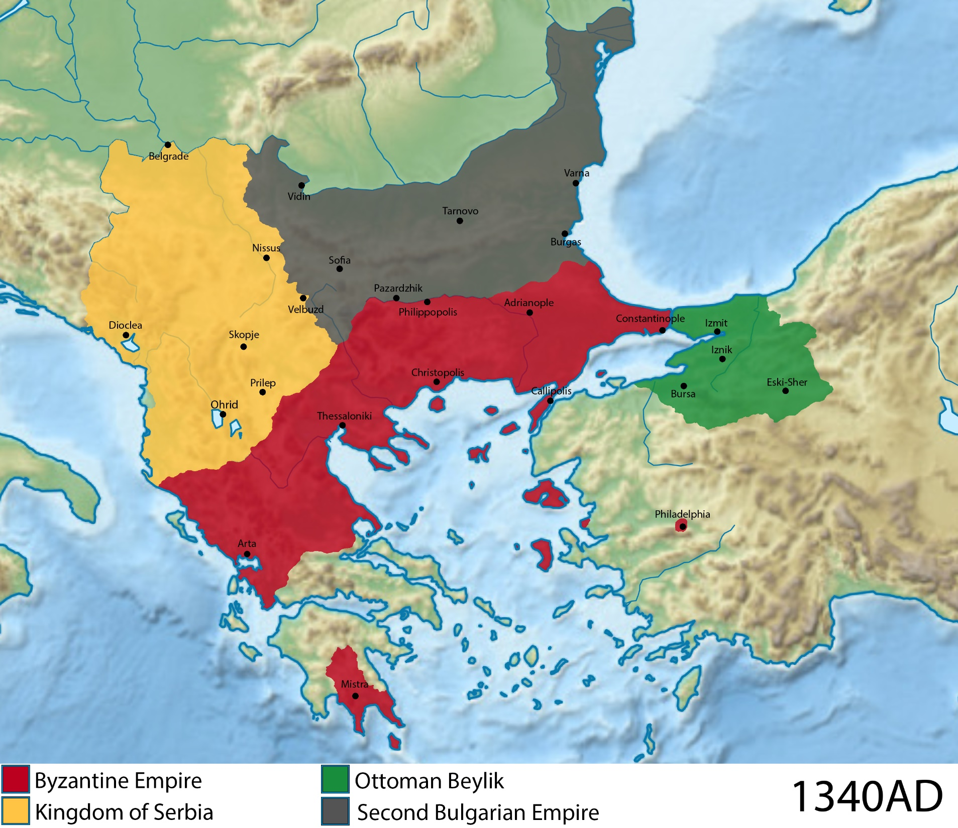

Slide 35
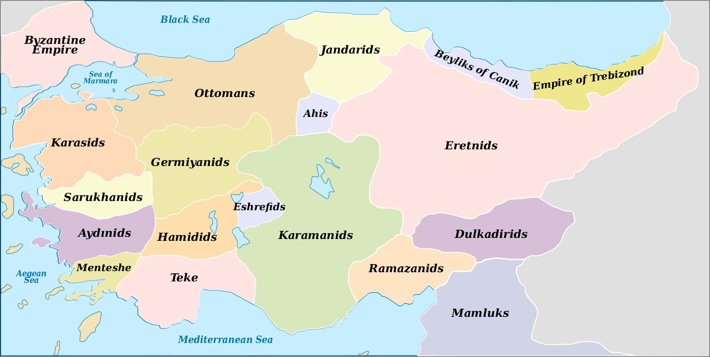

Slide 37
Osman (1281-1326)
Orhan (1326-1362)

Slide 38
Murad expanded Ottoman territory by over 400,000 Sq kms
95,000 Sq kms when Orhan died
500,000 Sq kms when Murad died
He was at the forefront of bringing Islam into Europe
Albania and Bosnia still remain majority Muslims as a result of this Ottoman expansion

Slide 39
Osman (1281-1326)
Orhan (1326-1362)
Murad (1362-1389)

Slide 40
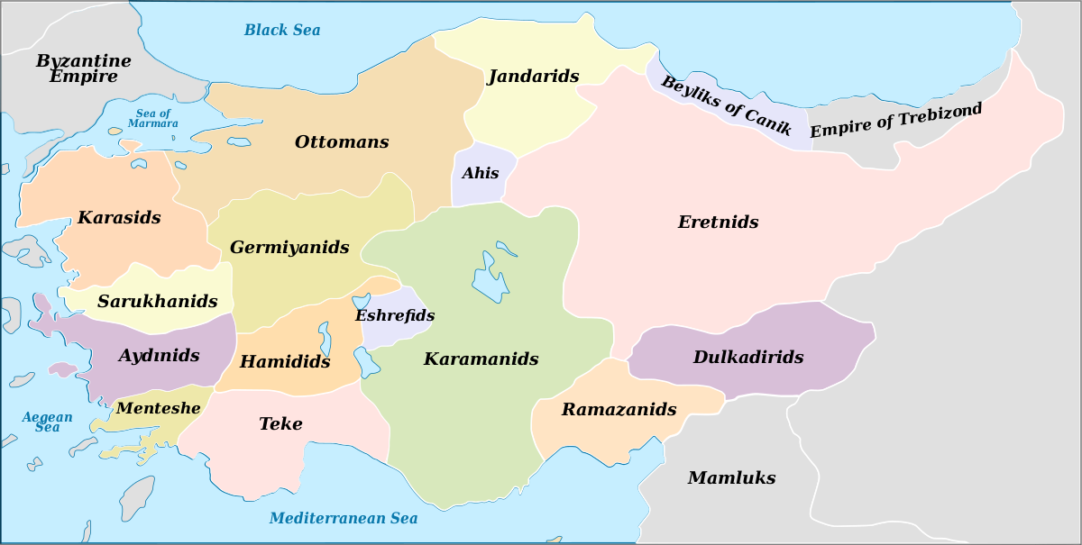
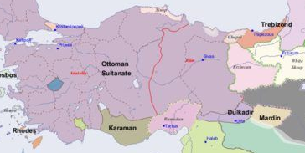
1300
1400
Bayezid’s Reign
Unifying Anatolia

Slide 41
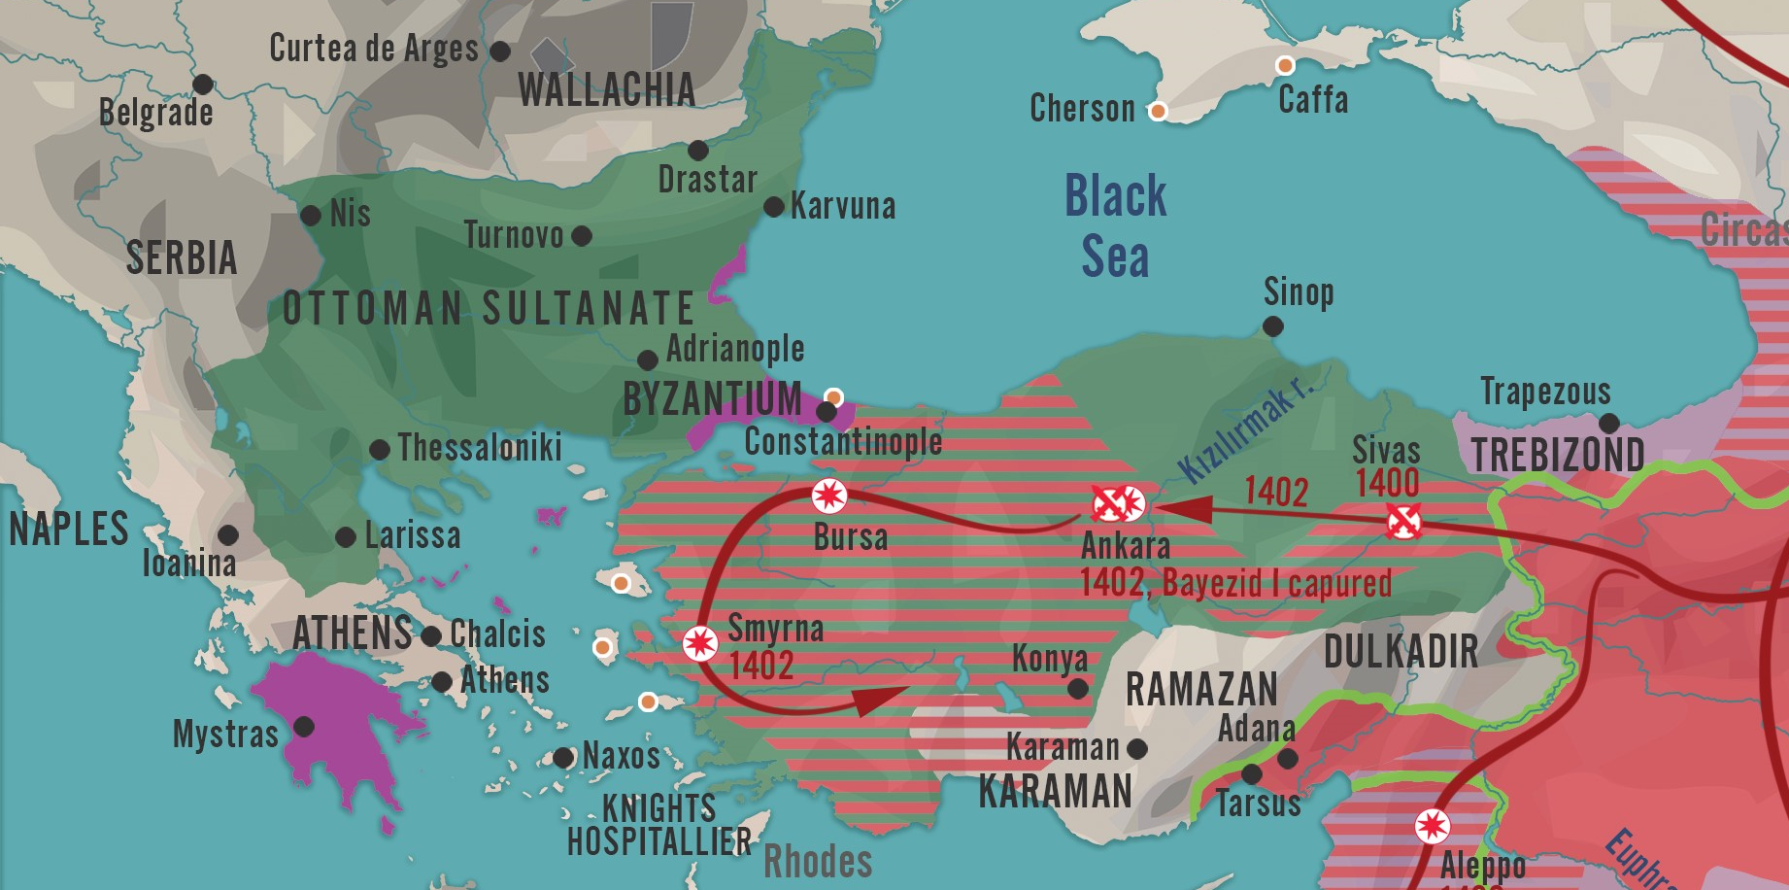
After Battle of Ankara
1405

Slide 42
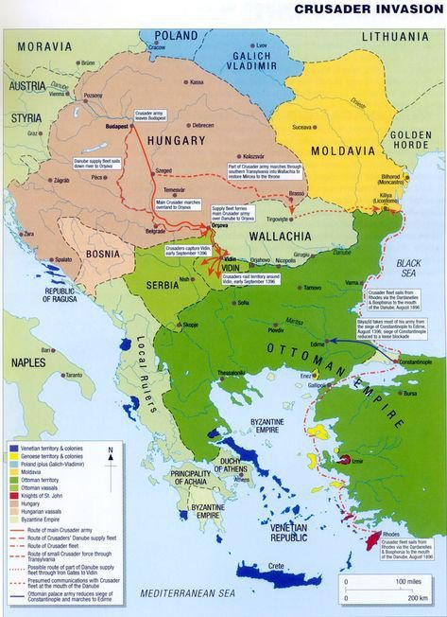

Slide 44
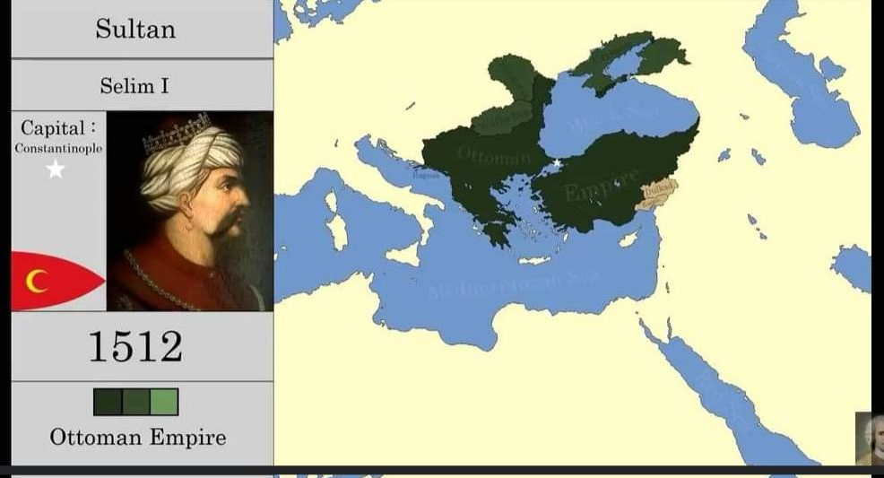

Slide 46
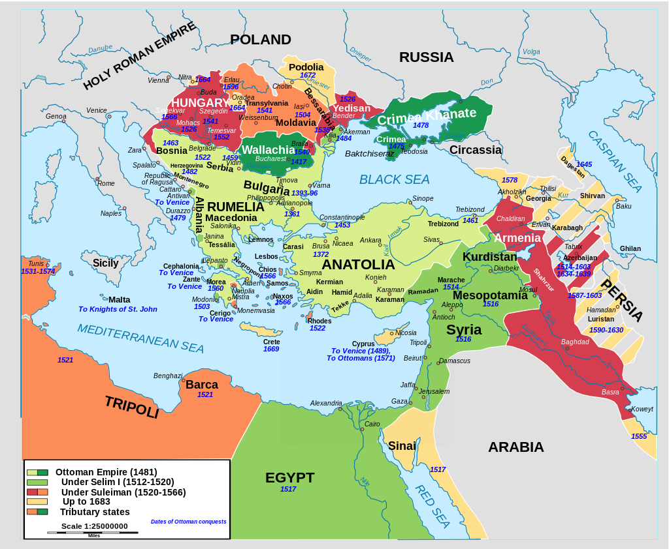
Territorial expansion of the Ottoman Empire under Suleiman
(in red and orange)

Slide 47
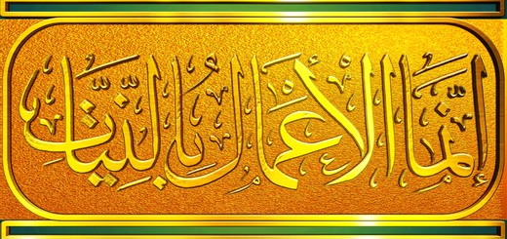
Reason for Ottoman’s Quick Expansion
They were located at the doorstep and frontiers of non-Muslim lands
The intentions of the early Sultans was sincere: they only wanted to protect their subjects from potential threat, to liberate the ones oppressed by tyrannical rulers and to spread the message of Islam into non-Muslim lands
They did not focus on expanding into Muslim lands, just for territory and riches, and so avoided the wrath of the people
The Muslim dynasties in the East struggled more as they fought against fellow Muslims
Intentions of Ottoman Sultans was pure and so victories were easy

Slide 48
Most Important Dates to Remember
1258: Birth of Osman
1299: Bilekoma and Yenisehir captured by Osman, Ottoman Empire established.
1326: Capture of Prousa (Bursa) by Orhan, death of Osman
1352: Suleyman Pasa, Orhan’s son expands into Rumelia
1365: Edirne became the capital
1374: Bulgaria, Constantinople, Serbia became vassals under Murad
1389: Battle of Kosovo against Crusader armies, Murad martyred
1396: Crusader army is defeated by Bayezid Yildirim at the Battle of Nicopolis
1402: The Ottomans are defeated by Timur at the Battle of Ankara, Bayezid is captured
1403-1413: Interregnum Period, Mehmed I finally becomes Sultan
1444: Murad II is victorious at Varna against a Crusader army
1451: Mehmet Fatih comes to power at the age of 19
1453: Constantinople is taken
1492: Reconquista is completed after Granada falls
1505: Kemal Reis was sent by Bayezid II to help Muslims and Jews in Spain
1517: Selim defeats Mamluks at Ridaniya, controls Egypt and Hijaz, adopts the title of Caliph
1534: Khizr Reis Barbarossa appointed as grand admiral
1566: Conquest of Szigetvar, death of Suleyman

Slide 49
Basic Ottoman Empire Timeline
1299-1326 Osman I is the ruler of a small state in northwest Anatolia.
1362 Janissary conscription instituted by Murad I.
1389 Murad I leads an army against Lazar of Serbia in the Battle of Kosovo.
1402 Battle of Ankara against the Central Asian ruler Tamerlane in which Bayezid I is captured.
1453 Conquest of Constantinople by Sultan Mehmed II.
1459 Mehmed II orders the construction of Top Kapi Palace.
1512-1520 Selim conquers Syria, Egypt & Hijaz. Takes the title of caliph in 1517.
1516 The Barbarossa brothers captured Algiers from Spain
1520-1566 Suleiman the Magnificent extends the empire to its greatest extent.
1533 Hayreddin Barbarossa was appointed Grand Admiral of the Ottoman Navy
1539 Suleiman makes Sinan his chief architect. He was responsible for the construction of over 300 major structures.
1571 Ottomans lose in the naval Battle of Lepanto against Holy League led by Spain.
1683 Second failed attempt to take Vienna.
1718-1730 Tulip Period, fascination with tulips, Art and poetry also flourishes in this period.
1774 Ottomans officially lose Crimea to the Russians.
1798 Napoleon invades Egypt.

Slide 50
Basic Ottoman Empire Timeline
1811 Mamluks were massacred by Mohammad Ali.
1830 Algeria is lost to the French.
1839-1876 Tanzimat Reforms instituted.
1853-1856 The Ottomans with the help of Britain and France face off Russia in the Crimean War.
1912-1913 Balkan Wars leave the Ottomans with almost no territory in Europe.
1914 The Ottomans join World War I on the side of Germany, Austria-Hungary against Russia, England and France
1915 The Gallipoli Campaign: Under the command of Mustafa Kemal, the Ottoman army successfully repels Britain's invasion of the Dardanelles in Turkey.
1918 Ottomans surrender and Armistice of Mudros is concluded.
1916-1919 Siege of Madinah led by the sons of Sharif Hussain, Ali, Abdullah and Faisal.
1917 Jerusalem is surrendered to the British
1919 Turkish War of Independence commences.
1922 The Ottoman sultanate is abolished and the last sultan, Mehmed VI is exiled.
1923 The Republic of Turkey is proclaimed on 29 October, with Mustafa Kemal as president.
1924 Abolition of the Caliphate by Grand National Assembly of Turkey.
1928 Islam removed as the religion of the state.

